Slide 1
Radial Basis Function Neural Network:

Slide 2
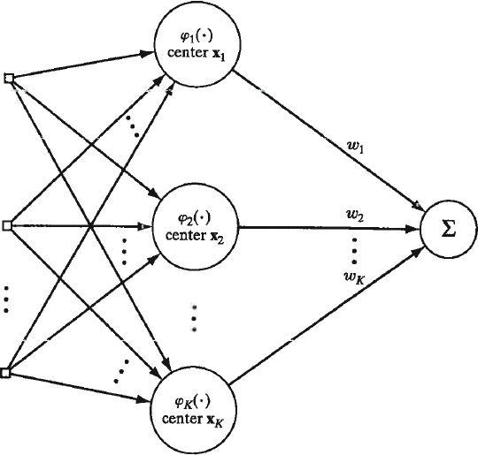
Example of Radial Basis Function (RBF) network
Single output that is linear combination of basis functions
Input vectors
d dimensions
K nodes in the hidden layer are basis functions with parameters defined by clustering of attribute vectors

Slide 3
Gaussians are the most frequently used basis function
ϕ_{j}(x) = exp(-½(|x-μ_{j}|/σ_{j})²)
Clusters of input data are
parameterized by a mean and
variance. X is an attribute
vector in the training set.
Optimum number of clusters is usually not obvious from training data. Validation set can be used to find best number.

Slide 4
Linear least squares with basis functions
Given training set
Find the mean and variance of K clusters of input data. Construct the NxK matrix D with columns that are each basis function evaluated at all the examples in the training set. Construct a Nx1 column vector r with the response values of the attribute vectors in the training set.
If needed, add a column of ones to include a bias node.
Solve normal equations D^{T}Dw = D^{T}r for a weight vector w connecting hidden nodes to output node

Slide 5
RBF networks perform best with large datasets
With large datasets, expect redundancy (i.e. multiple
examples expressing the same general pattern)
In RBF network, hidden layer is a feature-space
representation of the data where averaging has
been used to reduce noise.

Slide 6
Background on clustering
Clustering is unsupervised learning to find regularities in data.
In clustering, we look for regularities as group membership
Assume we know the best number of clusters, K
Given K and dataset X, we find the size of each cluster P(G_{i}) and its component density p_{i}(x|G_{i}), the probability that attribute vector x belongs to cluster i.

Slide 7
K-Means Clustering: hard labels
Find group labels using the geometric interpretation of a cluster
as points in attribute space closer to a “center” than they are to
data points not in the cluster
Define trial centers by reference vectors m_{j} j = 1…k
Define group labels
based on nearest center
Get new trial centers
based on group labels
Judge convergence by

Slide 8
Components of m_{i} are just the average of
components of attribute vector is cluster i
Dispersion of a cluster is the sum of the distance of each member from the mean of the cluster.
E is the sum of the dispersions of the k clusters

Slide 9
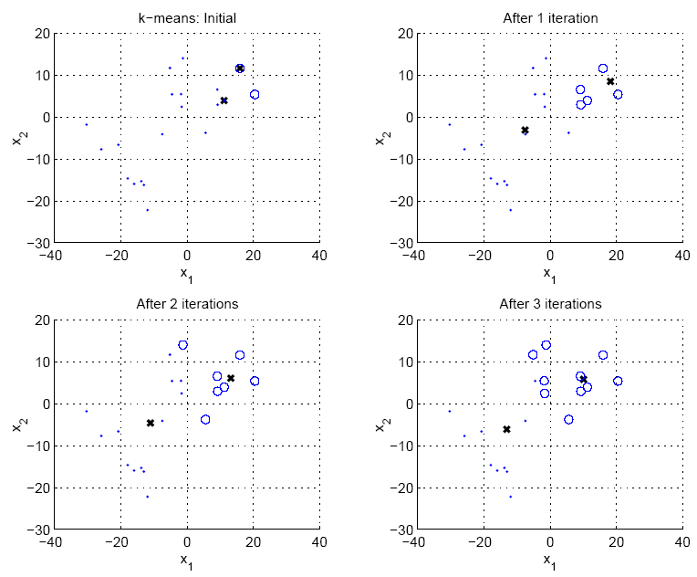
Initial centers are 2 randomly chosen data points

Slide 10
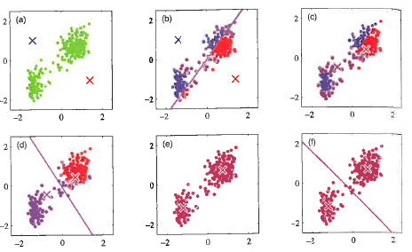
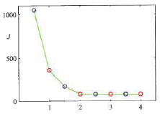
Initial centers are arbitrary points in attribute space.
Convergence

Slide 11
K-means is an example of the Expectation-Maximization (EM) approach to maximum likelihood estimation (MLE)
With simple models, like Gaussian distribution, likelihood of parameter values, like mean and variance, can be expressed analytically and calculus can be used to find the best estimates of the parameters.
Parameters of the mixture model cannot be solved analytically.
EM is a 2-step iterative method to solve the mixture problem.
E-step: estimate group labels of x^{t} from current knowledge
of mixture components
M-step: update mixture component using group labels
from E-step
11
Notes:
11

Slide 12
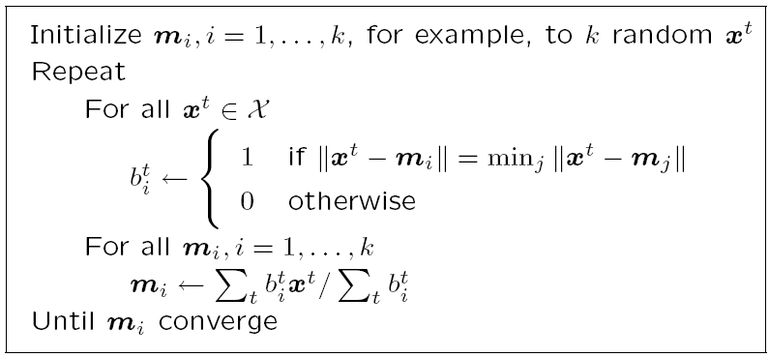
K-means clustering pseudo code
Assign training examples to clusters
Update centroids based on new assignments
12

Slide 13
Davies-Bouldin index (DBI) is used to find the optimum
number of clusters.
Rationale: Choose K that makes the clusters least similar
R_{ij} = similarity of clusters i and j = (S_{i} + S_{j})/M_{ij} where
S_{i} is the intra-dispersion of cluster i, which is the average
separation of its members from the centroid, and M_{ij} is the
distance between the centroids of clusters i and j.
Small dispersion and wide separation -> low similarity

Slide 14
With K clusters, calculate R_{ij} = similarity of clusters i and j
for K(K-1)/2 distinct ordered pairs.
For each cluster i, find R_{i} = max(R_{ij})
DBI is the simple average of R_{i} over the K clusters
Plot DBI(K) over the desired range of K.
Chose K with the minimum DBI(K)

Slide 15
https://pyshark.com/davies-bouldin-index-for-k-means-clustering-evaluation-in-python/
Davies-Bouldin Index for K-Means Clustering Evaluation in ...

Slide 16
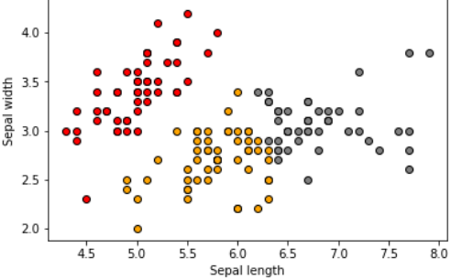
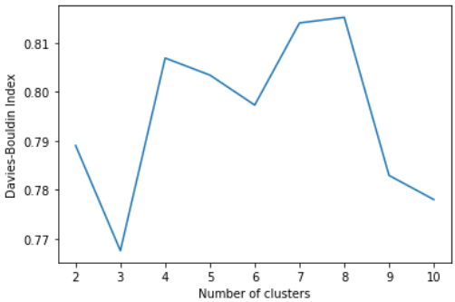
https://pyshark.com/davies-bouldin-index-for-k-means-clustering-evaluation-in-python/
Example from link: 2D labeled data.
DBI predicts 3 as best number of clusters between 2 and 10
With labeled data, the next question is usually
Are class members in the same cluster?

Slide 17
Application of K-means clustering to RBF network
ϕ_{j}(x) = exp(-½(|x-μ_{j}|/σ_{j})²)
Given converged K-means centers, estimate variance for RBFs by σ² = d²_{max}/2K, where d_{max} is the largest distance between clusters.
How do we calculate distance between clusters?
d_{ij} = ||m_{i}-m_{j}||

Slide 18
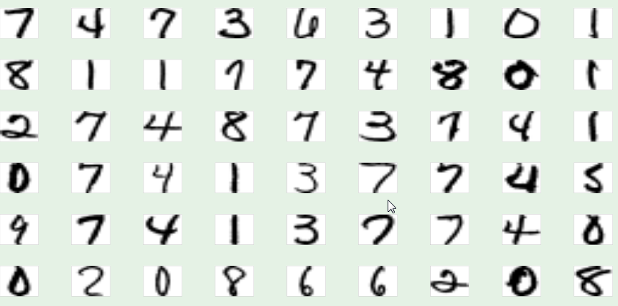
RBF network for digit recognition
Examples of hand-written digits from zip codes

Slide 19
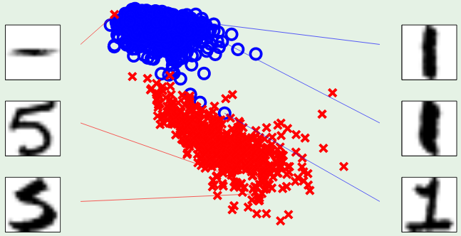
2-attribute digit model: intensity and symmetry
symmetry
intensity
Intensity: how much black is in the image
Symmetry: how similar are mirror images

Slide 20
Assignment 11
Use Weka’s RBFnetwork to distinguish hand-written digits 1vs5.
Load Weka’s RBFnetwork from package manager under Tools on the main menu.
Use 1-5-1561-no name.csv for training.
Use 1-5-424-no name.csv for testing. After loading the test set, select output predictions under more options. Choose CSV.
Run with default settings.
Save the results buffer that contains predictions of model on test-set examples. Edit to 2 columns, actual and predicted.
Use software like that for HW4 to calculate the accuracy of predictions in each class, the overall accuracy, and the confusion matrix with column sums equal to class size.

Slide 21
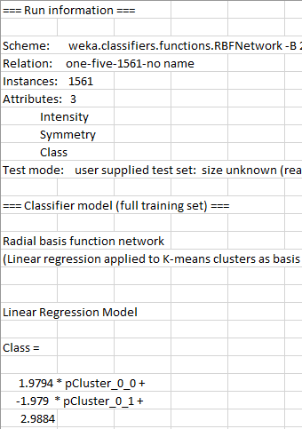
Part of csv file from
results buffer.

Slide 22
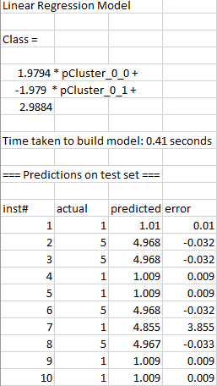
More of csv file from results buffer.
2D linear regression model.
R² = 95.75%
Note instance 7 where difference between actual and predicted is large
Copy and paste columns “actual”
and “predicted” into new csv file for analysis of predictions by class and confusion matrix.

Slide 23
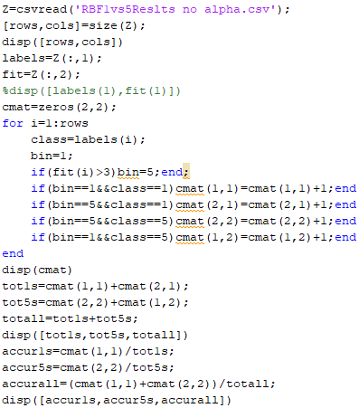
2 classes with labels 1 and 5.
Choose bin boundary
equal to 3 (average of 1 and 5)
Saved as scriptHW13.m on class web page.

