Slide 1
Multi-layer perceptron

Slide 2
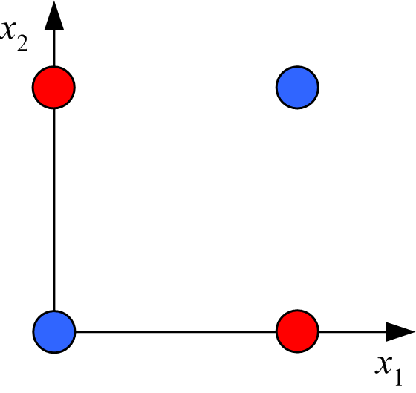
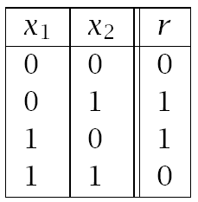
Boolean XOR: linearly inseparable 2D binary classification problem
data table
graphical representation
Exact classification by perceptron is not possible
Delayed neural network development for a decade

Slide 3
Boolean XOR: linearly inseparable 2Dbinary classification problem
data table
graphical representation
A solution to the XOR problem by “feature engineering” was well known.

Slide 4
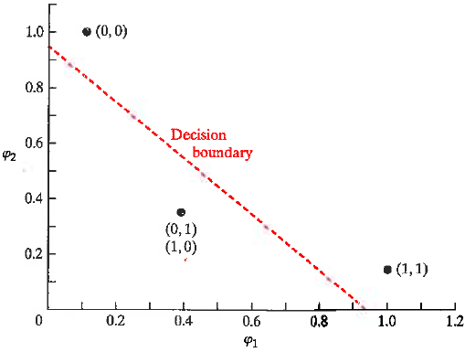
XOR problem in Gaussian feature space
φ₁ = exp(-|X – [1,1]|²)
φ₂ = exp(-|X – [0,0]|²)
X φ₁ φ₂
(1,1) 1 0.1353
(0,1) 0.3678 0.3678
(0,0) 0.1353 1
(1,0) 0.3678 0.3678
XOR data
r=0
This transformation puts examples (0,1) and (1,0) at the same point in feature space, which allows linear separability.
r=1

Slide 5
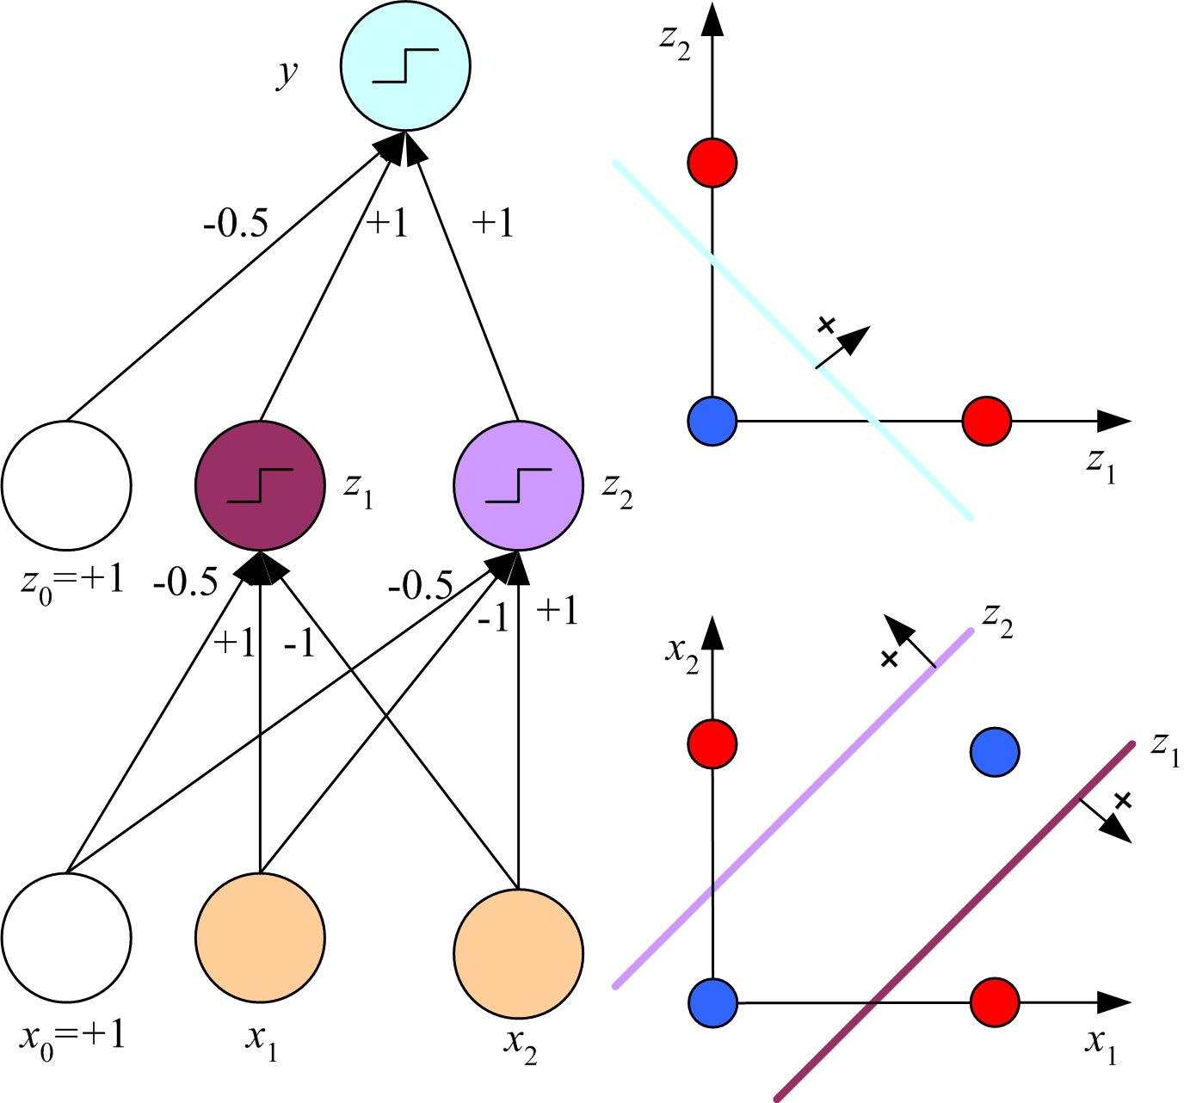
Solution using the tools of neural networks for “feature engineering”.
S denotes transformation of the input to a node by the sigmoid function.
S
Find 1 weight vector
connecting hidden layer to
output that defines a linear
discriminant separating the
features.
-0.78
S
S
Find 2 weight vectors
connecting input to
hidden layer that define
linearly separable features.
5

Slide 6
Consider hidden units z_{h} as features. Choose weight vectors w_{h} (with bias component) so that in feature space (0,0) and (1,1) are close to the same point.
z₂
ideal feature space
attribute space
z₁

Slide 7
Ideal data table in feature space
z₂
r z1 z2
0 ~0 ~0
1 ~0 ~1
1 ~1 ~0
0 ~0 ~0
z₁
If w_{h}^{T}x << 0 → z_{h} ~ 0
If w_{h}^{T}x >> 0 → z_{h} ~ 1

Slide 8
Find weights vectors for linearly separable features
w_{h}^{T}x = w₁x₁ + w₂x₂ +w₀
x1 x2 z1 constraints on w₁ choice
0 0 ~0 w0 <0 w0=-0.5
0 1 ~0 w2 + w0 <0 w2= -1
1 0 ~1 w1 + w0 >0 w1= 1
1 1 ~0 w1 + w2 + w0<0
x1 x2 z2 constraints on w₂ choice
0 0 ~0 w0 <0 w0=-0.5
0 1 ~1 w2 + w0 >0 w2= 1
1 0 ~0 w1 + w0 <0 w1= -1
1 1 ~0 w1 + w2 + w0<0

Slide 9
Transformation of
input by hidden layer
z1 = sigmoid(x1-x2-0.5)
z2 = sigmoid(-x1+x2-0.5)
x1 x2 arg1 z1 arg2 z2 r
0 0 -0.5 0.38 -0.5 0.38 0
0 1 -1.5 0.18 0.5 0.62 1
1 0 0.5 0.62 -1.5 0.18 1
1 1 -0.5 0.38 -0.5 0.38 0
By construction, ANN features are linearly separable.
If w=[1,1]^{T} bias for equal margins = -0.78.
Margins are not as wide as Gaussian features.
Gaussian = 0.141, ANN = 0.0141
Is the XOR data correctly classified by this w and bias?
z₂
z₁

Slide 10
Output transformed by y = sigmoid(z1 + z2 – 0.78)
r z₁ z₂ y
0 0.38 0.38 0.495 < 0.5 nonmember
1 0.18 0.62 0.505 > 0.5 member
1 0.62 0.18 0.505 > 0.5 member
0 0.38 0.38 0.495 < 0.5 nonmember
Solution based on ANN engineered features has zero input error, but not expected to generalize well due to narrow margins.
Can we do better by letting the data determine the weights through back propagation?

Slide 11
The real ANN solution to the XOR classification problem lets the data determine the hidden-layer features by back propagation.
Fundamental principle of all techniques of ANN.
Fundamental questions about the method:
Data can be erroneous and biased.
Data can be manipulated to achieve a desired result.
Amount of data may be insufficient.
S
Define an optimization
condition that enables
learning optimum
weights for both layers
-0.78
S
S
Data will determine the
best transform of the input
to give linearly separable
features in the hidden layer
11

Slide 12
Back propagation

Slide 13
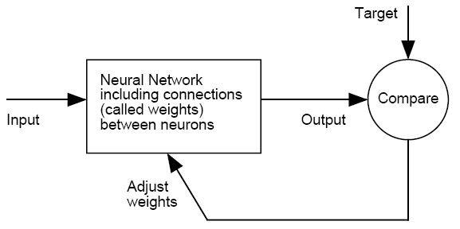
Training a neural network by back-propagation.
Initialize weights randomly.
Need a rule that relates changes in weights to the difference
between output and target.

Slide 14
If the expression for in-sample error is simple (e.g. squared
residuals) and network not too complex (e.g. < 3 hidden layers),
then an analytical expression for the rate of change of error with
change in weights can be derived from calculus.

Slide 15
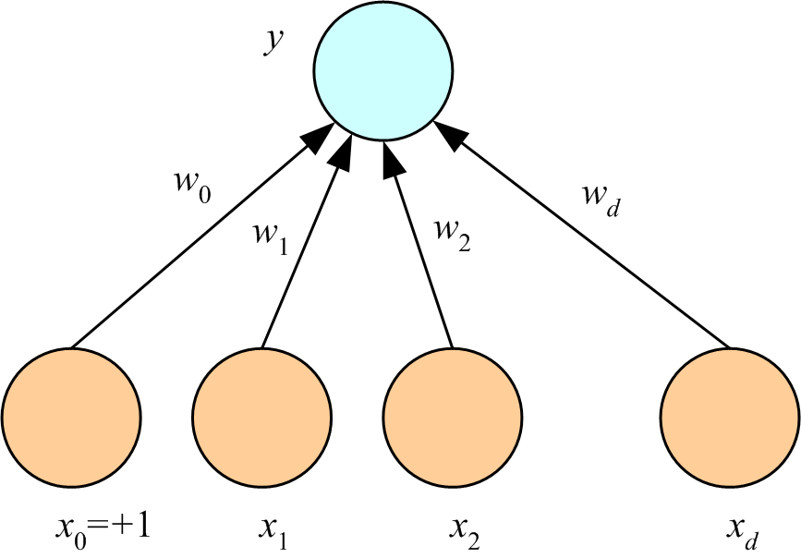
Simplest example: multivariate linear regression
In-sample error is squared residuals and no hidden layers.
Shown for illustration only.
Much easier to find optimum weights by normal equations.

Slide 16
Approaches to Training
Online: weights updated based on training-set examples seen one by one in random order
Batch: weights updated based on whole training set after summing deviations from individual examples
Weight-update formulas are simpler for “online” approach.
Formulas for “batch” can be derived from “online” formula by summing over examples in the training set.
16

Slide 17
How does the error in each example depend on the components of the weight vector?
Contribution to sum
of squared residuals
from single example
w_{j} is the j^{th} component of weight vector w connecting attribute vector x to scalar output y = w^{T}x
E^{t} depends on w_{j} through y^{t} = w^{T}x^{t}; hence use chain rule

Slide 18
Weight update formula called “stochastic gradient decent”
Negative sign means change of weight vector decreases in-sample error.
Proportionality constant η is called “learning rate”

Slide 19
Momentum parameter
Keep part of previous update
How do learning rate and momentum affect training?
As learning rate → 1, back-propagation becomes deterministic
Each example determines a set of weights optimal for itself only
As learning rate → 0, probably local minimum trapping → 1
because step size of weight change is so small
Large momentum parameter reduces trapping at small learning rate
but increases likelihood that data outliers with dramatically affect
weight optimization.
Lecture Notes for E Alpaydın 2010 Introduction to Machine Learning 2e © The MIT Press (V1.0)
19

Slide 20
Back propagation for MLP
For multivariate linear regression, much easier to find optimum weights by
normal equations than by back propagation.
Use MLP and back propagation for multivariate non-linear regression.
More than one hidden layer is seldom necessary.
What are the weight update rules in this case?

Slide 21
weight update rules for nonlinear regression
H nodes in hidden layer. w_{h} connects input to
node h. Weight vector v with H components
connects hidden layer to output.
Backward
Forward
x^{t}
Given a weights w_{h} and v
Each pass through all training data called “epoch”
Lecture Notes for E Alpaydın 2010 Introduction to Machine Learning 2e © The MIT Press (V1.0)
21

Slide 22
weight update rules for nonlinear regression
Backward
Forward
Calculate changes to w_{h} vectors before changing v
Learning rates can be different for Δω_{hj} and Δv_{h}
x
Given a weights w_{h} and v
Since Δw_{hj} is proportional x_{j}, all attributes should be roughly the same size. Normalization to achieve this may be helpful.
Lecture Notes for E Alpaydın 2010 Introduction to Machine Learning 2e © The MIT Press (V1.0)
22

Slide 23
weight update rules for nonlinear regression
Backward
Forward
x
normalized to [0,1]
Given a weights w_{h} and v
Other normalization method can be used
Transforms in the hidden layer do not require normalization
Lecture Notes for E Alpaydın 2010 Introduction to Machine Learning 2e © The MIT Press (V1.0)
23

Slide 24
Solve XOR classification problem by nonlinear regression on labels.

Slide 25
MLP applied to XOR problem
Implement “online” training for non-linear regression on the class labels of the XOR dataset.
Use MLP with one hidden layer that contains 3 nodes, bias, z₁ and z₂. Input layer contains 3 nodes x₀=1 plus x₁ and x₂ from dataset.
Transform the hidden nodes by sigmoid(w^{T}x)=1/(1+exp(-w^{T}x))
Initial weights for results of feature engineering:
w₁=[-0.5,1,-1], w₂=[-0.5,-1,1], v=[-0.78,1,1]
Learning rate=0.001, no momentum parameter
XOR dataset

Slide 26
MLP applied to XOR problem continued
Perform 1000 iterations with the example chosen randomly from
the dataset.
Before each weight update, calculate the sum of squared
residuals and save for semilog plot of convergence.
In addition to convergence plot, report the final weight vectors
and predicted r value for each example in the dataset.
With the final weights, calculate the values z₁ and z₂ for each example in the dataset.

Slide 27
MLP applied to XOR problem continued
Use the values of z₁ and z₂ associated with examples (0,0) and
(0,1) and weight vector w^{T}=[1,1] to calculate the bias of a decision boundary with equal margins for the 2 classes.
Plot of feature space with the decision boundary and location of features associated with the examples in the dataset.

Slide 28
Review: Solution of XOR problem by nonlinear regression
A possible structure of MLP to solve the XOR problem by back propagation.
S
S
Lecture Notes for E Alpaydın 2010 Introduction to Machine Learning 2e © The MIT Press (V1.0)
28

Slide 29
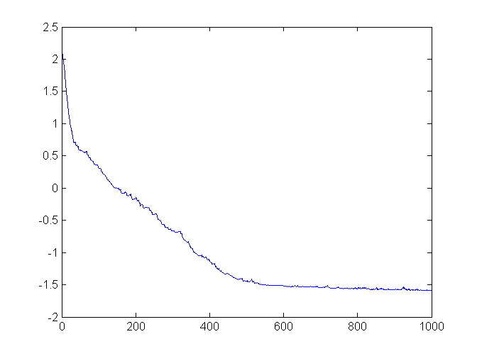
Error=sum of squared residuals
Log₁₀(error)
iteration

Slide 30
v w₁ w₂
23.8265 0.3721 0.3654
-20.0829 1.0139 -1.0137
-20.0828 -1.0098 1.0105
r z1 z2 y
0 0.5919 0.5902 0.0868
1 0.3456 0.7982 0.8570
1 0.7998 0.3432 0.8723
0 0.5926 0.5893 0.0911
Bin structure default bin=0, y>0.5 bin=1
solves XOR classification problem with zero in-sample error.
Margins slightly less than result with ANN feature engineering (margins 0.0141)
b margins
-1.1629 0.0136 0.0136

Slide 31
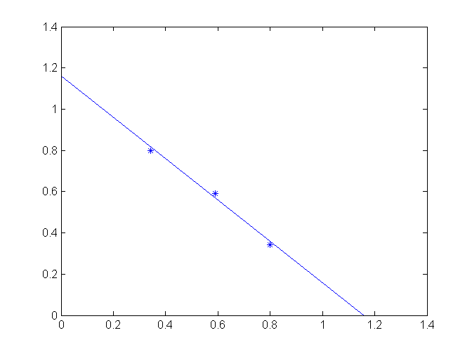
MLP feature space decision boundary for XOR dataset
z₂
z₁
margins
0.0136 0.0136

Slide 32
Weka implementation of MLP for classification

Slide 33
HW9 Weka implementation of MLP for classification
You might have to download MLP from package manager under Setup and Tools
Use Weka’s MLP and glass_data_HW11.csv to develop a classifier for beer-bottle glass. Use default settings. Hand in a copy Weka’s summary output with that includes accuracy and confusion matrix.
Transform the column-specific confusion matrix from HW4, classification by linear regression, to a row-specific confusion matrix and compare Weka’s MLP result. Compare overall accuracy of classification in HW4 with Weka’s MLP result.

Slide 34
Assignment 9 using WEKA’s MLP
1 | 1.521 | 13.64 | 4.49 | 1.1 | 71.78 | 0.06 | 8.75 | 0 | 0 | 1
2 | 1.517 | 13.89 | 3.6 | 1.36 | 72.73 | 0.48 | 7.83 | 0 | 0 | 1
3 | 1.516 | 13.53 | 3.55 | 1.54 | 72.99 | 0.39 | 7.78 | 0 | 0 | 1
1. Sample index
2. RI: refractive index
3. Na: Sodium
4. Mg: Magnesium
5. Al: Aluminum
6. Si: Silicon
7. K: Potassium
8. Ca: Calcium
9. Ba: Barium
10. Fe: Iron
11. Type of bottle (class)
WEKA requires class names
to be alpha-numeric
AB=Anheuser-Busch, Inc.
M=Miller Brewing Co.
PR=Plank Road Brewery
Notes:
Either: remove column 1and normalize attributes
WEKA: header with unique names and alpha-numeric class names

Slide 35
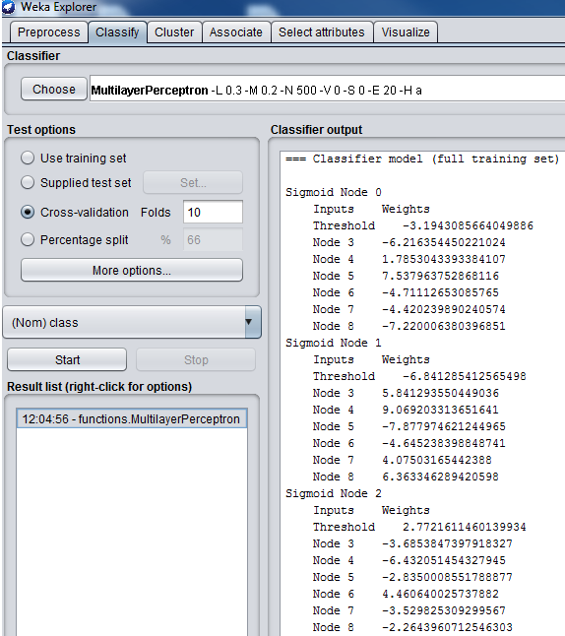

Slide 36
Click on bar for more options

Slide 37
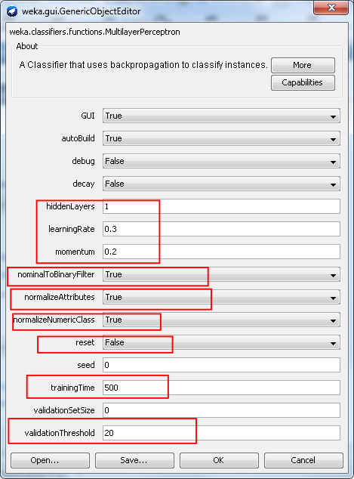
Weka MLP’s GUI
GUI = true gives visual of network
hidden layers means number of
hidden nodes in 1 hidden layer
Filters: nominal→0/1
normalize attributes and classes
Reset: allows resetting learning
rate and momentum
Validation threshold ?

Slide 38
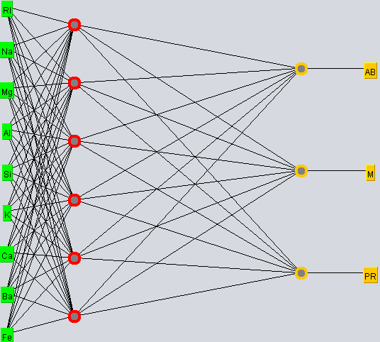
Weka’s MLP for glass classification problem (default settings)
9 predictors, 6 feature nodes, and 3 output nodes. Including bias nodes, network has 10x6+7x3 = 81
adjustable weights. Training set has 174 examples. ~ 2 examples per adjustable parameter. Less than ideal.

