Slide 1
Pattern recognition
Linear discriminants as decision boundaries
Margins
Perceptron Learning Algorithm (PLA)
Least Mean Square Algorithm

Slide 2
Decision Boundaries in Attribute Space
Optimize weights so that w^{T}x = 0 is a decision boundary in attribute space. Regions where w^{T}x > 0 are usually associated with examples from the positive class (members). Regions where w^{T}x < 0 are associated with examples of non-members. One dimensional case:
y=w^{T}x=w₁x+w₀ linear discriminate
Decision boundary, w^{T}x = 0 in 1D attribute space is a point.
These patterns are called “linearly
separable” because the decision
boundary defined by w^{T}x =0 allows separation of training examples with zero in-sample error.
x

Slide 3
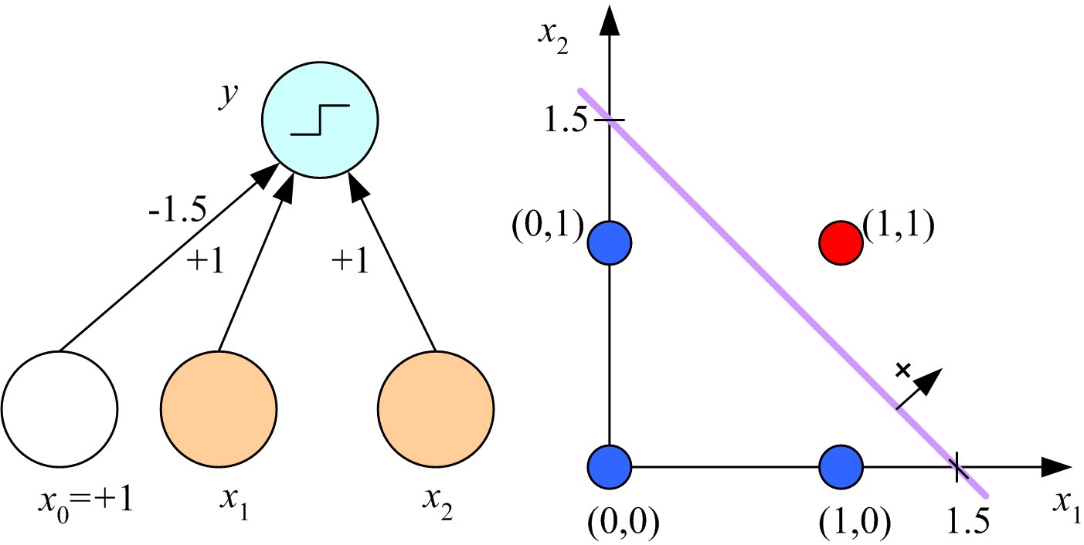
In addition to zero in-sample error, we want wide margins
to ensure low out-of-sample error. Margin of a class is distance between decision boundary and nearest datapoint in that class.
y=w^{T}x=w₁x+w₀
x

Slide 4
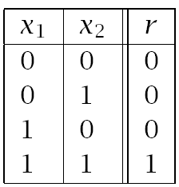
In 2D attribute space, decision boundary is the line w^{T}x=0.
The decision boundary shown has equal margins for both classes. How do I find such a boundary?
Boolean AND
Lecture Notes for E Alpaydın 2010 Introduction to Machine Learning 2e © The MIT Press (V1.0)
4

Slide 5
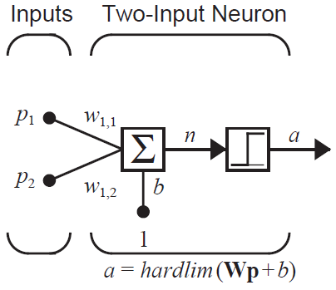
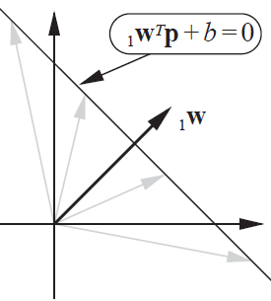
The notation used in Neural Network Design by Hagan et al.
has explicit bias, weight matrix W, and attribute vector p
d=2 attribute space
For any point p on the decision boundary, w^{T}p+b=0; hence, w^{T}p=-b.
w^{T}p is the component of p in the direction of w.
For dot product to be the same for any p on the decision boundary w must be perpendicular to it.

Slide 6
To get a decision boundary like the one shown, weight vector without a bias component, must point toward point (1,1). For example, w^{T} = [1,1]. To find the bias, b, choose any point p on the boundary and solve w^{T}p + b = 0.
Lecture Notes for E Alpaydın 2010 Introduction to Machine Learning 2e © The MIT Press (V1.0)
6

Slide 7
The point chosen on the decision boundary to calculate
the bias will determine the margins. The point (0,1.5) gives b=-1.5 and equal margins for both classes.
The equation of the decision boundary $wTp+b=$0 can be
written as x₁ + x₂ = 1.5. What are the margins?
$wTp=\left[1,1\right]\left[\begin{matrix}0 \\ 1.5\end{matrix}\right]$ = 1.5 = -b
Lecture Notes for E Alpaydın 2010 Introduction to Machine Learning 2e © The MIT Press (V1.0)
7

Slide 8
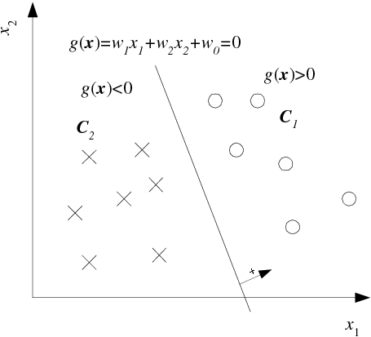
Distance of x^{t} from hyperplane w^{T}x = 0
Let x_{a} and x_{b}
be points on
the hyperplane
w^{T}x_{a} + w₀ = w^{T}x_{b} + w₀
w^{T}(x_{a} – x_{b}) = 0
x_{a} – x_{b} is in hyperplane
w must be normal to
hyperplane
Linear discriminant in 2D
r^{t} = -1
r^{t} = 1
Lecture Notes for E Alpaydın 2010 Introduction to Machine Learning 2e © The MIT Press (V1.0)
8

Slide 9
Distance of x^{t} from hyperplane w^{T}x = 0
Decompose any point x
into components parallel and perpendicular to the
hyperplane
x = x_{p} + d w/||w||
x_{p} is the component of x parallel to the hyperplane
d is distance of x from
hyperplane. w/||w|| is unit normal of the hyperplane.
r^{t} = -1
r^{t} = 1
Lecture Notes for E Alpaydın 2010 Introduction to Machine Learning 2e © The MIT Press (V1.0)
9

Slide 10
Distance of x^{t} from hyperplane w^{T}x = 0
For at any point x_{p} on decision boundary, g(x_{p})=0
g(x_{p}) = 0 = g(x - d w/||w||)
0 = w^{T}(x – d w/||w||) + w₀
0 = w^{T}x + w₀ – d ||w||
d = |w^{T}x + w₀|/||w||
d^{t} = |g(x^{t})|/||w||
r^{t} = 1
r^{t} = -1
Lecture Notes for E Alpaydın 2010 Introduction to Machine Learning 2e © The MIT Press (V1.0)
10

Slide 11
What are the margins of this decision boundary?
recall w^{T}= [1,1] and b = -1.5
||w|| = sqrt(1+1) = 1.414
For blue pattern, either (0,1) or (1,0) is the closest point
g((0,1))$=\left[1,1\right]\left[\begin{matrix}0 \\ 1\end{matrix}\right]$ - 1.5 = -0.5
margin = 0.5/1.414 = 0.3536
For red pattern,
g((1,1))$=\left[1,1\right]\left[\begin{matrix}1 \\ 1\end{matrix}\right]$ - 1.5 = 0.5
margin = 0.5/1.414 = 0.3536
Lecture Notes for E Alpaydın 2010 Introduction to Machine Learning 2e © The MIT Press (V1.0)
11

Slide 12
Summary: Given w, how do I find a decision boundary with equal margins for both patterns and calculate the margins.
d^{t} = |g(x^{t})|/||w|| = distance of example x^{t} from decision boundary
Let x⁺ and x⁰ be examples from member and non-member classes, respectively, closest to the decision boundary.
g(x⁺) = w^{T}x⁺ + b > 0 |g(x⁺)| = g(x⁺)
g(x⁰) = w^{T}x⁰ + b < 0 |g(x⁰)| = -g(x⁰)
For equal margins, d⁺ = d⁰ which means g(x⁺) = -g(x⁰) note: ||w|| cancels on both sides of the equation
w^{T}x⁺ + b = -w^{T}x⁰ – b
Solve for b = -(w^{T}x⁺ + w^{T}x⁰ )/2
Plot w^{T}x + b = 0
Calculate margins by (w^{T}x⁺ + b)/||w|| distance x⁺ from the decision boundary

Slide 13
Example: Boolean AND dataset
Choose w=[1,1]^{T}, x⁺ = [1,1]^{T}, and x⁰ = [0,1]^{T}, then
w^{T}x⁺ = 2, w^{T}x⁰ = 1, b = -(2+1)/2 = -1.5
Equation of the decision boundary, w^{T}x + b = 0, is x₁ + x₂ = 1.5
Margin = (w^{T}x⁺ + b)/||w|| = (2-1.5)/1.414 = 0.3536
13

Slide 14
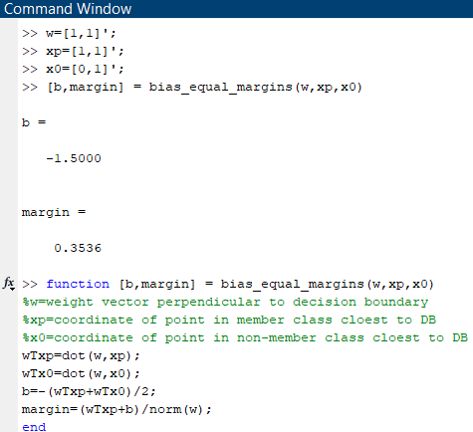
Script to use function “bias_equal_margins” to find a linear decision boundary with equal margins, given w, x⁺ and x⁰. dot is a MATLAB built-in for dot product.

Slide 15
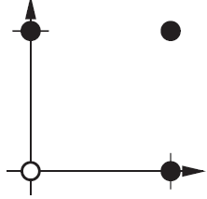
Assignment 7a: Boolean OR dataset
Chose w=[1,1]^{T}
Find the bias that gives equal margins
Calculate margins
Members have label = 1
p₁ p₂ t
0 0 0
0 1 1
1 0 1
1 1 1
Logical OR

Slide 16
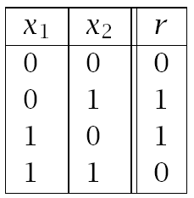
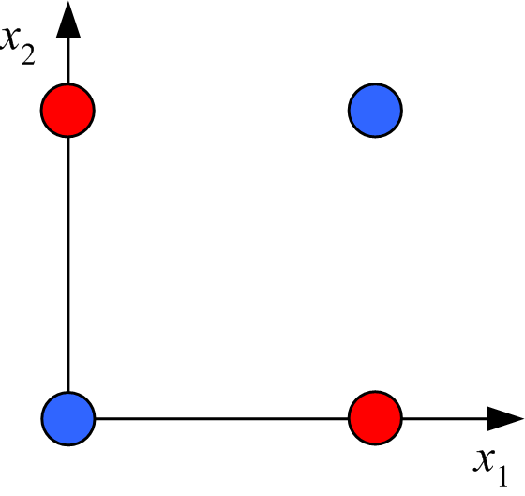
Boolean XOR:
Linearly inseparable pattern
data table
graphical representation
No line can separate the classes with zero error.
Solution: transform to linearly separable feature space

Slide 17
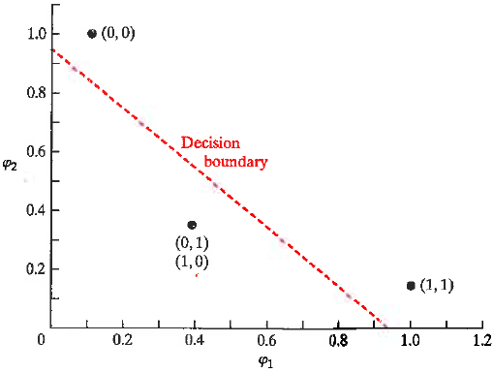
XOR data
XOR in Gaussian feature space
φ₁ = exp(-|X – [1,1]|²)
φ₂ = exp(-|X – [0,0]|²)
X φ₁ φ₂ r
(1,1) 1 0.1353 0
(0,1) 0.3678 0.3678 1
(0,0) 0.1353 1 0
(1,0) 0.3678 0.3678 1
r=0
Note that examples with r=1 lie of the side of the
decision boundary were g(φ)<0. To calculate b and margins, treat examples with r=0 as “members”.
g(φ)>0
r=1
g(φ)<0

Slide 18
XOR data
Assignment 9b: feature space Boolean XOR
Chose w=[1,1]^{T}
Find the bias that gives a decision boundary with equal margins.
Calculate margins.
XOR in Gaussian feature space
r=0
g(φ)>0
φ₁ = exp(-|X – [1,1]|²)
φ₂ = exp(-|X – [0,0]|²)
X φ₁ φ₂ r
(1,1) 1 0.1353 0
(0,1) 0.3678 0.3678 1
(0,0) 0.1353 1 0
(1,0) 0.3678 0.3678 1
r=1
g(φ)<0

Slide 19
Perceptron Learning Algorithm (PLA)

Slide 20
Perceptron Learning Algorithm (PLA)
A pattern is an arrangement of points plotted according to the
value of attributes and labeled by the class from which the
examples were drawn. The coordinate system of these plots
is called “attribute space”
The perceptron leaning algorithm is a method to find a boundary in attribute space that separates data by class. If the data are linearly separable, Rosenblatt proved that the algorithm converges to solution with zero in-sample error.

Slide 21
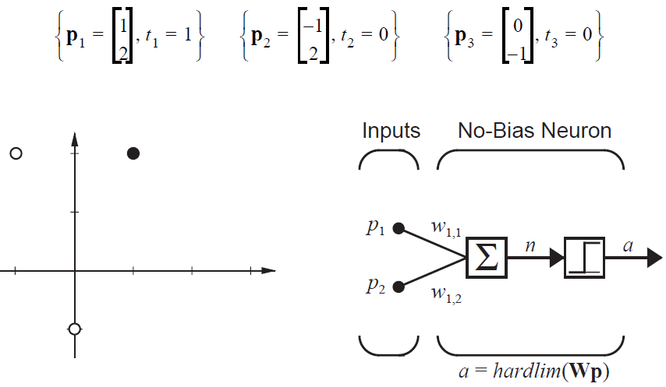
Example in 2D attribute space:
A decision boundary with b=0 goes though the origin. Use the PLA to find such a decision boundary that separates the classes with zero error using the hard limit to predict class.

Slide 22
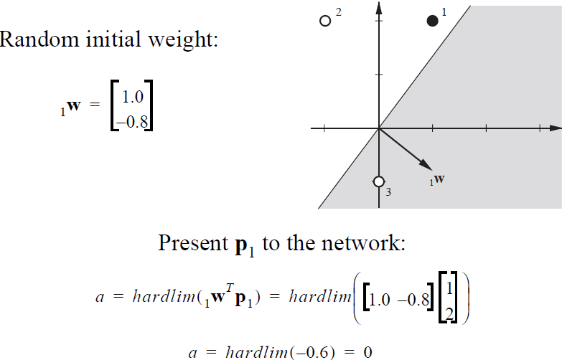
Misclassified: t₁=1, a=0 Black dot should be in shaded region
Example 3 is also misclassified.

Slide 23
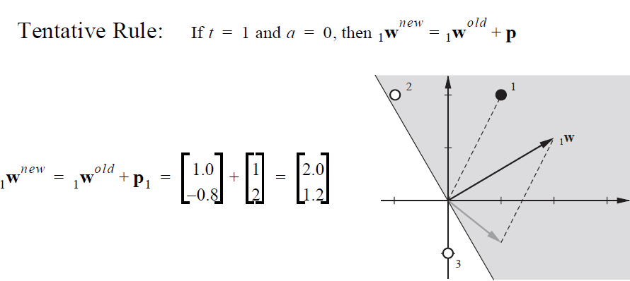
new
p
old
With new weight vector, only example 2 is misclassified. Modify weight vector based on this misclassification

Slide 24
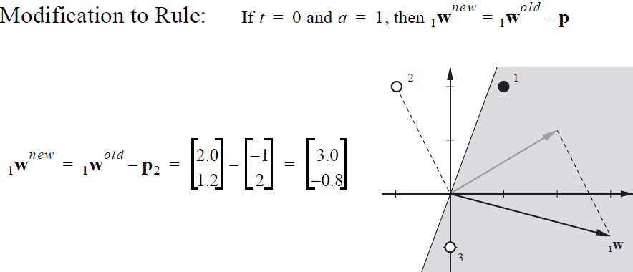
Note: sign change in weight update rule
old
-p
new
With new weight vector, examples 1 and 2 are correctly classified but now
example 3 is misclassified. Modify weight vector based on this misclassification.

Slide 25
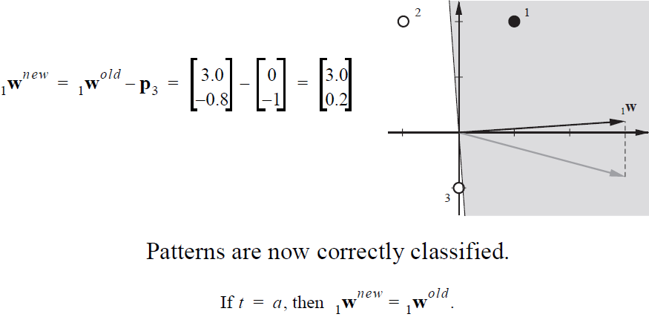
Again t=0 and a=1 implies a minus sign in weight update rule
Note how close example 3 is to the decision boundary.
This result will not generalize well.

Slide 26
Calculate class margins (remember b=0)
p₁ and p₃ are data in separate classes closest to the decision boundary
w^{T}=[3, 0.2]
||w|| = sqrt(9+0.04) = 3.0067
g(p₁)$=\left[3, 0.2\right]\left[\begin{matrix}1 \\ 2\end{matrix}\right]$ = 3.4
Margin positive class = 3.4/3.0067 = 1.1308
g(p₃)$=\left[3, 0.2\right]\left[\begin{matrix}0 \\ −1\end{matrix}\right]$ = -0.2
Margin non-member class = 0.2/3.0067 = 0.0665

Slide 27
Again t=0 and a=1 implies a minus sign in weight update rule
Margins: positive class = 1.13, negative class = 0.067

Slide 28
Summary of Perceptron Leaning Algorithm
Binomial labels t={0,1}
a = Perceptron output using hard limit
a = 1 if w^{T}p+b > 0
a = 0 if w^{T}p+b < 0
e = Error = t-a
Update weights after testing each example in training set.
Stop when all examples are correctly classified, or number misclassified does not change

Slide 29
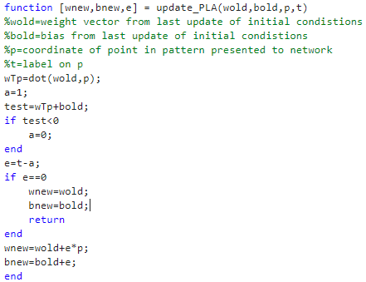
or
or
MATLAB function to perform a cycle of the PLA
Write a script to use this function to implement the PLA to find a decision boundary that separates 2 points in different classes and calculates the margins.

Slide 30
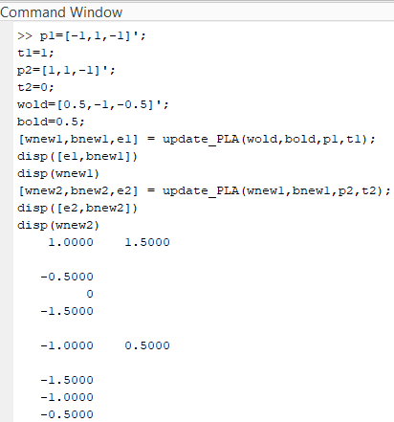
After 2 updates of the PLA, bnew2 and wnew2 define a decision boundary that separates the 2 points. Verify that update_PLA does not change the bias for weight vector.

Slide 31
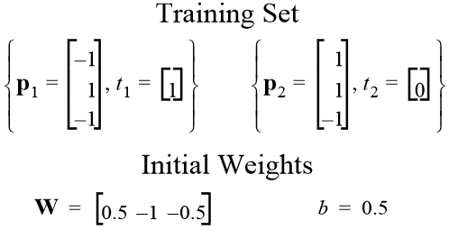
Assignment 8:
Use PLA with specified initial weights and bias to find a weight vector and bias that separates the 2 points below in 3D attribute space. Assume the output of the perceptron is hardlim(w^{T}p+b). Verify that PLA has converged. Report the resulting weight vector, bias. Calculate the distances of the points from the decision boundary. Show all steps of the calculations.
T

Slide 32
Alternate form of PLA
w^{T} = [b, w₁, …w_{d}] bias included in weight vector
(x^{t})^{T} = [1, x₁, …x_{d}] bias node in attribute vector
r^{t} = (-1,1) bipolar class labels
y^{t} = sign(w^{T}x) = 1 if w^{T}x > 0
= -1if w^{T}x < 0
w_{new} = w_{old} + y^{t} x^{t}
Verify that this is the same rule as in Hagan et al notation
Erroneous positive assignment, y^{t} = 1
Erroneous negative assignment, y^{t} = -1

Slide 33
Pseudo code for PLA in alternate form
Start with a randomly chosen of weight vector (w₀ = initial bias).
Compare sign(w^{T}x) to label of each attribute vector in training set.
If different, store y^{t} and x^{t} in a file of misclassified examples.
Randomly choose a misclassified example (x^{k}, y^{k}).
Update weight vector by w_{new} = w_{old} + y^{k}x^{k}.
Repeat 2-5 with the new weight vector.
Monitor the number of misclassified examples.
If data is linearly separable, stop when no misclassified examples.
If data is not linearly separable, when you stop at max iterations, w_{new} may not be the best choice for the smallest number of misclassified examples.
To avoid this problem, use the pocket algorithm (next slide).

Slide 34
Pseudo code for “pocket” algorithm
Set w_{best} to initial weight vector of PLA
Store misclassified examples
E_{best}=number misclassified
If E_{best}=0 return
For k=1 to max iterations
find w_{new} by PLA
find misclassified examples
E_{new}=number misclassified
if E_{new}<E_{best} w_{best}=w_{new} and E_{best}=E_{new}
if E_{best}=0 return
end
Output E_{best} and w_{best}

Slide 35
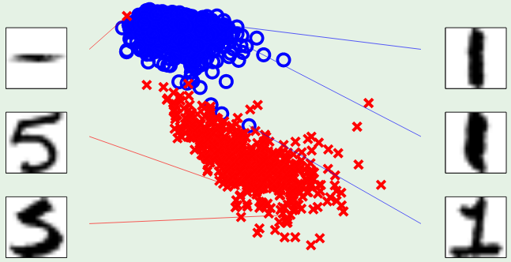
Application of pocket algorithm to digit recognition,1 vs 5
is not efficient.
symmetry
intensity
Patterns are nearly linearly separable
Algorithm sends most of its time searching for misclassifications
You will solve this problem by radial basis function neural network

Slide 36
Least Mean Square Algorithm

Slide 37
Digital Control Theory
No differential equations to model dynamics
Train for expected patterns of system behavior.
Periodically extract information from system.
Classify the information obtained based on training.
Control based on classification results.

Slide 38
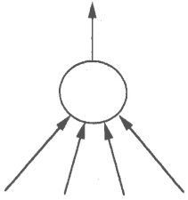
1962 Professor Bernard Widrow (Stanford) proposes the
Adaptive Linear Element (Adaline) trained by the
Least Mean Square algorithm for process control.
Dynamic output to control process
Dynamic input from sensors

Slide 39
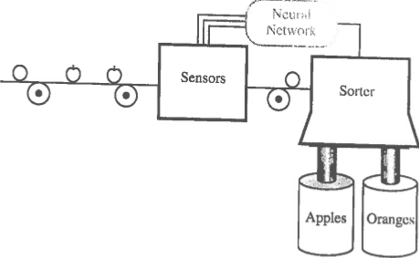
LMS applied to sorting apples from oranges
p$=\left[\begin{matrix}\begin{aligned}shape \\ texture\end{aligned} \\ weight\end{matrix}\right]$
A
adaline
Sensors measure shape, texture, and weight.
Adaline classifies data as orange or apple.
Sorter uses output to adjust path to collection bin.

Slide 40
To apply LMS, we need e = t - a to be a continuous variable.
Hence, output = a = w^{T}p + b = w^{T}p if b = 0
p_{O}$=\left[\begin{matrix}\begin{aligned}1 \\ −1\end{aligned} \\ −1\end{matrix}\right]$
Prototype input for orange
Target t_{O} = -1
Prototype input for apple
Target t_{A} = 1
p_{A}$=\left[\begin{matrix}\begin{aligned}1 \\ 1\end{aligned} \\ −1\end{matrix}\right]$
Data p from sensors will be classified by which prototype vector it is closest to. Error e = t-a = t-w^{T}p if b=0, where t is the label on the class the sensor data was assigned to, and w is the optimized weight vector of the adaline.

Slide 41
What class does p belong to and
what is the error in assignment
to that class?
p$=\left[\begin{matrix}\begin{aligned}shape \\ texture\end{aligned} \\ weight\end{matrix}\right]$=$\left[\begin{matrix}\begin{aligned}−1 \\ −1\end{aligned} \\ −1\end{matrix}\right]$
p-p_{O} =$\left[\begin{matrix}\begin{aligned}−2 \\ 0\end{aligned} \\ 0\end{matrix}\right]$
Classify p as orange data
p-p_{A} =$\left[\begin{matrix}\begin{aligned}−2 \\ −2\end{aligned} \\ 0\end{matrix}\right]$
A
adaline
If optimum w^{T} = [0,1,0], then
a = w^{T}p $=\left[0, 1, 0\right]\left[\begin{aligned}−1 \\ −1 \\ −1\end{aligned}\right]$ = -1
e = t_{O} – a =0

Slide 42
LMS formalism
Consider data from sensors as a population.
For a given w, t and e are population variables.
We want the w* for which expectation of e² is minimum.
F(w)=E[e²]=E[(t-a)²]=E[(t-w^{T}p)^{2]=}E[(t²-2w^{T}E[tp]+w^{T}E[pp^{T}]w)]
F(w) = c – 2w^{T}h + w^{T}Rw, where c=E[t²], h=E[tp], and R=E[pp^{T}]
gradient(F(w)) = -2h + 2Rw* = 0 -> w* = R⁻¹h
R is a covariance matrix, which is real and symmetric; hence
eigenvalues are real.
If all eigenvalues are non-negative then, the search for w* has
a global minimum.
Rather than estimate R by a sample, we perform a gradient
search for w*

Slide 43
Gradient search for w*
Approximate F(w)=E[e²] by e_{k}², square of error on k^{th} iteration
of the search.
e_{k}²(w) = (t_{k}-w^{T}p_{k})² gradient(e_{k}²(w)) = -2e_{k}p_{k}
Choose a gradient-decent step size α
w_{k+1} = w_{k} – α gradient(e_{k}²(w)) w_{k+1} = w_{k} + 2αe_{k}p_{k}
Step size 0.2 is reasonable.
Initial weight vector = w_{i}^{T}=[0,0,0].
Alternate between prototype vectors for orange and apple.
a = w^{T}p, e = t-a, t_{O}= -1, t_{A} = 1

Slide 44
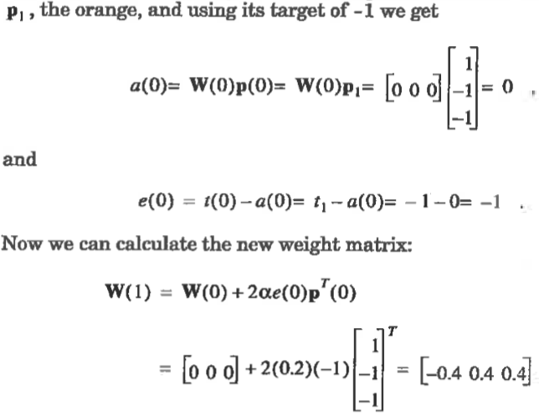

Slide 45
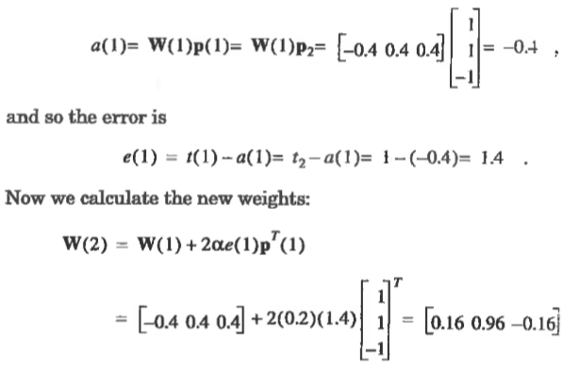
Present apple prototype vector with target = 1

Slide 46
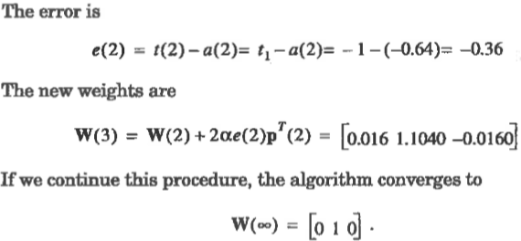
Present orange prototype again with target = -1

Slide 47
LMS decision boundary and margins
p_{O}$=\left[\begin{matrix}\begin{aligned}1 \\ −1\end{aligned} \\ −1\end{matrix}\right]$
Prototype orange
Prototype apple
p$=\left[\begin{matrix}\begin{aligned}shape \\ texture\end{aligned} \\ weight\end{matrix}\right]$
p_{A}$=\left[\begin{matrix}\begin{aligned}1 \\ 1\end{aligned} \\ −1\end{matrix}\right]$
Decision boundary defined by w^{T} = [0,1,0] and b=0
$\left[0, 1, 0\right]\left[\begin{matrix}p1 \\ \begin{aligned}p2 \\ p3\end{aligned}\end{matrix}\right]$ + 0 = p₂ = 0
Decision boundary is the p₂ = 0 plane

Slide 48
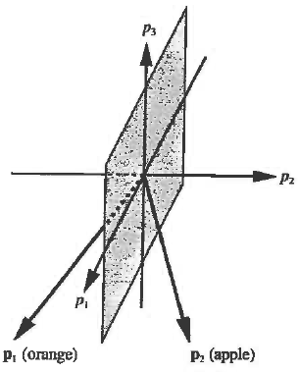
What are the margins on the orange and apple prototype points?
w^{T}=[0, 1, 0], ||w|| = sqrt(1) = 1
g(p_{O})$=\left[0,1,0\right]\left[\begin{matrix}1 \\ \begin{aligned}−1 \\ −1\end{aligned}\end{matrix}\right]$ = -1
Margin orange class = 1
g(p_{A})$=\left[0,1,0\right]\left[\begin{matrix}1 \\ \begin{aligned}1 \\ −1\end{aligned}\end{matrix}\right]$ = 1
Margin apple class =1

Slide 50
Assignment 11: one cycle in LMS with b=0.
Initial weight w_{i} = [0.5,-1, -0.5] ^{T}
Use prototype vector for apple p = [1,1,-1]^{T} with t = 1
Use a step size of 0.2
Carry out the first cycle of Least Mean Square search for optimum weight vector by
Calculating perceptron output, a
(b) Calculating the error in perceptron output, e
(c) Calculating the new weight vector, w

Slide 51
Hopfield neural-network pattern classifier:
Used to classify patterns defined by values of discrete variables.
Method of choice for large datasets due to efficiency.
Records are N-dimensional vectors with components = +1 that
specify presence or absence of specific values of discrete
variables.
Example of discrete variable: type of amino acid (values 1-20)
Classes: motifs defined by the type of amino acid at specified
points in the protein sequence

Slide 52
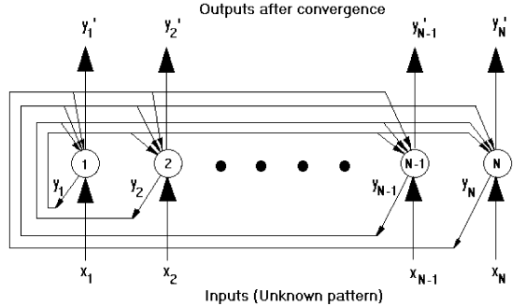
Hopfield neural network (aka associative memory)
Output from each node i fed back to all other nodes j
with weight w_{ij}

Slide 53
Weights: w_{ij}=sum over records of x_{i}x_{j} and w_{ij}=0 if i=j
Initialize output: y_{i}(t=0)=x_{i},
where x_{i} is i^{th} component of unknown pattern to be classified
Iterate: y_{j}(t+1)=H[sum over i of w_{ij}y_{i}(t)], where H[sum]=1 if sum>0 and H[sum]=-1 if sum<0
Converged outputs are the components of the record in the dataset most like the unknown pattern.
Assign the unknown to the class that contains that record.

Slide 55
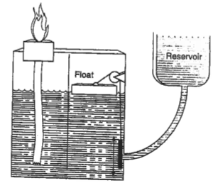
Application of perceptron classifier to set-point control
Philon (250 B.C>.) designs system to maintain fuel level in
oil-burning lamp.

Slide 56
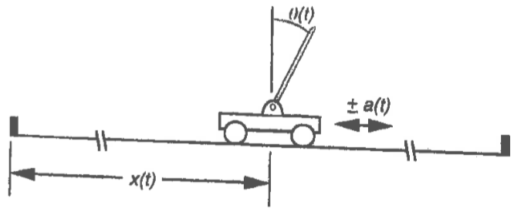
1962 Professor Widrow performs experiments at Stanford
to test adiline performance at pole balancing
2D version: Cart on track moves in x direction only.
Pool attached to cart by hinge joint. Moves in xy plane only.
Sensors measure cart position and velocity, deviation of pole
from vertical and angular velocity.

Slide 57
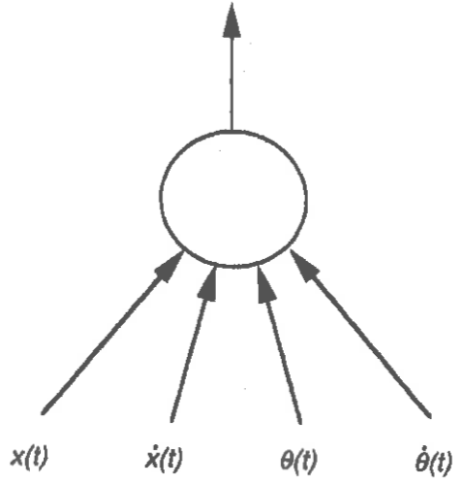
Need training data to determine the best linear combination
of input data to predict the acceleration applied to the cart that
will both balance pole and keep the cart at the center of the track
a(t)

Slide 58
In 1987 Widrow and graduate student revisit adiline training for
pole balancing. Obtain images of pole at 13 different angles
for each of 5 cart positions (far left, near left, center, near right
and far right).
All possible pairs of images (65² = 4225) were used to develop
a human-computer interface in which a trainer responded
with +1 to pairs of images showing previous and current states
of the system. (+1, -1) indicated the trainer’s opinion that force
should be applied (right, left) to maintain pole vertical and cart
near center.

Slide 59
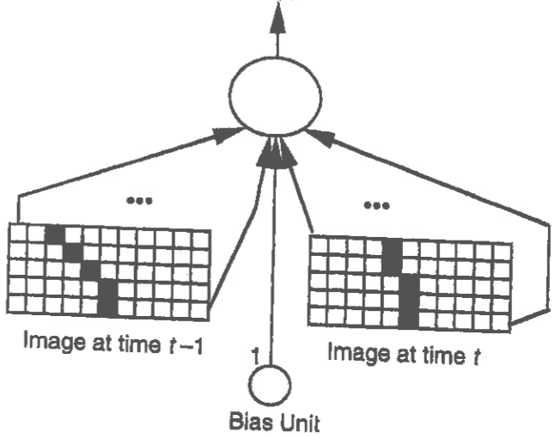
The 4225 human-labeled pairs of images became a training set of attribute vectors
(each with 111 components) for supervised learning by the adiline.
Output was a = sign(w^{T}p+b) and target was human judgement of direction of force.
+1

Slide 60
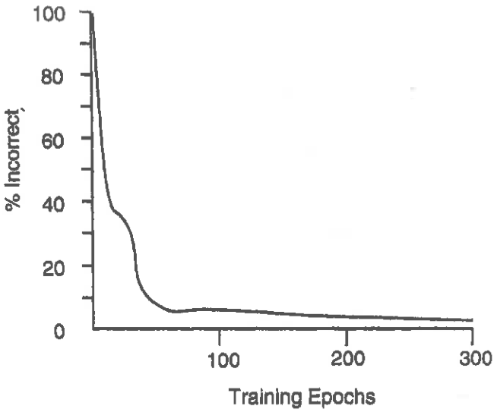
Training results
After 300 passes through all 4225 examples,
accuracy of classification was ~ 96%

Slide 61
Conclusion
It is evident from this example that obtaining training data is
the main challenge of implementing the perceptron classifier
in a control function.
We will return to this issue when we consider a non-linear
controller for pole balancing.

