Slide 1
Methods of classification
Classification by regression
Parametric Bayesian classification

Slide 2
Classify by perceptron regression

Slide 3
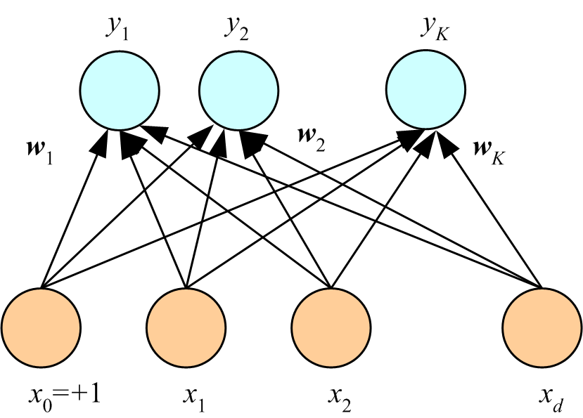
Perceptron for multi-class multivariate linear classification.
Each class has its own weight-vector connection to the input that is a column of a weight matrix W with K columns and d+1 rows. Output is the sigmoid function which is interpreted as probability of class membership (called softmax). Assign example to class with highest probability. Number weights = K(d+1)
Sig(w₁^{T}x)
Sig(w₂^{T}x)
…
Sig(w_{K}^{T}x)
…

Slide 4
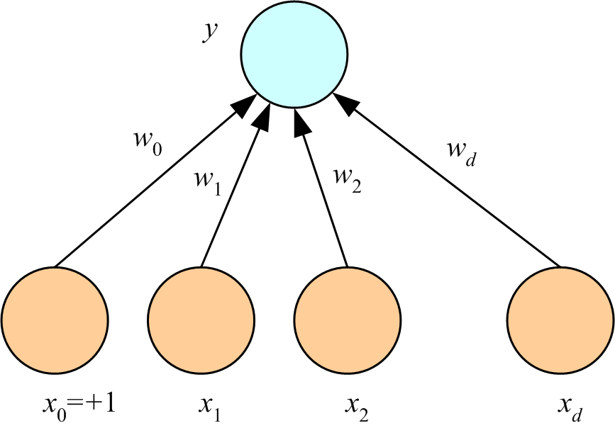
Classification by perceptron regression:
Response is class label, treated as continuous variable. Requires binning of response to assign an example a to class. Number of weights is d+1 regardless of the number of classes.
w^{T}x
x is input vector
w is weight vector
y = w^{T}x
…
Lecture Notes for E Alpaydın 2010 Introduction to Machine Learning 2e © The MIT Press (V1.0)
4

Slide 5
Classification by perceptron regression:
Advantages: Fewer parameters and one-step optimization by normal equations
Disadvantages: results will be affected by binning and no softmax
w^{T}x
x is input vector
w is weight vector
y = w^{T}x
…
Lecture Notes for E Alpaydın 2010 Introduction to Machine Learning 2e © The MIT Press (V1.0)
5

Slide 6
Example using the Beer-bottle glass dataset
Predict brewery from chemical composition of beer-bottle glass.
Data contains 214 samples of bottle glass from 6 breweries.
Each example has 9 attributes.
Counting bias, perceptron classification has 60 weights to be iteratively
optimized. Requires ~ 600 data points by the 10x rule of training set size.
Perceptron regression has 10 weights to be determine by normal equations.
Requires ~100 data points by the 10x rule.

Slide 7
First 3 rows of data
1 | 1.521 | 13.64 | 4.49 | 1.1 | 71.78 | 0.06 | 8.75 | 0 | 0 | 1
2 | 1.517 | 13.89 | 3.6 | 1.36 | 72.73 | 0.48 | 7.83 | 0 | 0 | 1
3 | 1.516 | 13.53 | 3.55 | 1.54 | 72.99 | 0.39 | 7.78 | 0 | 0 | 1
1. Sample index
2. RI: refractive index
3. Na: Sodium
4. Mg: Magnesium
5. Al: Aluminum
6. Si: Silicon
7. K: Potassium
8. Ca: Calcium
9. Ba: Barium
10. Fe: Iron
11. Type of bottle (class)
1=Anheuser-Busch, Inc.
2=Miller Brewing Co.
3=Blitz-Weinhard Brewing Co.
4=Pete’s Brewing Co.
5=Samuel Adams Brew House
6=Plank Road Brewery

Slide 8
Steps in classification by regression
Setup perceptron regression as though brewery number (column 11) is a continuous response.
Solve normal equations for optimum weight vector.
Bin y_{fit} to predict class assignment for examples in dataset.
Use predicted class and true class to calculate a confusion matrix.

Slide 9
6-way confusion matrix, columns are class specific
# in class 1 assigned class 1 # in class 2 assigned class 1 …
# in class 1 assigned class 2 # in class 2 assigned class 2 …
. .
. .
# in class 1 assigned class 6 # in class 2 assigned class 6 …
total in class 1 total in class 2
Note this confusion matrix designed so that sum of elements in a column is total class membership. In Weka confusion matrix sum of elements in a row is total class membership

Slide 10
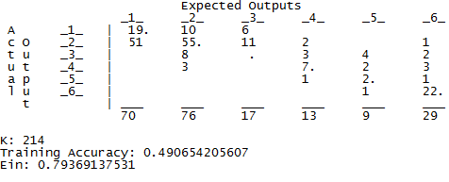
6-way confusion matrix for beer-bottle classification by regression
Classes
Classified as
Classes 1, 2, and 6 have the most data.
Data on class 3 is poor. No correct assignments.
HW6_classify_by_mir.m uses data in classes 1, 2, and 6.

Slide 11
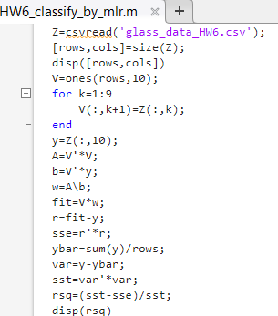
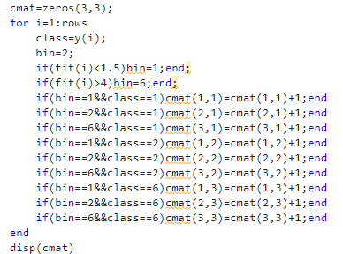
Calculate confusion matrix

Slide 12
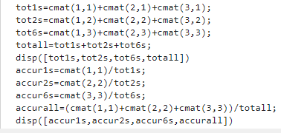
Calculate accuracies from confusion matrix

Slide 13
Assignment 4
Download HW6_classify_by_mir.m from the class web page. Run with dataset glass_data_HW6.csv to classify beer-bottle glass by perceptron regression. Keep the class labels as 1, 2, and 6. After fitting class labels as though they are a continuous response, bin the results to make predictions of class
assignment. Use bin structure default bin=2, Fit<1.5, bin=1, and Fit>4, bin=6.
Report the following:
Coefficient of determination, number of records in each class, accuracy of class assignment,
overall accuracy, and 3-way confusion matrix with class specific columns as outlined below.
Edit HW6_classify_by_mir.m to create the bin structure default bin=2, Fit<1.5, bin=1, and Fit>2.5, bin=6.
Run the edited code and report the results listed above.
# in class 1 assigned class 1 # in class 2 assigned class 1 # in class 6 assigned class 1
# in class 1 assigned class 2 # in class 2 assigned class 2 # in class 6 assigned class 2
# in class 1 assigned class 6 # in class 2 assigned class 6 # in class 6 assigned class 6

Slide 15
Methods of classification
Parametric Bayesian classification

Slide 16
Bayes’ Rule for binary classification
prior
Class likelihood
posterior
Normalization factor
Prior is usually the proportion of training examples in each class.
Class likelihood is probability that a member of class C will have attributes x
Assign example with attributes x to class C if P(C|x) > 0.5
Notes:
Prior is what we know about credit risk before we observe a clients attributes; might be per-capita bankrupties
Class likelihood, p(x|C), probability of observing x conditioned on the event being in class C
given client is high-risk (C = 1) how likely is X = {x₁, x₂}
deduced by data on a set of known high-risk clients
Evidence, p(x), is essentially a normalization; also called “marginal probability” that x is seen regardless of class
Posterior, P(C|x), probability that client belongs to class C conditioned on attributes being X
When normalized by evidence, posteriors add up to 1

Slide 17
Bayes’ Rule: K>2 Classes
Normalized priors
Assign example with attributes
Notes:
Priors, likelihoods, posteriors, and margins are class specific
Evidence is sum of margins over classes

Slide 18
Parametric Bayesian classification:
1. assume a distribution function for class likelihoods, p(x|C_{i})
(Gaussian, for example)
2. estimate parameters of the distribution from data
3. use relative class sizes in dataset for priors, p(C_{i})
4. assign example with attributes x to class with largest p(C_{i}|x)

Slide 19
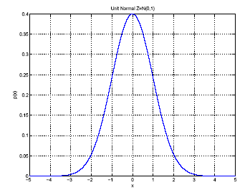
1-D Gaussian class likelihoods
Estimate μ and σ² by
μ
σ
Function of a single random
variable with a shape
characterized by 2 parameters

Slide 20
Naïve Bayes classification: Gaussian class likelihoods, d attributes.
Assumes that attributes of a class are uncorrelated. Unlikely to be entirely true; hence Naïve.
Class likelihood, P(x|C), is a product of 1D Gaussians for each attribute.
p(x_{i} |C) is the probability that an example in class C will have value x_{i} for attribute i
P(x |C) is the probability that an example in class C will have attribute vector x with d predictors
Class C is characterized by a mean and variance of the d attributes of examples in the dataset that belong to class C.
20

Slide 21
HW5 is an application of Naïve Bayes classification as implemented in Weka
The leukemia gene expression file (on class website) is data on individuals with 2 types of leukemia, ALL or AML. HW5 uses Naïve Bayes classification to address the question, “Can the type of leukemia, ALL or AML, be predicted from gene express data?”

Slide 22
Download and start the Weka GUI. Follow the instructions on the Weka site:
http://www.cs.waikato.ac.nz/ml/weka/
We will only use the Weka’s Explorer functionality. Extensive documentation can be found at Explorer guide
Open the leukemia gene expression file (on class website) in Explorer.
Under preprocess click open file.
Go to folder where you stored the leukemia gene expression file.
Under file type choose CSV, choose file, click open

Slide 23
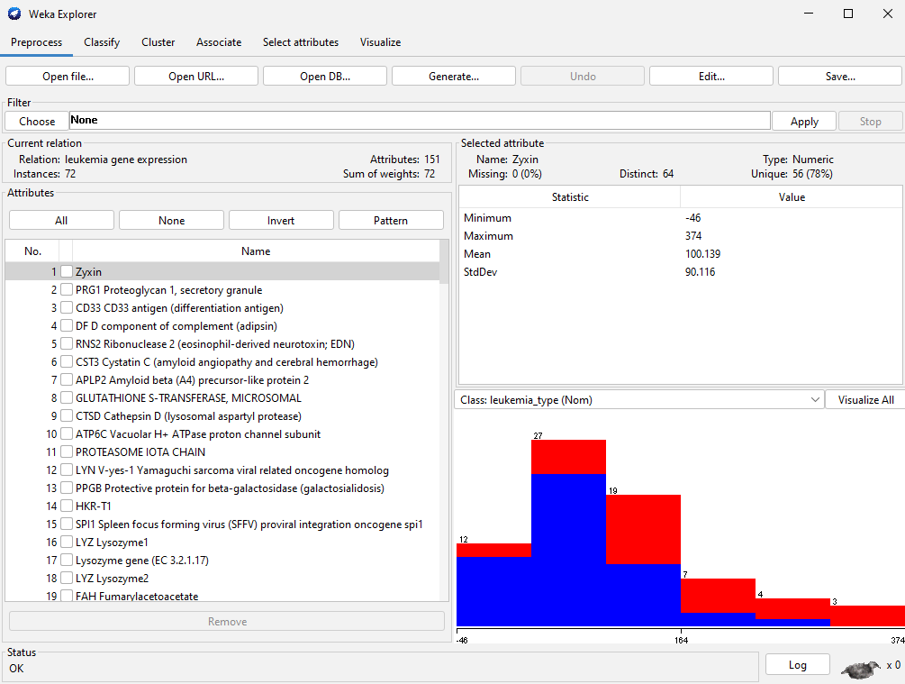

Slide 24
Under classify, find the Naïve Bayes classification method.
Under “Test options” choose “Cross-validation” and under “Folds” enter 5. The drop-down menu below Test options should say “(Nom) leukemia_type”. This means that the algorithm will classify “leukemia_type” (AML or ALL), using the gene expression values as attributes.
Click the start button

Slide 25
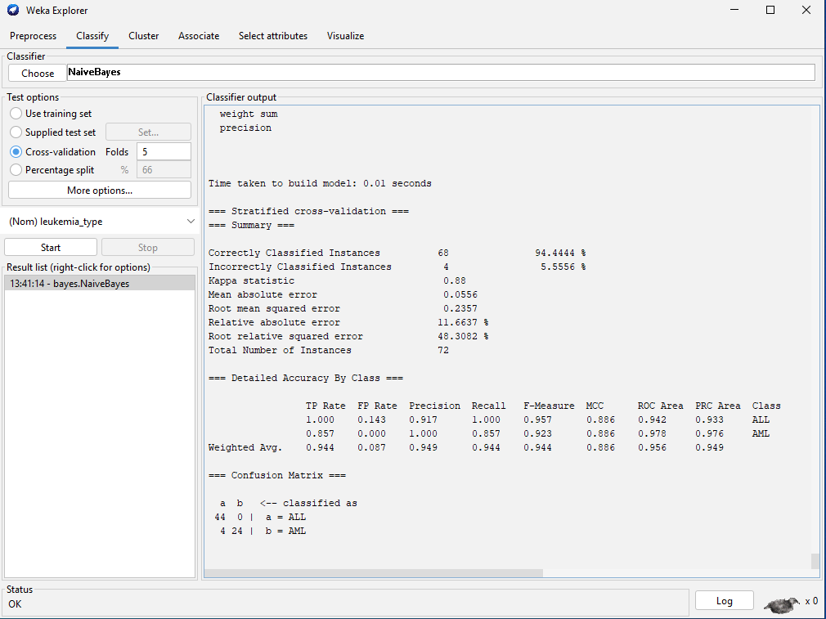

Slide 26
Assignment 5: Naïve Bayes classification
Use leukemia gene expression data (on class website) in Weka to predict the type of leukemia, ALL or AML.
Report accuracy of classification and confusion matrix assuming ALL is the positive class
Construct the confusion matrix assuming AML is the positive class.
Calculate the class-dependent TP and FP rates.
Show your work and compare to Weka’s class specific TP and FP rates.

Slide 28
Bayesian classification by discriminants:
A discriminant is a function whose value determines which class an example will be assigned to.

Slide 29
Define a discriminant function g_{i}(x) = log(p(C_{i}|x)) for a dataset where k classes are segregated by the value of one attribute, x. Use Bayes’ rule with class likelihoods that are Gaussian distributed.
We can drop the term log(p(x)) because it is not class dependent
Lecture Notes for E Alpaydın 2010 Introduction to Machine Learning 2e © The MIT Press (V1.0)
29

Slide 30
Using Gaussian class likelihood and natural logarithms
The prior is the faction of examples from class i in the dataset and the parameters for class i are the mean and standard deviation of values of the predictor among members of class i.

Slide 31
To classify an example with value of the predictor = x, calculate the value of the discriminate for all classes. Assign the example to the class with largest value of the discriminate.

Slide 32
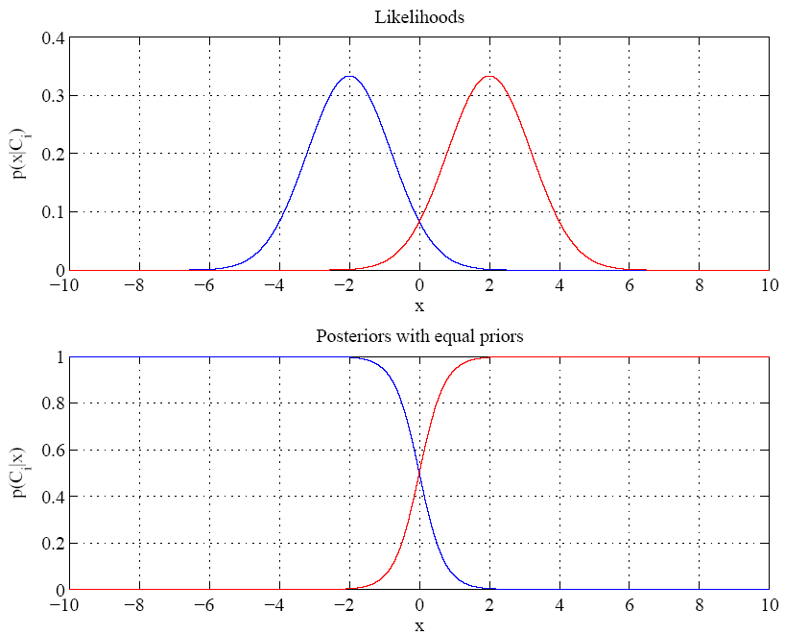
Equal variances
and priors
Example for
1D 2-class
problem
Between + 2, note
transition between
prediction of class
At boundary most probable class changes
Single boundary at
halfway between means where normalized posteriors are equal to 0.5
Lecture Notes for E Alpaydın 2010 Introduction to Machine Learning 2e © The MIT Press (V1.0)
32
Notes:
Example: 2 classes
Class likelihoods have means + 2 and equal variance
Priors are also equal.
Between -2 and 2 have transition between essentially certain classification of classes as a function of x

Slide 33
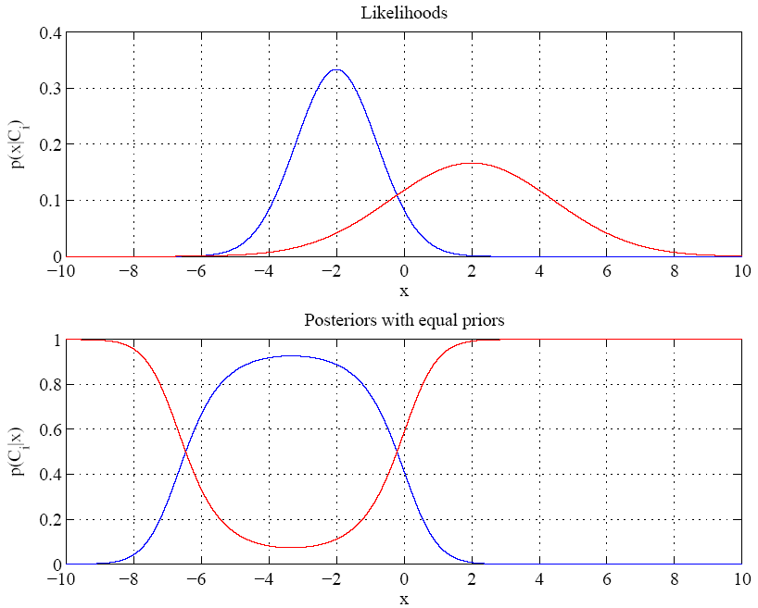
Red class likelihood
also dominant for
x < about -7 also
Variances are different
Boundaries where dominant
posterior changes are called
“Bayes discriminant points”
Lecture Notes for E Alpaydın 2010 Introduction to Machine Learning 2e © The MIT Press (V1.0)
33

Slide 34
Find the Bayes discriminate points for a 1D, 2-class dataset with equal priors.
Bayes discriminate points are where the discriminants for the 2 classes are equal.
Set g₁(x) = g₂(x) and solve for x.
After much tedious algebra you find a quadratic equation for discriminate points.
where μ and σ denote mean and standard deviation of x values in a class. Last term is zero for equal priors
If σ₁ = σ₂ , only one discriminate point. If, in addition P(C₁) = P(C₂), discriminate point is the average of the means.

Slide 35
Pseudo code for function [p1,p2] = bayespoints(m1,sd1,m2,sd2) with equal priors
Initialize p1 and p2 to zero
Calculate a, b, and c, coefficients of x², x, and constant in the quadratic equation below.
If both a and b are zero, no solution exist, Exit.
If a is zero and b is nonzero, find one point by solving bx+c=0 for x.
If both a and b are nonzero, return two points by solution of quadratic equation.
.
Due to round-off error, best not to test for exact zero. Set lower bound on absolute value

Slide 36
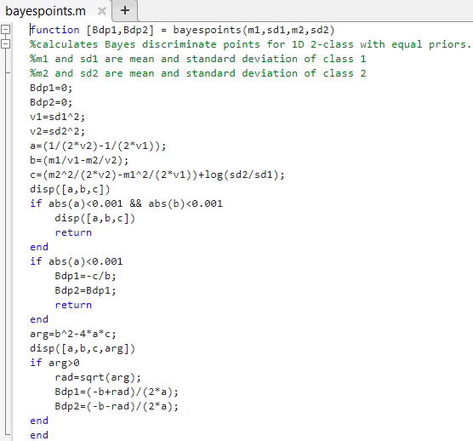

Slide 37
Assignment 6: Bayesian Classification by Discriminant
Write a script to find the Bayes’ discriminant points in a 1D, 2-class problem with equal priors and Gaussian class likelihoods with the following values for mean and standard deviation:
Use bayespoints function on the class webpage
Mean and standard deviation of C1 are 3 and 1, respectively
Mean and standard deviation of C2 are 2 and 0.3, respectively
Change the standard deviation of C2 to 1 and find the single Bayes discriminant point.

