Slide 1
Fundamentals of Classification
In-sample and out-of-sample errors
Version space
Margins
Confusion matrix

Slide 2
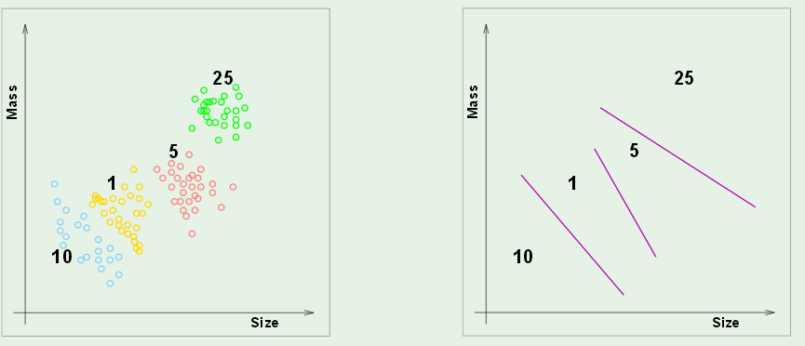
In-sample and out-of-sample error
Classify coins by size and weight
Design a vending machine that uses results
Boundaries in attribute space
Attribute space

Slide 3
In-sample error, E_{in}
How well do boundaries match training data?
Out-of-sample error, E_{out}
How often will this system fail if implement in the field?

Slide 4
A good model has small E_{in} and generalizes well (small E_{out}).
Will not be true if the E_{in} is made small by adapting the model
to the noise in the training set (over fitting).

Slide 5
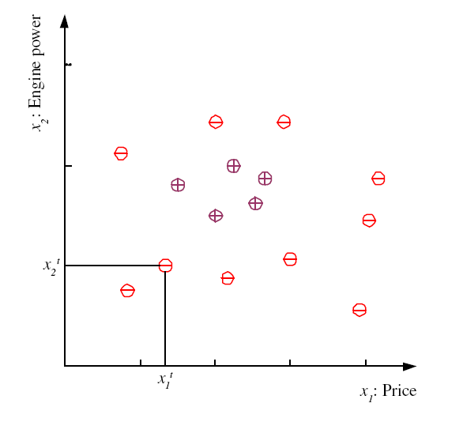
Binary classification in 2D attribute space
Dara set and labels
examples of family cars
Family-Car is a product line
No uncertainty in the label.
Issue is how well do price
and engine size distinguish
a family car.
examples of other product lines
5
Lecture Notes for E Alpaydın 2010 Introduction to Machine Learning 2e © The MIT Press (V1.0)
Notes:
Χ denotes training set
t is index of training set member
x^{t} is vector of attributes (dimensionality of problem)
r^{t} is label
Label can be either class (classification problem) or real number (regression problem)
This classification problem has only one class (family car) “dichotomizer”
Defined by 2 attributes (price and engine size)
Examples belonging to class are called “positive” and have r = 1
Examples not in class are called “negative” and have r = 0
For some machine learning techniques (SVM) better to assign r = -1 to negative examples
Unsupervised learning: finding attribute space were class members “cluster”

Slide 6
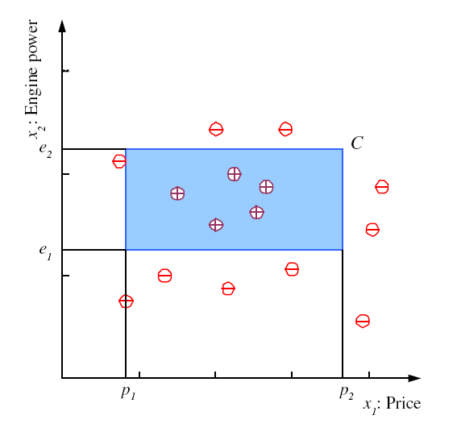
Model: assume that family cars are uniquely defined by a range
of price and engine power. Blue rectangle is one hypothesis of
this model with zero in-sample error on this data set.
6
Notes:
Clustering of positive examples in this training set allows setting of boundaries in the attribute plane that defines a class
Shape is arbitrary but choice of rectangle with sides parallel to attribute axes facilitates math definition of class

Slide 7
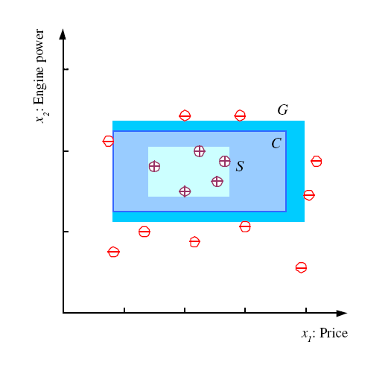
S, G, and the Version Space
most specific hypothesis, S, with no E_{in}
most general hypothesis, G,
with no E_{in}
The set of hypotheses (e.g., C) between S and G makes up the version space. All have no E_{in}. Which is best?
7
Notes:
S = h(x) with min error (zero in this case) and size (“most specific”)
G = h(x) with min error (zero) and max size (“most general”)
Mitchell calls the range of hypothesis classes between S and G the “version” space
Best choice of h(x) in the version space is one that makes most correct predictions (“generalization”)

Slide 8
Margin: distance between boundary of a hypothesis
and closest instance in a specified class
S and G hypotheses have
narrow margins; not expected to “generalize”
well because a small amount of noise can result in misclassification
G
S
8
Notes:
Define “margin” of h(x) as the distance between the boundary of h(x) and the instance closest to it
Hypotheses S and G have zero margin

Slide 9
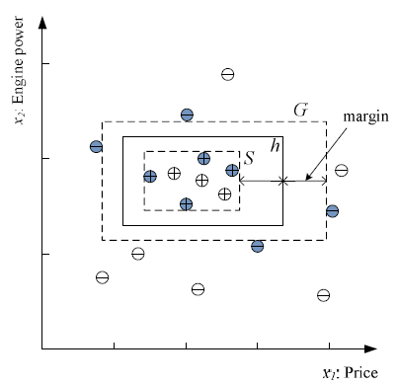
Best choice in version space is hypothesis with largest margins
Choose h in the version space with largest possible margins to maximize generalization.
Data points that determine S and G are shaded. These data points alone enable determination of h. They are called “support vectors”.
h is a hypothesis with E_{in}=0 and wide margins
9
Notes:
Among h(x) in the version space, the one with largest margin is generally considered to be the best choice for class separation, based on the training set
Data points that determine this choice are (shaded in figure) are said to “support” the optimum h(x)
Other data points could be deleted without effecting our choice of optimum h(x) in the version space

Slide 11
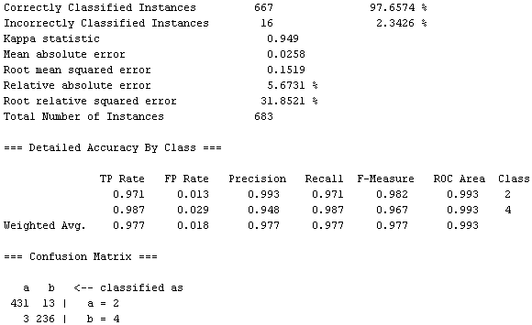
Performance metrics for classification (example from WEKA output)
WEKA is machine-learning software package.
Rows are class specific
Row sum is total class membership
Class labels are 2 and 4

Slide 12
Analysis of classification results: binary confusion matrix
Rows are class specific. Top row is positive class
False positive rate = FP / (FP+TN) = fraction of negative class instances misclassified.
True positive rate = TP / (TP+FN) = fraction of positive class instances correctly classified.
Lecture Notes for E Alpaydın 2010 Introduction to Machine Learning 2e © The MIT Press (V1.0)
12

Slide 13
Class dependent performance metrics
FP rate = FP/(FP+TN)
TP rate = TP/(TP+FN
If either class could be the “positive” class, then the Confusion Matrix, TP rate, and FP rates become class specific.
Example when top row is positive class:
a is the positive class
a b ← classified as
431 13 | a
236 | b
FP rate = 3/(3+236)=0.013
TP rate = 431/(431+13)=0.971
b is the positive class
b a ← classified as
236 3 | b
431 | a
FP rate = 13/(13+413)=0.029
TP rate = 236/(236+3)=0.987
13

Slide 14
Columns are class specific. Left column is positive class
False positive rate = FP / (FP+TN) = fraction of negative class instances misclassified.
True positive rate = TP / (TP+FN) = fraction of positive class instances correctly classified.
a is the positive class
a b
431 3 | classified as a
13 236 | classified as b
FP rate = 3/(3+236)=0.013
TP rate = 431/(431+13)=0.971
b is the positive class
b a ← classified as
236 13 | classified as b
3 431 | classified as a
FP rate = 13/(13+413)=0.029
TP rate = 236/(236+3)=0.987
14

