Slide 1
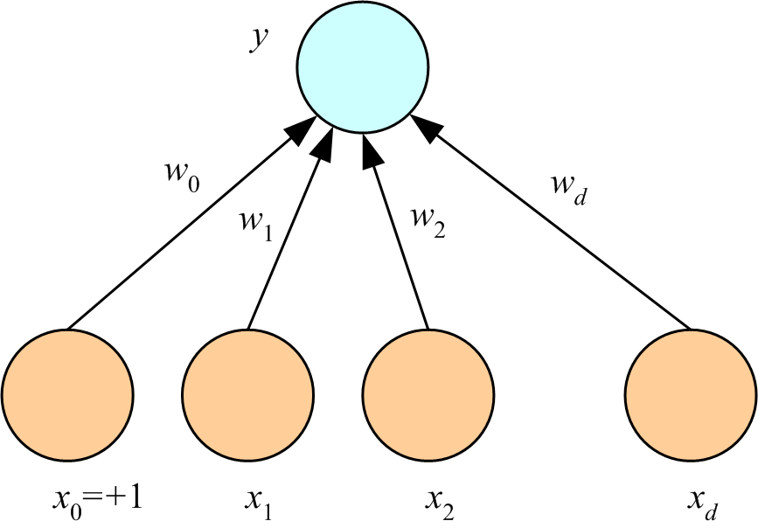
Rosenblatt recognized that without modification of the output node, the perceptron was just another representation of multivariate linear regression.
x is input vector
w is weight vector
y = w^{T}x
w^{T}x
…
Lecture Notes for E Alpaydın 2010 Introduction to Machine Learning 2e © The MIT Press (V1.0)
1

Slide 2
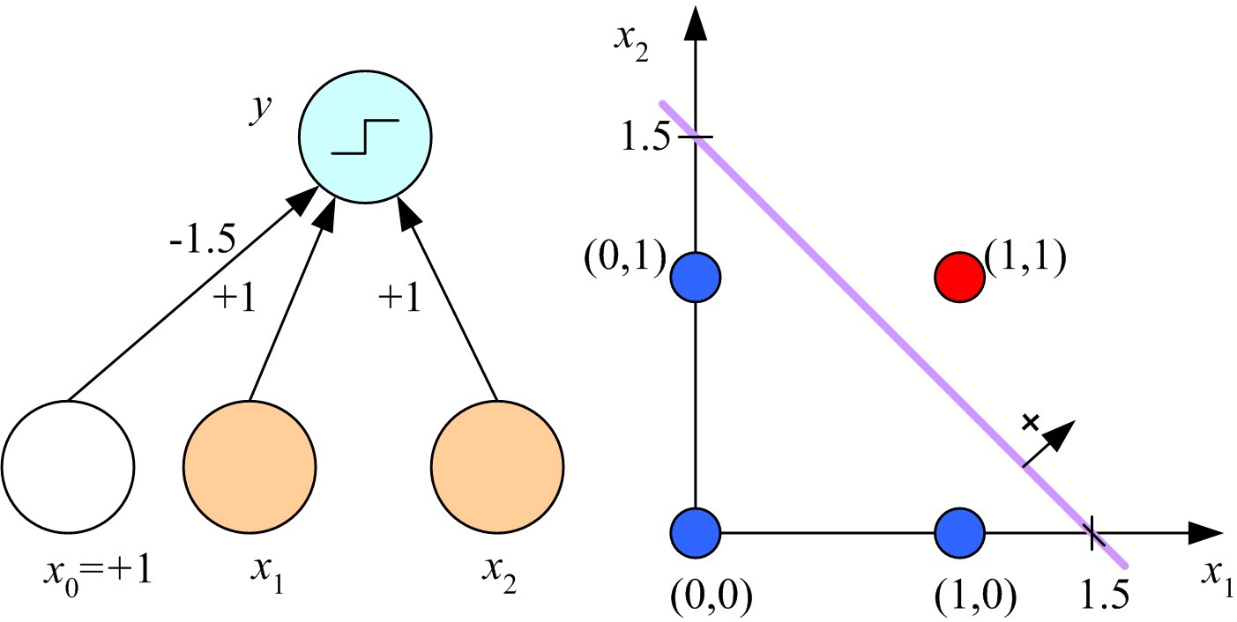
We will discuss Rosenblatt’s perceptron learning algorithm, which uses y = sign(w^{T}x) in the output node, in the context of pattern recognition.
…
Lecture Notes for E Alpaydın 2010 Introduction to Machine Learning 2e © The MIT Press (V1.0)
2

Slide 3
Linear regression: Use d attributes and a bias to predict a response.
Advantages: one-step optimization and statistical analysis.
w^{T}x
x is input vector
w is weight vector
y = w^{T}x
…
Lecture Notes for E Alpaydın 2010 Introduction to Machine Learning 2e © The MIT Press (V1.0)
3

Slide 4
Attributes and predictions are usually continuous variables, but categorical attributes are not excluded, class labels, for example. Allows regression to be used for classification. Will discuss later.
w^{T}x
x is input vector
w is weight vector
y = w^{T}x
…
Lecture Notes for E Alpaydın 2010 Introduction to Machine Learning 2e © The MIT Press (V1.0)
4

Slide 5
“one-step” optimization uses “normal equations” to determine weights.
Linear algebra facilitates this approach with any number of attributes.
x is input vector
w is weight vector
y = w^{T}x
w^{T}x
…
Weight optimization by “normal” equations
Lecture Notes for E Alpaydın 2010 Introduction to Machine Learning 2e © The MIT Press (V1.0)
5

Slide 6
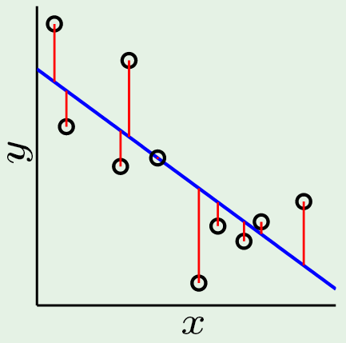
d=1 linear regression (fit a line to data)
x_{k} are attribute vectors with 1st component =1. These vectors are the rows of matrix X
Solve X^{T}Xw = X^{T}y for w₁ and w₀. Y_{fit} = Xw (vector of values of the fit at data points)
Lecture Notes for E Alpaydın 2010 Introduction to Machine Learning 2e © The MIT Press (V1.0)

Slide 7
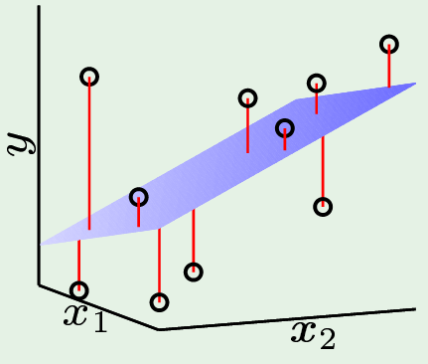
d=2 linear regression: fit a plane to data
Solve X^{T}Xw = X^{T}y
for w₂, w₁, and w₀
The X matrix has 3 column; 1st is all ones, 2nd and 3rd are values of predictors 1 and 2, respectively. The 1st component of w is the bias. The 2nd and 3rd components of w are the coefficients of predictors x₁ and x₂ in the regression model. Y_{fit} = Xw
Lecture Notes for E Alpaydın 2010 Introduction to Machine Learning 2e © The MIT Press (V1.0)

Slide 8
multivariate regression: fit a hyperplane to data
Solve X^{T}Xw = X^{T}y
for w₀, w₁, … w_{d}
Not easy to illustrate
Each row of the matrix X, is a vector that combines x₀=1 with the d attributes from a record in the training set. Y_{fit} = Xw
Lecture Notes for E Alpaydın 2010 Introduction to Machine Learning 2e © The MIT Press (V1.0)

Slide 9
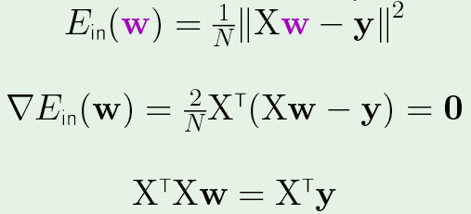
Derive the “normal” equations: E_{in} is the error in training examples
To solve the normal equations, define A= X^{T}X, b=X^{T}y and solve Aw=b by any
efficient method. (w=A\b in MATLAB).
y_{fit} = Xw are values of fit at the data points. y_{fit} - y are the residuals at the data points.

Slide 10
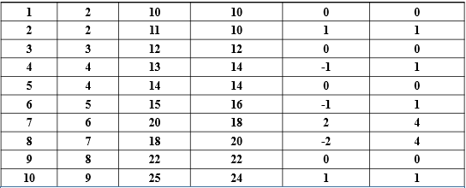
Simple dataset: distance hiked in km vs time
Index x=time y=distance fit=6+2x error (error)²
Write a MATLAB code to apply normal equations
to fit a line to these data

Slide 11
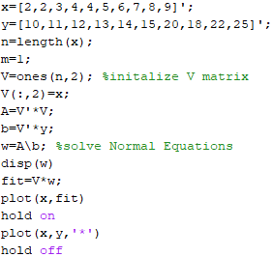
MATLAB code to fit a
line to hiker dataset.
n is the number of
training examples.
m is the number of
predictors. Only time in this problem.
Enter this code and run it.

Slide 12
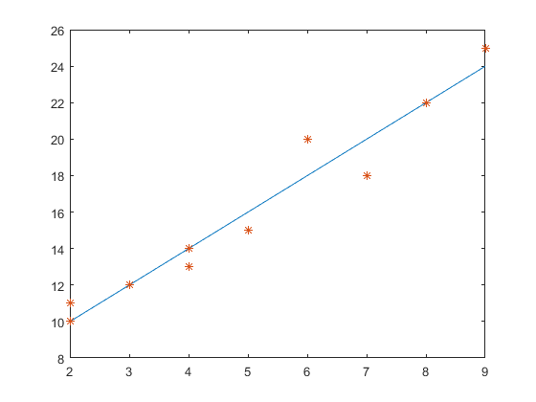
Output from MATLAB code
distance
fit=ax+b
w(1) = b = 6
w(2) = a = 2
distance
time

Slide 13
Analysis of fit

Slide 14
Quality of fit:
coefficient of determination and standard error of estimation
Index x=time y=distance fit=6+2x error (error)²
Sum of squared error (SSE) = 12

Slide 15
Sum of Squares Regression
Measures variability from mean response explained by regression
Sum of Squares Error
Measures variability in y from all other sources after linear relationship
between x and y has been accounted for
SST = SSR + SSE follows from the identity

Slide 16
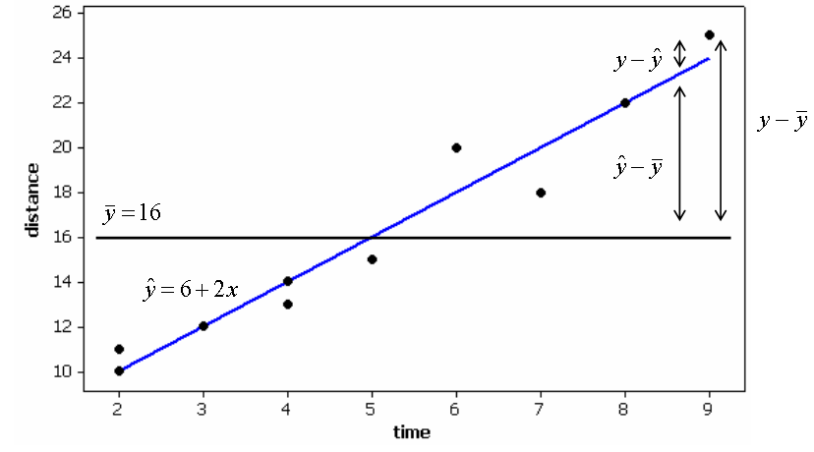
Coefficient of determination: r²= SSR/SST
SST = SSR + SSE
As SSE -> 0, SSR -> SST and r² -> 1 means a perfect fit to data.
As SSR -> 0, r² -> 0 means the fit is the same as the average.
r² interpreted as fraction of response variation from mean explained by the predictors. Time walked explains 95% of variation from mean of distance walked in this data set. Clearly a better model than the mean of 16 km.
SST=228
SSE=12
SSR=216
r² = 0.95

Slide 17
Standard Error of the Estimate
Mean Square Error (MSE)
m = number predictors, n = number observations
Standard Error of the Estimate
s is a "typical” residual or error in estimation
For hiker vs time dataset: m =1, n=10, SSE= 12 -> s = 1.225 km
Given time walked, estimate of hiking distance typically differs from actual distance by 1.2 km

Slide 18
MATLAB code to fit a
line to hiker dataset.
n is the number of
training examples.
m is the number of
predictors. Only time in this problem.
Add analysis to this code

Slide 19
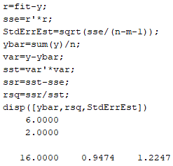
Add MATLAB code for standard error of estimation and coefficient of determination
r is vector of residuals at each data point
sse is the sum of squared residuals
Note: use of MATLAB keyword “sum” and
that all sums are calculated as vector norms
Optimum value of parameters from display statement on previous slide

Slide 20
Leverage of observations: potential to effect parameters of linear fit
leverage h_{i} for i^{th} observation:
leverage increases as distance of an x-value from the mean of x-values increases
1/n <= Leverage <= 1.0
observations with leverage > 2(m + 1)/n are considered to have high leverage

Slide 21
Standardized residuals and outliers
Standard error of i^{th} residual
Observation with leverage h_{i}
At minimum leverage of 1/n and large n, standard error of i^{th} residual approaches standard error of estimation
Standardized Residual:
As leverage approaches its maximum values of 1, standard error of residual approached zero, and standardized residual becomes large.
Generally, observations with absolute value of the standardized residual > 2 are considered outliers

Slide 22
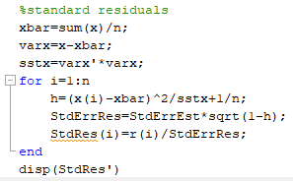
Add MATLAB code to calculate standardized residuals
Include fit an analysis (no plot) in function linfit

Slide 23
function [b0,b1,rsq,StdErrEst,StdRes] = linfit(x,y)
Available on the class webpage
Optimizes parameters by solving the normal equations.
Calculates coefficient of determination.
Calculates standard error of estimation.
Calculates standard residuals.
Does not plot.
To plot fit and data on the same axes use
fit=b0+b1*x;
plot(x,fit);
hold on
plot(x,y,’*’)
hold off

Slide 24
Assignment 1 : Linear fit with test for outliers
Add another data point to hiker dataset in slide 10
11th hiker traveled 20 km in 5 hours
Write a script to run function linfit(x,y) on expanded hiker dataset.
Plot fit and data on the same set of axes.
Report b₀, b₁, s, and r²
Determine if the new data point is an outlier.
Report standardized residual for the new datapoint

Slide 25
Fitting data with more than one predictor

Slide 26
Application of linfit to cereals dataset on class web page: nutritional rating vs sugar
cereals dataset as an Excel file

Slide 27
Data without labels to enable CSV read
fiber
sugar
rating

Slide 28
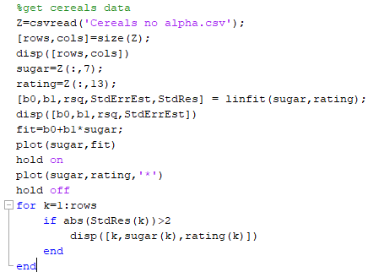
MATLAB script to use linfit:
Get fit, plot results, test for outliers.
From previous slide, sugar and fiber are columns 7 and 13.
If absolute value of standard residual >2, display

Slide 29
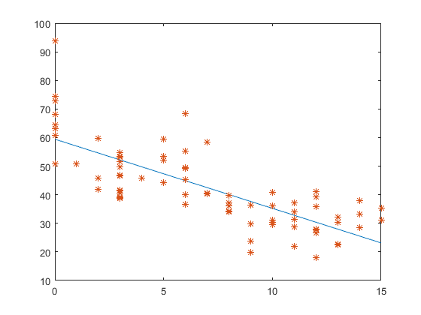
Fit to cereals data: nutritional rating VS sugar with outlier testing
b₀ = 59.4, b1 = -2.42, r²= 0.58, s = 9.16
Outliers:
(0, 93.7)
(6, 68.4)
rating
sugar

Slide 30
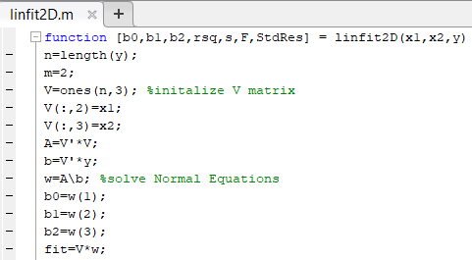
Add a second predictor, fiber, to linear model for rating using linfit 2D

Slide 31
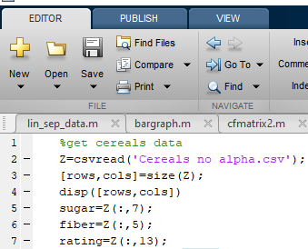
Get training data using MATLAB’s csvread

Slide 32
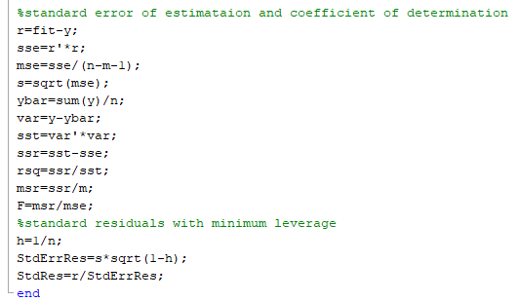
Error analysis in linfit2D: note minimum leverage assumed

Slide 33
What are the best attributes to explain the response?
R² always increases when an additional attribute is included.
To be useful, a new attribute must significantly increase R².
Example: R² = 58% for linear regression of rating on sugar only.
Adding fiber to the regression, allowed the model to account for an additional 81% – 58% = 23% of variability in rating over the Cereal dataset.
Fiber is a useful attribute to explain nutritional rating of cereals

Slide 34
Standard error of estimation, s, can be lower or higher when another
attribute is added to the model.
Linear regression of rating on sugars alone gives s = 9.16
s = 6.17 for regression on rating with sugar and fiber
Including fiber decreases s by (9.16 – 6.17) = 2.99 rating points, which indicates that fiber is a good attribute for predicting nutritional rating.
To be useful as a new attribute, it must decrease s.
Decrease should be significant to justify additional attribute in model

Slide 35
Assignment 2:
Use linfit 2D to model nutritional rating of cereals with sugar and fiber as predictors. Report R² and s.
Use linfit3D to consider protein, fat, and sodium separately as a third attribute,
in addition to sugar and fiber, to predict the nutritional rating cereals.
Report the change in R² and s, relative to results with fiber and sugar for each case.

Slide 36
statistical inference in multi-variate regression

Slide 37
Additional assumptions on perceptron regression to supports statistical inference
Assumes that response in a population of examples is described by
where, x₁, x₂, …, x_{m} are attributes values, β₀, β₁, …, β_{m} are parameters whose true values are unknown, and ε is the error in the model.
Let b₀, b₁, …, b_{m} denote estimates of β₀, β₁, …, β_{m} from a sample dataset using perceptron regression.
Assume errors in the predications of response by m attributes are independent and normally distributed with zero mean and constant variance.
These assumption makes response values, y, a population of independent, normal-distributed, random variables with variance = σ² and mean

Slide 38
With these additional assumptions, perceptron regression supports 5 types of
statistical inference
(1) T-test for relationship between response y and specific predictor x_{i}, in presence of other predictors x₁, x₂, …, x_{i-1}, x_{i+1}, …, x_{m} held constant at their optimum value.
(2) F-test for significance of entire regression equation
(3) Confidence interval for β_{i}, slope of i^{th} predictor
(4) Confidence interval for model prediction of mean of a population of responses.
(5) Confidence interval for model prediction of a random member of a population of responses.

Slide 39
T-test for Relationship Between x_{i} and y
Hypothesis Test for model:
H0: β_{i} = 0
Ha: β_{i} ≠ 0
Under Ha:
Under H0:
Only difference between models is absence/presence of i_{th} predictor
Under null hypothesis (i.e., H0), t = b_{i}/ s_{bi} follows t-distribution with n-m-1 degrees freedom, where s_{bi} is standard error of slope for i_{th} predictor

Slide 40
T-test for Relationship Between rating and sugar
H0: β_{s} = 0, Model: y = β₀ + β_{f}(fiber) + ε
Ha: β_{s} ≠ 0, Model: y = β₀ + β_{s}(sugars) + β_{f}(fiber) + ε
b_{s} = –2.2090 and s_{bs}=0.1633
T-statistic t = b_{s}/ s_{bs}= –2.2090/0.1633 = –13.53
P-value = p(t-statistic as least as extreme as –13.53 by chance alone) ~ 0.000
Null hypothesis rejected with high confidence when p-value is this small
Confident that regression provides evidence of linear relationship between rating and sugar, in the presence of fiber at its optimum value

Slide 41
T-test for Relationship Between rating and fiber
H0: β_{f} = 0, Model: y = β₀ + β_{s}(sugars) + ε
Ha: β_{f} ≠ 0, Model: y = β₀ + β_{s}(sugars) + β_{f}(fiber) + ε
b_{f} = 2.8408 and s_{bf}=0.3032
T-statistic t = b_{f}/ s_{bf}= 2.8408 /0.3032 = 9.37
P-value = p(t-statistic as least as extreme as 9.37 by chance alone) ~ 0.000
Null hypothesis rejected with high confidence when p-value is this small
Confident that regression provides evidence of linear relationship between rating and fiber, in the presence of sugar at its optimum value.

Slide 42
F-test for Significance of Overall Regression Model
F-statistic is a ratio of two mean squares, MSR/MSE, where each mean square equals a sum of squares divided by its degrees of freedom
ANOVA table is a standardized summary of regression statistics
Note that F-statistic has different degrees of freedom associated with numerator and denominator.
Source of Variation | Sum of Squares | Degrees of Freedom | Mean Square | F
Regression | SSR | m
Error (or Residual) | SSE
Total

Slide 43
F-test for Significance of Overall Regression Model
Hypotheses for F-Test:
H0: β₁ = β₂ = … = β_{m} = 0
Ha: At least one β_{i} ≠ 0
If H0 is true, yhat ~ ybar and SSR is small, but n>>m, so MSR ~ MSE, and F is about 1.
If Ha is true, SSR is at least as large as SSE and n>>m, so MSR>>MSE, and F>>1.

Slide 44
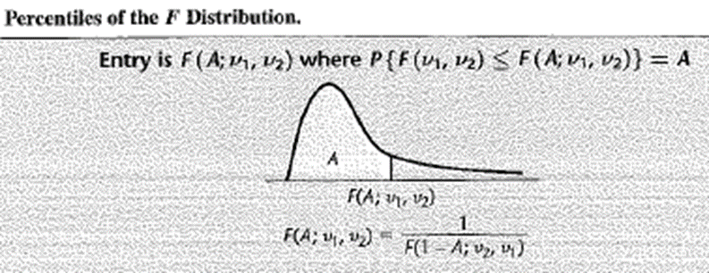
F-test for Significance of Overall Regression Model
The shape of the F_{m, n-m-1} distribution varies somewhat depending on degrees of freedom (m and n-m-1)
Nevertheless, if F_{m, n-m-1} is large, A is near 1, and area in tail is small.
Hence, the p-value for large F_{obs} = MSR/MSE will be small.
Therefore, reject H0.
Confident of a linear relationship between response and at least one of the predictors

Slide 45
F-test for relationship between rating and {sugars, fiber}
H0: β_{s} = β_{f} = 0, Model: y = β₀ + ε
Ha: At least one β_{i} ≠ 0, where Model: y = β₀ + β_{s}(sugars) + ε, or y = β₀ + β_{f}(fiber) + ε, or y = β₀ + β_{s}(sugars) + β_{f}(fiber) + ε
MSR = 6058.9, m degrees of freedom = 2
MSE = 38.9, n-m-1 degrees of freedom = 74
F-statistic F = 6058.9/38.9 = 155.73
P-value = p(F_{2,74} > 155.73) ~ 0.000
Reject H0.
Confident of linear relationship between rating and set of predictors, sugars and fiber

Slide 46
Confidence Interval on model parameter β_{i}
100(1-alpha)% confidence interval for coefficient β_{i} of predictor x_{i}
b_{i} is an estimate of β_{i} with standard error s_{bi}
t_{critical} is based on n-m-1 degrees of freedom and the desired confidence
100(1-alpha)% confidence that true slope β_{i} lies within
Example: construct 95% confidence interval for β_{s}, for sugars
b_{s} = –2.2090, and s_{bs}= 0.1633
T-critical value t_{74,95%} ~ 2.0 (my interpolation method yields 1.9926)
95% confidence interval = –2.2090 ± (2.0) (0.1633) = (–2.54, –1.88)

Slide 47
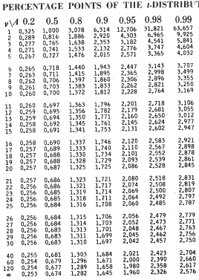
Tabular values for interpolation when
number of degrees of freedom exceeds 30.

Slide 48
Confidence Interval for prediction of a mean value
100(1-alpha)% confidence interval for prediction of a mean response
x_{p} is the attribute vector where prediction is made
E(y(x_{p})) is the mean response of a population of examples at x_{p}
y_{p} is the prediction of the regression model at x_{p}
t_{critical} is based on n-m-1 degrees of freedom at the desired confidence
s is the standard error of estimation of the regression model
100(1-alpha)% confidence that the true mean response lies within y_{p} + st_{critical}sqrt(h(x_{p}))
h(x_{p}) is the “leverage” of x_{p} bounded by 1/n < h(x_{p})<1
Apply at the low-leverage extreme y_{p} + st_{critical}sqrt(1/n)

Slide 49
Confidence Interval for prediction of a mean value at a low leverage point
h(x_{p})=1/n
95% confident that mean rating for all cereals with sugars = 5 gm and fiber = 5 gm is between (52.709, 57.183)

Slide 50
Confidence interval for prediction of response for random member of the population with attributes x_{p}
y_{p} + st_{critical}sqrt(1+h(x_{p}))
Only difference from confidence interval of a predicted mean value is 1+ in the square root.
The low-leverage extreme h(x_{p})=1/n does not affect the confidence interval much at large values of n because we add 1 in the argument of square root.
95% confident that rating for randomly chosen cereal with sugars = 5 gm and fiber = 5 gm is between 42.318 and 67.574 points, which is significantly wider than confidence interval for prediction of the mean value.

Slide 51
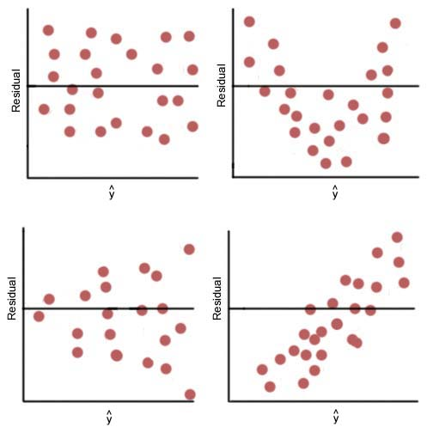
Standard residuals in predictions of optimum model give an indication of whether the errors in training
data match the assumptions of the regression model.
Independent
Normally distributed
Zero mean
Constant variance
Statistical tests are available to verify compliance
Plots of residuals vs model prediction can indicate
noncompliance of error assumptions
Probably compliant
Not independent
Variance not constant
Mean not zero
A
B
C
D

Slide 52
Assignment 3: Inference in multivariate linear regression on Cereals dataset
Write a script to use linfit2D for regression of nutritional rating vs sodium and fiber. Report b₀, b_{s}, b_{f}, r², s, and F. Plot standard residuals as a function of fit.
Expand your script to use inference2D to calculate 95% confidence intervals on slopes b_{s} and b_{f}.
Use the regression model to predict nutritional rating of cereals with 200 units of sodium and 5 units of fiber.
Find the 95% confidence intervals on prediction of the mean nutritional rating for a population of cereals with 200 units of sodium and 5 units of fiber.
Find the 95% confidence intervals on prediction of nutritional rating for a random cereal with 200 units of sodium and 5 units of fiber.

Slide 53
linfit 2D returns standard residuals as a column vector
fit = b0 + bs*sodium + bf*fiber;
plot(fit,StdRes,”*”)

Slide 54
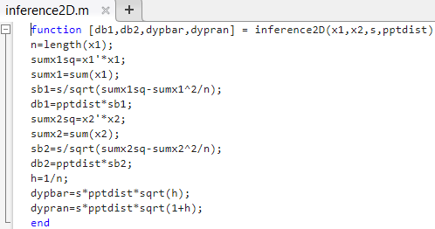
Note: input s comes from output of linfit2D
Input pptdist come from table in slide 47.

