Slide 1
Convolutional Neural Networks (CNNs):
Deep leaning neural networks for image classification

Slide 2
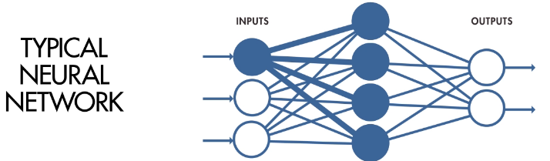
A typical ANN associates patterns (input and output) defined as vectors.
one hidden layer is usually sufficient
number hidden nodes is typically twice the number of output nodes
network is “fully connected”

Slide 3
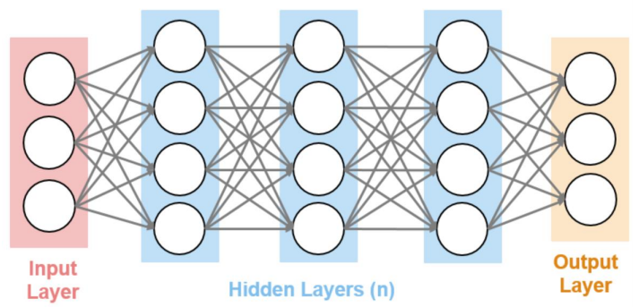
Deep learning ANNs have more hidden layer but still have vector input and output and are fully connected.

Slide 4
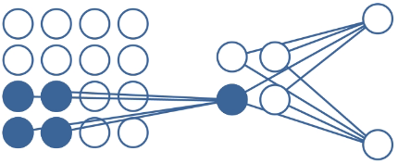
CNNs for image classification associates a pattern defined by an input array
with an output vector of class labels.
Input array (image pixels)
Class labels
Hidden layers

Slide 5
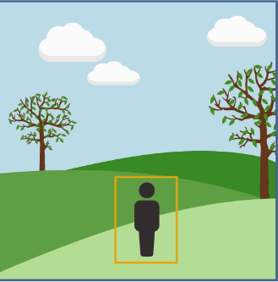
CNNs differ from traditional ANNs in 4 ways
Local receptive fields
Shared weights and biases
Activation and pooling
Transfer learning

Slide 6
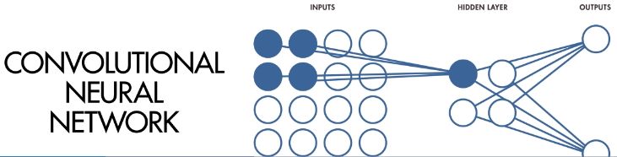
Input array is not fully connected to hidden layer
Parts of input array called local receptive fields (LRFs) are
connected to specific nodes in the hidden layer.

Slide 7
Sweeping LRFs across the input array creates a feature map
in the hidden layer. Convolution accomplishes feature mapping
efficiently; hence the name CNN

Slide 8
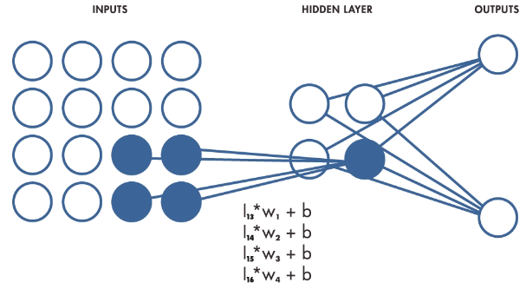
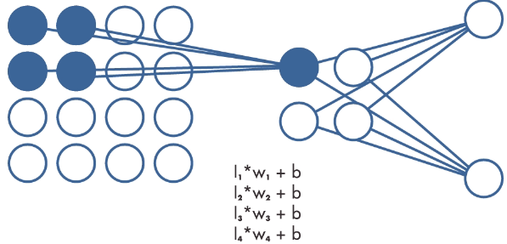
Shared weights and biases
All the local receptive fields are connected to their respective hidden node
by the same set of weights (w₁-w₄) and bias (b).
This makes the image analysis translationally invariant.
Whatever the weights are trained to detect can be anywhere in the image.

Slide 9
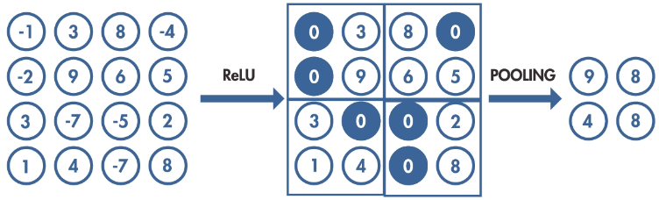
Input arrays can be very large. Activation and pooling is a way to effectively reduce the size of the input array and the number of weights and biases that need to be determined from a training set.
The ReLU activator shown below changes negative input values to zero.

Slide 10
Pooling partitions the input array into regions and takes the largest input value in the region as the input for that region.
Example below reduces the size of the input array from 4x4 to 2x2, which decreases size and resolution of feature maps

Slide 11
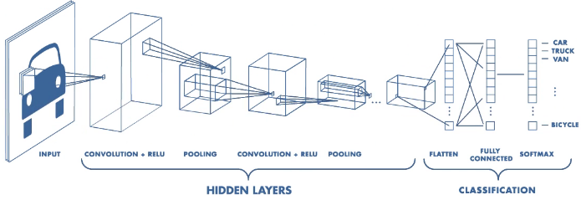
CNNs have many hidden layer to obtain feature maps of many input regions
After many cycles of convolution, ReLU activation, and pooling for multiple regions of the image, feature maps are classified to obtain class likelihoods. In example shown below, likelihood of car should be much greater than likelihood of other classes.

Slide 12
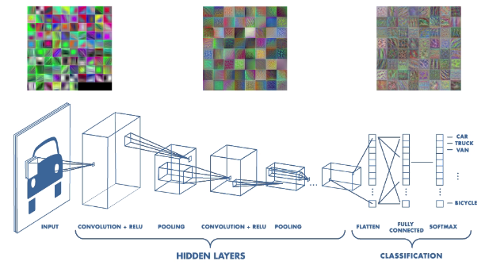
Image processing by CNNs is hierarchal. Early hidden layer may only detect edges. Hidden layers closer to classification detect more complex features

Slide 13
Features in hidden layers near the classifier will not be recognizable. We can trace then back to the image and quantify their importance in the classification.

Slide 14
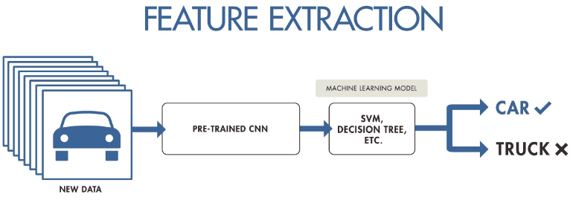
Flattened and fully connected output can drive different types of machine learning classifiers to realize specific advantages, like SVM for wide margins or decision trees for explainable results.

Slide 15
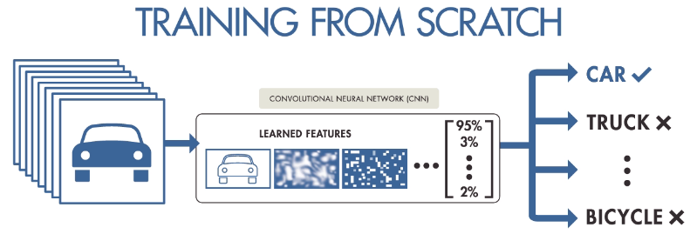
Training from scratch gives the most accurate predictions but
requires many images and large computational resources.

Slide 16
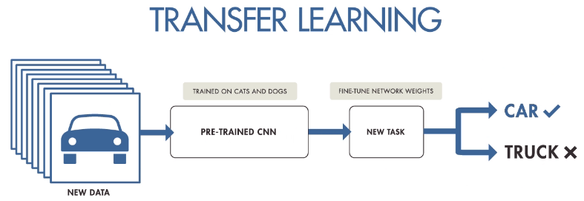
A pre-trained CNNs that embodies fundamentals of image segmentation, like edge detection, can be refined to identify many types of objects with less data and computational resources than training from scratch.
Example: transfer learning for trash classification
step 1 choose a pretrained network
step 2 get training images

Slide 17
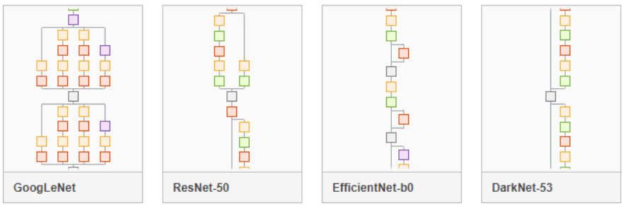
Select a pre-trained network. Many choices are available in MATLAB

Slide 18
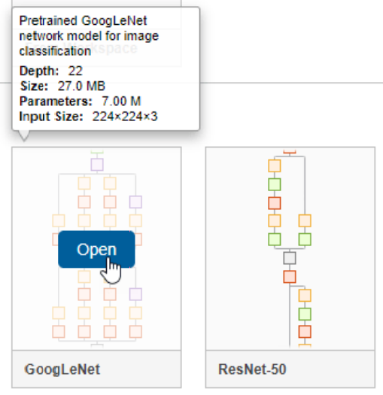
Try GoogLeNet

Slide 19
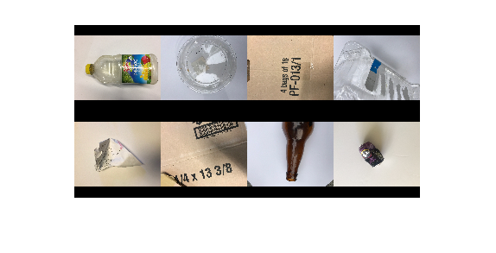
A database of trash images is available for training: 2390 images in 5 classes,
cardboard, glass, metal, paper, and plastic
We will use this database to create a MATLAB object called a “datastore”.

Slide 20
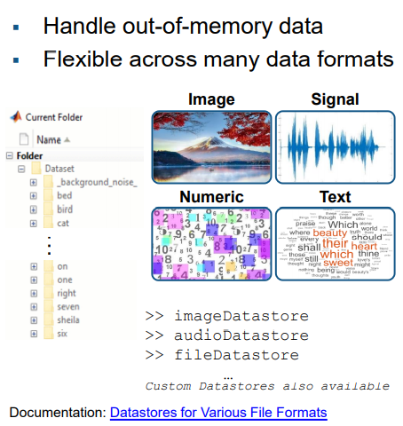
Datastores
trashnet datastore: 2390 images in 5 classes

Slide 21
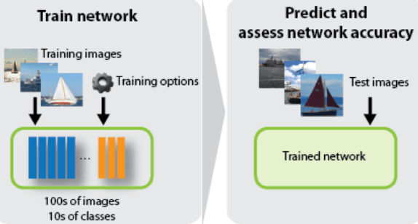
Training and testing images are the bottle neck.
Look for a public dataset related to your problem (e.g., Flowers, trashnet, etc.)
If all else fails, create your own database.

Slide 22
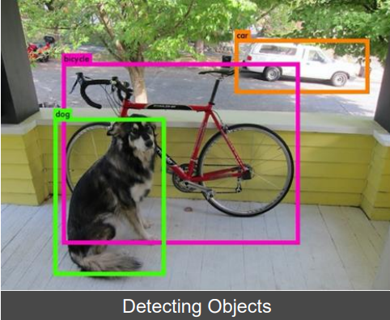
Creating training and/or testing images: labeled bounding boxes isolate the subject

Slide 23
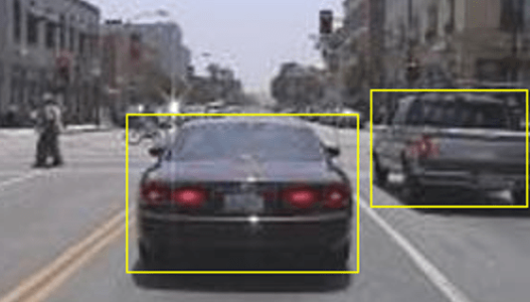
Video input to apps for automated image collection, bounding, and labeling

Slide 24
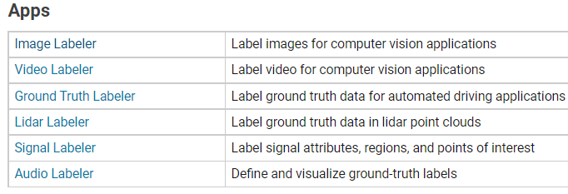
MATLAB has apps for several types of labeling tasks

Slide 25
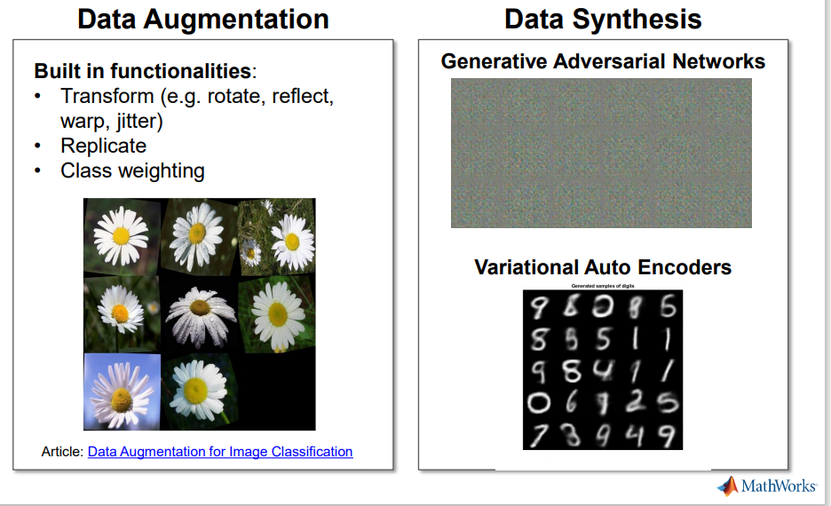
Data augmentation and/or synthesis will likely be required.
Data Augmentation for Image Classification Applications Using Deep Learning » Deep Learning - MATLAB & Simulink (mathworks.com)

Slide 26
Data augmentation
Augmentation enables you to train networks to be invariant to distortions in image data. For example, you can add randomized rotations to input images so that a network is invariant to the presence of rotation.
augmentedImageDatastore provides a convenient way to apply a limited set of augmentations to 2-D images for classification problems.
The augmented datastore contains the same number of images as the original image datastore.
augmentedImageDatastore applies the transformations when reading the datastore.
Each time you read an image you get a random combination of the augmentations defined.

Slide 27
Defining a data augmentation schemes
imageAugmenter = imageDataAugmenter('RandRotation',[-90 90],'RandScale',[1 2], 'RandXReflection', true);
This scheme applies random rotation between [–90,90] degrees. random scaling between [1,2], and random reflections.
Pass imageAugmenter to function augmentedImageDatastore to create an augmented datastore for training

Slide 28
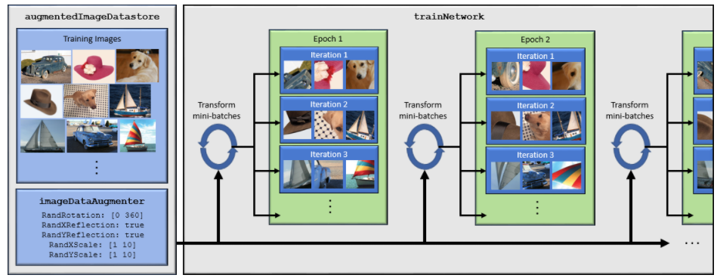
Network training with an augmented image datastore
Datastore randomly perturbs the training data for each epoch. Each epoch uses a slightly different data set, but the actual number of training images in each epoch does not change.

Slide 29
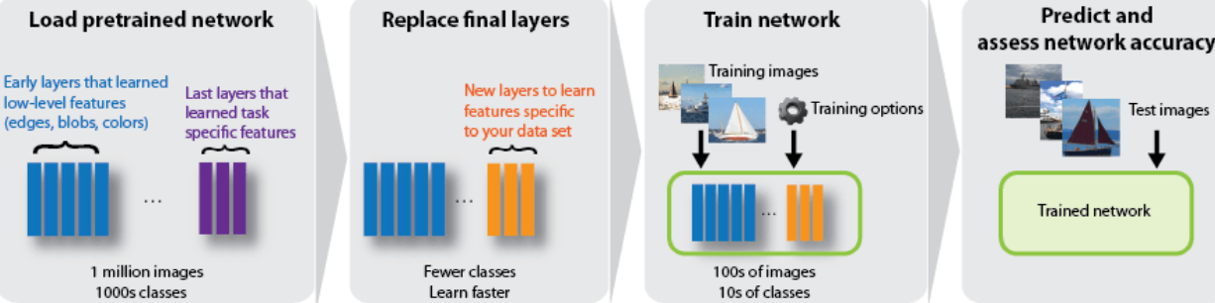
Transfer training workflow

Slide 30
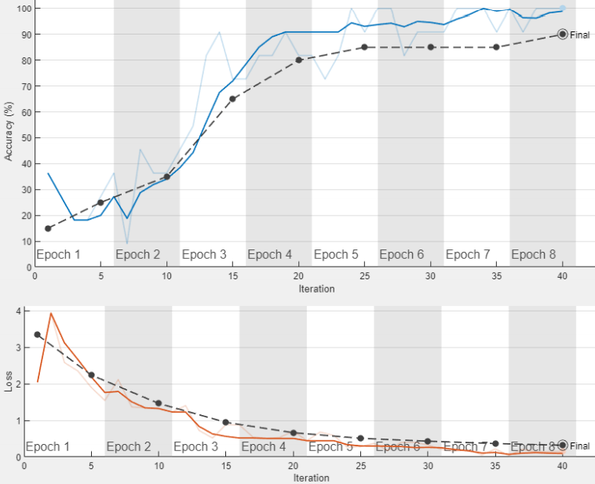
MATLAB tools to
monitor training

Slide 31
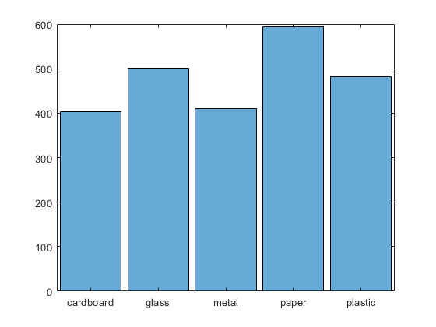
Transfer learning using googlenet and the trashnet database
In the folder that contains the trash images, create the datastore
trashImds = imageDatastore(‘C:\Users\jhmiller\Documents\MATLAB\MATLAB CNN\trashnet5F’,
'IncludeSubfolders',true,'LabelSource','foldernames’);
Get number of objects, number of classes, and display objects per class as a histogram
numObs = length(trashImds.Labels); disp(numObs)
numClasses=numel(categories(trashInds.Labels)); disp(numClasses)
histogram(trashImds.Labels)
set(gca,'TickLabelInterpreter','none’)

Slide 32
Displays 8 random images to check the content of the datastore
numObsToShow = 8;
idx = randperm(numObs,numObsToShow);
imshow(imtile(trashImds.Files(idx),'GridSize',[2 4],'ThumbnailSize',[100 100]))

Slide 33
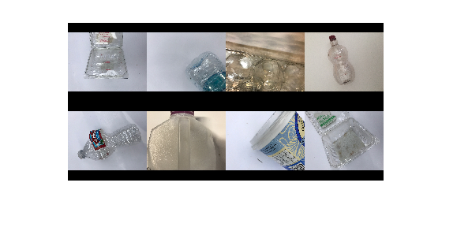
Displays 8 random images of a particular class
class = "plastic";
idxClass = find(trashImds.Labels == class);
idx = randsample(idxClass,numObsToShow);
imshow(imtile(trashImds.Files(idx),'GridSize',[2 4],'ThumbnailSize',[100 100]))

Slide 34
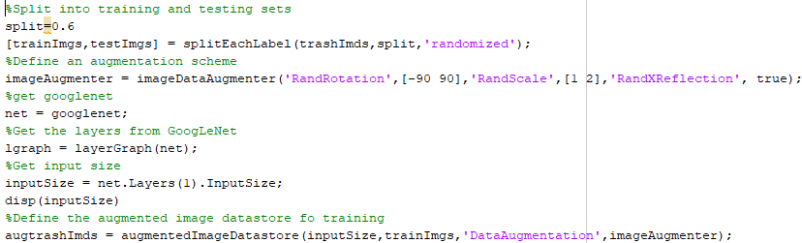
Split data into training and testing files, get the pretrained network, define image augmentation, and create an augmented datastore

Slide 35

Modify googlenet

Slide 36
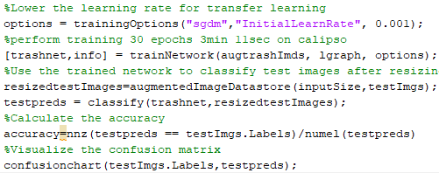
Train the network, Resize the testing images, Classify the test images, Report accuracy and confusion matrix

Slide 37
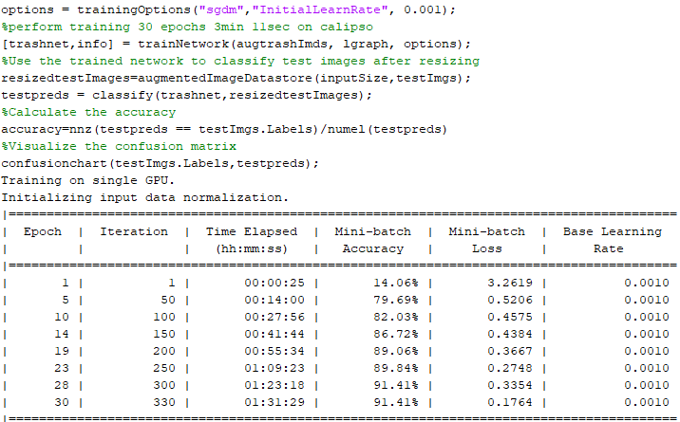
Runtime with a single GPU

Slide 38
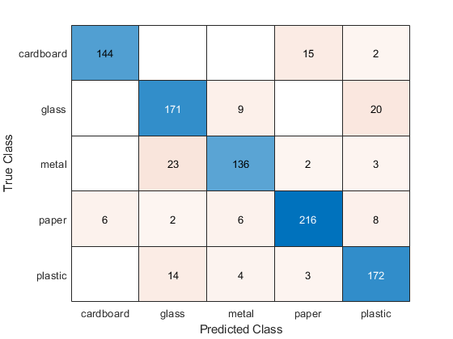
Use confusion matrix to get
class specific accuracies:
Cardboard = 0.894
Glass = 0.855
Metal = 0.829
Paper = 0.908
Plastic = 0.891

Slide 39
Assignment 13: CNN for flower classification
Use the images in the Flowers folder on the class web page to create a CNN to identify flower images by transfer learning on googlenet. MytrainflowersV3 on the class webpage uses the same imageAugmenter and training options as in lecture slides for trashnet. Report the number of objects, number of classes, image size, overall accuracy, confusion matrix, and the accuracy of each class.

