Slide 1
Useful links for MATLAB
Washington State University Portal
Students can go here to download and install MATLAB on their personal computers. They should log in with their university id when creating a MathWorks account.
Self-Paced courses: Online courses for students to learn on their own. They can also be accessed by going to the “Home” tab and clicking on “Learn MATLAB” from the resources section from within MATLAB.
Some specific courses which might be of interest students in this class:
MATLAB Onramp: Introduction to MATLAB (for students not already familiar with MATLAB).
Machine Learning Onramp: Basics of practical machine learning for classification problems.
Deep Learning Onramp: Walks the students through transfer learning for CNNs.

Slide 2
Basic MATLAB is all you need for this class
The online courses found at the links on the previous slide will introduce you to many high-level features in MATLAB. You will not need any of those high-level features for the coding requirements of this class.
Mainly, you will be writing scripts to use the MATLAB function on the class web page. The syntax of function calls in a script is [outputs] = name(inputs) with multiple inputs and outputs separated by commas. Include names for all output variables in a function call even if you do not use then all in the script.

Slide 3
How to download MATLAB codes from the class web page
Open MATLAB
Follow link http://www.tricity.wsu.edu/~jhmiller to the class web page
Find the MATLAB folder
Right-click on the .m file that you want
Choose “Save link as”
Navigate to the folder where you want to save the file
Click save
A download information box will appear.
Ignore information box if all you wanted was to save the file.
If you click on Open, file will open in the MATLAB editor

Slide 4
Arrays in MATLAB
Most of the arrays that you will encounter in this class have 1 or 2 dimensions.
1-dimensional arrays are called “vectors”
2-dimensional arrays are called “matrices”
The “length” of a vector is the number of elements in the 1D array.
The “size” of a matrix is the number of rows and columns in the 2D array.
MATLAB does not require specification of array size before it is used; however, it may remind you that for efficiency this is desirable.
The rows of a matrix M can be used as row-vectors M(k, :)
The columns of a matrix M can be used a column-vectors M(:, k)

Slide 5
Row and Column vectors in MATLAB
>> is the prompt to enter statements in the command window.
Start MATLAB and enter these statements in the command window.
>>x=linspace(-1,4,10);
produces a “row” vector (i.e., 1x10 matrix)
Semicolon at the end of a statement suppresses output
>>disp(x) displays the elements in x in rows
If x is a row vector, then x’ is a “column” vector (i.e., 10x1 matrix)
>>disp(x’) displays the elements in x as a column

Slide 6
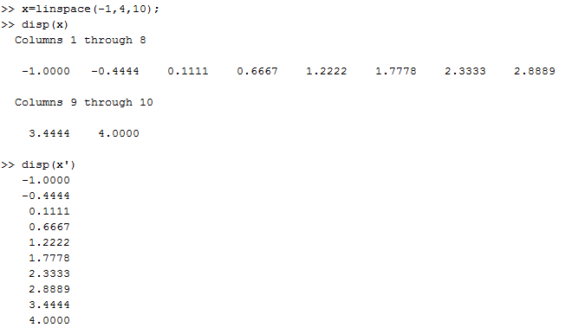

Slide 7
Vector input to MATLAB functions
x=linspace(-1,4,10); produces a “row” vector (i.e. 1x10 matrix)
If a row vector is passed to a function, MatLab returns a row vector.
If a column vector is passed to a function, MatLab returns a column vector.
>>myf=@(x) exp(x)-3*x.^2; is setup to receive vector input
x.^2 means square vector x “component by component”
Add this function to the command window, run it, and display the results as 2 columns, x and myf(x).
The arrays in a call to display (e.g. disp([x,y,z])) must all be the same size.
What is wrong with the statement disp(x’,myf(x))?
What 2 ways can it be fixed?

Slide 8
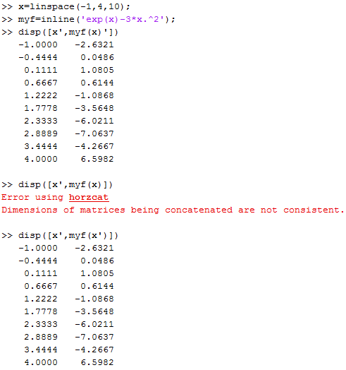

Slide 9
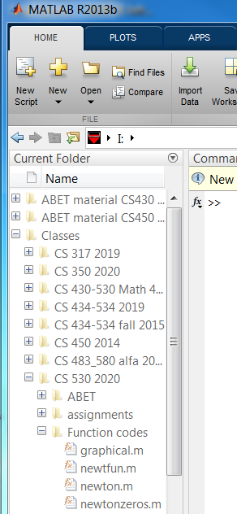
Setting the MATLAB path
I have the function codes on a thumb drive along with other lecture materials.
In this example, root-finding functions are in a folder called “function codes”
If I click on that folder name, MATLAB sets a path to these functions.

Slide 10
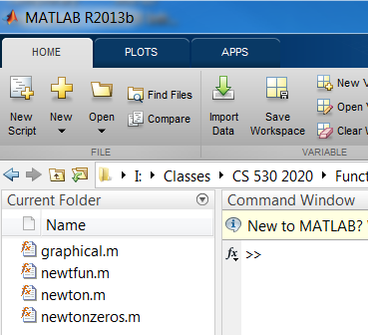
Clicking on a file in the current directory opens it in the editor.
Either “new script” or “new” opens a file in the editor to create a script.
Create the script
x=linspace(-1,4,10);
for i=1:10
myf(i)=exp(x(i))-3*x(i)^2;
end
Clear the command window and the workspace.
Copy and paste the script into the command window
Display the results as 2 columns, x and myf(x).
Change the first line of your script to create x as a column vector.
Run and display as 2 columns

Slide 11
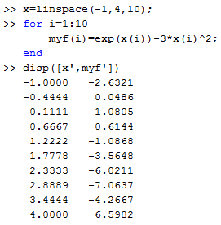
For loops generate row vectors
x=linspace(-1,4,10);
To specify components of x in a calculation, use x(index).
Note .^ is unnecessary
The for loop defined a
row vector

Slide 12
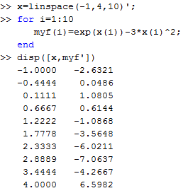
Arrays in MatLab
x=linspace(-1,4,10);
To specify components of x in a calculation, use x(index).
The for loop defined a row
vector even though x was
a column vector because
the calculation only involved
components of x.

