Slide 1
Review for Quiz 5 Thursday 12/9/21
Lectures L13 CNN and L14 SOM
Assignments 17 and 18

Slide 2
Convolutional Neural Networks (CNNs):
Deep leaning neural networks for image classification

Slide 3
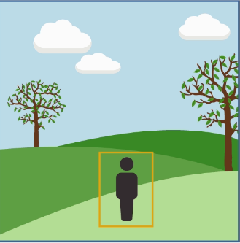
CNNs differ from traditional ANNs in 4 ways
Local receptive fields
Shared weights and biases
Activation and pooling
Transfer learning

Slide 4
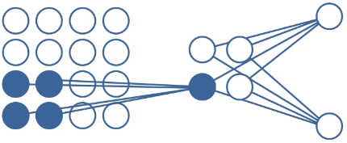
Input array is not fully connected to hidden layer
Parts of input array called local receptive fields (LRFs) are connected to specific nodes in the hidden layer. Sweeping LRFs of the input array across hidden layer creates a feature map in the hidden layer. Convolution accomplishes feature mapping efficiently; hence the name CNN

Slide 5
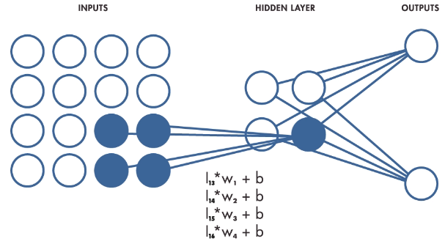
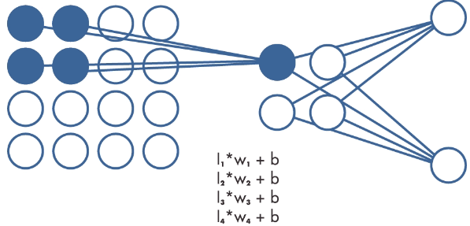
Shared weights and biases
All the local receptive fields are connected to their respective hidden node
by the same set of weights (w₁-w₄) and bias (b).
This makes the image analysis translationally invariant.
Whatever the weights are trained to detect can be anywhere in the image.

Slide 6
Input arrays can be very large. Activation and pooling is a way to effectively reduce the size of the input array and the number of weights and biases that need to be determined from a training set.
The ReLU activator shown below changes negative input values to zero.

Slide 7
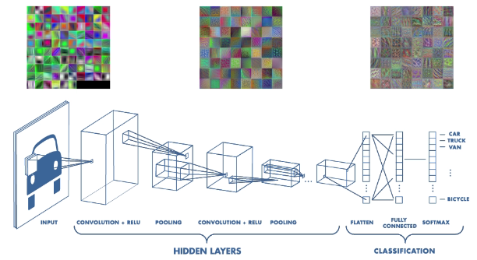
Features in hidden layers near the classifier will not be recognizable. We can trace then back to the image and quantify their importance in the classification.

Slide 8
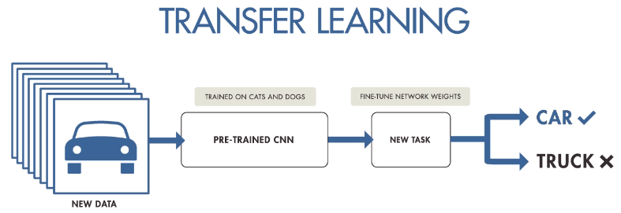
A pre-trained CNNs that embodies fundamentals of image segmentation, like edge detection, can be refined to identify many types of objects with less data and computational resources than training from scratch.
Example: transfer learning for trash classification
step 1 choose a pretrained network
step 2 get training images

Slide 9
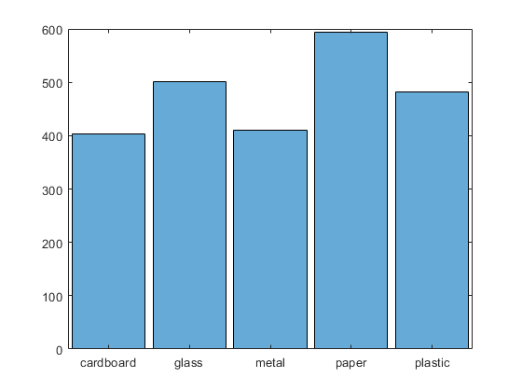
Transfer learning using googlenet and the trashnet database
In the folder that contains the trash images, create the datastore
trashImds = imageDatastore(‘C:\Users\jhmiller\Documents\MATLAB\MATLAB CNN\trashnet5F’,
'IncludeSubfolders',true,'LabelSource','foldernames’);
Get number of objects, number of classes, and display objects per class as a histogram
numObs = length(trashImds.Labels); disp(numObs)
numClasses=numel(categories(trashInds.Labels)); disp(numClasses)
histogram(trashImds.Labels)
set(gca,'TickLabelInterpreter','none’)

Slide 10
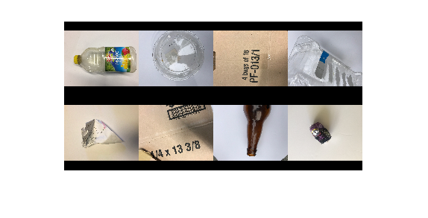
Displays 8 random images to check the content of the datastore
numObsToShow = 8;
idx = randperm(numObs,numObsToShow);
imshow(imtile(trashImds.Files(idx),'GridSize',[2 4],'ThumbnailSize',[100 100]))

Slide 11
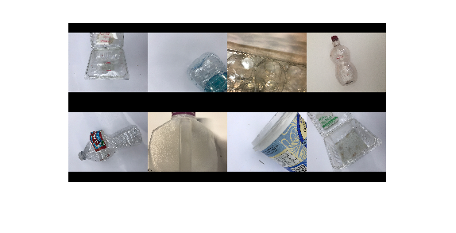
Displays 8 random images of a particular class
class = "plastic";
idxClass = find(trashImds.Labels == class);
idx = randsample(idxClass,numObsToShow);
imshow(imtile(trashImds.Files(idx),'GridSize',[2 4],'ThumbnailSize',[100 100]))

Slide 12
Split data into training and testing files, get the pretrained network, define image augmentation, and create an augmented datastore

Slide 13
Modify googlenet

Slide 14
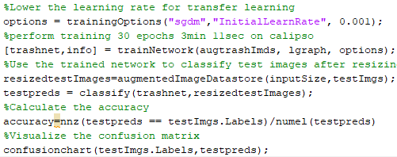
Train the network, Resize the testing images, Classify the test images, Report accuracy and confusion matrix

Slide 15
Self-organizing Maps
Unsupervised learning designed to achieve
dimensionality reduction by topographically
ordering of input patterns
Basic aim of SOM is similar to data compression
Given a large set of input vectors find a smaller set
of prototypes that provide a good approximation to
the whole input data space

Slide 16
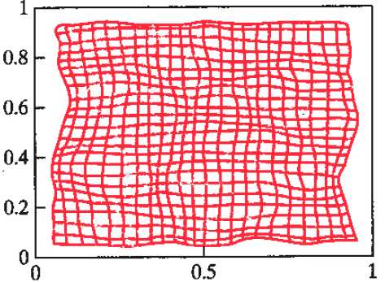
Elastic net over input space. Each nodes associated with a compressed representation of input space.
What phase of SOM convergence is illustrated by this figure?

Slide 17
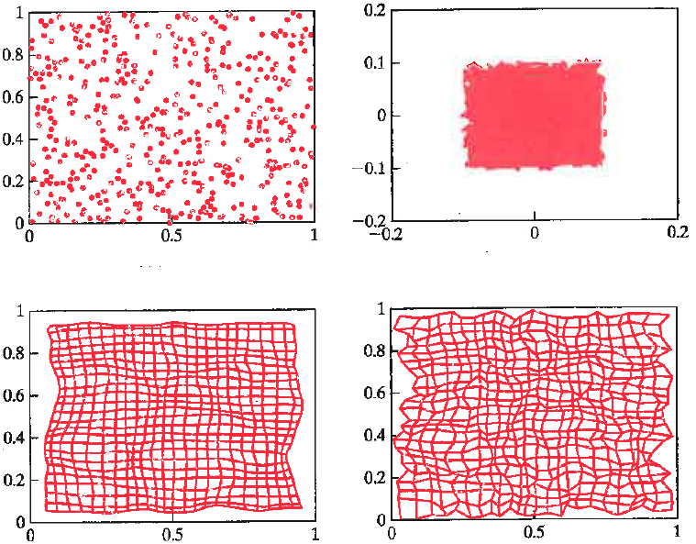
Refinement distorts the net to reflect input statistics
Input distribution
Initial weights
Ordering phase
Refined map

Slide 18
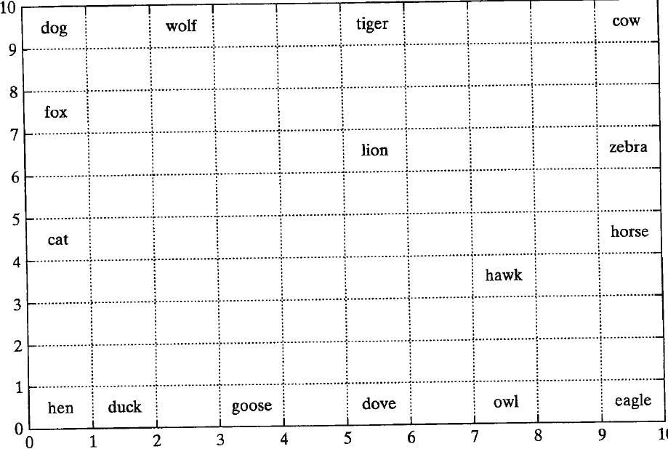
Contextual map shows best match unit (BMU) of data records.
BMU is output node with weight most like data record
Input topologically organized
Compression linked to higher level of understanding

Slide 19
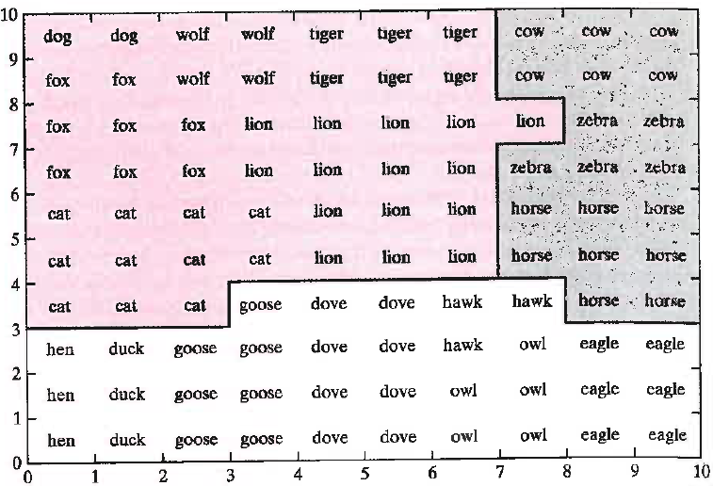
Semantic map: Lattice sites label by animal type
inducing the strongest response at that node. Shows clustering of similar data types

Slide 20
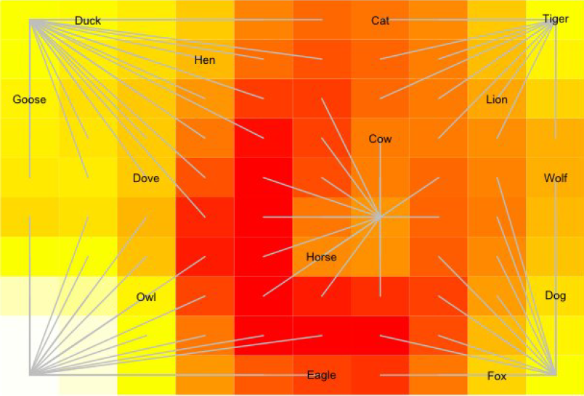
U-mat with stars: Centers show local minima of UMAT. Each output node connected to a unique center. Use with BMU to cluster input data.

Slide 21
SOM using MATLAB: Link to video
https://www.mathworks.com/videos/iris-flower-clustering-with-neural-clustering-tool-68796.html
Code from video
iris dataset: 3 classes, 50 records each,
4 attributes/record
load iris_dataset
inputs=irisInputs;
d1=6;
d2=6;
net=selforgmap([d1,d2]);
[net,tr]=train(net,inputs);
outputs=net(inputs);
%plots: neighbor distances (UMAT), sample hits, weight positions
SeedC=net.IW(1);
w=SeedC(1);
% weight vectors for node of SOM output array

Slide 22
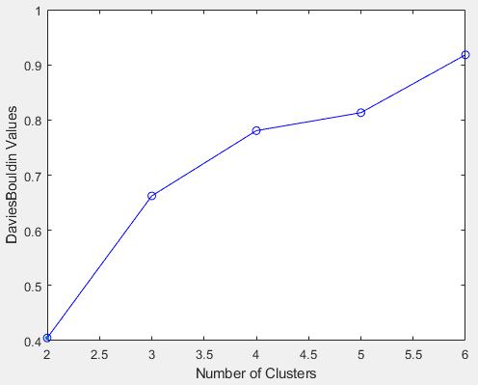
BDI index for K-means. K-2 favored by minimum similarity.
Is this consistent with SOM results?
x= irisInputs';
E= evalclusters(x,'kmeans','DaviesBouldin','klist',[1:6]);
plot(E)

Slide 23
Compare centroids of K-means
with SOM weight positions
clusters=2;
[idx,C]=kmeans(inputs',clusters);
meandist=0;
for i=1:clusters
for k=1:36
dist(k)=(C(i,1)-w(k,1))^2+(C(i,2)-w(k,2))^2;
end
kmin=1;
mindist=dist(1);
for k=2:36
if dist(k)<mindist
kmin=k;
mindist=dist(k);
end
end
disp([i,kmin,mindist])
meandist=meandist+mindist;
end
meandist=meandist/clusters;
disp(meandist)
2 cluster
. 8 0.0059
. 23 0.0227
Mean 0.0143
3 clusters
.10 0.0006
. 7 0.0007
. 36 0.0249
Mean 0.0087
4 clusters
. 7 0.0007
. 10 0.0619
. 31 0.0145
. 23 0.0213
Mean 0.0246
3-means most like SOM

Slide 24
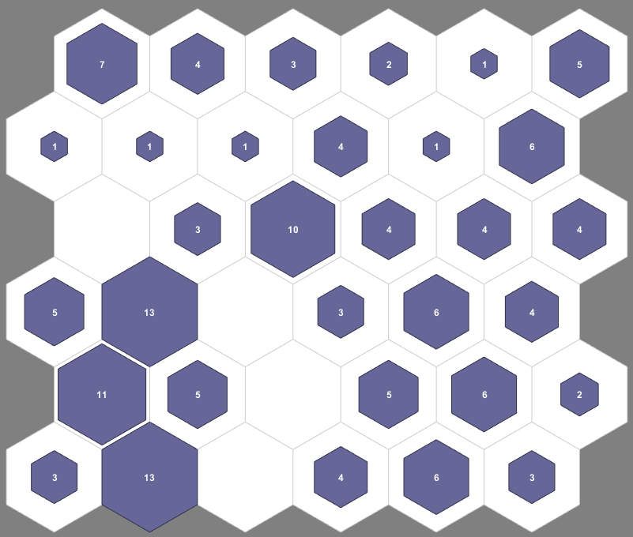
3-means: nodes with weight position closest to centroids
Node 1 is in the lower left courner.

