Slide 1
Review for Quiz 4 Thursday 12/5/24
Lecture L14 genetic algorithm
Lectures L16 CNN and L17 SOM
Assignments 12 and 14

Slide 2
Genetic Algorithm

Slide 3
Feed-Forward Neural Network
Fitness
Genetic Algorithm
Experimental Spectra
Molecules
Kinetic Monte Carlo
CID Model
Neural Network
In Silico Spectra

Slide 4
Form a chromosome from weight vector of a feed-forward ANN
11 weights (8 to hidden layer, 3 to output) are genes on chromosome w_{1A} w_{1B} w_{2A} w_{2B} w_{3A} w_{3B} w_{0A} w_{0B} w_{AZ} w_{BZ} w_{0Z}
Fitness defined by quality of a model that uses the output Z.
Find weight that give the best fitness by genetic algorithm

Slide 5
Method to select chromosomes for refinement
Given the fitness f(x_{i}) for each chromosome in population,
assign each chromosome a discrete probability by
Divide number line between 0 and 1 into segments of length
equal to discrete probabilities sorted in increasing order.
Get r, random number uniformly distributed between 0 and 1
Choose the chromosome of the line segment containing r
Repeat to get a second chromosome for replication to form
the next generation.

Slide 6
1st generation: 5-bit binary numbers chosen randomly
00100 = 4 fitness = 0.0011 pi = 0.044
01001 = 9 fitness = 0.0216 pi = 0.861
11011 = 27 fitness = 0.0023 pi = 0.091
11111 = 31 fitness = 0.0001 pi = 0.004
Σ_{i} f(x_{i}) = 0.0251
Divide the number line 0 ->1 into 4 segments by decreasing size of pi. Choose a uniform random number between 0 and 1.
The segment the random number falls in picks a chromosome to be modified for the next generation.
In this case what range of random numbers will result in picking the most and least fit chromosomes?

Slide 7
Clustering data by kmeans with DBI for best k

Slide 8
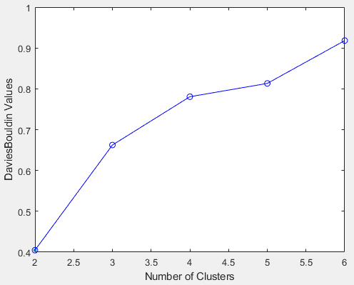
BDI index for K-means clustering of iris dataset suggests K=2.
[idx,C]=kmeans(inputs',clusters);
x= irisInputs';
E= evalclusters(x,'kmeans','DaviesBouldin','klist',[1:6]);
plot(E)

Slide 9
BDI index for K-means clustering of iris dataset suggests K=2.
Get cluster assignments and centroids
irisInputs is 4x150: a column for each record, a row for each attribute
kmeans requires a row for each record and column for each attribute
x= irisInputs';
E= evalclusters(x,'kmeans','DaviesBouldin','klist',[1:6]);
plot(E)
[idx,C]=kmeans(x, 2);

Slide 10
Clustering data by SOM

Slide 11
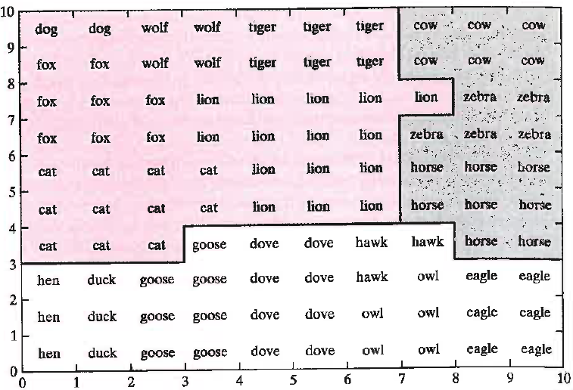
Semantic map: All lattice sites labeled by animal type
inducing the strongest response
Topology of responses define 4 region of output array based on our prior understanding of the meaning of the labels. Each region defines a cluster in the dataset determined by BMU.

Slide 12
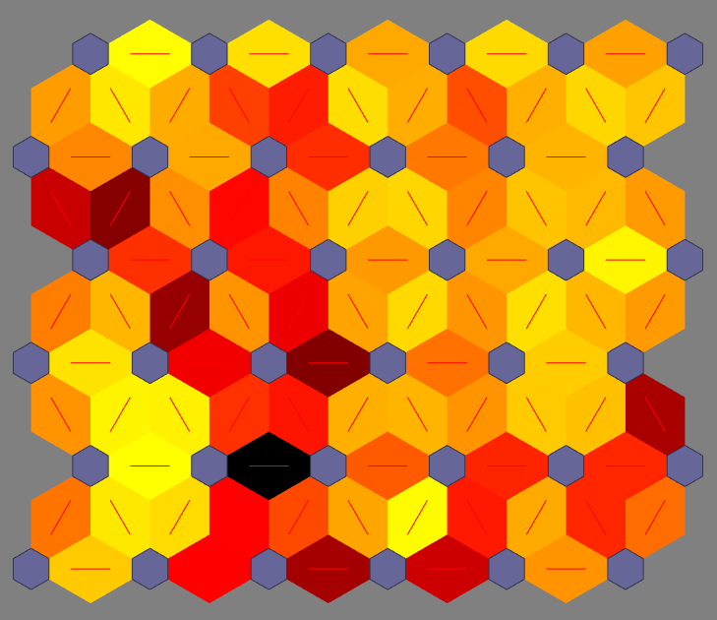
UMAT displayed as heatmap on connections between nodes.
Bright colors highlight connections between similar nodes.

Slide 13
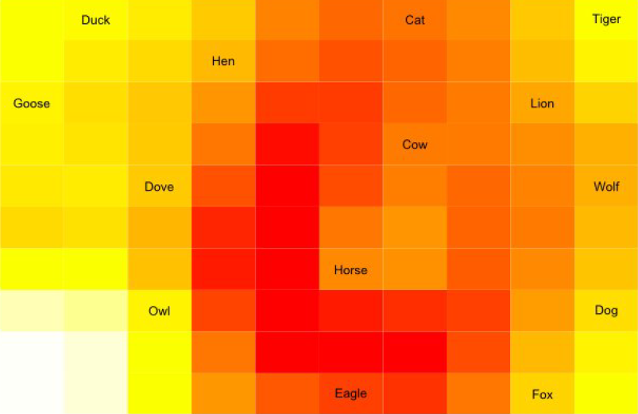
UMAT of Kohonen’s animal SOM: birds and mammals are in
separate clusters but fine structure is present.
birds
mammals

Slide 14

UMAT with stars: Each output node is connected by direct link
to one and only one local minimum of the UMAT.

Slide 15
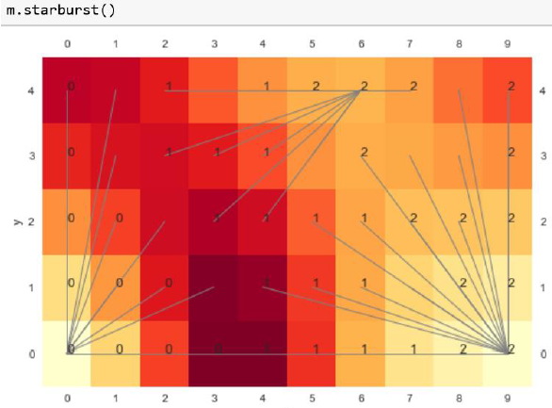
Starburst: Iris SOM, Python POPSOM, 3 classes labeled 0,1, 2. Relationship between labels and stars indicats expected mix of classes in clusters. Which cluster is most pure in class?

Slide 16
Relationship of clustering by SOM to clustering by kmeans

Slide 17
UMAT displayed as heatmap on connections between nodes.
Bright colors highlight connections between similar nodes.

Slide 18
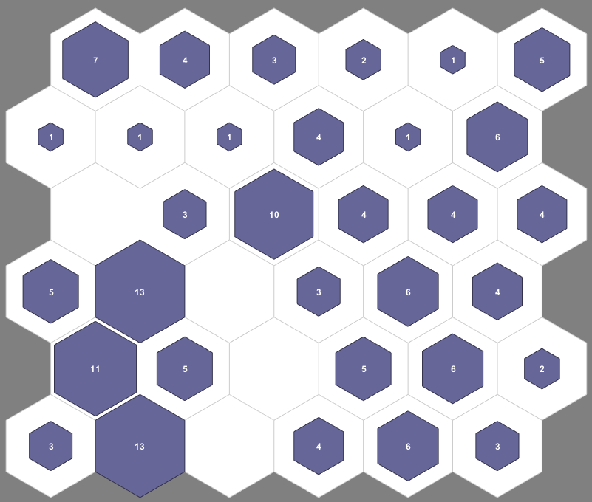
Nodes in “hits” display with weight position closest to centroids of 3-means clustering of iris dataset. Only one centroids falls on a high-hit node.

Slide 19
Assignment 13
load simplecluster_dataset.MAT;
Inputs=simplecluster_dataset;
Perform SOM with 5x5 output as in iris example.
Report Hits, UMAT, and weight positions displays
Plot DBI for K-means 2<K<6
For each of the 4-means clusters find the output node with weight vector closest to the centroid.
Circle these nodes on the Hits display of SOM

Slide 20
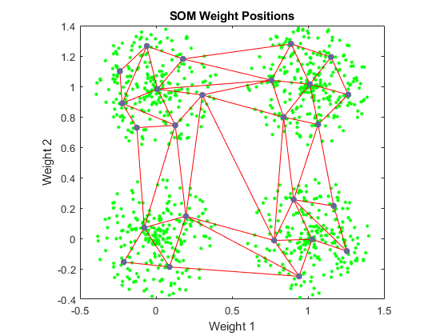

Slide 21
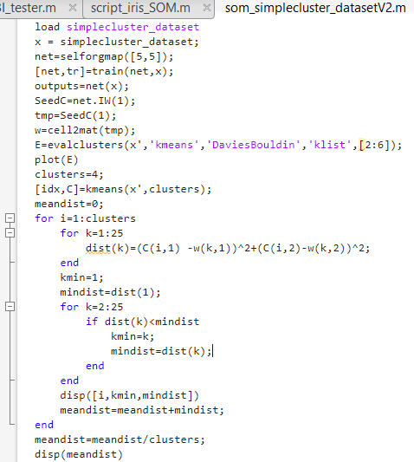
HW 14
X is 2x1000: 1000 records with 2 attributes
W is 25x2: 25 prototypes with 2 attributes
C is 4x2: 4 centroids with 2 attributes
For each cluster, find the output node prototype most like the centroid. Report distance and average

Slide 22
Convolutional Neural Networks (CNNs):
Deep leaning neural networks for image classification
Transfer learning

Slide 23
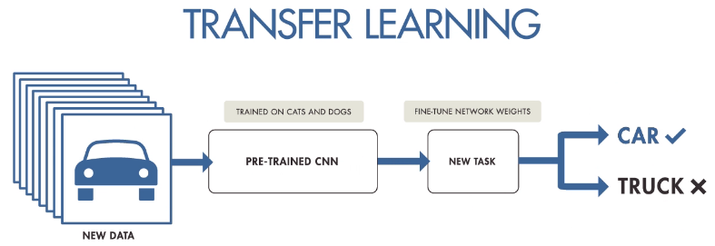
A pre-trained CNNs that embodies fundamentals of image segmentation, like edge detection, can be refined to identify many types of objects with less data and computational resources than training from scratch.
Example: transfer learning for trash classification
step 1 choose a pretrained network
step 2 get training images

Slide 24
Assignment 14 : CNN for flower classification
Use the images in the test Flowers folder on the class web page to create a CNN to identify flower images by transfer learning on googlenet. Use the same imageAugmenter as in lecture slides for trashnet. Use 50/50 split of training and testing images. Report the number of objects, number of classes, image size, random sample of image data, overall accuracy, the confusion matrix, and the accuracy of each class.
You will need to add on the Deep Learning Toolbox Model for Googlnet to do transfer leaning using googlenet

Slide 25
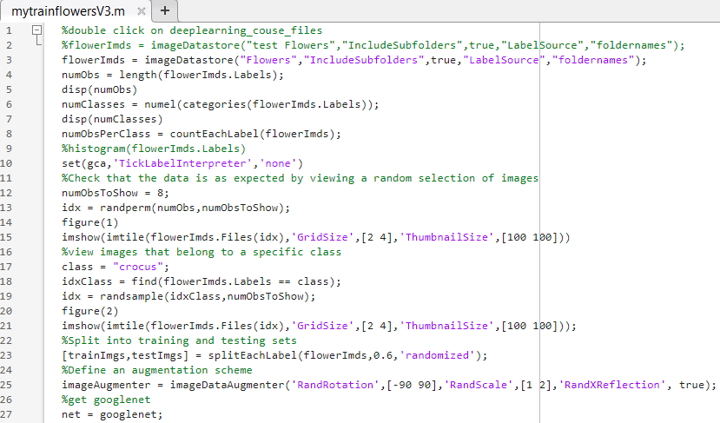
mytrainflowers part 1
Note using Flowers folder
6-way classification

Slide 26
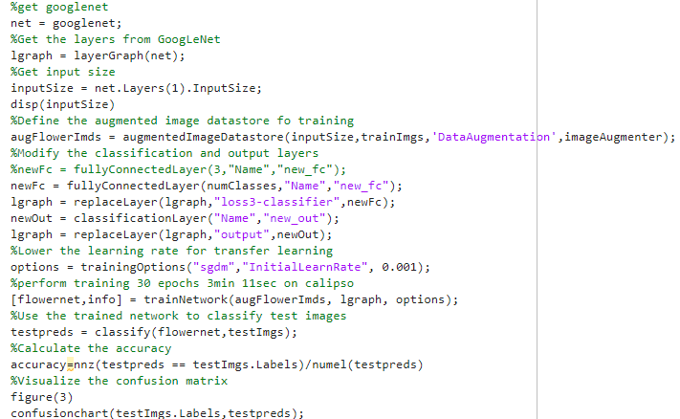
mytrainflowers part 2

Slide 27
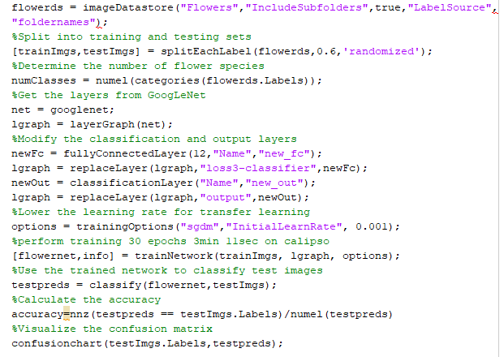
mytrainflowers.m
60%-40% split
Constant learning rate
30 epochs
3 minutes on Calypso

Slide 28
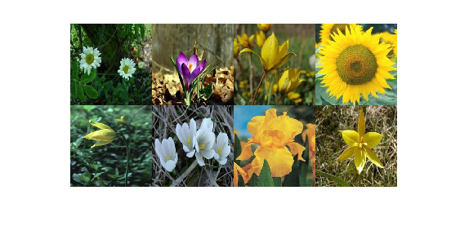
Random images from Flowers

Slide 29
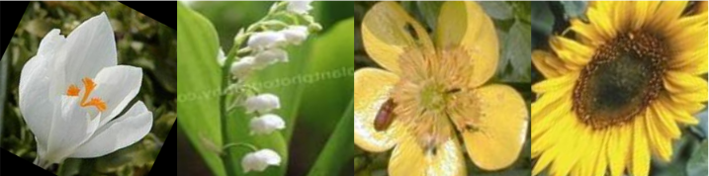
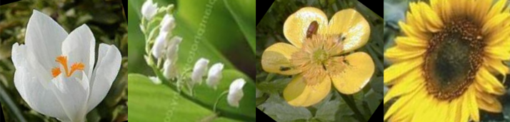
Examples of augmentations

Slide 30
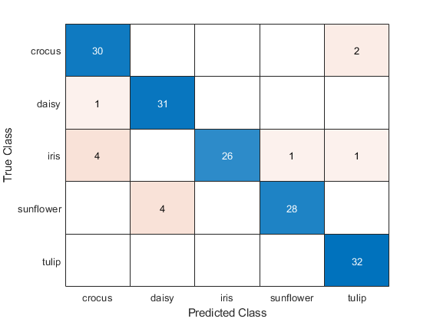
60-40 run 2

Slide 31
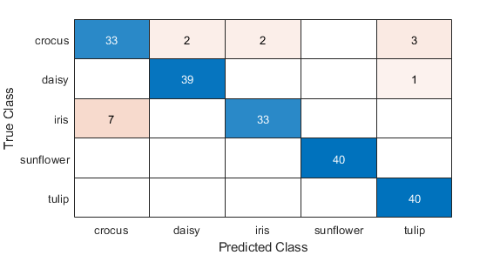
50-50

