Slide 1
Review for quiz 3
L10 SVM
L11 RBF network
L12 PCA
L13 PCA profiling
L14 genetic algorithm
L16 CNN
L17 SOM
Assignments HW 9-14
Review of hand calculations

Slide 2
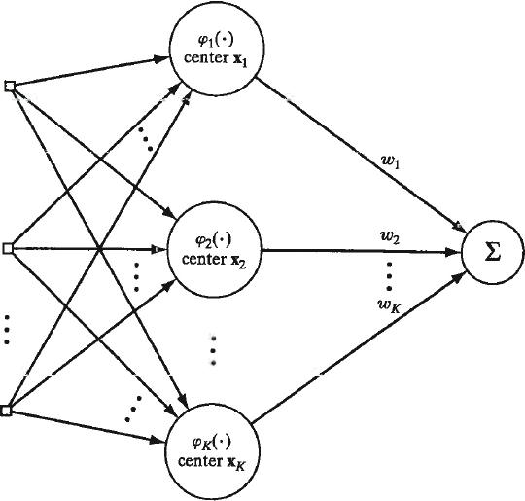
Hand calculation in RBF-ANN
Given converged K-means centers, estimate variance for RBFs by σ² = d²_{max}/2K, where d_{max} is the largest distance between clusters.
Given m₁, m₂, and m₂ how do we find σ²?
d_{max} = max(d₁₂, d₁₃, d₂₃)
d_{ij} = ||m_{i}-m_{j}||

Slide 3
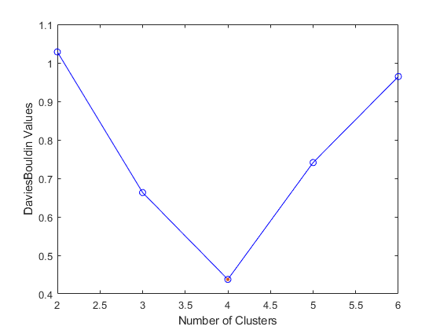
K-means in MATLAB with DBI
load simplecluster_dataset;
x = simplecluster_dataset;
E=evalclusters(x','kmeans','DaviesBouldin','klist',[2:6]);
plot(E)

Slide 4
Hand calculations in SVM

Slide 5
Linearly-separable 2-class problem: find weights such that
for all instances and for
support vectors on margins. Given w and support vector x^{t}, use the constraint on support vectors to calculate w₀.
Lecture Notes for E Alpaydın 2010 Introduction to Machine Learning 2e © The MIT Press (V1.0)
5

Slide 6

For support vectors (x^{t} on margin), r^{t} (w^{T}x^{t} + w₀) = 1
(r^{t})² = 1; therefore w₀ = r^{t} – w^{T}x^{t}
Lecture Notes for E Alpaydın 2010 Introduction to Machine Learning 2e © The MIT Press (V1.0)
6

Slide 7
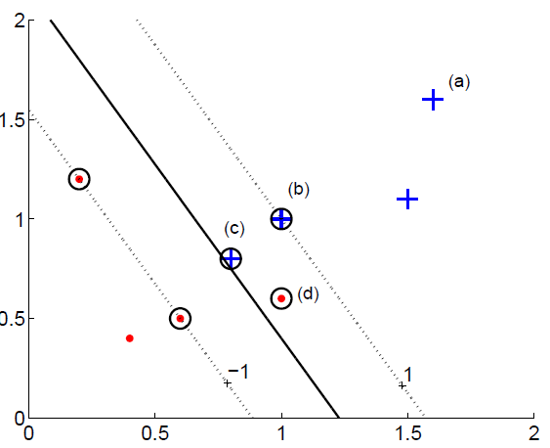
Given values for discriminant, y^{t}, and class label, r^{t}, find contribution to soft error (aka hinge loss).
Discriminant is y^{t}.
Bipolar label is r^{t}.
+1 for members
-1 for nonmembers
Lecture Notes for E Alpaydın 2010 Introduction to Machine Learning 2e © The MIT Press (V1.0)
7

Slide 8
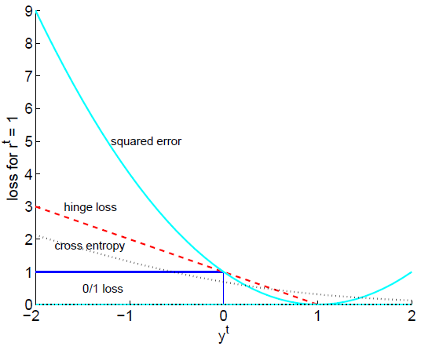
Add a line to graph below that shows the hinge loss function for instances in the non-member class.

Slide 9
Hand calculations in PCA

Slide 10
Proportion of Variance (PoV)
Eigenvalues ranked in decreasing order
PoV(k) =
A plot PoV(k) vs k shows how many PCs are required to capture a given part of the total variance of attributes
10

Slide 11
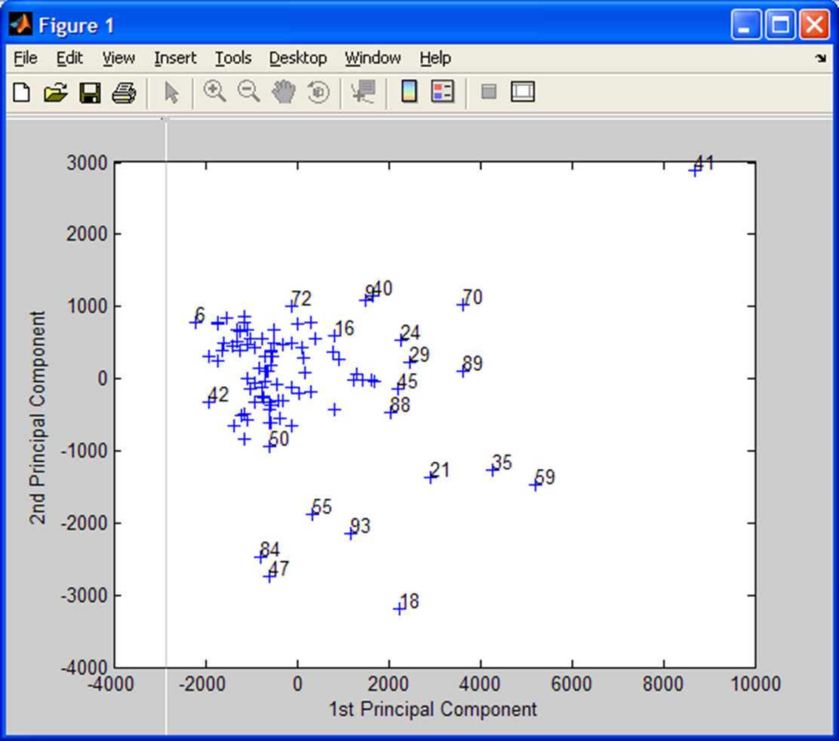
PCs are defined by the eigenvectors of the covariance matrix.
z_{i} = w_{i}^{T}x is the value of i^{th} PC for attribute vector x.
w_{i} is the i^{th} eigenvector.
Given eigenvalues and eigenvectors, how do you find (z₁^{t} , z₂^{t}) associated with attribute vector x^{t} in a scatter plot of the second largest PC as a function of the largest PC?

Slide 12
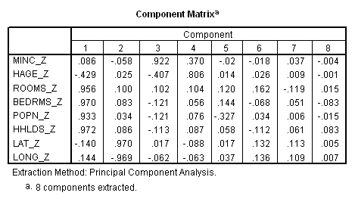
Component matrix: PC loadings
What correlated variable contribute to a PC?
k^{th} PC: z_{k} = w_{k}^{T}x, where w_{k} is the solution of Σw_{k} = λ_{k}w_{k} and λ_{k} = var(z_{k})
Define L_{k} = sqrt(λ_{k})w_{k} is the loading vector of PC_{k} where w_{k} and λ_{k} are eigenvector and eigenvalue of PC_{k}. Loading vectors are the columns of the “Component Matrix”. L_{ij} is the loading of the j^{th} PC by
the i^{th} z-score. -1< L_{ij} <+1
_z denotes z-scores as attributes

Slide 13
squared loading = amount of a variable’s total variability explained by a PC
Communality: proportion of variance of a particular variable that is shared with other variables
.025
.025
  Communality for housing median age, 3 PCs retained:
  (-0.429)² + (0.025)² + (-0.407)² = 0.350315 < 0.5
    housing median age not adequate represented in this PCA
  Communality for housing median age, 4 PCs retained:
  (-0.429)² + (0.025)² + (-0.407)² + (0.806)² = 0.999951
    housing median age adequately represented in this PCA
  Conclusion: if we want to include housing median age in any downstream analysis, we must retain 4 PCs

Slide 14
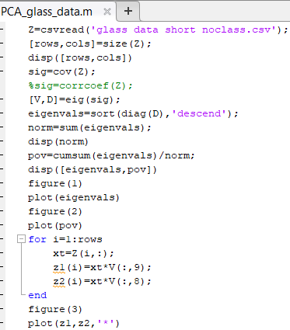
MATLAB functions
that make HW13
easier
Every attribute vector in the dataset generates a value of every PC.
z_{i} = w_{i}^{T}x is the value of i^{th} PC for attribute vector x. Both w_{i} and x are column vectors.
Is this correct?

Slide 15
Hand calculations in genetic algorithm

Slide 16
Method to select chromosomes for refinement
Calculate fitness f(x_{i}) for each chromosome in population
Assign each chromosome a discrete probability by
Divide number line between 0 and 1 into segments of length
equal to selection probabilities sorted in decreasing order.
Get r, random number uniformly distributed between 0 and 1
Choose the chromosome of the line segment containing r.
Remove selected chromosome and repeat to get a second chromosome for replication to form the next generation.

Slide 17
MATLAB’s sum and cumsum can be used to segment number line between 0 and 1 just as they were used to obtain PoV in PCA_glass_data.m (see slide 14)
1st generation: 5-bit binary numbers chosen randomly
00100 = 4 fitness = 0.0011 pi = 0.044
01001 = 9 fitness = 0.0216 pi = 0.861
11011 = 27 fitness = 0.0023 pi = 0.091
11111 = 31 fitness = 0.0001 pi = 0.004
Σ_{i} f(x_{i}) = 0.0251
Assume the pair with greatest fitness (01001 and 11011)
are selected for replication

Slide 18
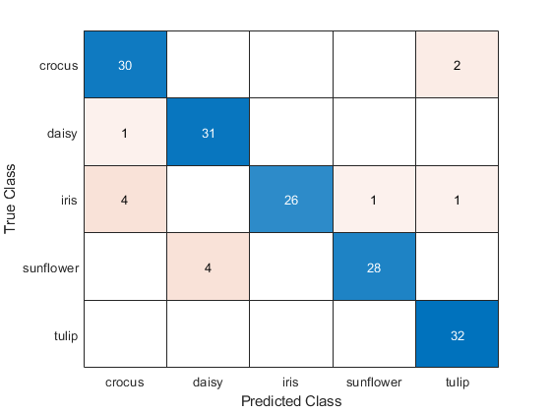
Hand calculation in CNN

Slide 19
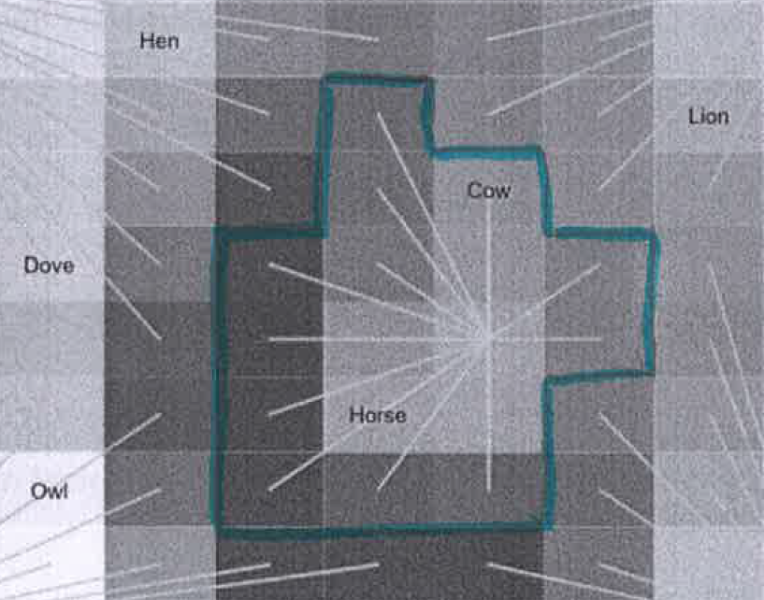
Hand calculation in SOM

