Slide 1
Review for quiz 3
L9 MLP
L10 SVM
L11 RBF network
L12 -13 PCA with profiling
Assignments HW 8-11
Review of hand calculations

Slide 2
Weight update rules for one-layer nonlinear regression
h weight vectors connect input to
hidden layer. v weight vector
connects hidden layer to output.
Backward
Forward
x^{t}
Given a weights w_{h} and v
How would the weight update rule in red box change if sigmoid(w^{T}x) was replaced
by sin(w^{T}x)?
2
Lecture Notes for E Alpaydın 2010 Introduction to Machine Learning 2e © The MIT Press (V1.0)

Slide 3
Weight update rules for one-layer nonlinear regression
h weight vectors connect input to
hidden layer. v weight vector
connects hidden layer to output.
Backward
Forward
x^{t}
Given a weights w_{h} and v
If z = sin(w^{T}x) dz/d (w^{T}x) = cos (w^{T}x) = sqrt(1-z² )
3
Lecture Notes for E Alpaydın 2010 Introduction to Machine Learning 2e © The MIT Press (V1.0)

Slide 4
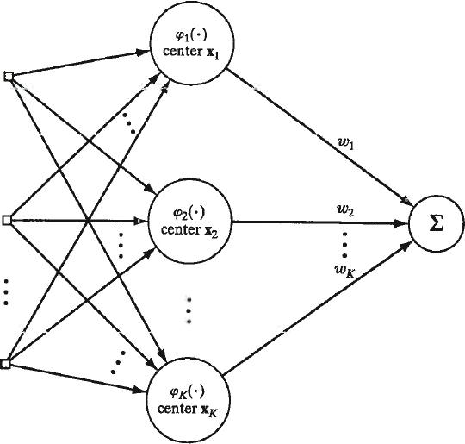
Application of K-means clustering to RBF-ANN
Given converged K-means centers, estimate variance for RBFs by σ² = d²_{max}/2K, where d_{max} is the largest distance between clusters.
Given m₁, m₂, and m₂ how do we find σ²

Slide 5
Application of K-means clustering to RBF-ANN
Given converged K-means centers, estimate variance for RBFs by σ² = d²_{max}/2K, where d_{max} is the largest distance between clusters.
Given m₁, m₂, and m₂ how do we find σ²
d_{max} = max(d₁₂, d₁₃, d₂₃)
d_{ij} = ||m_{i}-m_{j}||

Slide 6
Solving constrained optimization by Lagrange multipliers
find the stationary point of
f(x₁, x₂) = 1 - x₁² – x₂²
subject to the constraint
g(x₁, x₂) = x₁ + x₂ = 1

Slide 7
Set the partial derivatives of L with respect to
x₁, x₂, and λ equal to zero
L(x, λ) = 1-x₁²-x₂² +λ(x₁+x₂-1)
-2x₁ + λ = 0
-2x₂ + λ = 0
x₁ + x₂ -1 = 0
Solve for x₁ and x₂
In this case, not necessary to find λ
x₁* = x₂* = ½
Notes:
-2x₁ + λ = 0
-2x₂ + λ = 0
x₁ + x₂ -1 = 0
Solve for x₁ and x₂

Slide 8
Construct the dual and use it to solve this problem

Slide 9
Use the equations below to form the dual by eliminating x₁ and x₂ from L_{p}. Solve problem by finding the stationary point of L_{d}.
L_{p}(x, λ) = 1-x₁²-x₂² +λ(x₁+x₂-1)
-2x₁ + λ = 0
-2x₂ + λ = 0
x₁ + x₂ -1 = 0
Use x₁ = x₂ = λ/2 to eliminate x₁ and x₂ from L_{p}
L_{d}= 1- λ + λ²/2 dL_{d}/dλ = -1+λ = 0 λ*=1
x₁* = x₂* = 1/2
Notes:
-2x₁ + λ = 0
-2x₂ + λ = 0
x₁ + x₂ -1 = 0
Solve for x₁ and x₂

Slide 10
Linearly-separable 2-class problem: find weights such that
for all instances and for
support vectors on margins. Given w and x^{t}, how is the constraint
on support vectors used to determine w₀?
Lecture Notes for E Alpaydın 2010 Introduction to Machine Learning 2e © The MIT Press (V1.0)
10

Slide 11

For support vectors (x^{t} on margin), r^{t} (w^{T}x^{t} + w₀) = 1
(r^{t})² = 1; therefore w₀ = r^{t} – w^{T}x^{t}
Lecture Notes for E Alpaydın 2010 Introduction to Machine Learning 2e © The MIT Press (V1.0)
11

Slide 12
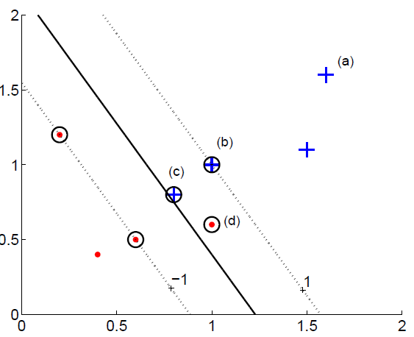
Given values for discriminant, y^{t}, and class label, r^{t}, find contribution to soft error (aka hinge loss).
Discriminant is y^{t}.
Bipolar label is r^{t}.
Lecture Notes for E Alpaydın 2010 Introduction to Machine Learning 2e © The MIT Press (V1.0)
12

Slide 13
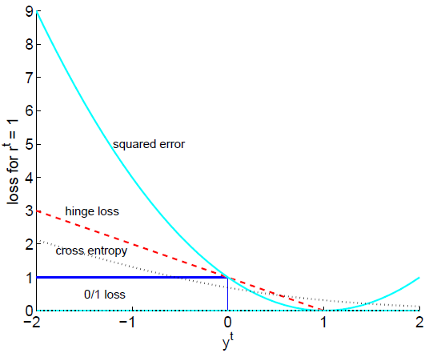
Add a line to graph below that shows the hinge loss function for instances in the non-member class.

Slide 14
Proportion of Variance (PoV)
Eigenvalues ranked in decreasing order
PoV(k) =
A plot PoV(k) vs k shows how many PCs are required to capture a given part of the total variance of attributes
14

Slide 15
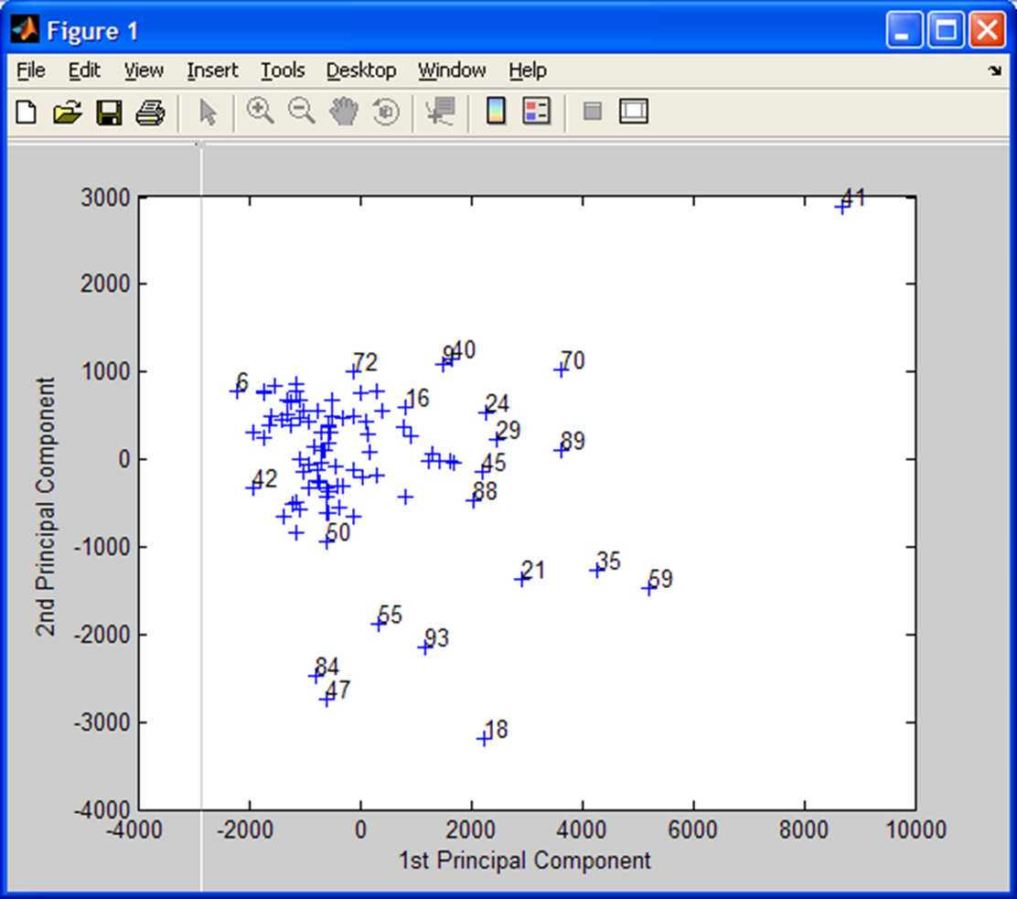
PCs are defined by the eigenvectors of the covariance matrix.
z_{i} = w_{i}^{T}x is the value of i^{th} PC for attribute vector x.
w_{i} is the i^{th} eigenvector.
Given eigenvalues and eigenvectors, how do you find (z₁^{t} , z₂^{t}) associated with attribute vector x^{t} in a scatter plot of the second largest PC as a function of the largest PC

Slide 16
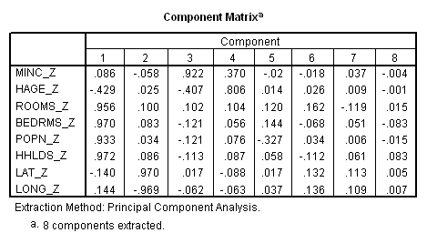
Component matrix: PC loadings
What correlated variable contribute to a PC?
k^{th} PC: z_{k} = w_{k}^{T}x, where w_{k} is the solution of Σw_{k} = λ_{k}w_{k} and λ_{k} = var(z_{k})
Define L_{k} = sqrt(λ_{k})w_{k} is the loading vector of PC_{k} where w_{k} and λ_{k} are eigenvector and eigenvalue of PC_{k}. Loading vectors are the columns of the “Component Matrix”. L_{ij} is the loading of the j^{th} PC by
the i^{th} z-score. -1< L_{ij} <+1
_z denotes z-scores as attributes

Slide 17
squared loading = amount of the variable’s total variability explained by a PC
Communality: proportion of variance of a particular variable that is shared with other variables
.025
.025
  Communality for housing median age, 3 PCs retained:
  (-0.429)² + (0.025)² + (-0.407)² = 0.350315
    housing median age not adequate represented in this PCA
  Communality for housing median age, 4 PCs retained:
  (-0.429)² + (0.025)² + (-0.407)² + (0.806)² = 0.999951
    meets requirement for inclusion in PCA
  Conclusion: if we want to include housing median age in any downstream analysis, we must retain 4 PCs

