Slide 1
Review for quiz 2 on Thursday 10/3/24
L6 Fundamentals of classification
L7 Methods of classification
L8 Pattern recognition
Assignments HW4-7

Slide 2
Assignment 4
Download HW6_classify_by_mir.m from the class web page. Run with dataset glass_data_HW6.csv. Use bin structure default bin=2, Fit<1.5, bin=1, and Fit>4, bin=6.
Report the following:
Coefficient of determination, number of records in each class, accuracy of class assignment,
overall accuracy, and 3-way confusion matrix with class specific columns as outlined below.
Edit HW6_classify_by_mir.m to create the bin structure default bin=2, Fit<1.5, bin=1, and Fit>2.5, bin=6. Run the edited code and report the results listed above.
# in class 1 assigned class 1 # in class 2 assigned class 1 # in class 6 assigned class 1
# in class 1 assigned class 2 # in class 2 assigned class 2 # in class 6 assigned class 2
# in class 1 assigned class 6 # in class 2 assigned class 6 # in class 6 assigned class 6

Slide 3
Analysis of classification results: binary confusion matrix
Rows are class specific. Top row is positive class
False positive rate = FP / (FP+TN) = fraction of negative class instances misclassified.
True positive rate = TP / (TP+FN) = fraction of positive class instances correctly classified.
Lecture Notes for E Alpaydın 2010 Introduction to Machine Learning 2e © The MIT Press (V1.0)
3

Slide 4
Rows are class specific: top row is positive class
FP rate = FP/(FP+TN)
TP rate = TP/(TP+FN
a b ← classified as
431 13 | a
236 | b
FP rate = 3/(3+236)=0.013
TP rate = 431/(431+13)=0.971
b a ← classified as
236 3 | b
431 | a
FP rate = 13/(13+413)=0.029
TP rate = 236/(236+3)=0.987
4

Slide 5
Columns are class specific. Left column is positive class
False positive rate = FP / (FP+TN) = fraction of negative class instances misclassified.
True positive rate = TP / (TP+FN) = fraction of positive class instances correctly classified.
a b
431 3 | classified as a
13 236 | classified as b
FP rate = 3/(3+236)=0.013
TP rate = 431/(431+13)=0.971
b a
236 13 | classified as b
3 431 | classified as a
FP rate = 13/(13+413)=0.029
TP rate = 236/(236+3)=0.987
5

Slide 6
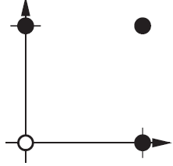
Assignment 5:
Boolean OR dataset. Members have label = 1.
Chose w=[1,1]^{T}
Write a script to find a decision boundary with equal margins using the function bias_equal_margins on the class web page.
Hand in a copy of the command window showing script and results.
p₁ p₂ t
0 0 0
0 1 1
1 0 1
1 1 1
Logical OR

Slide 7
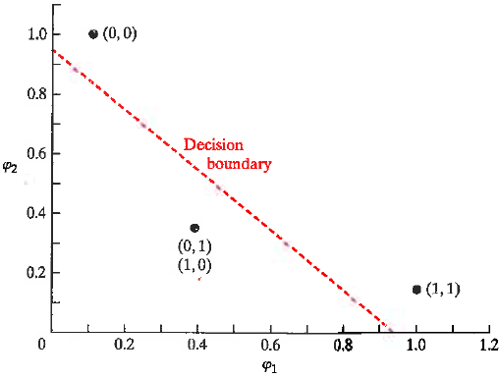
Assignment 6: feature space Boolean XOR Members have label 0
Chose w=[1,1]^{T}
Write a script to find a decision boundary with equal margins using the function bias_equal_margins on the class web page.
Hand in a copy of the command window showing script and results.
XOR in Gaussian feature space
r=0
g(φ)>0
φ₁ = exp(-|X – [1,1]|²)
φ₂ = exp(-|X – [0,0]|²)
X φ₁ φ₂ r
(1,1) 1 0.1353 0
(0,1) 0.3678 0.3678 1
(0,0) 0.1353 1 0
(1,0) 0.3678 0.3678 1
r=1
g(φ)<0

Slide 8
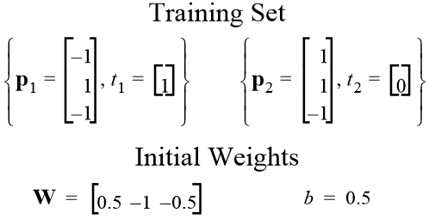
Assignment 7:
Write a script to use function update_PLA on the class web page to find a weight vector and bias that separates the 2 points below in 3D attribute space. Your script must verify that the both points are correctly classified. Find the margins of both points. Hand in a copy of the command window showing script and results.
T

