Slide 1
Review for quiz 1 on Tuesday 9/10/24
L3 perceptron regression
linfit, linfit2D, linfit3D, inference2D
Assignments HW1-3

Slide 2
How to download MATLAB codes from the class web page
Open MATLAB
Follow link in the Syllabus to the class web page
Find the MATLAB folder
Right-click on the .m file that you want download
Choose “Save link as”
Navigate to the folder where you want to save the file
Click save
A download information box will appear. Ignore if all you wanted was to save the file. If you click on Open, file will open in the MATLAB editor

Slide 3
Assignment 1: Linear fit with test for outliers
Add another data point to hiker dataset
11th hiker traveled 20 km in 5 hours
Write a script to run function linfit(x,y) on expanded hiker dataset.
Plot fit and data on the same set of axes.
Report b₀, b₁, s, and r²
Determine if the new data point is an outlier.
Report standardized residual for the new datapoint

Slide 4
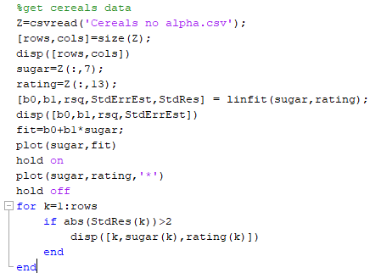
MATLAB script to use linfit:
Get fit, plot results, test for outliers.
From previous slide, sugar and fiber are columns 7 and 13.
linfit does not plot. Create fit at each
data point from parameters of model.

Slide 5
Application of linfit to cereals dataset on class web page: nutritional rating vs sugar
cereals dataset as an Excel file

Slide 6
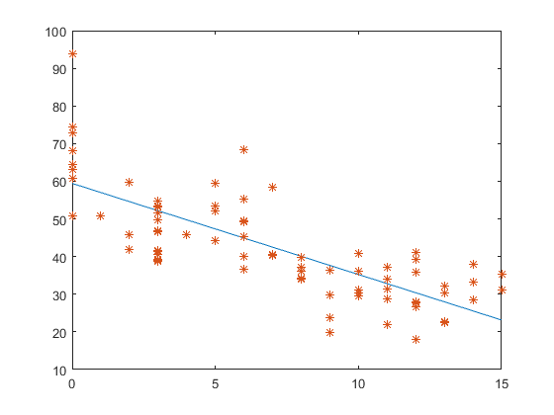
Fit to cereals data: nutritional rating VS sugar with outlier testing
b₀ = 59.4, b1 = -2.42, r²= 0.58, s = 9.16
Outliers:
(0, 93.7)
(6, 68.4)
rating
sugar

Slide 7
Assignment 2:
Use linfit 2D to model nutritional rating of cereals with sugar and fiber as predictors. Report R² and s.
Use linfit3D to consider protein, fat, and sodium separately as a third attribute,
in addition to sugar and fiber, to predict the nutritional rating cereals.
Report the change in R² and s, relative to results with fiber and sugar for each case.

Slide 8
Confidence Interval for Particular Coefficient, β_{i}
100(1-alpha)% confidence interval for coefficient β_{i},
b_{i} is an estimate of β_{i} with standard error s_{bi}
t_{critical} is based on n-m-1 degrees of freedom and the desired confidence
100(1-alpha)% confidence that true slope β_{i} lies within
Example: construct 95% confidence interval for β_{s}, for sugars
b_{s} = –2.2090, and s_{bs}= 0.1633
T-critical value t_{74,95%} ~ 2.0 (my interpolation method yields 1.9926)
95% confidence interval = –2.2090 ± (2.0) (0.1633) = (–2.54, –1.88)

Slide 9
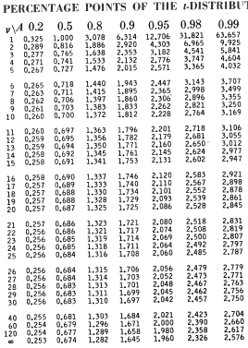
Tabular values for interpolation when
number of degrees of freedom exceeds 30.

Slide 10
Assignment 3: Inference in multivariate linear regression on Cereals dataset
Write a script to use linfit2D for regression of nutritional rating vs sodium and fiber. Report b₀, b_{s}, b_{f}, r², s, and F. Plot standard residuals as a function of fit.
Expand your script to use inference2D to calculate 95% confidence intervals on slopes bs and bf. Use 2 for pptdist (i.e., tcritical)
Use the regression model to predict nutritional rating for 200 units of sodium and 5 units of fiber.
Find the 95% confidence intervals on prediction of the mean nutritional rating for a population of cereals with 200 units of sodium and 5 units of fiber.
Find the 95% confidence intervals on prediction of nutritional rating for a random cereal with 200 units of sodium and 5 units of fiber.

Slide 11
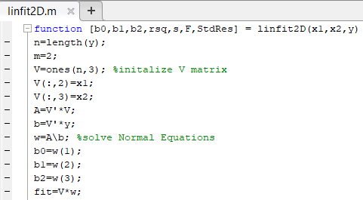
linfit 2D returns standard residuals as a column vector
fit = b0 + bs*sodium + bf*fiber;
plot(fit,StdRes,”*”)

