Slide 1
Pattern recognition
Linear discriminants as decision boundaries
Calculation of margins
Perceptron Learning Algorithm (PLA)
Least Mean Square Algorithm

Slide 2
Digital Control Theory
No differential equations for model dynamics
Train for expected patterns of system behavior.
Periodically extract information from system.
Classify the information obtained based on training.
Control based on classification results.

Slide 3
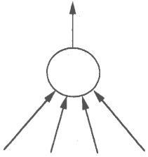
1962 Professor Bernard Widrow (Stanford) proposes the
Adaptive Linear Element (Adaline) trained by the
Least Mean Square algorithm for process control.
Dynamic output to control process
Dynamic input from sensors

Slide 4
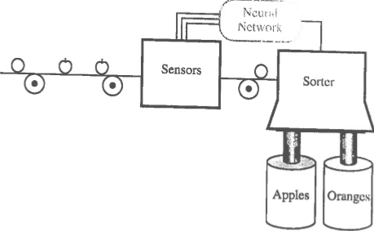
Example: sorting apples from oranges
p$=\left[\begin{matrix}\begin{aligned}shape \\ texture\end{aligned} \\ weight\end{matrix}\right]$
A
adaline
Based on training, the adaline classifies
attribute vector p as apple or orange
and adjust sorter accordingly.

Slide 5
Decision Boundaries in Attribute Space
Optimize weights so that w^{T}x = 0 is a decision boundary in attribute space. Regions where w^{T}x > 0 are usually associated with patterns of examples from the positive class (members). Regions where w^{T}x < 0 are associated with patterns of examples of non-members.
y=w^{T}x=w₁x+w₀ linear discriminate
Decision boundary, w^{T}x = 0 in 1D attribute space, the x axis, is a point.
This pattern is called “linearly
separable” because the decision
boundary defined by w^{T}x =0 allows separation of training examples with zero in-sample error.
x

Slide 6
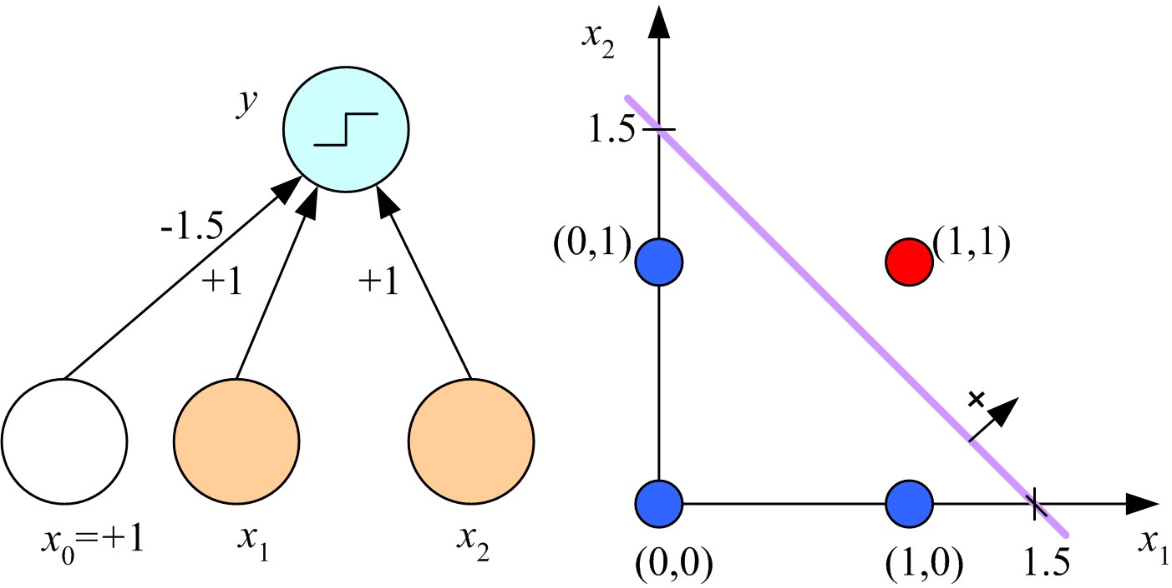
In addition to zero in-sample error, we want wide margins
to ensure low out-of-sample error. Margin is distance between decision boundary and nearest datapoint. Note, maximum margins are equal for both classes.
y=w^{T}x=w₁x+w₀
x

Slide 7
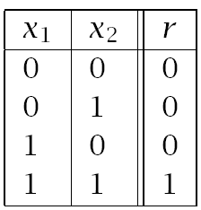
In 2D attribute space, decision boundary is the line w^{T}x=0.
The decision boundary shown has maximum margins for both classes. How do I find such a boundary?
Boolean AND
Lecture Notes for E Alpaydın 2010 Introduction to Machine Learning 2e © The MIT Press (V1.0)
7

Slide 8
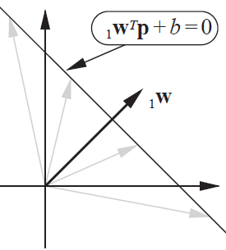
Optimized weight vectors is perpendicular to decision boundary
2D attribute space with attribute vectors p
For any point on the decision boundary, w^{T}p+b=0; hence, w^{T}p=-b.
w^{T}p is the component of p in the direction of w
For dot product to be the same for any p on the decision boundary w must be perpendicular to it.

Slide 9
To get a decision boundary like the one shown, weight vector without a bias component must point toward point (1,1). For example, w^{T} = [1,1]. To find the bias, b, choose any point p on the boundary and solve w^{T}p + b = 0.
Lecture Notes for E Alpaydın 2010 Introduction to Machine Learning 2e © The MIT Press (V1.0)
9

Slide 10
The point chosen on the decision boundary to calculate the bias will determine the margins. The point (0,1.5) gives b = -1.5 and equal margins for both classes. If the components of p are x₁ and x₂, then the equation of the decision boundary can be written as x₁ + x₂ = 1.5.
What are the margins in this case?
$wTp=\left[1,1\right]\left[\begin{matrix}0 \\ 1.5\end{matrix}\right]$ = 1.5 = -b
Lecture Notes for E Alpaydın 2010 Introduction to Machine Learning 2e © The MIT Press (V1.0)
10

Slide 11
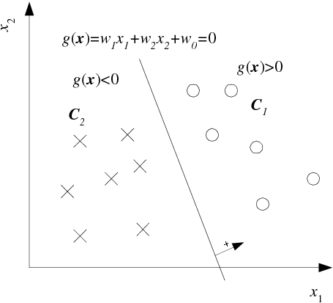
Distance of x^{t} from hyperplane w^{T}x = 0
Let x_{a} and x_{b}
be points on
the hyperplane
w^{T}x_{a} + w₀ = w^{T}x_{b} + w₀
w^{T}(x_{a} – x_{b}) = 0
x_{a} – x_{b} is in hyperplane
w must be normal to
hyperplane
Linear discriminant in 2D
r^{t} = -1
r^{t} = 1
Lecture Notes for E Alpaydın 2010 Introduction to Machine Learning 2e © The MIT Press (V1.0)
11

Slide 12
Distance of x^{t} from hyperplane w^{T}x = 0
Decompose any point x
into components parallel and perpendicular to the
hyperplane
x = x_{p} + d w/||w||
x_{p} is projection of x on
hyperplane
d is distance of x from
hyperplane
w/||w|| is unit normal of
hyperplane
r^{t} = -1
r^{t} = 1
Lecture Notes for E Alpaydın 2010 Introduction to Machine Learning 2e © The MIT Press (V1.0)
12

Slide 13
Distance of x^{t} from hyperplane w^{T}x = 0
For at any point x_{p} on decision boundary, g(x_{p})=0
g(x_{p}) = g(x^{t} - d w/||w||) = 0
0 = w^{T}(x^{t} – d^{t} w/||w||) + w₀
w^{T}w = ||w||²
0 = w^{T}x^{t} + w₀ – d^{t} ||w||
Solve for d^{t}
d^{t} = |w^{T}x^{t} + w₀|/||w||
d^{t} = |g(x^{t})|/||w||
r^{t} = 1
r^{t} = -1
Lecture Notes for E Alpaydın 2010 Introduction to Machine Learning 2e © The MIT Press (V1.0)
13

Slide 14
What are the margins of this decision boundary?
recall w^{T}= [1,1] and b = -1.5
||w|| = sqrt(1+1) = 1.414
For blue pattern,
g((0,1))$=\left[1,1\right]\left[\begin{matrix}0 \\ 1\end{matrix}\right]$ - 1.5 = -0.5
margin = 0.5/1.414 = 0.3536
For red pattern,
g((1,1))$=\left[1,1\right]\left[\begin{matrix}1 \\ 1\end{matrix}\right]$ - 1.5 = 0.5
margin = 0.5/1.414 = 0.3536
Lecture Notes for E Alpaydın 2010 Introduction to Machine Learning 2e © The MIT Press (V1.0)
14

Slide 15
Summary: Given w, how do I find a decision boundary with equal margins for both patterns and calculate the margins.
d^{t} = |g(x^{t})|/||w|| = distance of example x^{t} from decision boundary
Let x⁺ and x⁰ be examples from member and non-member classes, respectively, closest to the decision boundary.
g(x⁺) = w^{T}x⁺ + b > 0 |g(x⁺)| = g(x⁺)
g(x⁰) = w^{T}x⁰ + b < 0 |g(x⁰)| = -g(x⁰)
For equal margins, d⁺ = d⁰ which means g(x⁺) = -g(x⁰) note: ||w|| cancels on both sides of the equation
w^{T}x⁺ + b = -w^{T}x⁰ – b
Solve for b = -(w^{T}x⁺ + w^{T}x⁰ )/2
Plot w^{T}x + b = 0 (find intercepts with x and y axes)
Calculate margins by (w^{T}x⁺ + b)/||w|| distance x⁺ from the decision boundary

Slide 16
Example: Boolean AND dataset
Choose w=[1,1]^{T}, x⁺ = [1,1]^{T}, and x⁰ = [0,1]^{T}, then
w^{T}x⁺ = 2, w^{T}x⁰ = 1, b = -(2+1)/2 = -1.5
Equation of the decision boundary, w^{T}x + b = 0, is x₁ + x₂ = 1.5
Margin = (w^{T}x⁺ + b)/||w|| = (2-1.5)/1.414 = 0.3536
g((1,1))$=\left[1,1\right]\left[\begin{matrix}1 \\ 1\end{matrix}\right]$ - 1.5 = 0.5
margin = 0.5/1.414 = 0.3536
g((0,1))$=\left[1,1\right]\left[\begin{matrix}0 \\ 1\end{matrix}\right]$ - 1.5 = -0.5
margin = 0.5/1.414 = 0.3536
16

Slide 17
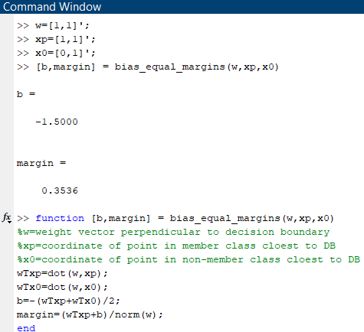

Slide 18
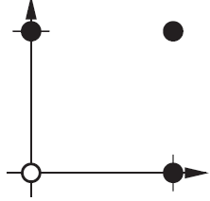
Assignment 5: Boolean OR dataset
Chose w=[1,1]^{T}
Find a decision boundary with equal margins
Calculate x and y intercepts of the decision boundary
Calculate margins
Members have label = 1
p₁ p₂ t
0 0 0
0 1 1
1 0 1
1 1 1
Logical OR

Slide 19
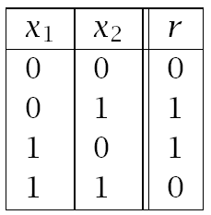
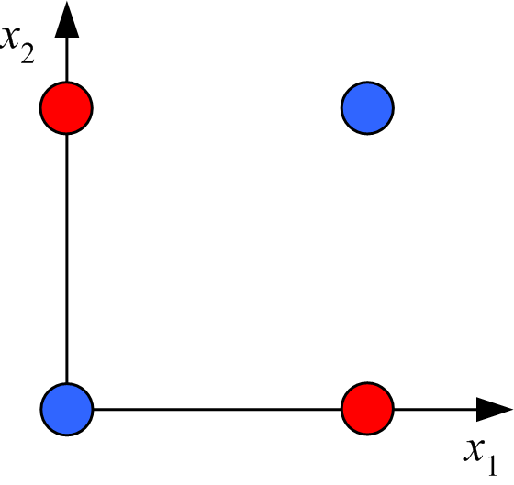
Boolean XOR:
Linearly inseparable pattern
data table
graphical representation
Solution: transform to linearly separable feature space

Slide 20
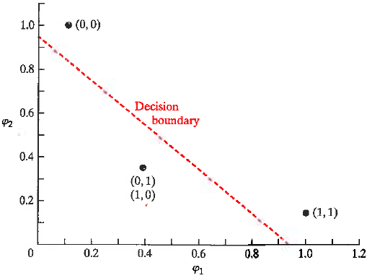
XOR data
XOR in Gaussian feature space
φ₁ = exp(-|X – [1,1]|²)
φ₂ = exp(-|X – [0,0]|²)
X φ₁ φ₂ r
(1,1) 1 0.1353 0
(0,1) 0.3678 0.3678 1
(0,0) 0.1353 1 0
(1,0) 0.3678 0.3678 1
r=0
Note that examples with r=1 lie of the side of the
decision boundary were g(φ)<0. To calculate b and margins, treat examples with r=0 as “members”.
The decision bound in the figure is perpendicular to w=[1,1]^{T}. Points are labeled by their coordinates in attribute space.
g(φ)>0
r=1
g(φ)<0

Slide 21
XOR data
Assignment 6: feature space Boolean XOR
Chose w=[1,1]^{T}
Find a decision boundary with equal margins
Calculate the x and y intercepts the of decision boundary.
Calculate margins
XOR in Gaussian feature space
r=0
g(φ)>0
φ₁ = exp(-|X – [1,1]|²)
φ₂ = exp(-|X – [0,0]|²)
X φ₁ φ₂ r
(1,1) 1 0.1353 0
(0,1) 0.3678 0.3678 1
(0,0) 0.1353 1 0
(1,0) 0.3678 0.3678 1
r=1
g(φ)<0

Slide 22
Perceptron Learning Algorithm (PLA)

Slide 23
Classification of patterns by the
Perceptron Learning Algorithm (PLA)
A pattern is an arrangement of points plotted according to the
value of attributes and labeled by the class from which the
examples were drawn. The coordinate system of these plots
is called “attribute space”
The perceptron leaning algorithm is a method to find a boundary in attribute space that separates data by class. If the data are linearly separable, Rosenblatt proved that the algorithm converges to solution with zero in-sample error.

Slide 24
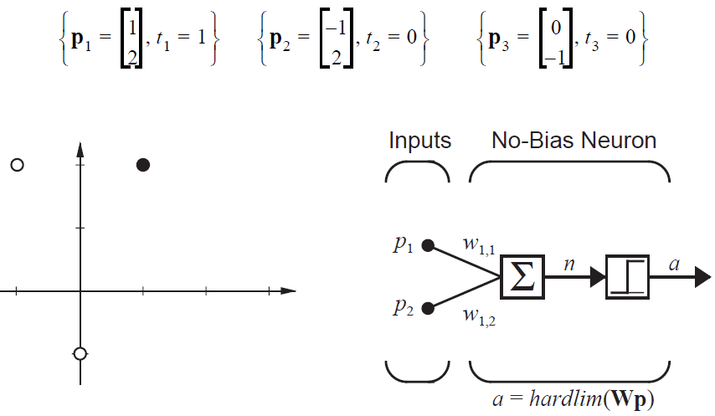
Example in 2D attribute space:
A decision boundary with b=0 goes though the origin. Use the PLA to find such a decision boundary that distinguish the pattern in the points below, using the hard limit to predict class.

Slide 25
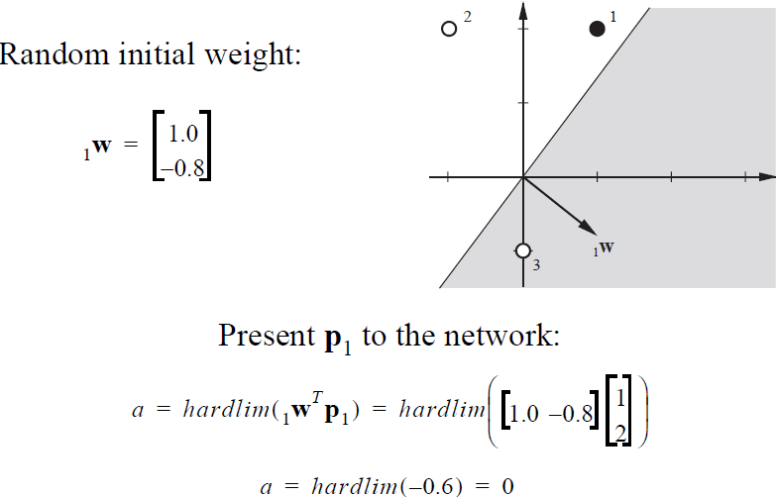
Misclassified: t₁=1, a=0 Black dot should be in shaded region
Example 3 is also misclassified.

Slide 26
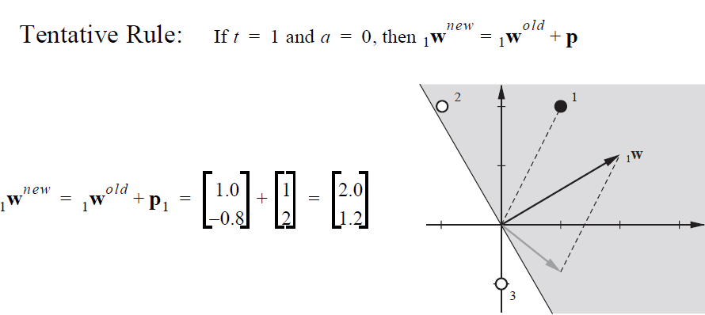
new
p
old
With new weight vector, only example 2 is misclassified. Modify weight vector based on this misclassification

Slide 27
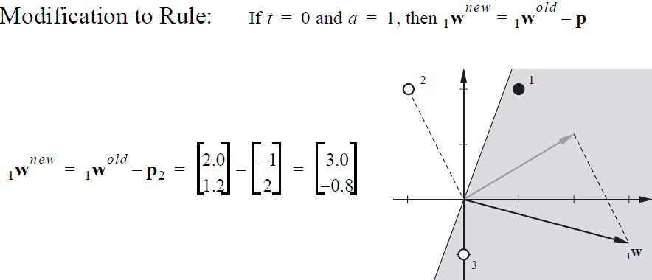
Note: sign change in weight update rule
old
-p
new
With new weight vector, examples 1 and 2 are correctly classified but now
example 3 is misclassified. Modify weight vector based on this misclassification.

Slide 28
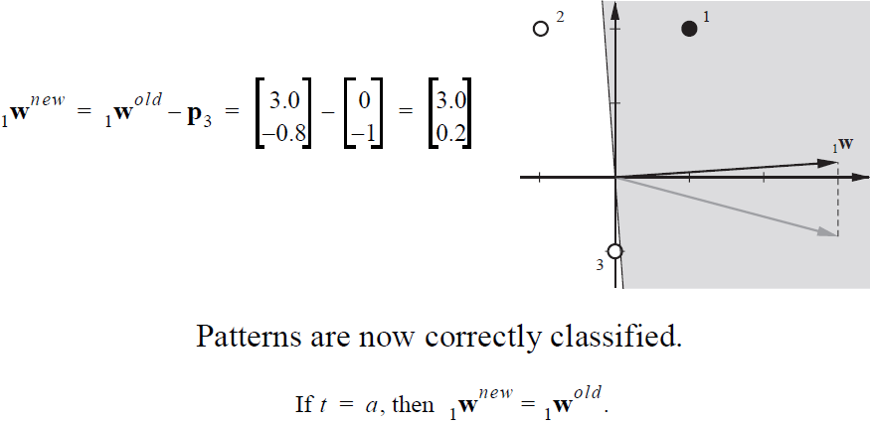
Again t=0 and a=1 implies a minus sign in weight update rule
Note how close example 3 is to the decision boundary.
This result will not generalize well.

Slide 29
Calculate class margins (remember b=0)
p₁ and p₃ are data in separate classes closest to the decision boundary. w^{T}=[3, 0.2]

Slide 30
Calculate class margins (remember b=0)
p₁ and p₃ are data in separate classes closest to the decision boundary, G(p₁) is positive.
w^{T}=[3, 0.2]
||w|| = sqrt(9+0.04) = 3.0067
g(p₁)$=\left[3, 0.2\right]\left[\begin{matrix}1 \\ 2\end{matrix}\right]$ = 3.4
Margin positive class = 3.4/3.0067 = 1.1308
g(p₃)$=\left[3, 0.2\right]\left[\begin{matrix}0 \\ −1\end{matrix}\right]$ = -0.2
Margin non-member class = 0.2/3.0067 = 0.0665
Note: w and b are fixed. Margins are not equal.

Slide 31
Summary of Perceptron Leaning Algorithm
Binomial labels t={0,1}
a = Perceptron output
a = 1 if w^{T}p+b > 0
a = 0 if w^{T}p+b < 0
e = Error = t-a
Update weights after testing each example in training set.
Stop when all examples are correctly classified or number misclassified does not change

Slide 32
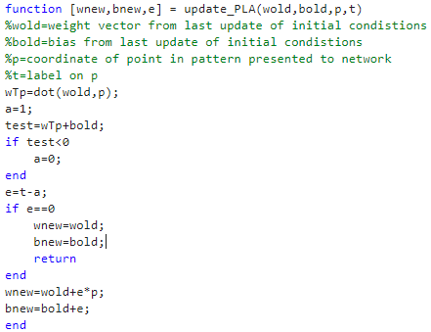

Slide 33
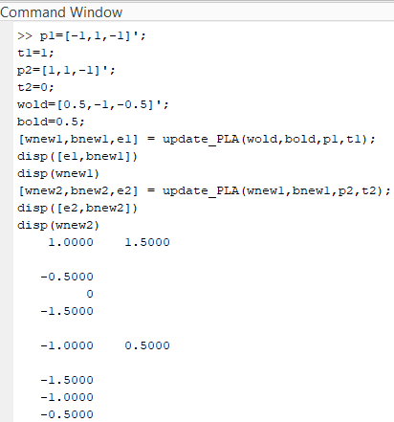
Confirm that this combination of b and w classify
p1 and p2 with no error.

Slide 34
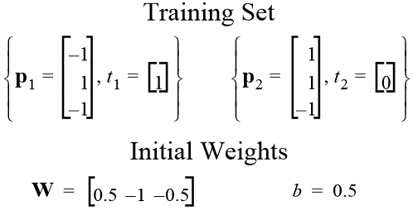
Assignment 7:
Use PLA with specified initial weights and bias to find a weight vector and bias that classify the 2 points below in 3D attribute space with no error. Assume the output of the perceptron is hardlim(w^{T}p+b). Report the resulting weight vector, bias, and the equation of the decision boundary. Calculate the distances of the points from the decision boundary (i.e., margins).
T

Slide 35
Alternate form of PLA
w^{T} = [b, w₁, …w_{d}] bias included in weight vector
(x^{t})^{T} = [1, x₁, …x_{d}] bias node in attribute vector
r^{t} = (-1,1) bipolar class labels
y^{t} = sign(w^{T}x) = 1 if w^{T}x > 0
= -1if w^{T}x < 0
w_{new} = w_{old} + y^{t} x^{t}
Correct classification if y^{t} = r^{t}

Slide 36
Pseudo code for PLA in alternate form
Start with a randomly chosen of weight vector (w₀ = initial bias).
Compare sign(w^{T}x) to label of each attribute vector in training set.
If different, store y^{t} and x^{t} in a file of misclassified examples.
Randomly choose a misclassified example (x^{k}, y^{k}).
Update weight vector by w_{new} = w_{old} + y^{k}x^{k}.
Repeat 2-5 with the new weight vector.
Monitor the number of misclassified examples.
If data is linearly separable, stop when no misclassified examples.
If data is not linearly separable, when you stop at max iterations, w_{new} may not be the best choice for the smallest number of misclassified examples.
To avoid this problem, use the pocket algorithm (next slide).

Slide 37
Pseudo code for “pocket” algorithm
Set w_{best} to initial weight vector of PLA
Store misclassified examples
E_{best}=number misclassified
If E_{best}=0 return
For k=1 to max iterations
find w_{new} by PLA
find misclassified examples
E_{new}=number misclassified
if E_{new}<E_{best} w_{best}=w_{new} and E_{best}=E_{new}
if E_{best}=0 return
end
Output E_{best} and w_{best}

Slide 38
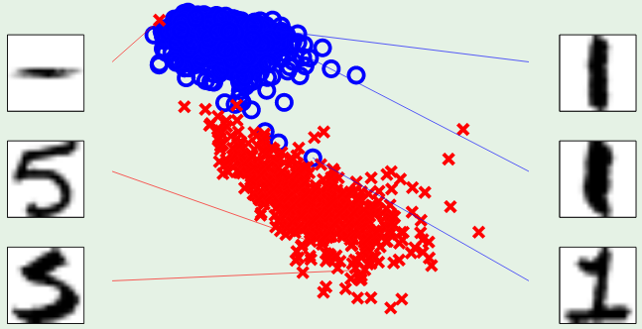
Application of pocket algorithm to digit recognition,1 vs 5
is not efficient.
symmetry
intensity
Patterns are nearly linearly separable
Algorithm sends most of its time searching for misclassifications
You will solve this problem by radial basis function neural network

Slide 39
Least Mean Square Algorithm

Slide 40
LMS applied to sorting apples from oranges
p$=\left[\begin{matrix}\begin{aligned}shape \\ texture\end{aligned} \\ weight\end{matrix}\right]$
A
adaline
Sensors measure shape, texture, and weight.
Adaline classifies data as orange or apple.
Sorter uses output to adjust path to collection bin.

Slide 41
To apply LMS, we need e = t - a to be a continuous variable, not hard limit. Output a = w^{T}p + b = w^{T}p if b = 0.
p_{O}$=\left[\begin{matrix}\begin{aligned}1 \\ −1\end{aligned} \\ −1\end{matrix}\right]$
Prototype input for orange
Target t_{O} = -1
Prototype input for apple
Target t_{A} = 1
p_{A}$=\left[\begin{matrix}\begin{aligned}1 \\ 1\end{aligned} \\ −1\end{matrix}\right]$
Data p from sensors will be classified by which prototype vector with label t it is closest to. Error e = t-a = t-w^{T}p if b=0. where w is the optimized weight vector of the adaline.

Slide 42
p$=\left[\begin{matrix}\begin{aligned}shape \\ texture\end{aligned} \\ weight\end{matrix}\right]$=$\left[\begin{matrix}\begin{aligned}−1 \\ −1\end{aligned} \\ −1\end{matrix}\right]$
What class will p be assigned to and what is the error in assignment?
p-p_{O} =$\left[\begin{matrix}\begin{aligned}−2 \\ 0\end{aligned} \\ 0\end{matrix}\right]$
p-p_{A} =$\left[\begin{matrix}\begin{aligned}−2 \\ −2\end{aligned} \\ 0\end{matrix}\right]$
Classify p as orange data
A
adaline
If optimum w^{T} = [0,1,0], then
a = w^{T}p $=\left[0, 1, 0\right]\left[\begin{aligned}−1 \\ −1 \\ −1\end{aligned}\right]$ = -1
e = t_{O} – a = 0
Correct assignment

Slide 43
LMS formalism
Consider data from sensors as a population.
For a given w, t and e are population variables.
We want to find the w* for which expectation of e² is minimum.
F(w)=E[e²]=E[(t-a)²]=E[(t-w^{T}p)^{2]=}E[(t²-2w^{T}E[tp]+w^{T}E[pp^{T}]w)]
F(w) = c – 2w^{T}h + w^{T}Rw, where c=E[t²], h=E[tp], and R=E[pp^{T}]
gradient(F(w)) = -2h + 2Rw* = 0 -> w* = R⁻¹h
One-step optimization.
Rather than estimate R by a sample and do one-step optimization, we perform a gradient search for w*

Slide 44
Gradient search for w*
Approximate F(w)=E[e²] by e_{k}², square of error on k^{th} iteration
of the search.
e_{k}²(w) = (t_{k}-w^{T}p_{k})² gradient(e_{k}²(w)) = -2e_{k}p_{k}
Choose a gradient-decent step size α
w_{k+1} = w_{k} – α gradient(e_{k}²(w)) w_{k+1} = w_{k} + 2αe_{k}p_{k}
Step size 0.2 is reasonable.
Initial weight vector = w_{i}^{T}=[0,0,0].
Alternate between prototype vectors for orange and apple.
a = w^{T}p, e = t-a, t_{O}= -1, t_{A} = 1

Slide 45
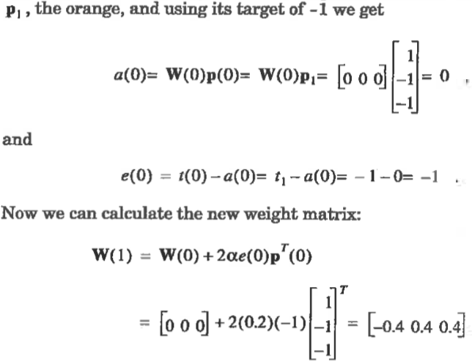
In this formulation W is a row vector; hence to transpose.

Slide 46
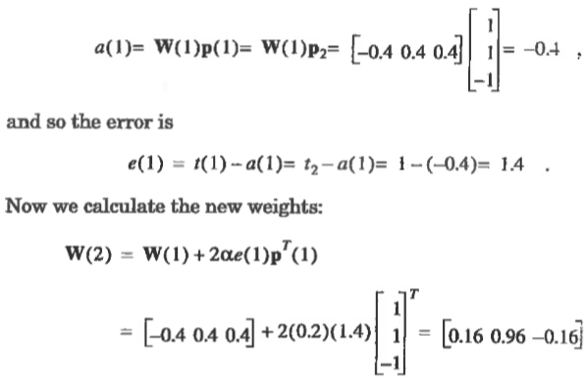
Present apple prototype vector with target = 1

Slide 47
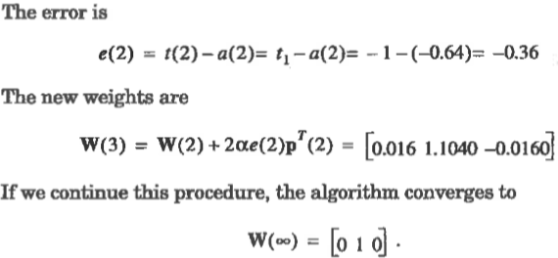
Present orange prototype again with target = -1

Slide 48
LMS decision boundary and margins
p_{O}$=\left[\begin{matrix}\begin{aligned}1 \\ −1\end{aligned} \\ −1\end{matrix}\right]$
Prototype orange
Prototype apple
p$=\left[\begin{matrix}\begin{aligned}shape \\ texture\end{aligned} \\ weight\end{matrix}\right]$
p_{A}$=\left[\begin{matrix}\begin{aligned}1 \\ 1\end{aligned} \\ −1\end{matrix}\right]$
Decision boundary defined by w^{T} = [0,1,0] and b=0
$\left[0, 1, 0\right]\left[\begin{matrix}p1 \\ \begin{aligned}p2 \\ p3\end{aligned}\end{matrix}\right]$ + 0 = p₂ = 0
Decision boundary is the p₂ = 0 plane

Slide 49
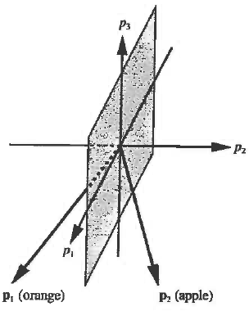
What are the margins on the orange and apple prototype points?
w^{T}=[0, 1, 0], ||w|| = sqrt(1) = 1
g(p_{O})$=\left[0,1,0\right]\left[\begin{matrix}1 \\ \begin{aligned}−1 \\ −1\end{aligned}\end{matrix}\right]$ = -1
Margin orange class = 1
g(p_{A})$=\left[0,1,0\right]\left[\begin{matrix}1 \\ \begin{aligned}1 \\ −1\end{aligned}\end{matrix}\right]$ = 1
Margin apple class =1

