Slide 1
Lecture 7: Classification by perceptron regression
Parametric Bayesian classification has been removed from L7.
After we cover classification by regression, we will turn to pattern recognition by perceptron classification.

Slide 2
Review of Confusion matrix:
Application of confusion matrices will be on the next quiz
Row and column specific
Class specific TP and FP rates
Class accuracies
Overall accuracy

Slide 3
Analysis of classification results: binary confusion matrix
Rows are class specific. Top row is positive class
False positive rate = FP / (FP+TN) = fraction of negative class examples misclassified.
True positive rate = TP / (TP+FN) = fraction of positive class examples correctly classified.
Lecture Notes for E Alpaydın 2010 Introduction to Machine Learning 2e © The MIT Press (V1.0)
3

Slide 4
Class dependent performance metrics
FP rate = FP/(FP+TN)
TP rate = TP/(TP+FN
If either class could be the “positive” class, then the Confusion Matrix, TP rate, and FP rates become class specific.
Examples when top row is positive class:
a is the positive class
a b ← classified as
431 13 | a
236 | b
FP rate = 3/(3+236)=0.013
TP rate = 431/(431+13)=0.971
Accuracy of class a = 97%
b is the positive class
b a ← classified as
236 3 | b
431 | a
FP rate = 13/(13+413)=0.029
TP rate = 236/(236+3)=0.987
Accuracy of class b = 98%
4
Overall accuracy = (431 + 236)/(444 + 239) = 97.7%

Slide 5
Transform the confusion matrix on the previous slide to Columns are class specific.
Left column is positive class
a is the positive class
a b
431 3 | classified as a
13 236 | classified as b
FP rate = 3/(3+236)=0.013
TP rate = 431/(431+13)=0.971
Class accuracy = 97.1%
b is the positive class
b a ← classified as
236 13 | classified as b
3 431 | classified as a
FP rate = 13/(13+413)=0.029
TP rate = 236/(236+3)=0.987
Class accuracy = 98.7%
5

Slide 6
Classification by perceptron regression

Slide 7
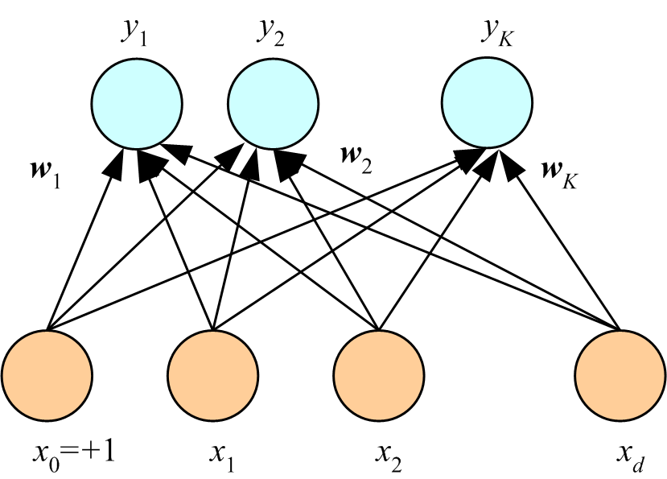
Perceptron for multi-class multivariate linear classification.
Each class has its own weight-vector connection to the input that is a column of a weight matrix W with K columns and d+1 rows. Output is the sigmoid function which is interpreted as probability of class membership (called softmax). Assign example to class with highest probability. Number weights = K(d+1)
Sig(w₁^{T}x)
Sig(w₂^{T}x)
…
Sig(w_{K}^{T}x)
…

Slide 8
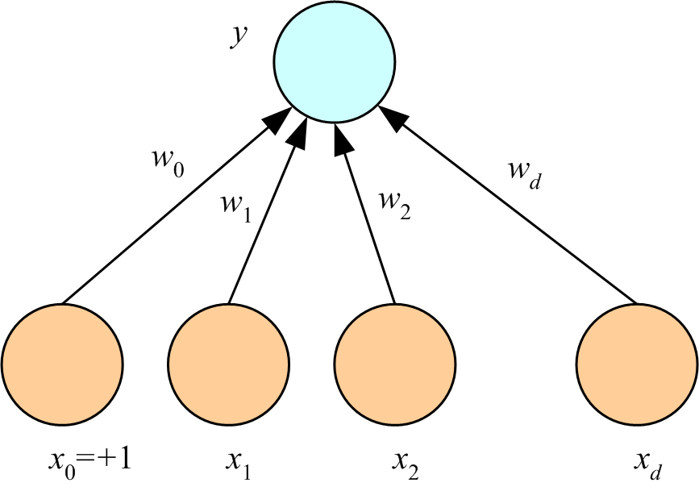
Classification by perceptron regression:
Response is class label (treated as continuous) when regression is used for multi-class classification. Requires binning of response to assign an example a to class. Number of weights = d+1
w^{T}x
x is input vector
w is weight vector
y = w^{T}x
…
Lecture Notes for E Alpaydın 2010 Introduction to Machine Learning 2e © The MIT Press (V1.0)
8

Slide 9
Classification by perceptron regression:
Advantages: Fewer parameters (d+1 regardless of number of classes)
One-step optimization by normal equations
Disadvantages: results can be affected by binning, no softmax
w^{T}x
x is input vector
w is weight vector
y = w^{T}x
…
Lecture Notes for E Alpaydın 2010 Introduction to Machine Learning 2e © The MIT Press (V1.0)
9

Slide 10
Example using the Beer-bottle glass dataset
Predict brewery from chemical composition of beer-bottle glass.
Data contains 214 samples of bottle glass from 6 breweries.
Each example has 9 attributes.
Counting bias, multivariant- multiclass classification has 60 weights to be
iteratively optimized. Requires ~ 600 data points by the 10x rule.
Perceptron regression has 10 weights to be determine by normal equations.
Requires ~100 data points by the 10x rule.

Slide 11
First 3 rows of data
1 | 1.521 | 13.64 | 4.49 | 1.1 | 71.78 | 0.06 | 8.75 | 0 | 0 | 1
2 | 1.517 | 13.89 | 3.6 | 1.36 | 72.73 | 0.48 | 7.83 | 0 | 0 | 1
3 | 1.516 | 13.53 | 3.55 | 1.54 | 72.99 | 0.39 | 7.78 | 0 | 0 | 1
1. Sample index
2. RI: refractive index
3. Na: Sodium
4. Mg: Magnesium
5. Al: Aluminum
6. Si: Silicon
7. K: Potassium
8. Ca: Calcium
9. Ba: Barium
10. Fe: Iron
11. Type of bottle (class)
1=Anheuser-Busch, Inc.
2=Miller Brewing Co.
3=Blitz-Weinhard Brewing Co.
4=Pete’s Brewing Co.
5=Samuel Adams Brew House
6=Plank Road Brewery

Slide 12
Steps in classification by regression
Setup perceptron regression as though brewery number (column 11) is a continuous response.
Solve normal equations for optimum weight vector.
Bin y_{fit} to predict class assignment for examples in dataset.
Use predicted class and true class to calculate a confusion matrix.

Slide 13
6-way confusion matrix, columns are class specific
# in class 1 assigned class 1 # in class 2 assigned class 1 …
# in class 1 assigned class 2 # in class 2 assigned class 2 …
. .
. .
# in class 1 assigned class 6 # in class 2 assigned class 6 …
total in class 1 total in class 2
Note this confusion matrix designed so that sum of elements in a column
is total class membership. In Weka confusion matrix (example in L6) sum
of elements in a row is total class membership

Slide 14
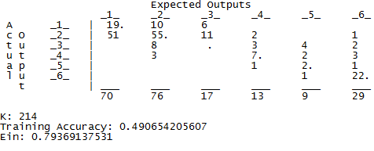
6-way confusion matrix for beer-bottle classification by regression
Classes
Classified as
Classes 1, 2, and 6 have the most data.
Data on class 3 is poor. No correct assignments.
HW6_classify_by_mlr.m uses data in classes 1, 2, and 6.

Slide 15
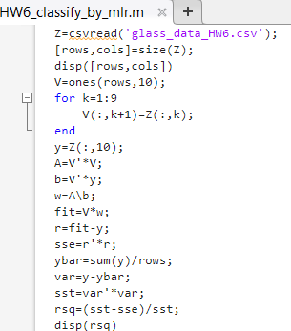
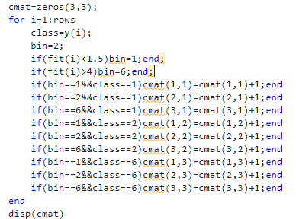
Calculate confusion matrix

Slide 16
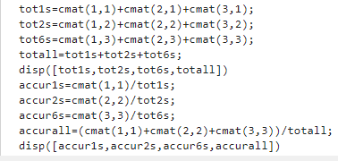
Calculate accuracies from confusion matrix

Slide 17
Assignment 4
Download HW6_classify_by_mlr.m from the class web page. Run with dataset glass_data_HW6.csv to classify beer-bottle glass by perceptron regression. Keep the class labels as 1, 2, and 6. After fitting class labels as though they are a continuous response, bin the results to make predictions of class
assignment. Use bin structure default bin=2, Fit<1.5, bin=1, and Fit>4, bin=6.
Report the following:
Coefficient of determination, number of records in each class, accuracy of class assignment,
overall accuracy, and 3-way confusion matrix with class specific columns as outlined below.
Edit HW6_classify_by_mlr.m to create the bin structure default bin=2, Fit<1.5, bin=1, and Fit>2.5, bin=6.
Run the edited code and report the results listed above.
# in class 1 assigned class 1 # in class 2 assigned class 1 # in class 6 assigned class 1
# in class 1 assigned class 2 # in class 2 assigned class 2 # in class 6 assigned class 2
# in class 1 assigned class 6 # in class 2 assigned class 6 # in class 6 assigned class 6

Slide 19
Methods of classification
Parametric Bayesian classification

Slide 20
Review Bayes’ Rule for binary classification
prior
Class likelihood
posterior
Normalization factor
Prior is usually the proportion of training examples in each class.
Class likelihood is probability that a member of class C will have attributes x
Assign example with attributes x to class C if P(C|x) > 0.5
Notes:
Prior is what we know about credit risk before we observe a clients attributes; might be per-capita bankrupties
Class likelihood, p(x|C), probability of observing x conditioned on the event being in class C
given client is high-risk (C = 1) how likely is X = {x₁, x₂}
deduced by data on a set of known high-risk clients
Evidence, p(x), is essentially a normalization; also called “marginal probability” that x is seen regardless of class
Posterior, P(C|x), probability that client belongs to class C conditioned on attributes being X
When normalized by evidence, posteriors add up to 1

Slide 21
Bayes’ Rule: K>2 Classes
Normalized priors
Assign example with attributes
Notes:
Priors, likelihoods, posteriors, and margins are class specific
Evidence is sum of margins over classes

Slide 22
Parametric Bayesian classification:
1. assume a distribution function for class likelihoods, p(x|C_{i})
(Gaussian, for example)
2. estimate parameters of the distribution from data
3. use relative class sizes in dataset for priors, p(C_{i})
4. assign example with attributes x to class with largest p(C_{i}|x)

Slide 23
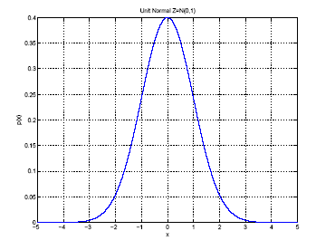
1-D Gaussian class likelihoods
Estimate μ and σ² by
μ
σ
Function of a single random
variable with a shape
characterized by 2 parameters

Slide 24
Naïve Bayes classification: Gaussian class likelihoods, d attributes.
Assumes that attributes of a class are uncorrelated and Gaussian distributed.
Unlikely to be entirely true; hence Naïve.
Class likelihood, P(x|C), is a product of 1D Gaussians for each attribute.
p(x_{i} |C) is the probability that an example in class C will have value x_{i} for attribute i
P(x |C) is the probability that an example in class C will have attribute vector x with d predictors
Class C is characterized by means and variances of the d attributes of examples in the dataset that belong to class C.
24

Slide 25
HW5 is an application of Naïve Bayes classification as implemented in Weka
The leukemia gene expression file (on class website) is data on individuals with 2 types of leukemia, ALL or AML. HW7 uses Naïve Bayes classification to address the question, Can the type of leukemia, ALL or AML, be predicted from gene express data?

Slide 26
Download and start the Weka GUI. Follow the instructions on the Weka site:
http://www.cs.waikato.ac.nz/ml/weka/
We will only use the Weka’s Explorer functionality. Extensive documentation can be found at Explorer guide
Open the leukemia gene expression file (on class website) in Explorer.
Under preprocess click open file.
Go to folder where you stored the leukemia gene expression file.
Under file type choose CSV, choose file, click open

Slide 27
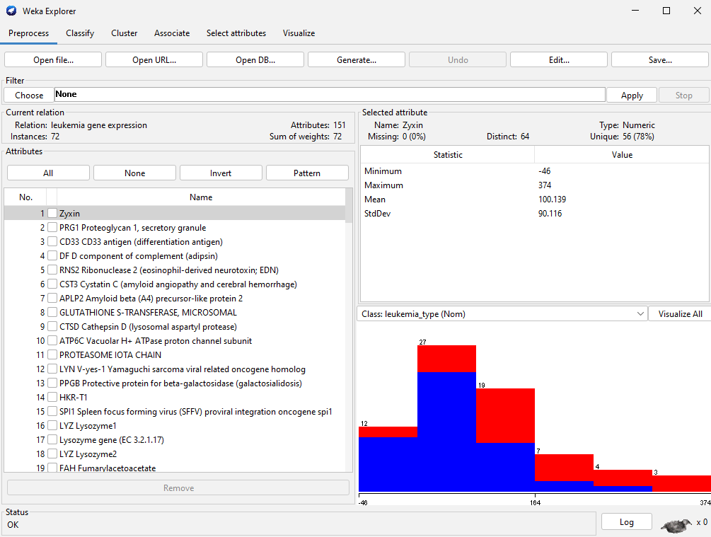

Slide 28
Under classify, find the Naïve Bayes classification method.
Under “Test options” choose “Cross-validation” and under “Folds” enter 5. The drop-down menu below Test options should say “(Nom) leukemia_type”. This means that the algorithm will classify “leukemia_type” (AML or ALL), using the gene expression values as attributes.
Click the start button

Slide 29
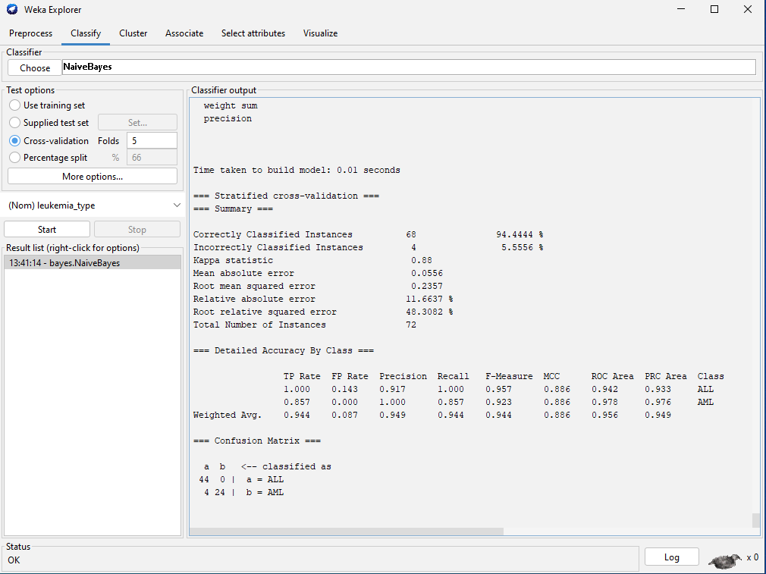

Slide 30
Assignment 7: Naïve Bayes classification
Use leukemia gene expression data (on class website) in Weka to predict the type of leukemia, ALL or AML.
Report accuracy of classification and confusion matrix assuming ALL is the positive class
Construct the confusion matrix assuming AML is the positive class.
Calculate the class-dependent TP and FP rates.
Show your work and compare to Weka’s class specific TP and FP rates.

Slide 32
Bayesian classification by discriminants:
A discriminant is a function whose value determines which class an example will be assigned to.

Slide 33
Define a discriminant function g_{i}(x) = log(p(C_{i}|x)) for a dataset where k classes are segregated by the value of one attribute, x. Use Bayes’ rule with class likelihoods that are Gaussian distributed.
We can drop the term log(p(x)) because it is not class dependent
Lecture Notes for E Alpaydın 2010 Introduction to Machine Learning 2e © The MIT Press (V1.0)
33

Slide 34
Using Gaussian class likelihood and natural logarithms
The prior is the faction of examples from class i in the dataset and the parameters for class i are the mean and variance of values of the predictor among members of class i.

Slide 35
To classify an example with value of the predictor = x, calculate the value of the discriminate for all classes. Assign the example to the class with largest value of the discriminate.

Slide 36
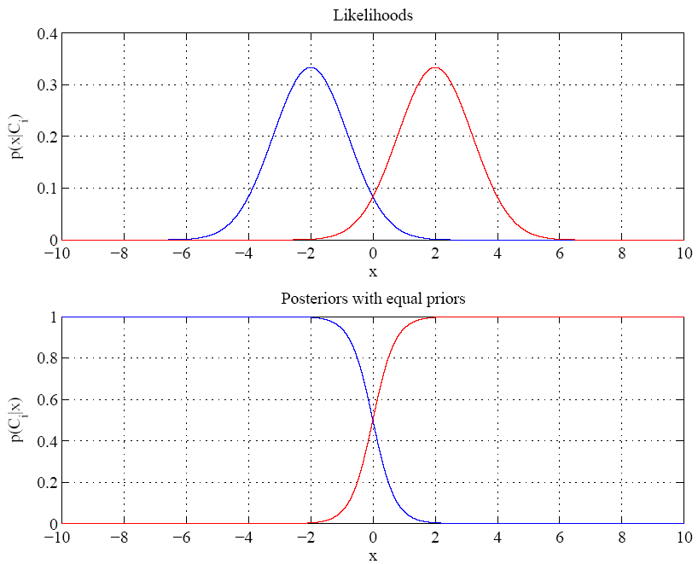
Equal variances
and priors
Example for
1D 2-class
problem
Between + 2, note
transition between
prediction of class
At boundary most probable class changes
Single boundary at
halfway between means where normalized posteriors are equal to 0.5
Lecture Notes for E Alpaydın 2010 Introduction to Machine Learning 2e © The MIT Press (V1.0)
36
Notes:
Example: 2 classes
Class likelihoods have means + 2 and equal variance
Priors are also equal.
Between -2 and 2 have transition between essentially certain classification of classes as a function of x

Slide 37
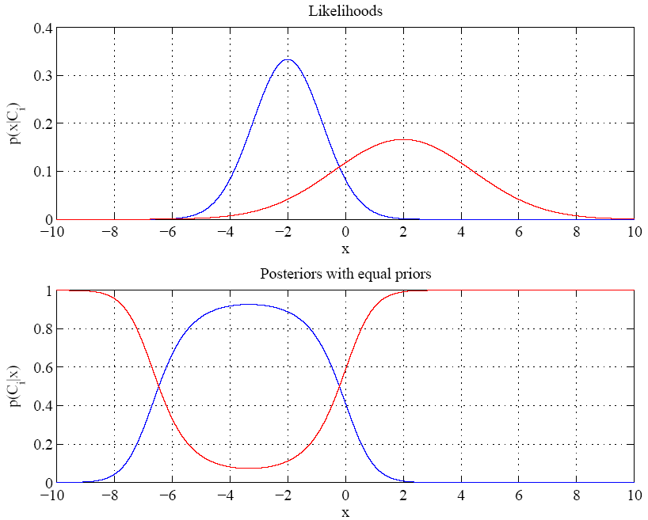
Red class likelihood
also dominant for
x < about -7 also
Variances are different
Boundaries where dominant
posterior changes are called
“Bayes discriminant points”
Lecture Notes for E Alpaydın 2010 Introduction to Machine Learning 2e © The MIT Press (V1.0)
37

Slide 38
Find the Bayes discriminate points for a 1D, 2-class dataset with equal priors.
Bayes discriminate points are where the discriminants for the 2 classes are equal.
Set g₁(x) = g₂(x) and solve for x.
After much tedious algebra you find a quadratic equation for discriminate points.
where μ and σ denote mean and standard deviation of x values in a class. Last term is zero for equal priors
If σ₁ = σ₂ , only one discriminate point. If, in addition P(C₁) = P(C₂), discriminate point is the average of the means.

Slide 39
Pseudo code for function [p1,p2] = bayespoints(m1,sd1,m2,sd2) with equal priors
Initialize p1 and p2 to zero
Calculate a, b, and c, coefficients of x², x, and constant in the quadratic equation below.
If both a and b are zero, no solution exist, Exit.
If a is zero and b is nonzero, find one point by solving bx+c=0 for x.
If both a and b are nonzero, return two points by solution of quadratic equation.
.
Due to round-off error, best not to test for exact zero. Set lower bound on absolute value

Slide 40
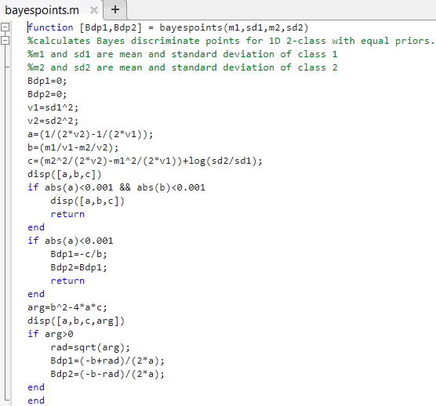

Slide 41
Assignment 8: Bayesian Classification by Discriminant
Write a script to find the Bayes’ discriminant points in a 1D, 2-class problem with equal priors and Gaussian class likelihoods with the following values for mean and standard deviation:
Use bayespoints function on the class webpage
Mean and standard deviation of C1 are 3 and 1, respectively
Mean and standard deviation of C2 are 2 and 0.3, respectively
Change the standard deviation of C2 to 1 and find the single Bayes discriminant point.

Slide 43
Methods of classification
K Nearest Neighbors (KNN)

Slide 44
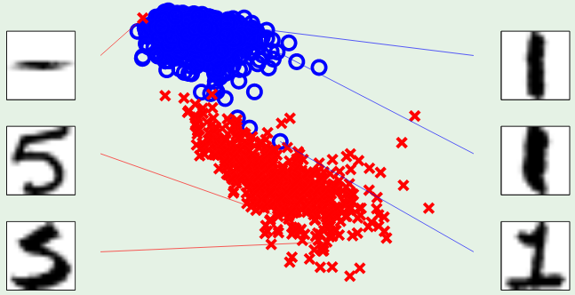
KNN is a “similarity” classification method based on the assumption that examples with small differences in attributes usually belong to the same class. The degree to which this assumption is valid depends on the quality of the attributes and the degree of noise in the data.
symmetry
intensity
Symmetry and intensity are good attributes to distinguish 1 from 5

Slide 45
KNN method of binary classification
For each attribute vector x_{k} in the dataset (without the 1 for a bias node), calculate ||x_{k}-x_{i}||, where x_{i} is every other attribute vector in the dataset.
Rank the results by increasing value.
Choose an odd positive integer for K (typically 1<K<10).
Assign the example with attributes x_{k} to the predominate class among the K examples closest to x_{k}.
For binary classification with an odd value of K, the predominate class among the K examples closest to x_{k} will be unique. A tie between members and non-members is avoided.

Slide 46
KNN is an “instance based” approach to binary classification.
There are no weights to optimize. It classifies based on the similarity of attributes.
Usually try several values of K (3, 5, 7, 9, etc). Pick the value that gives the smallest in-sample error calculated as the number misclassified.
If in-sample error is acceptable, calculate the mean of attribute vectors in both classes (members and non-members).
Use the mean attribute vectors to predict class membership of examples in a test set (i.e., assign example to class with closest mean attributes).

