Slide 1
Fundamentals of Classification
In-sample and out-of-sample errors
Version space
Margins
Confusion matrix

Slide 2
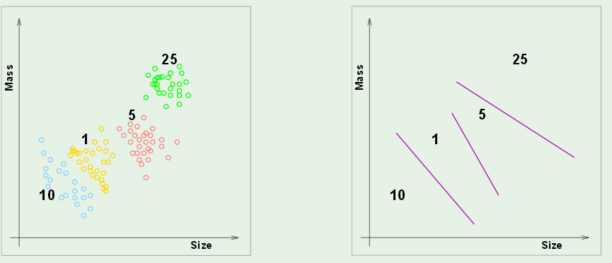
In-sample and out-of-sample error
Classify coins by size and weight
Design a vending machine that uses results
Boundaries in attribute space
Attribute space

Slide 3
In-sample error, E_{in}
How well do boundaries match training data?
Out-of-sample error, E_{out}
How often will this system fail if implement in the field?

Slide 4
A good model has small E_{in} and generalizes well (small E_{out}).
Will not be true if the E_{in} is made small by adapting the model
to the noise in the training set (over fitting).

Slide 5
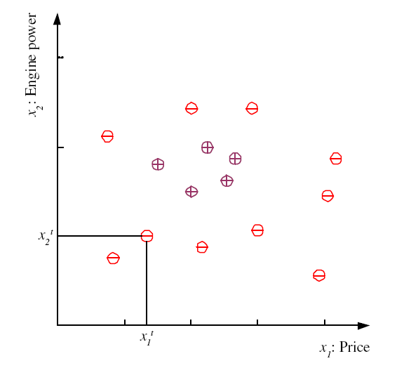
Binary classification in 2D attribute space
Dara set and labels
examples of family cars
Family-Car is a product line
No uncertainty in the label.
Issue is how well do price
and engine size distinguish
a family car.
examples of other product lines
5
Lecture Notes for E Alpaydın 2010 Introduction to Machine Learning 2e © The MIT Press (V1.0)
Notes:
Χ denotes training set
t is index of training set member
x^{t} is vector of attributes (dimensionality of problem)
r^{t} is label
Label can be either class (classification problem) or real number (regression problem)
This classification problem has only one class (family car) “dichotomizer”
Defined by 2 attributes (price and engine size)
Examples belonging to class are called “positive” and have r = 1
Examples not in class are called “negative” and have r = 0
For some machine learning techniques (SVM) better to assign r = -1 to negative examples
Unsupervised learning: finding attribute space were class members “cluster”

Slide 6
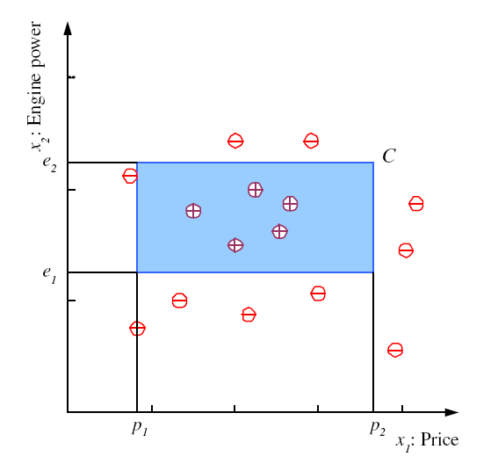
Model: assume that family cars are uniquely defined by a range
of price and engine power. Blue rectangle is one hypothesis of
this model with zero in-sample error on this data set.
6
Notes:
Clustering of positive examples in this training set allows setting of boundaries in the attribute plane that defines a class
Shape is arbitrary but choice of rectangle with sides parallel to attribute axes facilitates math definition of class

Slide 7
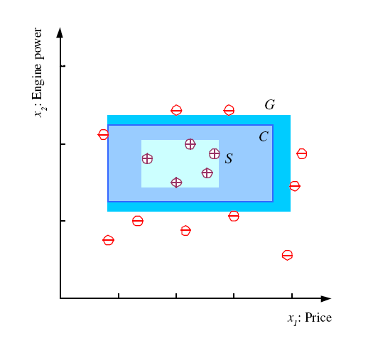
S, G, and the Version Space
most specific hypothesis, S, with no E_{in}
most general hypothesis, G,
with no E_{in}
The set of hypotheses (e.g., C) between S and G makes up the version space. All have no E_{in}. Which is best?
7
Notes:
S = h(x) with min error (zero in this case) and size (“most specific”)
G = h(x) with min error (zero) and max size (“most general”)
Mitchell calls the range of hypothesis classes between S and G the “version” space
Best choice of h(x) in the version space is one that makes most correct predictions (“generalization”)

Slide 8
Margin: distance between boundary of a hypothesis
and closest instance in a specified class
S and G hypotheses have
narrow margins; not expected to “generalize”
well because a small amount of noise can result in misclassification
G
S
8
Notes:
Define “margin” of h(x) as the distance between the boundary of h(x) and the instance closest to it
Hypotheses S and G have zero margin

Slide 9
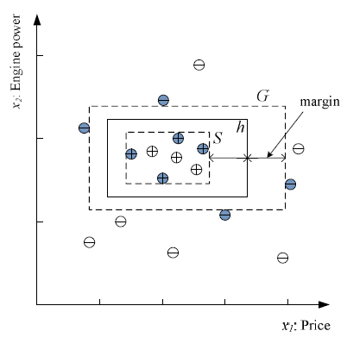
Best choice in version space is hypothesis with largest margins
Choose h in the version space with largest possible margins to maximize generalization.
Data points that determine S and G are shaded. These data points alone enable determination of h. They are called “support vectors”.
h is a hypothesis with E_{in}=0 and wide margins
9
Notes:
Among h(x) in the version space, the one with largest margin is generally considered to be the best choice for class separation, based on the training set
Data points that determine this choice are (shaded in figure) are said to “support” the optimum h(x)
Other data points could be deleted without effecting our choice of optimum h(x) in the version space

Slide 11
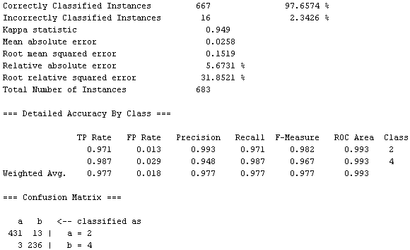
Performance metrics for classification (example from WEKA output)
WEKA is machine-learning software package.
Rows are class specific
Row sum is total class membership
Class labels are 2 and 4

Slide 12
Analysis of classification results: binary confusion matrix
Rows are class specific. Top row is positive class
False positive rate = FP / (FP+TN) = fraction of negative class instances misclassified.
True positive rate = TP / (TP+FN) = fraction of positive class instances correctly classified.
Lecture Notes for E Alpaydın 2010 Introduction to Machine Learning 2e © The MIT Press (V1.0)
12

Slide 13
Class dependent performance metrics
FP rate = FP/(FP+TN)
TP rate = TP/(TP+FN
If either class could be the “positive” class, then the Confusion Matrix, TP rate, and FP rates become class specific.
Example when top row is positive class:
a is the positive class
a b ← classified as
431 13 | a
236 | b
FP rate = 3/(3+236)=0.013
TP rate = 431/(431+13)=0.971
b is the positive class
b a ← classified as
236 3 | b
431 | a
FP rate = 13/(13+413)=0.029
TP rate = 236/(236+3)=0.987
13

Slide 14
Columns are class specific. Left column is positive class
False positive rate = FP / (FP+TN) = fraction of negative class instances misclassified.
True positive rate = TP / (TP+FN) = fraction of positive class instances correctly classified.
a is the positive class
a b
431 3 | classified as a
13 236 | classified as b
FP rate = 3/(3+236)=0.013
TP rate = 431/(431+13)=0.971
b is the positive class
b a ← classified as
236 13 | classified as b
3 431 | classified as a
FP rate = 13/(13+413)=0.029
TP rate = 236/(236+3)=0.987
14

Slide 16
ROC curves: evaluation of a class diagnostics
θ is the score of a diagnostic test (e.g., blood sugar).
ROC curves visualize and quantify the quality of θ
(e.g., as a diagnostic for type-2 diabetes).

Slide 17
Pseudo-code for ROC construction
Rank the test subjects by decreasing value of diagnostic score
Flag test subjects by class (member or non-member)
For each test subject calculate the point (NegFrac, PosFrac).
PosFrac= fraction of members with equal or greater score
NegFrac= fraction of non-members with equal or greater score
Plot points and calculate area under curve

Slide 18
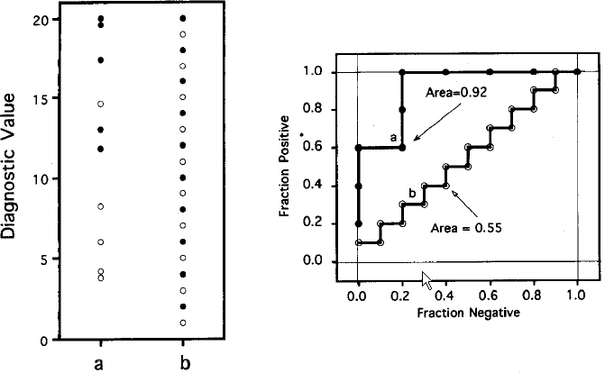
Filled circles: members, Open circle: non-members
data
ROC curves
LH-dataset: 3 out 5 members have highest scores. These 3
points are on ROC with faction negative =0
RH-dataset: members/nonmember alternate in score ranking

Slide 20
Bayes’ Rule for binary classification
prior
Class likelihood
posterior
Evidence (normalization)
Prior is information relevant to classifying that is independent of attributes in vector x
Class likelihood is probability that a member of class C will have attribute vector x
Posterior is the probability that example with attributes x should be assigned to class C
Since P(C|x) is normalized, assign example with attributes x to class C if P(C|x) > 0.5
Notes:
Prior is what we know about credit risk before we observe a clients attributes; might be per-capita bankrupties
Class likelihood, p(x|C), probability of observing x conditioned on the event being in class C
given client is high-risk (C = 1) how likely is X = {x₁, x₂}
deduced by data on a set of known high-risk clients
Evidence, p(x), is essentially a normalization; also called “marginal probability” that x is seen regardless of class
Posterior, P(C|x), probability that client belongs to class C conditioned on attributes being X
When normalized by evidence, posteriors add up to 1

Slide 21
Bayes’ Rule for binary classification
prior
Class likelihood
posterior
Evidence (normalization)
If your only interest is whether x belongs in class C or not (i.e., if P(C|x) >0.5), then you don’t have to calculate p(x).
Just determine which is larger P(C)p(x|C) or P(C)p(x|C), where C denotes the non-member class.
Normalization help us interpret the result. If P(C|x) >0.5 but very close to 0.5, the result could be due to noise in the data, and we have little confidence in the class assignment.
Notes:
Prior is what we know about credit risk before we observe a clients attributes; might be per-capita bankrupties
Class likelihood, p(x|C), probability of observing x conditioned on the event being in class C
given client is high-risk (C = 1) how likely is X = {x₁, x₂}
deduced by data on a set of known high-risk clients
Evidence, p(x), is essentially a normalization; also called “marginal probability” that x is seen regardless of class
Posterior, P(C|x), probability that client belongs to class C conditioned on attributes being X
When normalized by evidence, posteriors add up to 1

Slide 22
Example of Bayes’ Rule for binary classification
prior
Class likelihood
posterior
Evidence (normalization)
Phone service offers discount for 1st year.
Cancellation after 1st year called “churn”
Phone service has options, voice mail, international plan, caller ID, etc.
Based on historical data, how do these options affect the probability of churn?
Let C denote the class of churn=true
Let C denote the class of churn=false
p(x) = P(C)P(C|x) + P(C)P(C|x)
Notes:
Prior is what we know about credit risk before we observe a clients attributes; might be per-capita bankrupties
Class likelihood, p(x|C), probability of observing x conditioned on the event being in class C
given client is high-risk (C = 1) how likely is X = {x₁, x₂}
deduced by data on a set of known high-risk clients
Evidence, p(x), is essentially a normalization; also called “marginal probability” that x is seen regardless of class
Posterior, P(C|x), probability that client belongs to class C conditioned on attributes being X
When normalized by evidence, posteriors add up to 1

Slide 23
Data on churn: 3333 records
Class size: 483 churn = true -> prior(C) = 483/3333 = 0.1449
Prior knowledge: most customer stick with the service
Since P(C|x) proportional to P(C)P(x|C), x must be a strong predictor of churn to
overcome our prior knowledge that churn is rare.
For records with churn=true, 80 out of 483 sign up for voice mail: P(V|C)=0.1656
Voice mail is not an attribute that makes the likelihood of churn high.
For records with churn=true, 137 out of 483 sign up for International plan:
P(I|C)=0.2836 is a stronger likelihood of churn but is it strong enough?

Slide 24
Is international plan a predictor of churn?
churn not churn
Total records 483 2850
International 137 186
P(C) = 483/3333 = 0.1449 P(C) = 1-P(C) = 0.8551
p(I|C) = 137/483 = 0.2836 p(I|C) = 186/2850 = 0.0653
P(C)p(I|C) = 0.0411 P(C)p(I|C) = 0.0558
p(I) = 0.0411+ 0.0558 = 0.0969
P(C|I) = 0.0411/0.0969 = 0.4241 P(C|I) = 1-P(C|I) = 0.5759
International plan membership might contribute to churn.

Slide 25
Dominance of priors
The imbalance in the dataset toward customers that do not churn makes the posterior for the non-churn class greater for both voice mail and international.
To explore the fine detail of how options might influence churning requires a more
balanced data set.
This might be achieved by randomly deleting some non-churner examples in the data set.

Slide 26
Random deletion of data on customers that do not churn results in a dataset with the following characteristics.
churn not churn
Total records 483 1425
Voice mail 80 421
International 137 93
Use normalized Bayes’ rules to test the following hypotheses:
Subscribers with voice mail are more likely to churn
Subscribers with international option are more likely to churn
Consider writing a MATLAB code for this problem

Slide 27
Under New find a macro for writing functions. Basically, it is
function [output] = name(input)
For our problem is could be
function [PCgivenx] = bayesrule(NC,NnotC,NCx,NnotCx)
churn not churn
Total records 483 1425
Voice mail 80 421
International 137 93

Slide 28
function [PCgivenx] = bayesrule(NC,NnotC,NCx,NnotCx) pseudocode
Calculate P(C) and P(notC)
Calculate P(C)P(x|C) and P(notC)P(x|notC)
Calculate p(x)
Calculate P(C|x) = PCgivenx
Save as bayesrule. Check results by hand calculation.
churn not churn
Total records 483 1425
Voice mail 80 54
International 137 93

Slide 30
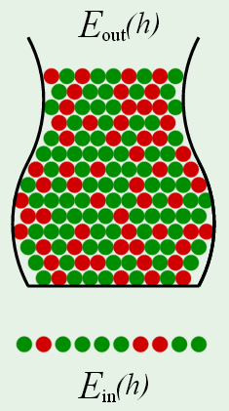
Hoeffding’s rule in hypothesis testing with a sample of size N
Let h be a hypothesis tested by data mining.
Example: Signing up for international calling plan causes churn
E_{test}(h) is the error when h is applied to a test set
E_{out}(h) is the error when h is applied to the general population
Hoeffding’s inequality to gives an upper bound on |E_{test}(h)-E_{out}(h)|
E_{test}(h)
The probability that |E_{test}(h)-E_{out}(h)| > ε can be calculated from the values of ε, the specified upper bound, and N, the number of examples in the test set.
E_{test}(h)

Slide 31
Upper bound as a function of confidence and sample size
E_{test}(h)
Call δ = 2exp(-2ε²N) the “doubt threshold”
Confidence level = 1-δ
Solve for ε as a function of δ and N by taking the natural log of both sides of doubt threshold equation.
With sample of size N, we can say with confidence 1-δ that
|E_{test} - E_{out}|< ε(δ,N) = sqrt(ln(2/δ)/2N)
E_{test}(h)

Slide 32
Sample size as a function of upper bound and confidence
Solve ε = sqrt(ln(2/δ)/2N) for N
How large must N be to have 95% confidence that error from sample
of size N differs from error in whole population by less than 10%?
N = ln(2/δ)/(2ε²) = 184.4
N = 185
E_{test}(h)

Slide 33
Confidence as a function of upper bound and sample size
How much confidence can we have that the error in a sample of size 100 differs from the error in the whole population by less than 10%?
1−δ = 1-2exp(-2ε²N) = 0.7293
Confidence = 73%
E_{test}(h)

Slide 34
Typical applications of Hoeffding’s rule
Sponsor requires 98% confidence that |E_{test} - E_{out}| < 0.1.
How large does N have to be to meet this requirement?
Solve ε = sqrt(ln(2/δ)/2N) for N
N=500
How much confidence can I have that |E_{test} - E_{out}| < 0.1?
Solve ε = sqrt(ln(2/δ)/2N) for δ
Confidence = 1-δ

