Slide 1
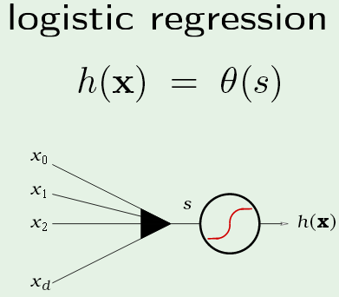
Perceptron with soft limit: predicting probability of class membership
s=w^{T}x is interpreted as a score.
Training data are examples of members and nonmembers.
Optimize weights so that members have high scores.
θ(s) is interpreted as probably of class membership

Slide 2
Deriving the cross-entropy error function for logistic regression by
maximum likelihood estimation (MLE)
Weight vector w are parameters of a distribution function p_{w}(r^{t} =1|x^{t}) that is the probability of class member given attribute vector x^{t}.
Choose w that maximizes the likelihood that x^{t} was drawn from this distribution.
Use bipolar class labels; +1 for the positive class, -1 for non-members of positive class.
Normalize distribution p_{w}(r^{t} =-1|x^{t}) = 1 - p_{w}(r^{t} =1|x^{t}) to avoid constrained optimization.
Since the logistic function has the property θ(s)+θ(-s) =1, p_{w}(r^{t}|x^{t}) = q(r^{t}w^{T}x^{t}) is normalized if we use bipolar class labels.

Slide 3
Maximum Likelihood Estimation is used to estimate parameters of a probability distribution given a sample X assumed to be drawn from that distribution.
To simply the likelihood function we also assume that members of our sample (training data) are independent and identically distributed.
In logistic regression, parameters of distribution function are the weights
Likelihood of w given the sample X -> l(w|X) = p (X |w) = ∏_{t} p(x^{t}|w)
Choose w that maximizes log(l(w|X)) = ∑_{t} log p(x^{t}|w)
In logistic regression, p(x^{t}|w) = θ(r^{t}w^{T}x^{t})

Slide 4
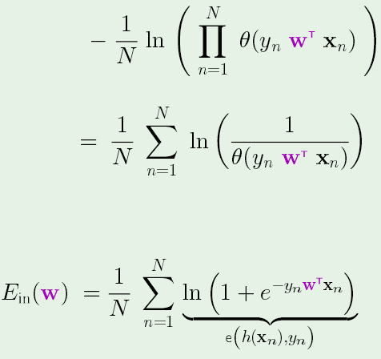
Since Log is a monotone increasing function, maximizing log(likelihood) is equivalent to minimizing -log(likelihood)
Dividing by N, size if training set; hence in-sample error function becomes
E_{in}(w)=
E_{in}(w)
Using θ(s) = e^{s}/(1+e^{s}) = 1/(1+e^{-s})
where y_{n} is the label on the n^{th} attribute vector

Slide 5
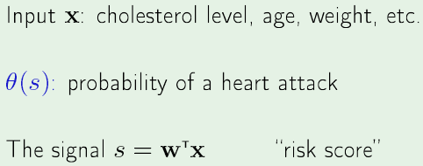
Application: Probability of heart attack
Objective: find w such that risk score >> 0 for attribute vectors x of patients that have had a heart attack (θ(s) ~ 1) and risk score << 0 for attribute vectors x of patients who have not had a heart attack (θ(s) ~ 0).

Slide 6
The in-sample error function of logistic regression (called cross entropy) has the
desired properties to optimize weights by minimum in-sample error.
If x_{n} are the attributes of a person who has had a heart attack, w^{T}x_{n} >> 0 and y_{n} > 0, so the contribution to E_{in}(w) is small.
If x_{n} are the attributes of person who has not had a heart attack, w^{T}x_{n} << 0 and y_{n} < 0, so the contribution to E_{in}(w) is again small.

Slide 7
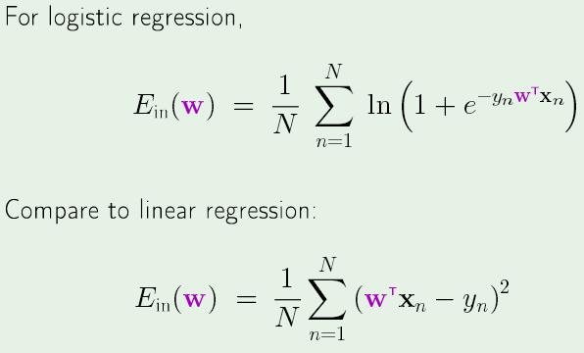
Error function of linear regression allows “1-step” optimization by solving the normal
equations for w. Not true for the error function of logistic regression. Finding w that
minimizes cross entropy is an iterative process. One such iterative method is called
“gradient decent”.

Slide 8
Stochastic gradient decent: correct weights by error in each data point
η is “learning rate” with value << 1

Slide 9
Batch gradient decent: correct the weights w(n+1) = w(n) + Δ w based on the average in-sample error. Weights change fastest where gradient is largest

Slide 10
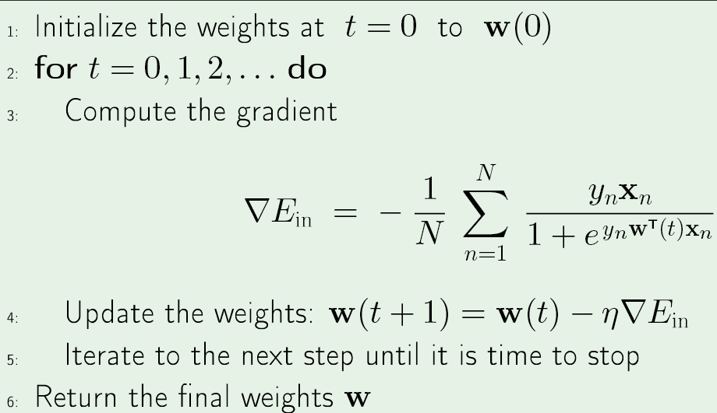
Logistics regression algorithm (batch weight update)

Slide 11
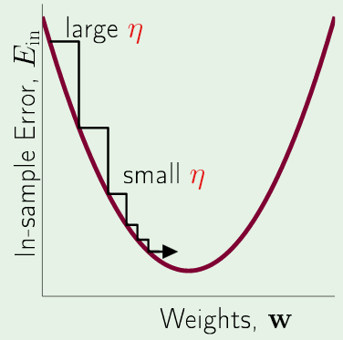
Batch gradient decent fixed leaning rate η
w(1) = w(0) + Δ w
Weights change fastest where gradient is largest
Note: sum of vectors

Slide 12
Stop when one of the following is true
Max iterations: typically, 50,000
Small norm of gradient: typically, < 0.01
Small E_{in} : typically, < 0.5

Slide 13
Joe’s results (not converged)
iterations: 100
Learning rate: 0.0005
Final weights: 0.5964, 0.9967, 0.9850, 0.0719, -0.1431, 0.9982, 0.9960, -0.1344, 1.0009, 0.9987, 0.9910, 1.0020, 0.9804
E_{in}(mean cross entropy) = 2.2766 at termination
Accuracy = 0.6812
high risk low risk <- classified as
94 44 138 total high risk
51 109 160 total low risk

Slide 14
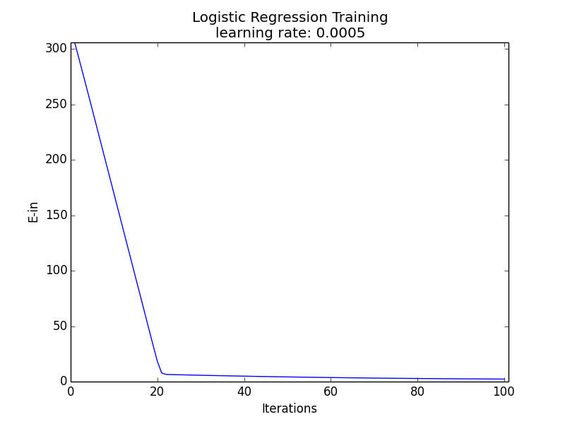
Small changes in weights due to small
gradient of E_{in}

Slide 15
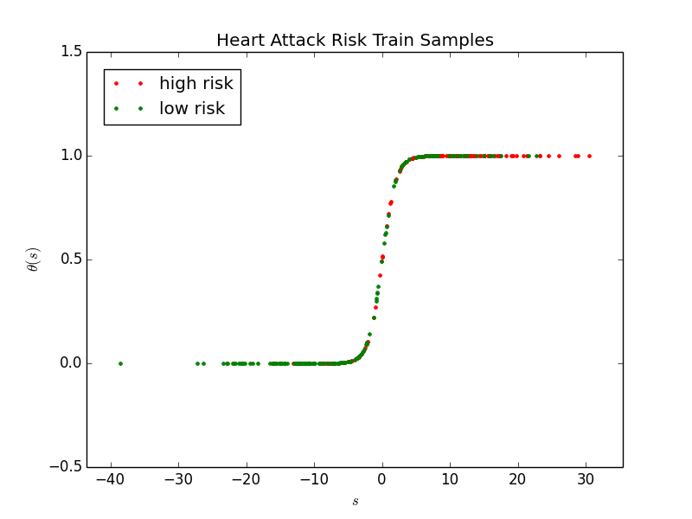
Probability of a heart attack

Slide 16
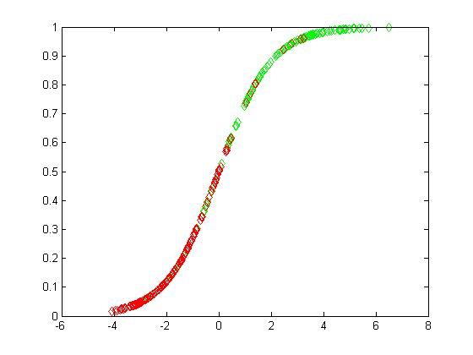
Heng’s result (converged)
η = 0.0001, iteration = 50000, Ein = 0.3727, Accuracy = 0.8452
high risk low risk <- classified as
109 28 138 total high risk
18 142 160 total low risk

Slide 17
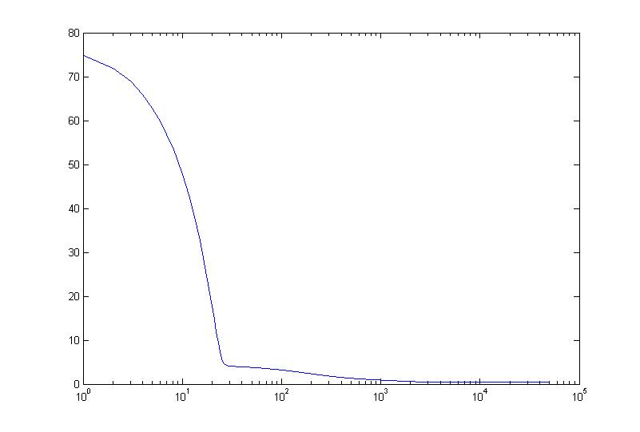
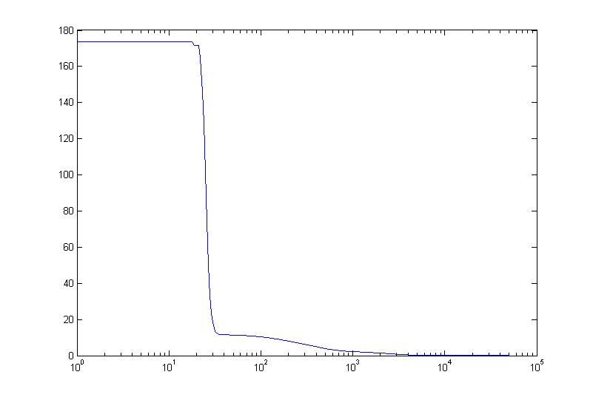
E_{in} VS iteration
Norm grad(E_{in}) VS iteration
Note: Basically, the same shape as Joe’s result for 100 iterations

Slide 18
Assignment 16
Start WEKA 3.8 and open the “Explorer window”
On the Preprocess tab, open the “logit-data.csv” file on website
Filter the data by clicking on “Choose” button -> filters -> unsupervised -> attribute -> NumericToNominal, then click “Apply” to generate a .arff file
Go to the “Classify” tab and click the “Choose” button. Choose “SimpleLogistic” classifiers under “functions”.
Run with default settings and 10-fold cross-validation.
Include accuracy and confusion matrix in your report
Return to the “Classify” tab and “Logistic” classifiers under “functions”.
Run with default settings and 10-fold cross-validation.
Include accuracy and confusion matrix in your report
The secret to the success of Simple Logistics may be its automatic attribute selection. In the output for Simple Logistics, find the attributes in the best case. Modify the excel file of logistic data to include only these attributes and rerun the Logistics case with default settings and 10-fold cross-validation. Include the accuracy and confusion matrix in your report.

Slide 19
Weka’s Simple Logistic

Slide 21
More on multidimensional optimization

Slide 22
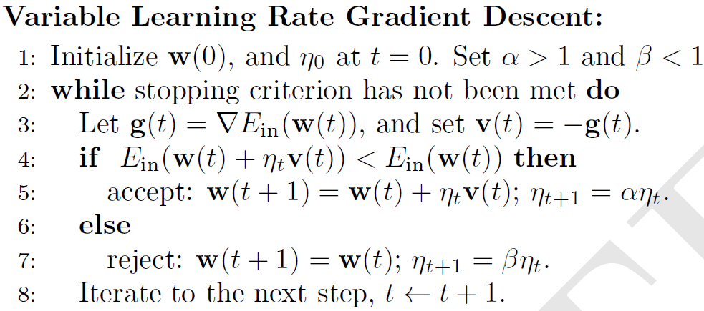
Improving convergence of gradient decent
Typical values: α = 1.05 to 1.1 β = 0.5 to 0.8

Slide 24
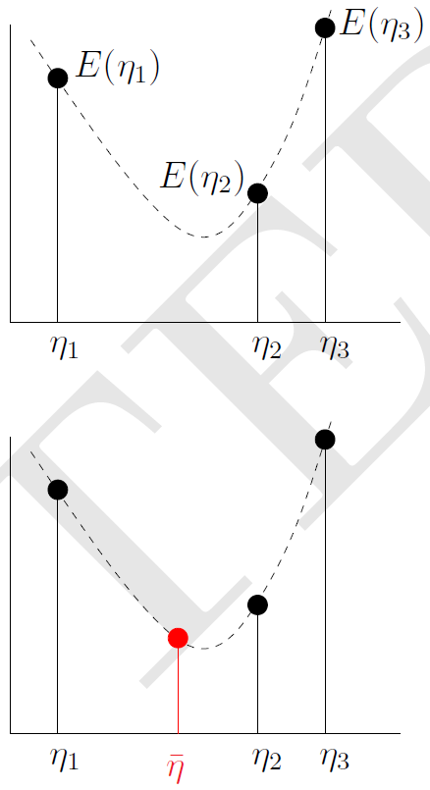
Find η₁, η₂ and η₃ such that η₁ < η₂ < η₃ and
and E(η₂) < min( E(η₁), E(η₃))
Guess η = (η₁ + η₃ )/2 as solution of line search
If E(η) < E(η₂) repeat with η₁ < η < η₂ (shown)
If E(η) > E(η₂) repeat with η < η₂ < η₃
Stop when E(η_{k+1}) ~ E(η_{k}) or max iterations
To find initial set of η’s, start with η₁ = 0 and η₃ = ε
If E(η₂) < E(η₁) try η = 0, ε, 2ε, 4ε, etc. until E increases
If E(η₂) > E(η₁) try η = ε, 0, −2ε, −4ε, etc. until E increases

Slide 25
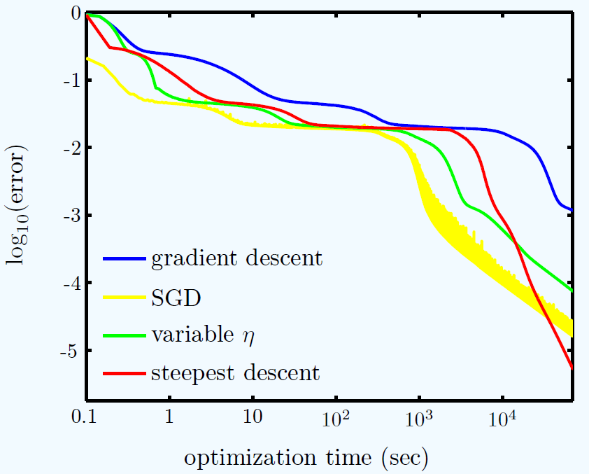

Slide 26
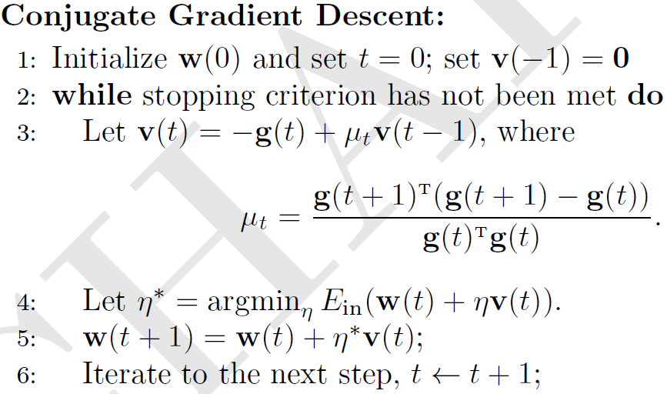
After a few conjugate gradient iterations, do an iterations with μ = 0
(i.e., steepest decent)

Slide 27
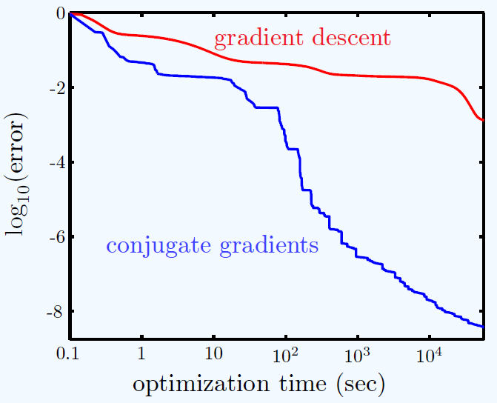

Slide 28
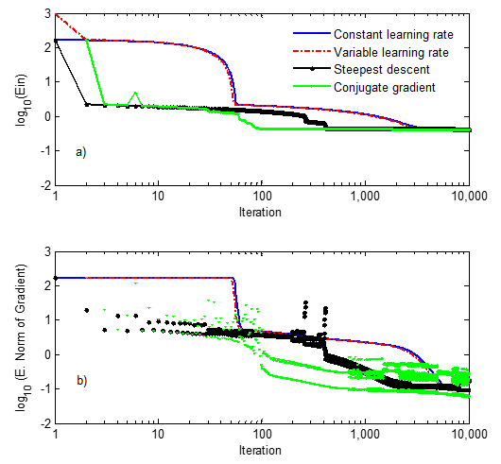
Edom’s results on optimization methods leaning rate = 0.001
Conclusions:
All methods, except constant leaning rate,
are stable with leaning rate as high as 0.001.
For stability, momentum term of conjugate
gradient set to zero on ever other iteration.
Line search by bisection method significantly
decreases speed per iteration.
In norm of gradient, see evidence of multiple
local minima.

Slide 30
Binary Linear Classification: Predicting class membership
Binary linear classification optimizes weights so that w^{T}x = 0 is the best decision boundary in attribute space. Regions where w^{T}x > 0 are associated with examples of positive class membership. Regions where w^{T}x < 0 are associated with examples of non-members. If examples are not “linearly separable” then optimization finds the weights that minimize misclassifications.
y=w₁x+w₀
Linearly separable data in 1D.
y=0 defines a decision point on the x axis that
separates a region where values of attribute x
predict class membership from a region where
values of x predict non-membership.
x

Slide 31
Logistic Regression: Predicting probability of class membership
In logistic regression, s = w^{T}x becomes the argument of the logistic function, (aka sigmoid) which is interpreted as the probability of class membership. Weights are optimized by minimizing an error function called “cross entropy”
y=w₁x+w₀
x
w^{T}x=0 defines a region of attribute space where examples
have probability > 0.5 of being members of the positive class.

Slide 32
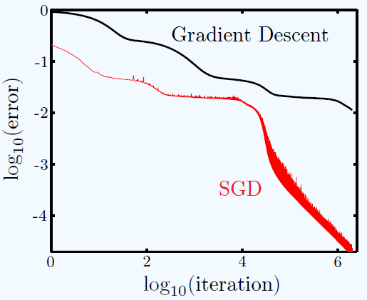
Benefits of stochastic gradient decent
Less computation than Batch gradient decent
Randomness helps avoid getting stuck in local minima

Slide 33
Batch gradient decent fixed leaning rate η
w(1) = w(0) + Δ w
Weights change fastest where gradient is largest
Note: sum of vectors

Slide 34
Chose w(0) randomly on [-0.01, 0.01]
Chose a learning rate of 0.001 or less
How do you avoid overflow in calculation of
the gradient of E_{in} ?
Update weights w(t+1)=w(t) - η gradient(E_{in})

Slide 35
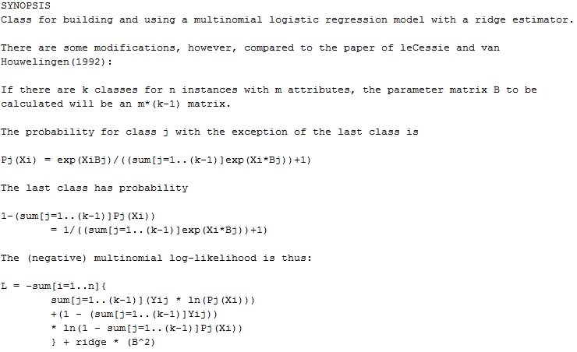
Weka’s Logistic Regression

