Slide 1
Why Reduce Dimensionality?
Reduces time complexity: Less computation
Reduces space complexity: Less parameters
Simpler models are more robust on small datasets
More interpretable
Easier to visualize
Lecture Notes for E Alpaydın 2010 Introduction to Machine Learning 2e © The MIT Press (V1.0)
1

Slide 2
A few methods of Dimensionality Reduction
Radial basis function neural networks can be viewed as dimensionality reduction by clustering.
Dimensionality reduction by attribute selection
Selection by genetic algorithm (lecture 13)
Selection by information gain (not covered)
Dimensionality reduction by feature extraction
Principal component analysis
Eigenvalues and vectors of covariance matrix
Based on assumption that attributes are normally distributed
Principal components defined by an auto-association ANN avoids this assumption.

Slide 3
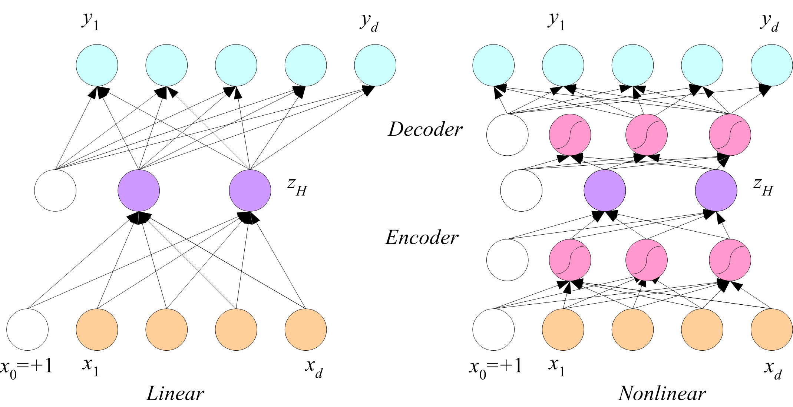
Application of auto-association networks for data smoothing
Each arrow denotes a component of
weight vectors connecting input to
hidden layer and hidden layer to output
Input: raw attribute vector
Output: smoother attribute vector
z_{H}: “principal components”
reconstruction error: squared
differences between raw and
smoothed data

Slide 4
Application to gene expression data
Expression of 21,509 genes in B16 mice was measured for 2880 min after treatment with LPS, an agonist that induces inflammation.
Source: http://www.innateimmunity-systemsbiology.org

Slide 5
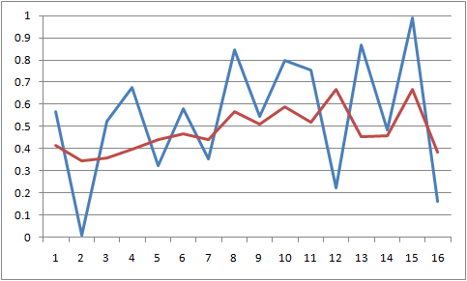
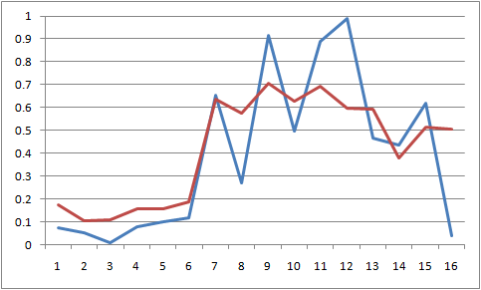
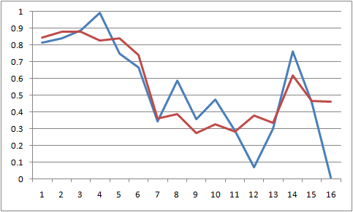
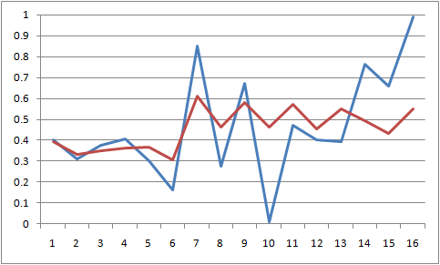
Neural-Network Smoothing
Input: expression level at 16 time points
Variance before smoothing: 0.08283
Variance after smoothing: 0.02895
Examples (blue: original, red: smoothed):

Slide 6
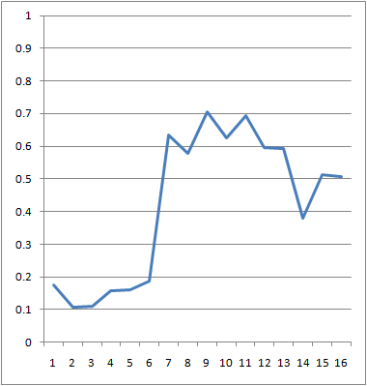
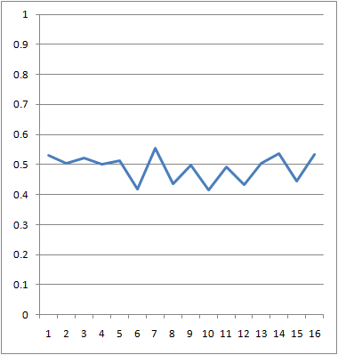
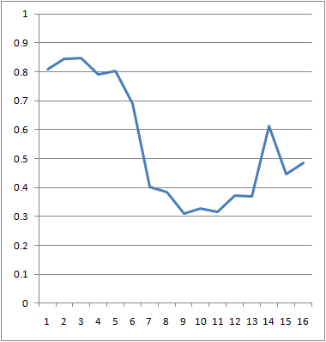
Temporal Patterns of Gene Expression
up regulation
unchanged
down regulation

Slide 7
Data interpretation
In addition to smoothing, plotting the z_{H1} vs z_{H2} for all 21,509 genes shows clusters of expression profiles.

Slide 8
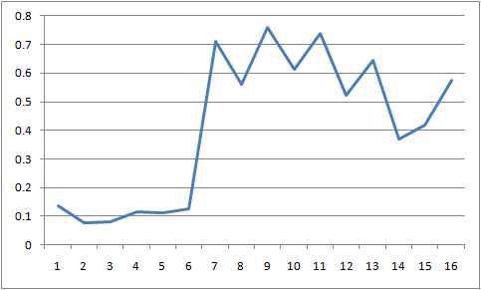
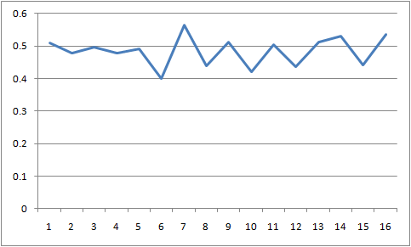
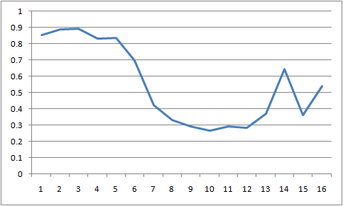
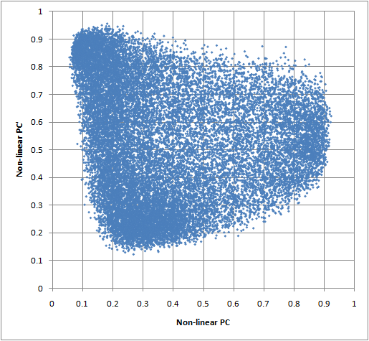
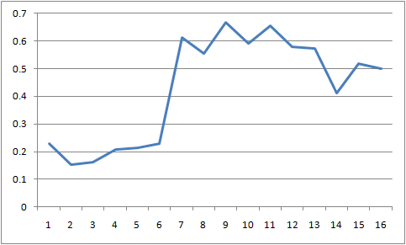
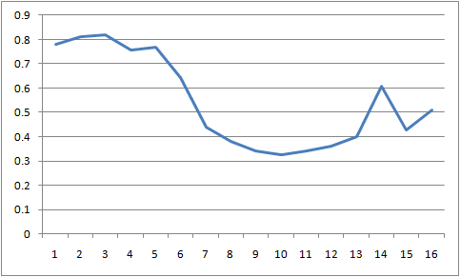
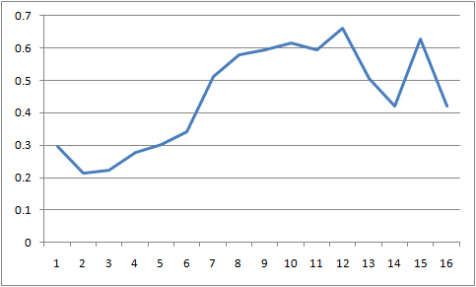
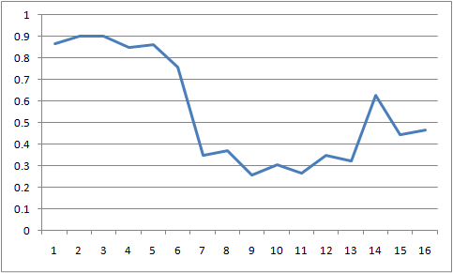
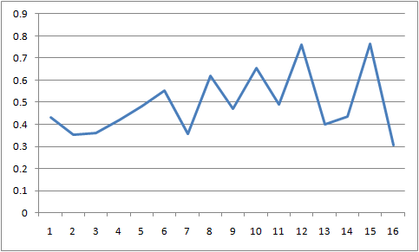
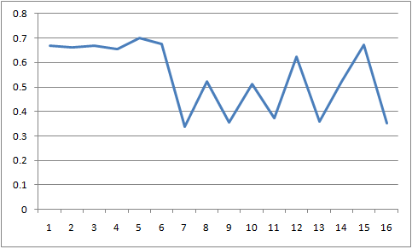
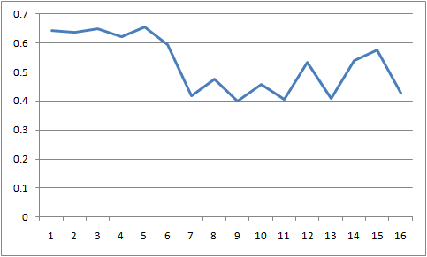
z_{H2}
z_{H1}

Slide 9
Principal Components Analysis (PCA)
Assume that attributes in dataset are drawn from a multivariate normal distribution. P(x)=N(μ, Σ)
Covariance matrix:
diagonal elements are σ² of individual attributes.
Off diagonals show
correlation between variation of attributes.
dxd
dx1
1xd
9

Slide 10
dxd
dx1
1xd
Dividing elements covariance matrix by the product of standard
deviations produces the “correlation” matrix with 1’s on diagonal.
Off-diagonals are “correlation coefficients”
Correlation among attributes makes it difficult to say how
each attribute contributes to a prediction.

Slide 11
If attributes are normally distributed, then features obtained
by linear transformation of attributes, z = Mx ,
where M is any dxd matrix, will also be normally distributed.
A choice of M that results in a diagonal covariance matrix
in feature-space has the following advantages:
1. Interpretation of uncorrelated features is easier
2. Total variance of features is the sum of diagonal elements
3. Since the trace of a matrix (sum of diagonal elements) is invariant under diagonalization, total variance of Mx features equals total variance of attributes.
4. After diagonalization, total variance is concentrated into a few diagonal elements called principal components.

Slide 12
Diagonalization of the covariance matrix:
The transformation z = Mx that leads to a diagonal feature-space covariance has M = W^{T} where the columns of W are the eigenvectors, w_{k}, of the covariance matrix Σ, obtained by solution of the eigenvalue equations Σw_{k} = λ_{k}w_{k}
The collection of eigenvalue equations can be written as ΣW = WD where D = diag(λ₁...λ_{d}) and W is formed by column vectors [w₁ ... w_{d}].
W is an “orthogonal” matrix with the property W^{T}= W⁻¹
Hence W^{T}ΣW = W⁻¹WD = D and z = W^{T}x is a vector of features with the desirable properties on the previous side.
If we arrange the eigenvectors in W so that their eigenvalues λ₁...λ_{d} are in decreasing order of magnitude, then the components of z, z_{i} = w_{i}^{T}x, are called “principal components” (PCs).

Slide 13
Proof that if attributes x are normally distributed with mean μ and covariance Σ then, for any feature, z=w^{T}x is normally distributed with mean w^{T}μ and variance w^{T}Σw.
Mean(z) = E(w^{T}x) = w^{T}E(x) = w^{T}μ
Var(z) = Var(w^{T}x) = E[(w^{T}x – w^{T}μ)²]
= E[(w^{T}x – w^{T}μ)(x^{T}w – μ^{T}w)]
= E[w^{T}(x – μ)(x – μ)^{T}w]
= w^{T} E[(x – μ)(x –μ)^{T}]w = w^{T} ∑ w
Find w = w₁ such that Var(z₁)=w₁^{T} ∑ w₁ is a maximum
subject to the constraint ||w₁|| = w₁^{T}w₁ = 1
Lecture Notes for E Alpaydın 2010 Introduction to Machine Learning 2e © The MIT Press (V1.0)
13

Slide 14
Application of Lagrange multipliers
Find w₁ such that w₁^{T}Σw₁ is maximum subject to constraint w₁^{T}w₁ = 1
Maximize L = w₁^{T}Σw₁ + c(w₁^{T}w₁ – 1)
gradient of L = 2Σw₁+ 2cw₁ = 0
Σw₁ = -cw₁
w₁ is an eigenvector of covariance matrix
let c = -λ₁
λ₁ is eigenvalue associate with eigenvector w₁
z₁ is a PC
Lecture Notes for E Alpaydın 2010 Introduction to Machine Learning 2e © The MIT Press (V1.0)
14

Slide 15
Prove that λ₁ is the variance of z₁
z₁ = w₁^{T}x
Σw₁ = λ₁ w₁
var(z₁) = w₁^{T}Σw₁ = w₁^{T} λ₁ w₁ = λ₁w₁^{T}w₁ = λ₁
To maximize var(z₁), chose λ₁ as largest eigenvalue of the covariance matrix.
Definition of PC1
Eigenvalue equation of PC1
15

Slide 16
Proportion of Variance (PoV)
PoV(k) =
A plot PoV(k) vs k shows how many PCs are required to capture a given part of the total variance of attributes
16

Slide 17
Example: cancer diagnostics
Metabolomics data
94 samples
35 metabolites in each sample = d
60 samples non-cancer patients
34 samples cancer patients

Slide 18
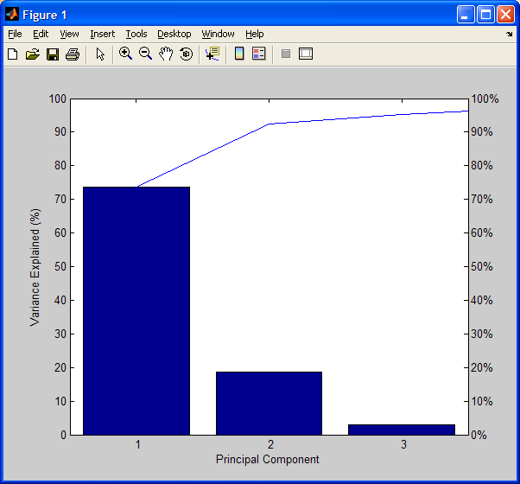
proportion of variance plot
ranked
eigenvalues
3 PCs capture > 95%
73.6809
18.7491
2.8856
1.9068
0.7278
0.5444
0.4238
0.3501
0.1631

Slide 19
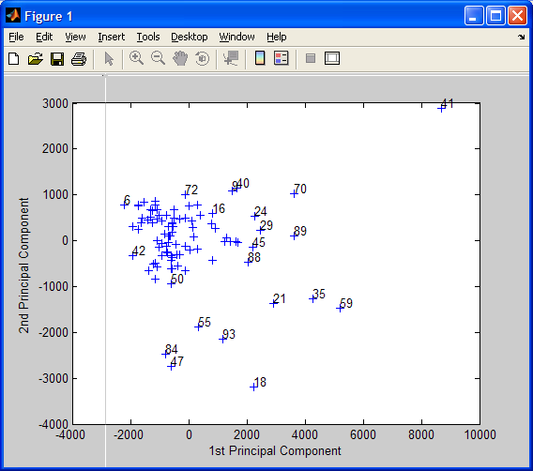
Scatter plot of PCs 1 and 2
1-34 cancer, >35 control

Slide 20
Review PCs
PCs are defined by the eigenvectors of the covariance matrix.
z_{i} = w_{i}^{T}x is the value of i^{th} PC for attribute vector x.
Var(z_{i}) = λ_{i}
Due to invariance of the trace in matrix diagonalization, sum over i of Var(z_{i}) = total variance of attributes in dataset.
PCs are ordered by decreasing variance. Potentially as many PC as attributes, but we hope to capture most of the total variance with a few of the PCs with largest eigenvalues
Covariance matrix of PCs is diagonal; hence no correlation.
Profiling PCs is an attempt to discover how each PC retained affects the response being modeled

Slide 21
Assignment 11
Calculate principal components of attributes in
glass data short noclass.csv on the class webpage. Plot the eigenvalues ranked by decreasing magnitude. Calculate PoV for all eigenvalues and plot. Make a scatter plot of PC2 as a function of PC1.
Last HW assignment before quiz 3 that covers, MLP (HW8), SVM (HW9), RBF(HW10), and PCA (HW11).
One more lecture (L13 profiling PCA) before quiz 3.

Slide 22
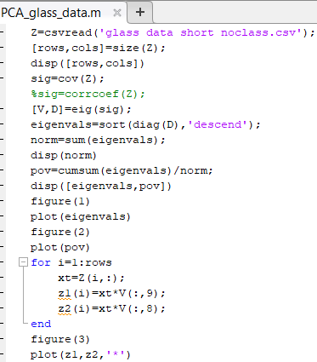
MATLAB functions
that make HW13
easier
Every attribute vector in the dataset generates a value of every PC.
z_{i} = w_{i}^{T}x is the value of i^{th} PC for attribute vector x. Both w_{i} and x are column vectors.
Is this correct?

Slide 23
Z-scores: attributes transformed to zero mean and unit variance
If variable x is normally distributed with mean μ and variance σ²,
then z = (x – μ)/σ
is a normally-distributed variable with zero mean and unit variance.
The covariance matrix of z-scores is the correlation matrix with ones on the
diagonal and correlation coefficients of diagonal.

Slide 24
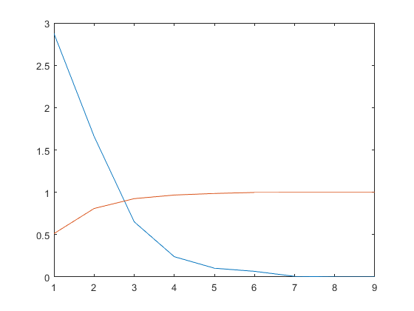
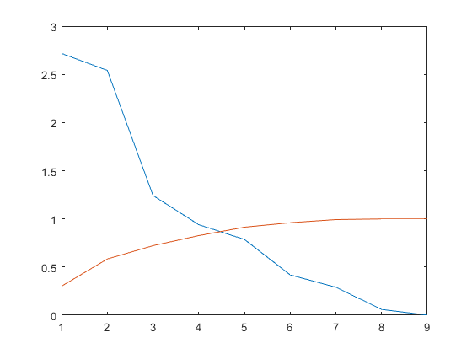
Eigenvalues of covariance matrix
sum=5.6046
Eigenvalues of correlation matrix
sum=9
eigenvals
eigenvals
PoV
PoV

Slide 25
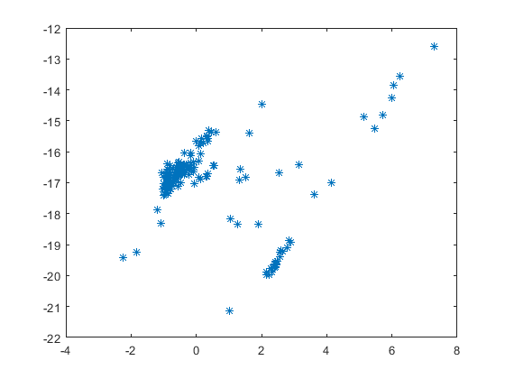
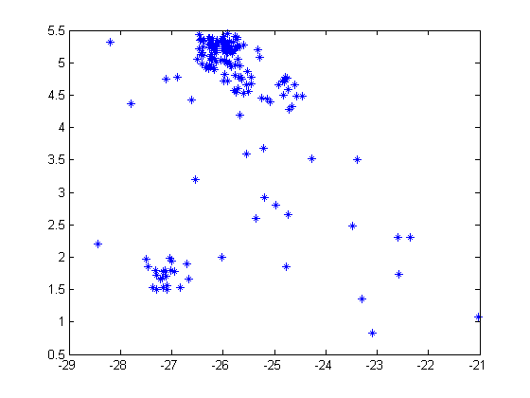
attributes
z-scores
PC 2
PC 1

