Slide 1
Quiz #4: Tuesday 4/9/24
Solution of linear systems of equations by matrix factorization
Text section 8.1
Eigenvalues Text section 8.3
Linear least squares
Text Chapters 12
Lectures L16-20
Assignments HW15-20

Slide 2
Solution of linear systems of equations

Slide 3
Example: Cholesky to solve Ax = b
A=[4,-1,-1,0;-1,4,0,-1;-1,0,4,-1;0,-1,-1,4];
b=[2;4;8;-6];
L=Cholesky(A);
U=L’;
y=forsub(L,b);
x=backsub(U,y);
disp(x)
test=A\b;
disp(test)
Cholesky, forsub, and backsup are on the class web page

Slide 4
Example: use MatLab’s lu(A) to solve Ax = b
A=[2,4,-2;4,9,-3;-2,-1,7];
b=[4;8;-6];
[L,U,P]=lu(A);
newb=P*b;
y=forsub(L,newb);
x=backsub(U,y)
disp(x)
test=A\b
disp(test)

Slide 5
Linear least squares

Slide 6
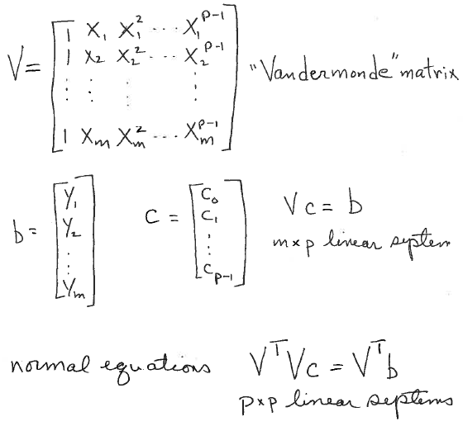
Fit a polynomial of degree p-1 to m data points (x_{k}, y_{k})

Slide 7
Fit a parabola surface tension as a function of temperature: no weights
T = [0, 10, 20, 30, 40, 80, 90, 95]’; % column vector
S = [68.0, 67.1, 66.4, 65.6, 64.6, 61.8, 61.0, 60.0]’; %column vector
npts=8;
V=ones(npts,3);
V(:,2)=T;
T2=T.*T;
V(:,3)=T2;
A=V’*V; (3x8*8x3)=3x3
b=V’S; (3x8*8x1)=3x1
x=A\b; %returns a column vector
disp(x)
fit=V*x;
r=fit-S;
chisq=r’*r;
disp(chisq)
plot(T,S,’*’);
hold on
plot(T,fit);
hold off

Slide 8
T = [0, 10, 20, 30, 40, 80, 90, 95]’; % column vector
S = [68.0, 67.1, 66.4, 65.6, 64.6, 61.8, 61.0, 60.0]’; %column vector
dS=[6, 2, 5, 3, 7, 8, 4,1]’; % note small uncertainty in last point
npts=8;
V=ones(npts,3); V(:,2)=T; T2=T.*T; V(:,3)=T2; %fit a parabola
weights=1./dS % do not square the weights here
W=diag(weights);
WS=W*S; %weighted vector of observations
WV=W*V; %weighted Vantemonte matrix
A=WV’*WV; % weights are squared
b=WV’*WS; %weights are squared
x=A\b;
disp(x)
fit=V*x;
r=fit-S;
chisq=r’*r;
disp(chisq)
errorbar(T,S,dS,’*’);
hold on
plot(T,fit);
hold off
Fit a parabola surface tension as a function of temperature: with weights

Slide 9
Solution of linear systems by singular values decomposition using the
Moore-Penrose pseudo inverse
A=[1,2,3; 4,5,6; 7,8,9; 10,11,12];
b=[1,2,3,4]’;
[U,S,V]=svd(A);
disp(S)
pS=pinv(S);
x=V*pS*U’*b;
disp(x)
Moore-Penrose enables a solution of rank deficient linear systems but
the solution is probably not unique. Call rank(A) or displace S to discover rank deficiency.

Slide 10
Fit parabola to surface tension data using singular value decomposition
T = [0, 10, 20, 30, 40, 80, 90, 95]’; % column vector
ST = [68.0, 67.1, 66.4, 65.6, 64.6, 61.8, 61.0, 60.0]’; %column vector
npts=8;
Vparab=ones(npts,3);
Vparab(:,2)=T;
T2=T.*T;
Vparab(:,3)=T2;
[U,S,V] = svd(Vparab);
disp(S)
pS=pinv(S);
x=V*pS*U’*ST; %returns a column vector
disp(x)
fit=Vparab*x;
r=fit-ST;
chisq=r^{T}r;
disp(chisq)
plot(T,ST,’*’); %plot data as points (no error bars)
hold on
plot(T,fit);
hold off

Slide 11
Numerical methods to find eigenvalues and eigenvectors

Slide 12
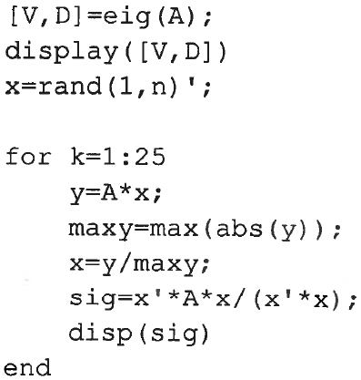
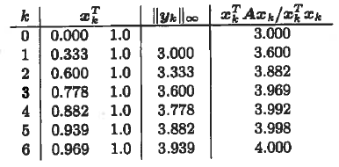
MATLAB code for power iteration for largest eigenvalue and its
eigenvector using infinity norm and Rayleigh quotient.
% MATLAB's built in for eigenvalues
% x is nx1 with random components
10
output when x₀ =[0,1]’
Infinity norm also converges to largest eigenvalue but the
Rayleigh quotient converges faster.

Slide 13
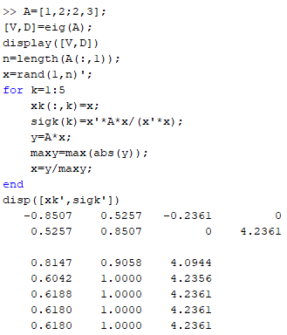
Renormalize MATLAB 0.5257/0.8507 = 0.6180

Slide 14
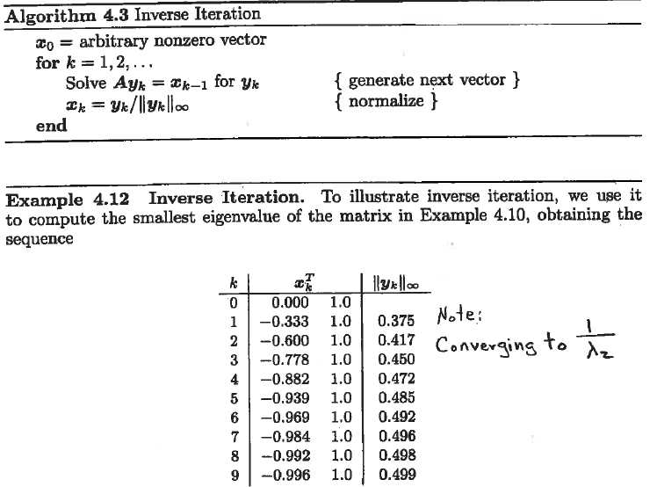
output when x₀ =[0,1]’
A =
λ₂=2
Using infinity norm,
v₂ = [-1,1]^{T}
and corresponding
eigenvector

Slide 15
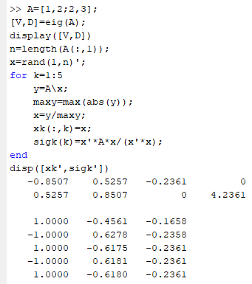
Renormalize MATLAB -0.5257/0.8507 = -0.6180

Slide 16
Inverse iteration with shift
If Ax = λx then (A – σI)x = (λ-σ)x.
If σ is good guess for eigenvalue λ_{k}, then λ_{k} – σ will be the smallest eigenvalue of A – σI
with shift, inverse iteration can be used to compute any eigenvalue and corresponding eigenvector of A using an initial guess

Slide 17
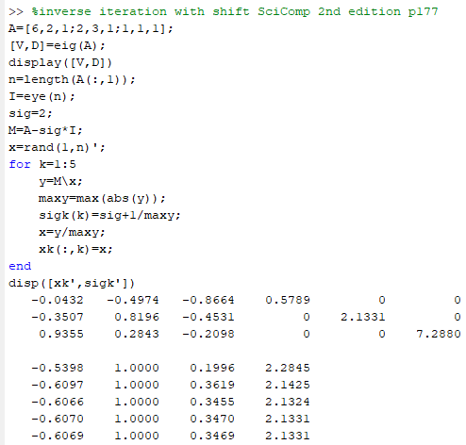
Renormalize MATLAB -0.4974/0.8196 = -0.6069
0.2843/0.8196 = 0.3469

