Slide 1
Quiz #3: 4/7/22
Floating point number systems
Loss of significance
Text Chapter 2
Single and systems of ODEs
Text Chapters 10,11
Covers material in HW11-14

Slide 2
Review of Floating-Point Number Systems and Loss of Significance

Slide 3
Definition of a normalized floating point number system
β = base
p = precision (number of digits: d₀, d₁,…d_{p-1})
L = lower limit of exponent
U = upper limit of exponent
All floating-point numbers in the system can be written as
fl(d₀,d₁…d_{p-1}) = (d₀ + d₁/β + d₂/β² + ... + d_{p-1}/β^{p-1})β^{E}
In a normalized system d₀ ≠ 0
0 < d_{i} < β -1 for i = 1, ..., p-1
E is any integer such that L < E < U.
A period is commonly placed between d₀ and d₁
The base is commonly indicated by a subscript on d_{p-1}
Example: 1.11₂x2¹ = (3.5)₁₀

Slide 4
Typical quiz question:
β = base = 2
p = precision (number of digits: d₀, d₁,…d_{p-1}) =3
L = lower limit of exponent = -1
U = upper limit of exponent = 1
Total number of floating-point numbers?, UFL?, OFL?, ε _{mach}?

Slide 5
Bring this slide to the quiz
number of normalized floating-point numbers = 1+2(β-1)β^{p –1} (U – L + 1)
smallest possible = UFL = β^{L}
largest possible = OFL = β^{U +1} (1-β^{-p})
ε _{mach} = β^{1-p}

Slide 6
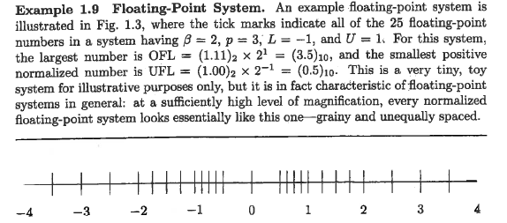
What is ε_{mach} in this system?
Note gap between 0 and β^{L} (UFL)
Filled be allowing d₀ to be zero when exponent has its smallest value
Called “sub-normals”
What are the sub-normals in this system?
How do sub-normal change the UFL?

Slide 7
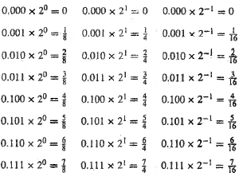
Express these base 2 numbers as fractions

Slide 8
Which of the base 2 number below are part a normalized system with β=2, p=3, L=-1, U=1?

Slide 9
Which of the base 2 number below are sub-normals in the system with β=2, p=3, L=-1, U=1?

Slide 10
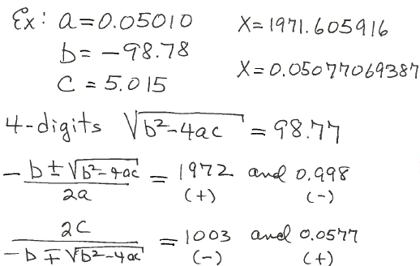
Example: loss of significance when
ax² + bx + c = 0 solved by quadratic formula

Slide 11
Problem from text p68 #4:
y = 1-sin(x)
For what values of x does this assignment involve loss of significance?
Find a way to make the assignment without loss of significance.
Solution:
When x ~ π/2, sin(x)~1, y~0 with low significance.
(1-sin(x)) 1+sin(x) = (1-sin²(x)) = cos²(x)
1+sin(x) 1+sin(x) 1+sin(x)
y= cos²(x)/(1+sin(x)) ~ 0 with high significance when x ~ π/2

Slide 12
Solution to Problem from text p69 #6:
f(x) = tan(x)-sin(x)
x-sqrt(1+x²)
For x>>1 denominator -> 0 with low significance
Solution: rationalize the denominator
f(x) = (tan(x)-sin(x)) x+sqrt(1+x²) = (sin(x)-tan(x))(x+sqrt(1+x²))
x-sqrt(1+x²) x+sqrt(1+x²)
when x~0, f(x) ~ (sin(x)-tan(x))(1+x) ~ 0 with low significance
Using power series expansion of sin(x) and tan(x),
f(x) ~ -(1+x)x³/2 ~ 0 with high significance when x~0

Slide 13
Assignment 11: show all algebra in derivations
(a) Derive a form of the function f(x) = sqrt(x²+1) - x that can be evaluated at x>>1 without loss of significance.
(b) Use power series to derive a form of f(x) = exp(x)-sin(x)-cos(x) that can be evaluated at x near zero without loss of significance.
(c) Find solutions of quadratic equation x² – 10⁵ x + 1 = 0 without loss of significance.

Slide 14
Review of Differential Equations
Euler
Extended Euler
ODE 45

Slide 15
Assignment 13
Use ode45 to solve x’ = 1 + x² + t³ for x(t=2) given x(t=1) = -4.
Use the same number of points as ode45 to solve for x(t) by
Euler and extended Euler methods.
In all 3 cases, calculate the absolute percent difference from the exact
value x(2) = 4.371221866 on p434 of text.
Encoder is inline function definition in main program

Slide 16
Assignment 14
Use ode45 to solve the system of equations
x’=x – y + 2t – t² – t³
y’=x + y – 4t² + t³
for 0 < t < 3, subject to the initial condition x(0)=1, y(0)=0
Solve with Eulersys and ex_Eulersys using the same number of points as ode45
Exact solutions are x(t)=exp(t)cos(t) + t² and y(t)=exp(t)sin(t) - t³
For each method:
Calculate the absolute percent difference from the exact values at t=3
Plot the exact and numerical solutions on the same set of axes.
Make sure your plots can distinguish exact from numerical results.
Encoder is a .m file in the folder with Eulersys and ex_Eulersys

Slide 17
For the system x’=-3y and y’=x/3 encoder could be
function f=xpsys(t,x)
f1=-3*x(2);
f2=x(1)/3;
f=[f1,f2];
For Euler and extended Euler
function f=xpsys45(t,x)
f1=-3*x(2);
f2=x(1)/3;
f=[f1;f2];
For ode45
With more equations in system, we have more components of x in the input and return vector f with more components.

