Slide 1
Quiz 2: 3/9/21
Numerical Integration
Text Chapters 5 & 6
Lectures L7-L11
Assignments 5-10

Slide 2
Application of function codes for
trapezoid rule with arbitrary spacing
composite trapezoid rule
composite Simpson’s rule
Gauss Quadrature
Laguerre Quadrature
Analysis
upper bound on absolute error in ctraprule
deriving numerical integration formulas

Slide 3
MatLab script to apply trapezoid rule with arbitrarily spaced points
to estimate with logarithmically spaced points
integrand=@(x) exp(-x);
exact=exp(-1)-exp(-5);
y=linspace(0,log(5),10);
newx=exp(y);
A2 = arbitrary_points(newx,integrand(newx));
PD2 = 100*abs((A2-exact)/exact);
disp([A2, exact, PD2)

Slide 4
MATLAB script to calculate the actual absolute error
in the composite trapezoid rule approximation to
with 10 equally spaced points.
integrand=@(x) sin(x);
exact=cos(2)-cos(5);
A=ctraprule(integrand,2,5,10);
error=abs(A-exact);
disp([A,exact,error])

Slide 5
Upper bound on the error in approximating
by the composite trapezoid rule with 10 points
|ε| < (b-a)³|f “(ξ)|_{max} /12n² n=npts-1
f(x) = sin(x), f ’(x) = cos(x), f ”(x) = -sin(x)
Plot |f “(x)| = |sin(x)| between 2 and 5 to find its maximum value

Slide 6
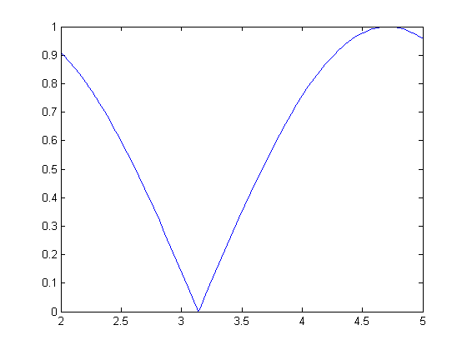
|f “(ξ)|_{max} = 1
myf=@(x) abs(sin(x));
fplot(myf,[2,5])
|sin(x)|
radians (by default)
|ε| < (b-a)³|f “(ξ)|_{max} /12n² n=npts-1

Slide 7
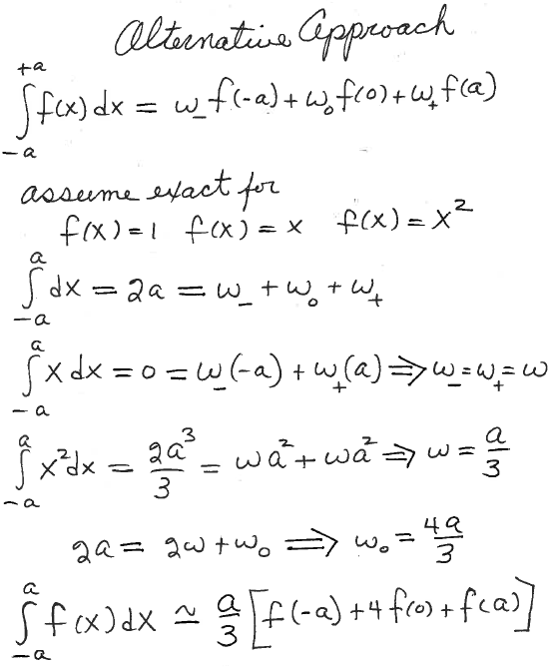
Derive Simpson’s rule with 1 pair of subintervals for range of integration [-a,a]
Find weights that give exact results for polynomials up to degree 2 by requiring it to be exact for

Slide 8
Download composite Simpson’s rule from the class web page. Write a script for the problem “Approximate the integral
by composite trapezoid and Simpson’s rules with 3 and 5 points. Report the absolute percent difference from the “exact” value of -18.79829683678703 in each case.
integrand=@(x) sin(10/x)*100/x;
exact= -18.79829683678703;
for npairs=1:2
ntps=2*npairs+1;
T=ctraprule(integrand,1,3,npts);
S=simprule(integrand,1,3,npairs);
pdT=100*abs((T-exact)/exact);
pdS=100*abs((S-exact)/exact);
disp([npts, T, pdT, S, pdS]);
end

Slide 9
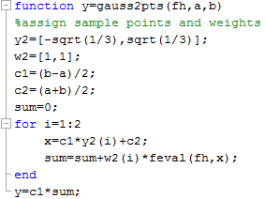
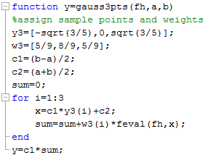
fh(x);
fh(x);

Slide 10
MatLab script to apply Gauss quadrature
to estimate with 2, 3, 4, and 5 points
integrand=@(x) exp(-x);
exact=exp(-1)-exp(-5);
A2=gauss2pts(integrand,1,5);
PD2 = 100*abs((A2-exact)/exact);
disp([A2, exact, PD2])
Similarly for 3 points

Slide 11
MatLab script to apply Laguerre quadrature
to estimate with 2, 3, 4, and 5 points
integrand=@(x) exp(-y/2);
exact=2;
[A2,A3,A4,A5]=lag2345_Garima(integrand);
PD2 = 100*abs((A2-exact)/exact);
disp([A2, exact, PD2])
Similarly for 3 points

