Slide 1
Deriving numerical integration methods

Slide 2
As was the case for the composite trapezoid rule, most numerical integration formulas have the form of a weighted average of values of the integrand.
One approach to deriving such formulas is to replace the integrand by a polynomial. Find the equation of the polynomial and integrate it.
For example, trapezoid rule with 2 points.
Do on board

Slide 3
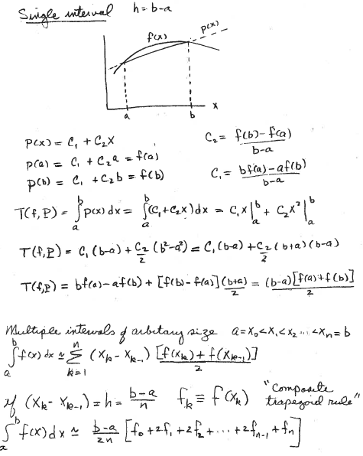
replace integrand with line (polynomial of degree = 1)
2
This example illustrates that any numerical integration formula that evaluates the integrand at n+1 point will be exact for a polynomial of degree n because we have enough information to find the polynomial and integrate it analytically.
However, this approach to deriving numerical integration approximations is hard to generalize to polynomials of degree higher than 1.

Slide 4
Derive the Simpson’s rule approximation for numerical integration
Approximate the integrand by a parabola (polynomial degree 2)
Divide the range of integration into pairs of subintervals of equal width.
Develop a system of equations for the weights in the average of integrand
values by requiring the formula
to be exact for f(x) equal to 1, x, and x².
Do on board

Slide 5
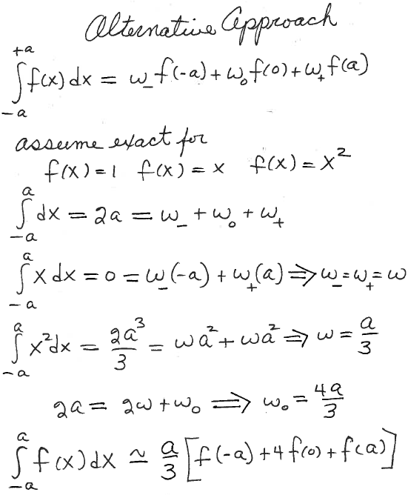
Derive Simpson’s rule with 1 pair of subintervals for range of integration [-a,a]
Find weights that give exact results for polynomials up to degree 2 by requiring it to be exact for

Slide 6
Assignment 7
-
Find values for weights α, β, and γ by requiring the formula
to be exact for f(x) = 1, f(x) = x, and f(x) = x².

Slide 7
Composite Simpson’s rule:
Generalized this result for 1 pair of subintervals on [-a, a] to n pairs of subintervals on [a, b], where we donote the width of subintervals as h.

Slide 8
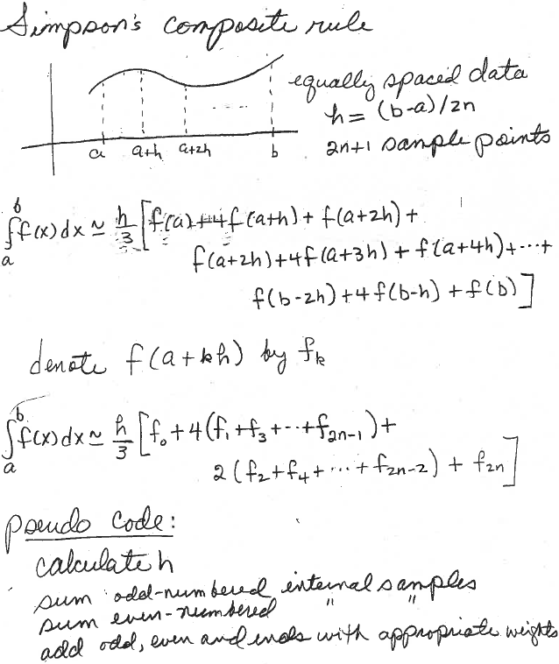
n pairs of subintervals

Slide 9
MATLAB code for composite Simpson’s rule:
Layout of points when npairs = 4, npts = 2(npairs)+1 = 9
h = (b-a)/2(npairs)
i=0 1 2 3 4 5 6 7 8
|-----|------|-------|-------|------|-------|------|-------| n=2npairs=8
a a+h b
Do on board

Slide 10
MatLab code for composite Simpson’s rule: 4 pairs of subintervals
i=0 1 2 3 4 5 6 7 8
|-----|------|-------|-------|------|-------|------|-------| npoints = 9
a a+h b
function A = simprule(fh,a,b,npairs)
n=2*npairs; %number of sub intervals
h=(b-a)/n;
sum_even=0;
for i=2:2:n-2
sum_even=sum_even+fh(a+i*h);
end
sum_odd=0;
for i=1:2:n-1
sum_odd=sum_odd+fh(a+i*h);
end
A=h*(fh(a)+4*sum_odd+2*sum_even+fh(b))/3;
end

Slide 11
Download composite Simpson’s rule from the class web page. Write a script for the problem “Approximate the integral
by composite trapezoid and Simpson’s rules with 3 and 5 points. Report the absolute percent difference from the “exact” value of -18.79829683678703 in each case.
What is wrong with this script? How do you fix it?
integrand=@(x) sin(10/x)*100/x; Why no ./ ?
exact= -18.79829683678703;
for npts=3:2:5
T=ctraprule(integrand,1,3,npts)
S=simprule(integrand,1,3,npts)
pdT=100*abs((T-exact)/exact);
pdS=100*abs((S-exact)/exact);
disp([npts, T, pdT, S, pdS]);
end

Slide 12
Download composite Simpson’s rule from the class web page. Write a script for the problem “Approximate the integral
by composite trapezoid and Simpson’s rules with 3 and 5 points. Report the absolute percent difference from the “exact” value of -18.79829683678703 in each case.
integrand=@(x) sin(10/x)*100/x;
exact= -18.79829683678703;
for npairs=1:2
ntps=2*npairs+1;
T=ctraprule(integrand,1,3,npts)
S=simprule(integrand,1,3,npairs)
pdT=100*abs((T-exact)/exact);
pdS=100*abs((S-exact)/exact);
disp([npts, T, pdT, S, pdS]);
end

Slide 13
Assignment 8: Approximate the integral
by composite trapezoid and Simpson’s rules with 3, 5, 7,and 9 points. Report the absolute percent difference from the “exact” value of -18.79829683678703 in each case. Hand in a copy of command window that shows your script for using the composite trapezoid and Simpson’s rules and the results.

Slide 14
Let {x₀, x₁, …, x_{n}} be n+1 points on [a, b] where integrand evaluated, then the numerical integration formula
Will be exact for polynomials of degree at least n.
Derive weights by a system of n+1 linear equations obtained by requiring the formula to be exact for
f(x) = 1, x, x², …x^{n}
Trapezoid rule: (n = 1) exact for a line
In general, error proportional to |f’’(ζ)|
Simpson’s rule: (n = 2) exact for a cubic
In general, error proportional to |f⁽⁴⁾(ζ)|
How is this extra performance (cubic) possible?

