Slide 1
Composite trapezoid rule

Slide 2
Composite trapezoid rule
Trapezoid rule for n arbitrarily spaced points
Can be simplifies for equally spaced points due to the common width of trapezoid base, (b-a)/(npt-1). In the sum over trapezoid areas, the heights f(x₁)=f(a) and f(x_{npt})=f(b) occur once. All other values of the integrand occur twice.
ω₁ = ω_{npt} = ½
ω_{k} = 1 2<k<npt-1
Download MatLab code for composite trapezoid rule from
class webpage

Slide 3
MatLab code for composite trapezoid rule
function A=ctraprule(fh,a,b,npts)
h=(b-a)/(npts-1);
x=a;
sum=0;
for i=2:npts-1
x=x+h;
sum=sum+fh(x);
end %contribution from internal points
sum=sum+(fh(a)+fh(b))/2;
A=h*sum;
end
The function handle does not need to be designed for vector input.
This function should give the same results as arbitrary_spacing
when points are equally spaced in the range of integration.

Slide 4
Estimating absolute error in composite trapezoid rule
More points in the range of integration where the integrand is evaluated
makes the trapezoid rule more accurate. To find a relation between error
and number of points:
Use Taylor formula to derive an analytic expression for
and the trapezoid rule approximation h[f(a+h) + f(a)]/2 up to h³.
Difference will be an estimate of the error in the composite trapezoid rule for one interval of width h.
Generalize to n intervals of width h between a and b.

Slide 5
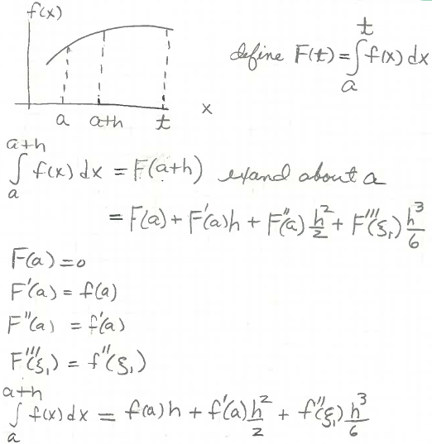
Estimate error in Trap Rule: single subinterval of size h
a<ξ₁<a+h
By fundamental theorem of calculus
exact result but we don’t know the value of ξ₁

Slide 6
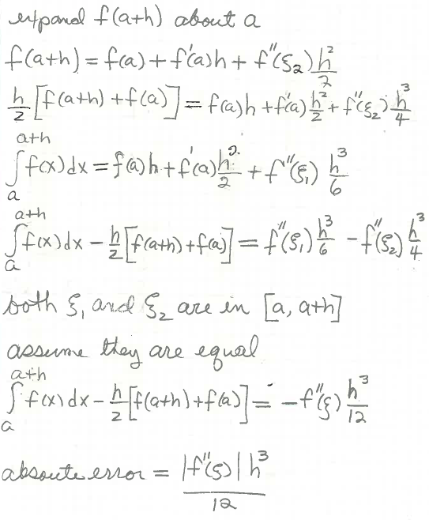
Estimate error in Trap Rule: single subinterval of size h
a<ξ₂<a+h
Trap rule approximation
Exact from previous slide
Difference between
exact and trap rule

Slide 7
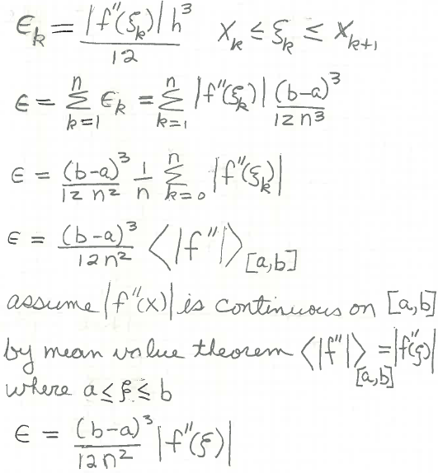
Estimate error in Trap Rule: n subinterval of size h
1
n is number of subinterval
For upper bound use largest value of f ”(x) for a<x<b

Slide 8
Example: upper bound on the error in approximating
by the composite trapezoid rule with 10 points
|ε| < (b-a)³|f “(ξ)|_{max} /12n² n=npts-1
f(x) = sin(x), f ’(x) = cos(x), f ”(x) = -sin(x)
Plot |f “(x)| = |sin(x)| between 2 and 5 to find its maximum value
myf=@(x) abs(sin(x)); fplot(myf,[2,5])

Slide 9
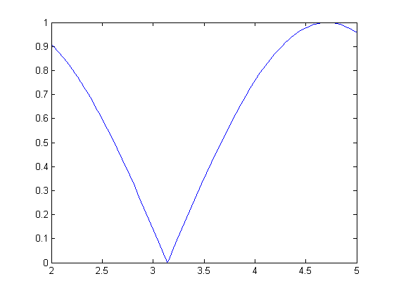
|f “(ξ)|_{max} = 1
myf=@(x) abs(sin(x));
fplot(myf,[2,5])
|sin(x)|
radians (by default)
Note: maximum does no occur at either end point of integration.
Note: max(|sin(x)|) is not equal to max(sin(x)) for 2<x<5

Slide 10
(b-a)=3, |f “(ξ)|_{max} = 1, n = 9
|ε| < (b-a)³|f “(ξ)|_{max}/12n² ~ 0.0278
What is the actual absolute error in approximating
by the composite trapezoid rule with 10 points
Get the exact value by anti derivative (do on board)
Calculate trapezoid-rule estimate
Actual absolute error = abs(traprule-exact)
Write a script to do this problem

Slide 12
MATLAB script to apply function ctraprule to calculate the actual absolute error
in the composite trapezoid rule approximation to
with 10 equally spaced points.
integrand=@(x) sin(x);
exact=cos(2)-cos(5);
A=ctraprule(integrand,2,5,10);
error=abs(A-exact);
disp([A,exact,error])
Run this script and compare to the upper bound on absolute error that we derived from calculus = 0.0278

Slide 13
Exact value = -0.6998
Trap-rule 10 pts = -0.6933
Actual absolute error = 0.0065 ~ 1% of exact value
Upper bound on absolute error = 0.0278 ~ 4% of exact value

Slide 14
Assignment 6
Approximate the integral
by the composite trapezoid rule with 10 points. Report your value.
Show a plot of the absolute value of the second derivative of the integrand in the range of integration.
Use the plot to get an upper bound on the absolute error in the composite trapezoid rule approximation.
Assume the exact value is 0.882081. (no anti-derivative of integrand)
What is the actual absolute error in this trapezoid rule approximation?

