Slide 1
Numerical Integration (Chapters 5 & 6, C&K 6th edition)
Code development
trapezoid rule
Simpson’s rule
Gauss quadrature
Laguerre quadrature
Analysis
changing the variable of integration
upper bound on error in trapezoid rule
uniform method to derive numerical integration

Slide 2
Derive the trapezoid rule

Slide 3
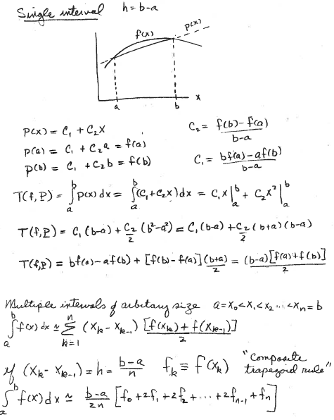
Replace integrand f(x) on [a,b] by line p(x)
Area of a trapezoid
Multiple intervals with f(x) on [x_{k-1},x_{k}] replaced by a line
Usually, x₁ = a and x_{n} = b

Slide 4
MatLab code for trapezoid rule with integrand evaluated at n
arbitrary points in the range of integration:
Basic idea:
Input 2 arrays of length n:
x = values where the integrand is evaluated.
f = values of the integrand at those points
In a for-loop, accumulate the area of n-1 trapezoids
Output sum as trapezoid rule approximation to integral

Slide 5
MatLab code for trapezoid rule integration with integrand evaluated at n
arbitrary points in the range of integration
function A=arbitrary_spacing(x,f)
n=length(x);
sum=0;
for k=2:n
sum=sum+(x(k)-x(k-1))*(f(k)+f(k-1))/2;
end
A=sum;
end
Download arbitrary_spacing.m from class web page

Slide 6
We will approximate
by the trapezoid rule in several forms and compare their accuracy as percent
difference from the exact value.
How do we find the exact value of an integral?
What is the anti-derivative of e^{-x} ?

Slide 7
Write a script to apply trapezoid rule function to
estimate with 10 equally spaced points and compare to exact value as absolute percent difference.
Pseudocode:
Function handle for integrand
Exact value from anti-derivative = e⁻¹ – e⁻⁵
Vector of x values where integrand will be evaluated
Call to arbitrary_spacing.m with arguments x and integrand(x)
Calculate ercent absolute difference
Display exact, trap approximation, and percent difference

Slide 8
MatLab script to apply trapezoid rule function
to estimate with 10 equally spaced points.
integrand=@(x) exp(-x);
exact=exp(-1)-exp(-5);
x=linspace(1,5,10);
A1=arbitrary_spacing(x,integrand(x));
PD1=100*abs((A1-exact)/exact);
disp([A1,exact, PD1])
Run this script

Slide 9
Accuracy of numerical integration depends on where the integrand is evaluated. Since e^{-x} is rapidly decreasing, expect some advantage of more points near 1 and less near 5.
Write a script to estimate
with 10 logarithmically spaced points between 1 and 5.
To get “logarithmic” spacing, define y vector with 10 equally spacing points between 0 and ln(5). Get new x vector newx=exp(y).
Modify previous script to get the absolute percent difference from exact.

Slide 10
MATLAB script to apply trapezoid rule function
to estimate with logarithmically spaced points
integrand=@(x) exp(-x);
exact=exp(-1)-exp(-5);
y=linspace(0,log(5),10);
newx=exp(y);
A2 = arbitrary_spacing(newx,integrand(newx));
PD2 = 100*abs((A2-exact)/exact);
disp([A2, exact, PD2)
Run this script

Slide 11
What is the difference between the two choices of where the integrand is evaluated?
Plot the 2 choices

Slide 12
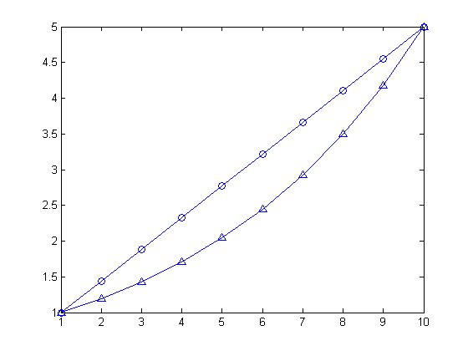
equal spacing
x-value
log spacing
index

Slide 13
Change variable of integration to y=ln(x)

Slide 14
Use the transformation y = ln(x) to change the variable of integration. dy = dx/x dx=x(y)dy
x(y)= exp(y)
Integrand is a function of y through x(y)

Slide 15
Write a script to approximate
x(y)= exp(y)
using the integration variable y with 10 equally spaced points between 0 and ln(5), estimate integral without make the integrand an explicit function of y.
Pseudocode
function_handle for e^{-x}
exact value
vector of y_values
vector xofy = e^{y}
arbitrary_spacing(y_values, function_handle(xofy).*xofy
absolute percent difference from exact
display

Slide 16
MATLAB script to apply trapezoid rule to approximate
with a new integration variable y=ln(x).
integrand=@(x) exp(-x);
exact=exp(-1)-exp(-5);
y=linspace(0,log(5),10);
xofy=exp(y);
A3 = arbitrary_spacing(y, xofy.*integrand(xofy));
PD3=100*abs((A3-exact)/exact);
disp([A3,exact,PD3])
Run this script

Slide 17
Summary of results to estimate
by the trapezoid rule with 10 points when the points are chosen in the following ways:
1. Equally spaced on [1, 5]
2. Logarithmically spaced [1, 5]
3. Equally spaced on [0, ln(5)] in the new integration variable y = ln(x).
Results for percent difference: (1) 1.6407, (2) 1.1756, (3) 0.0995

Slide 18
What we learned from this exercise
For a given numerical integration method and a specified number of points, additional factors affect the accuracy of approximation. Two important factors are:
1. Where the integrand is evaluated.
2. Which integration variable is used.

Slide 19
Assignment 5
Assume -18.79829683678703 is the “exact” value of the integral.
Estimate this integral by the trapezoid rule with 10 points when the points are chosen in the following ways:
1. Equally spaced on [1, 3]
2. Logarithmically spaced [1, 3]
3. Equally spaced on [0, ln(3)] in the new integration variable y = ln(x).
Calculate the absolute percent difference,100*abs((A-exact)/exact), from the exact value in each case. Hand in a copy of command window that shows your scripts and results.

