Slide 1
Secant method

Slide 2
Bisection method does not require the derivative of a function to find its zeros.
However, convergence is slow.
Secant method does not require an analytical derivative and converges almost
as fast as Newton’s method.
Secant method uses numerical approximation df/dx ~ (f_{n}-f_{n-1})/(x_{n}-x_{n-1}) and requires 2 starting values

Slide 3
Develop a pseudocode for secant Method
Basic idea behind the calculation;
Given 2 initial guesses and equation for f(x)
calculate sequence x₁, x₂, … x_{k}, x_{k+1},…
using Newton’s update formula with
f ’(x) ~ Δf/Δx = (f(x_{k})-f(x_{k-1}))/(x_{k} –x_{k-1})
stop when change x_{k}-> x_{k+1} is small
assign root to x_{k+1}
calculate f(x_{k+1}) to verify near zero

Slide 4
Basic pseudocode for secant method is almost the same as for Newton’s method
function [r,fr]=secant(fh,xnm1,xn)
Initialize: steps, maxsteps, re and myrel
x = xn
while (myrel>re) && (steps<maxsteps)
increment steps
save current estimate of root
calculate next estimate of root
myrel = absolute value of fractional change
end while loop
r = best estimate of root
fr = fh(r)
end function

Slide 5
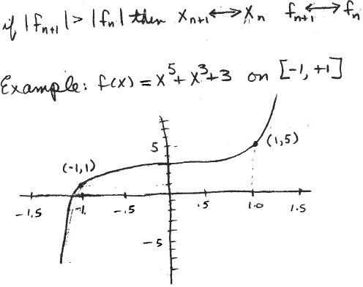
Convergence may not be uniform
In each cycle, x_{n} should be the best estimate of root thus far
If starting values are 1 and -1,
what do we expect to happen?

Slide 6
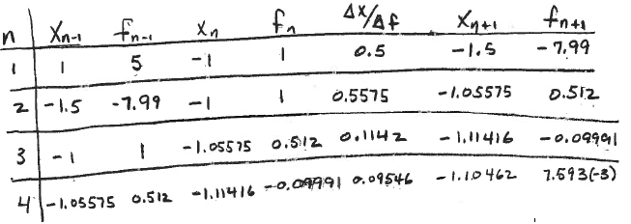
Initial x_{n+1} is not as good as x_{n}, (how do we know this?)
Use best estimate of root as x_{n} (what value is this?)
Use bad first estimate as x_{n-1}
Did the second attempt improve estimate of root?
How do we avoid this type of convergence?

Slide 7
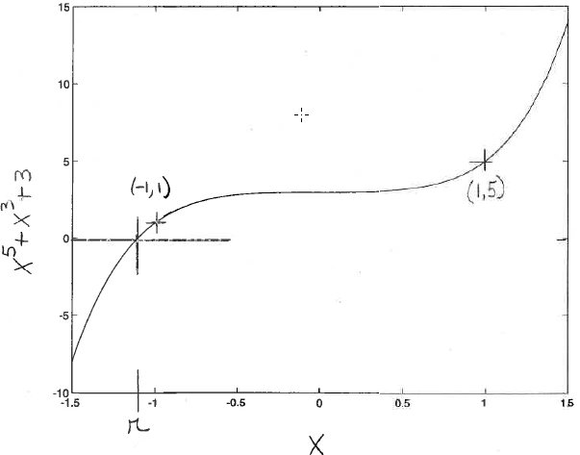
Graphical solution

Slide 8
Extended pseudocode for secant method
function [r,fr]=secant(fh,xnm1,xn)
Test if |fn|<|fnm1|; otherwise interchange xn and xnm1
Initialize steps, re and myre (as in Newton)
x<-xn
while (myre>re) && (steps<maxsteps)
increment steps
approximate derivative and calculate xnp1
test if |fnp1|<|fn|; otherwise interchange xnp1 and xnm1
calculate myre = |(xn-xnm1)/xn|
end while loop
r = best estimate of root
fr = fh(r)
end function

Slide 9
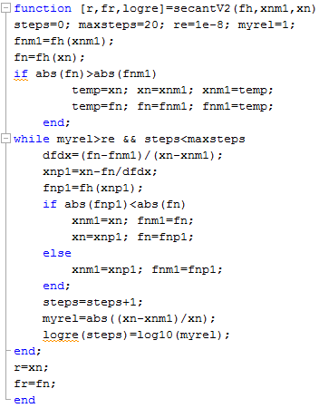
This version of secant
code is on the class
webpage.

Slide 10
Graphical solution
Write a script to compare the rate of convergence of secant method with different starting values; 1 and -1 compared to -1 and -1.1
Do they converge to the same value?
Which converges faster?

Slide 11
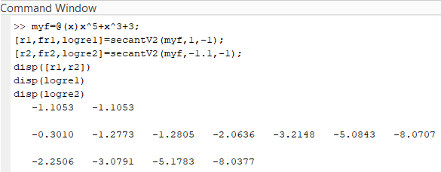
Compare rate of convergence with different initial guesses

Slide 12
Assignment 4
Find the value of x that is > 0 and at the intersections of x³ and 2sin(x) graphically. Hand in a copy of your graph with the estimate of x marked. Refine the graphical estimate by the secant method. Hand in a copy of command window that shows your script for using the secant method and the result.

Slide 13
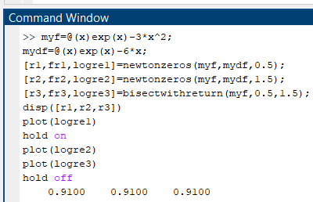
Expand this script to include secant with starting values 0.5 and 1.5
How does secant’s rate of convergence compare with newton and bisection?

Slide 14
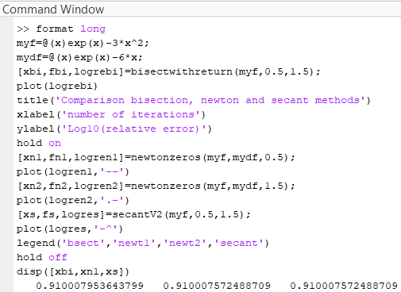
Script to make a fancy plot

Slide 15
