Slide 1
Bisection method
Does not require a derivative of f(x)
Cannot have the convergence problems if conditions on starting values are met
Disadvantage: slow convergence

Slide 2
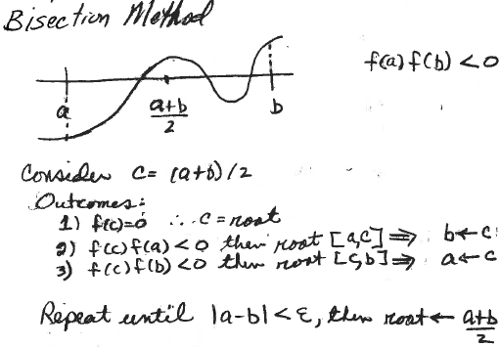
Bisection method for continuous functions
If f(x) is continuous, this implies at least one zero between a and b
c=(a+b)/2
Exactly one of the following will be true
If f(c)=0 then c is a root.
If f(c)f(a)<0 then a root is in [a,c].
If f(c)f(b)<0 then a root is in [c,b].
Which is true here?
Bisection method requires starting values a and b with f(a)f(b)<0
What is wrong with the choice of a and b here?

Slide 3
Starting values for bisection method
Let c = (a+b)/2
f(a)f(b)<0 as required but
Only one root should be between starting values.
Use graphical solution to choose good starting values.

Slide 4
Basic idea of bisection method
In each cycle of iteration, a and b are end points and c = (a+b)/2 is the next estimate of the zero.
If f(c) = 0 stop. c is the zero between a and b
Decrease the interval around the zero by half by making c one of the ends of the new interval.
If f(a)f(c) < 0, a is the other end: b <- c;
otherwise, b is the other end: a <- c
Converged?
no: recycle
yes: stop
Put this idea into a pseudocode

Slide 5
Basic pseudocode for bisection method
function [r,fr]=bisection(fh,xa,xb)
Initialize steps, maxsteps, re and myrel (as in Newton)
xc=(xa+xb)/2;
while (myrel>re) && (steps<maxsteps)
increment steps
save current estimate of root (oldxc)
reassign either xa or xb to xc
calculate a new xc=(xa+xb)/2
myrel = absolute value of fractional change in xc
end while loop
r = best estimate of root
fr = fh(r)
end function
What is missing from this basic bisection code?
What is the requirement on xa and xb?
This pseudocode assumes it is met.

Slide 6
Basic pseudocode for bisection method
function [r,fr]=bisection(fh,xa,xb)
Initialize steps, maxsteps, re and myrel (as in Newton)
xc=(xa+xb)/2;
while (myrel>re) && (steps<maxsteps)
increment steps
save current estimate of root (oldxc)
reassign either xa or xb to xc
calculate a new xc=(xa+xb)/2
myrel = absolute value of fractional change in xc
end while loop
r = best estimate of root
fr = fh(r)
end function
To add a check for a sign change of function between initial xa and xb, and allow for f(xc)=0, we need a way to leave the function prematurely. RETURN provides this option

Slide 7
Extended pseudocode for bisection method
function [r,fr]=bisection(fh,xa,xb)
If f(xa)f(xb)>0, write message and return
Initialize steps, maxsteps, remin, and re
xc=(xa+xb)/2; if f(xc)=0 return
while (re>remin) && (steps<maxsteps)
increment steps
save current estimate of root (oldxc)
reassign either xa or xb to xc,
calculate a new xc (why don’t we need to check for f(xc)=0 here?)
re = absolute value of fractional change in xc
end while loop
r = best estimate of root
fr = fh(r)
end function
Very unlikely that f(xc) is identically zero, unless starting values
have are chosen to make that true

Slide 8
Implement logic of bisection method in MATLAB
Relational operators in MatLab
< less than
<= less than or equal
== equal
-= not equal
> greater than
>= greater than or equal

Slide 9
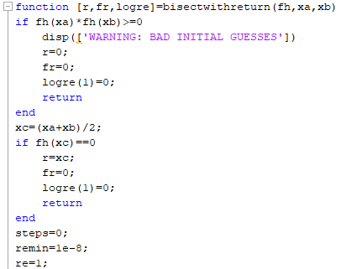
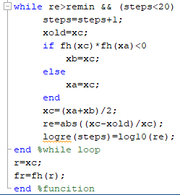
MATLAB code for bisection method on the class webpage

Slide 10
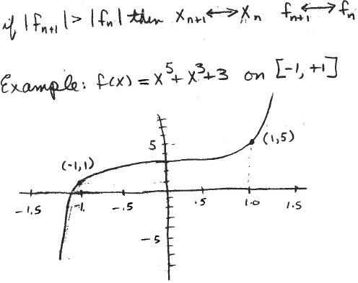
Test of bisectionwithreturn
f(x)=x⁵ + x³ +3 does not have a zero on [-1,1]
Write a script to call bisectwithreturn for this function with xa=-1 and xb=1
What do you need in your script?
Do you get warning message?

Slide 11
More testing of bisectwithreturn
f(x)=x⁵ + x³ +3 has a zero between -1.5 and -1
What value does bisectwithreturn find for this zero?

Slide 12
Test of bisectwithreturn
f(x)=x⁵ + x³ +3 has a zero between -1.5 and -1
Did bisectwithreturn return a value of -1.1053?

Slide 13
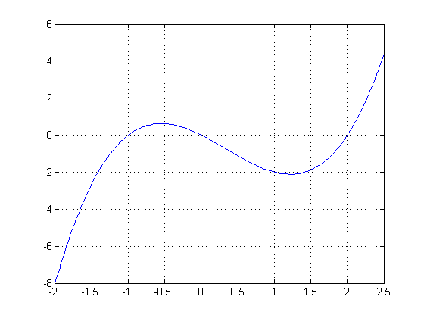
More testing of bisectwithreturn
We know from factoring that f(x) = x³-x²-2x has a zero at x=2. Write a script to call bisectwithreturn with this function and initial values 1.5 and 2.5. What happens?

Slide 14
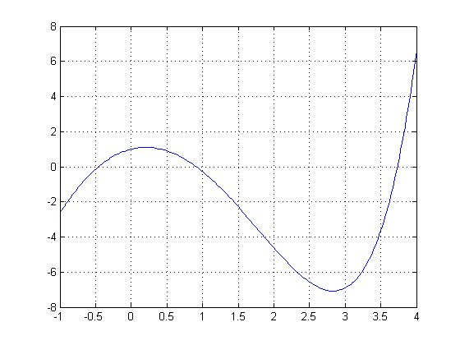
Write a script to find all the zeros of f(x) = e^{x} - 3x² by the bisection method.
From graphical we found that -0.5, 1, and 3.75 are good approximations.
For bisection method we need 2 values near each zero with a sign change in the function between them.

Slide 15
Possible starting values
r xa xb
-0.5 -1 0
1.0 0.5 1.5
3.75 3.5 4

Slide 16
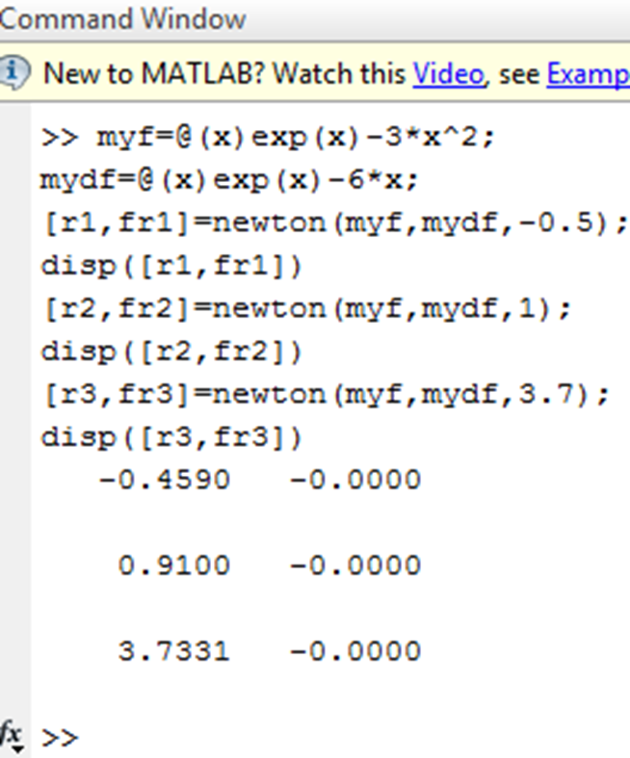
Write a script to find all the zeros of f(x) = e^{x} - 3x² by the bisection method.
Your script for Newton’s method is a good starting point. Since you don’t need logre for this problem you can replace it with ~ in the call to bisectwithreturn, as in
[r, fr, ~] = bisectwithreturn(myf,-1,0).

Slide 17
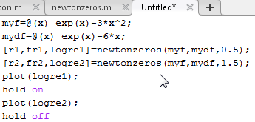
Expand your script that compares rates of convergence of Newton’s method to include convergence of the bisection method to the zero of f(x) = e^{x} - 3x² near 1, when the starting values are 0.5 and 1.5. Display all 3 estimates of the root.
Put all 3 convergence curves on the same axes

Slide 18
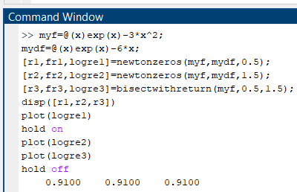
Script to compare convergence of Newton and bisection methods method.

Slide 19
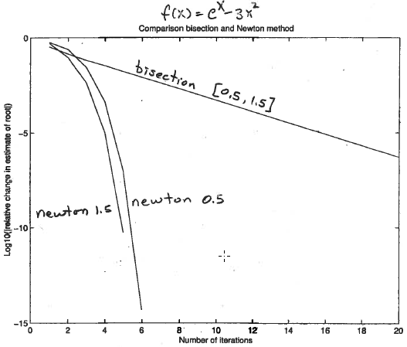
Bisection method converges slower than Newton
How does the initial guess affect convergence of the bisection method?

Slide 20
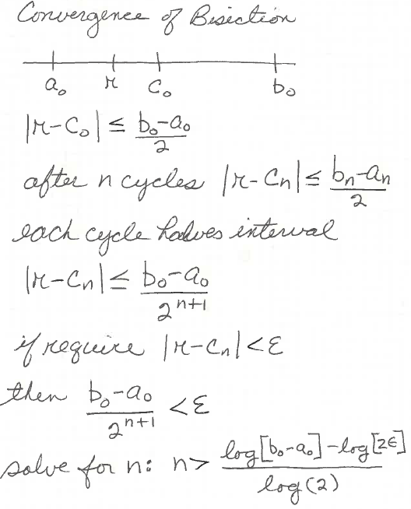
log(|r-c_{n}|) < log(b₀-a₀)-(n+1)log(2)
Initial guess affects the y-intercept of log(|r-c_{n}|) but slope is always log(2)

Slide 21
Assignment 3
Estimate the real zero of x³+3x-1 graphically. Hand in a copy of your graph with estimate marked. Refine the graphical solution by the bisection method. Hand in a copy of command window that shows your script for using bisection method and results.

