Slide 1
Newton’s Method

Slide 2
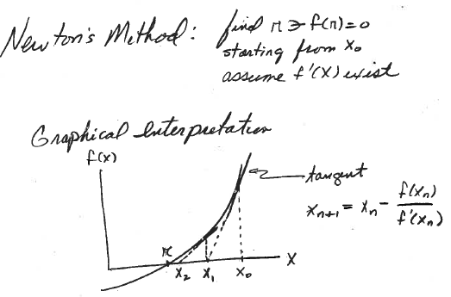
How do we get this result?
Use Taylor series expansion

Slide 3
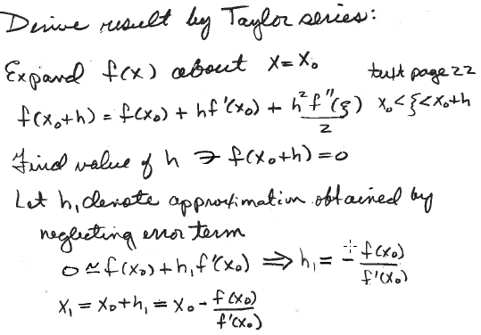
Generalize to x_{k} and x_{k+1}

Slide 4
Develop a MatLab code for Newton’s method
What is the basic idea?
Put basic idea into a pseudocode
Translate pseudocode into MATLAB syntax

Slide 5
Basic idea behind a MATLAB function for Newton’s Method
function [r,fr]=newton(fh,dfh,x0)
Inputs are function handles for f(x) and f ’(x) and initial guess of root
How do we get an initial guess?
Function handles are defined in the script that calls newton for a particular problem
Inside the function
calculate sequence x₁, x₂, … x_{k}, x_{k+1},…
stop when change x_{k}-> x_{k+1} is small
assign root to x_{k+1}
calculate f(x_{k+1}) to verify it is near zero

Slide 6
pseudocode for Newton’s method: function [r,fr]=newton(fh,dfh,x0)
steps = 0
x₁ = x₀
re = convergence requirement on fractional change on an iteration
myrel = value of fractional change on the current iteration
while (myrel>re) and (steps<maxsteps)
increment steps
save current estimate of root
calculate next estimate of root
myrel = absolute value of fractional change
end while loop
r = best estimate of root
fr = fh(r)
Put pseudocode into MATLAB syntex

Slide 7
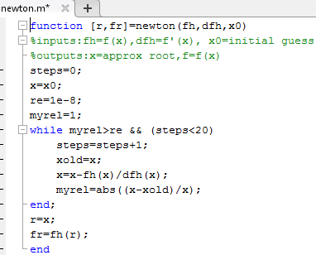
MATLAB code for Newton’s method on class webpage

Slide 8
Write scripts to use graphical and newton to find all the values
of x where the graphs of e^{x} and 3x² intersect.
How do you formulate this problem in terms of zeros of a function?
How do you translate this formulation into a function handle that can be used in graphical?

Slide 9
Exponentials dominate polynomials; hence no intersections at very
large values of x.
Both e^{x} and 3x² are non-negative; hence intersections at negative values of x are possible.
Start with a range of x values and refine it until you have good estimates for all possible points of intersection
Write your script in the editor. Copy and paste into command window

Slide 10
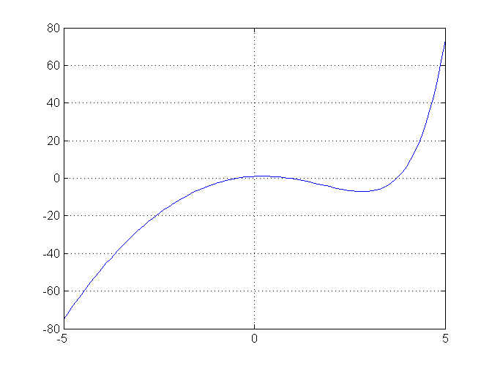
myf=@(x) exp(x)-3*x.^2
graphical(myf,-5,5)
3 zeros but 2 near zero are not well resolved.
Change range -1 to 4 and run it

Slide 11
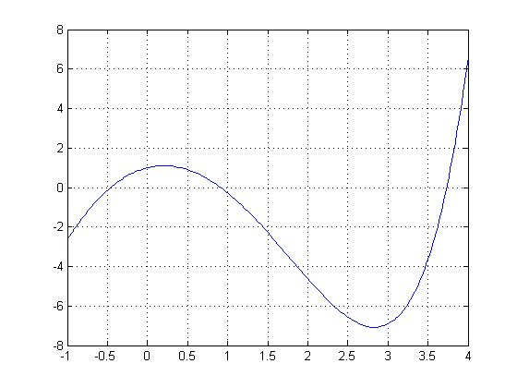
Solution after refining range of x axis:
approximate points of intersection of e^{x} and 3x² are -0.5, 1, and 3.75

Slide 12
Work in class
Write a script to refine graphical estimates (-0.5, 1, and 3.75) by Newton’s method.
In addition to function handle for f(x), you will need a function handle for f’(x). What is the derivative of f(x) = e^{x} - 3x² ?
The function handle for graphical allowed vector input. Is this needed for newton?

Slide 13
At a minimum, your script need the following:
function handle for f and df/dx
call to newton that returns values for r and f(r)
display of r and f(r)
If your script works for one zero, it can be easily modified for other zeros.
Modification can be done in the command window using the up arrow or you can write a script in the editor that returns all 3 refined zeros
Write the script, run it, and let me know when you have results. Let me know if you have problems.

Slide 14
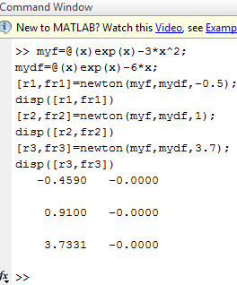
Script to refine multiple intersections of e^{x} and 3x² by Newton’s method copied to and run in the command window
When you know the script runs
successfully, you might want to save it.
The script in the editor is called “Untitled”.
If you want to keep it, use “save as” and
rename.

Slide 15
Assignment 1
Estimate all the zeros of x³-x²-2x+1 graphically.
Hand in copies of your graph with estimates marked
Use Newton’s method to improve estimates of zeros.
Hand in a copy of command window that shows your script for using Newton’s method and results.

Slide 16
Rate of convergence of Newton’s method
Use Taylor series to relate error in iteration n to error in iteration n+1

Slide 17
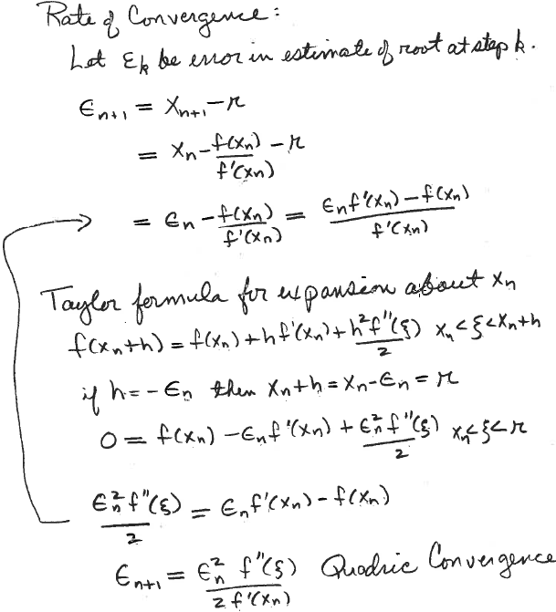
Derive expected convergence rate of Newton’s method

Slide 18
The convergence of Newton’s method is usually quadratic.
Error in the n+1 estimate is proportional to the square of error in n^{th} estimate.
Proportionality constant, f “(ζ)/(2f ‘(x_{n}), depends on the initial guesses, which makes rate of convergence slightly dependent on the initial guess. Your next HW assignment will explore these differences.
How do I change the newton function to get convergence data?

Slide 19
Modify Newton to get convergence data
Absolute value of relative change in the estimate for the root, myrel, is our measure of convergence.
With an initial value of 1 and rapid decrease to convergence requirement, 1x10⁻⁸, a linear plot will not show much.
We could return values of myrel and make a semi-log plot.
An alternative is return log10(myrel) and use plot.
In either case, we must return an array whose length is unknown.
MATLAB’s dynamic array storage makes this easy.

Slide 20
Extended pseudocode for Newton’s method
function [r,fr,logre]=newton(fh,dfh,x0)
Initialization
steps = 0
x = x₀
re = convergence requirement on fractional change
myrel = current value of fractional change
while (myrel>re) and (steps<maxsteps)
increment steps
save current estimate of root
calculate next estimate of root
myrel = absolute value of fractional change
logre(steps) = log base10(myrel)
end while loop
r = best estimate of root
fr = fh(r)
end function

Slide 21
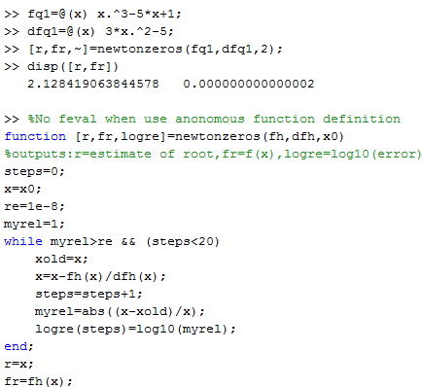
New version of Newton’s method on class website to get
convergence data to compare rates of convergence for
different initial guesses
Note alternative to “inline”
Note suppressed output of logre

Slide 22
Write script to get convergence data for same root with different initial guesses
How do we ensure convergence to the same root?
Put convergence data for both guesses on the same set of axes
How do we put 2 graphs on the same axes?

Slide 23
Graphs of e^{x} and 3x² have an intersection of near x=1
For initial guesses 0.5 and 1.5, Newton’s method should converge to the zero near 1, since max and min separate these initial guesses from other zeros.

Slide 24
Pseudocode for script to compare the convergence Newton’s method for different initial guesses
define function handles for f(x) and f ’(x)
Call newtonzeros with initial guess1= 0.5
Save r1 and convergence data as logre1
Call newtonzeros with initial guess2 = 1.5
Save r2 and convergence data as logre2
Display r1 and r2 to ensure convergence to same zero
Call plot(logre1) Note: just one argument
hold on
Call plot(logre2)
hold off
When plot is called with 1 vector input, the array index is treated as the x coordinate.

Slide 25
Write a script for this pseudocode and run it. Adapt a script you have, if possible.
define function handles for f(x) and f ’(x)
Call newtonzeros with initial guess1= 0.5
Save r1 and convergence data as logre1
Call newtonzeros with initial guess2 = 1.5
Save r2 and convergence data as logre2
Display r1 and r2 to ensure convergence to same zero
Call plot(logre1) Note: just one argument
hold on
Call plot(logre2)
hold off

Slide 26
define function handles for f(x) and f ’(x)
Call newtonzeros with initial guess1= 0.5
Save r1 and convergence data as logre1
Call newtonzeros with initial guess2 = 1.5
Save r2 and convergence data as logre2
Display r1 and r2 to ensure convergence to same zero
Call plot(logre1) Note: just one argument
hold on
Call plot(logre2)
hold off

Slide 27
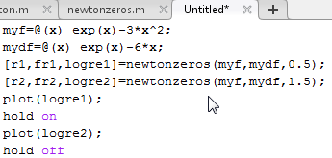
Script to compare convergence of Newton’s method
What did I forget to do in this script?

Slide 28
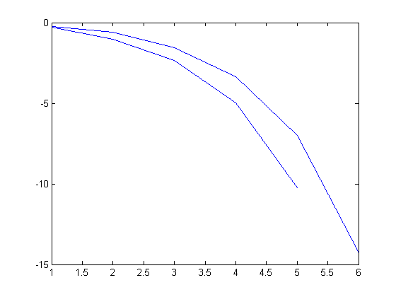
Convergence of Newton’s method with different initial guesses
Note: only axes and curves returned from MatLab
X₀=0.5
X₀=1.5
Y axis is log10(re)
-5 corresponds to
myrel = 10⁻⁵
Convergence to root of e^{x} – 3x²
in [0.5,1.5] with different x₀
How do I know which label goes on what curve?
X axis is number of iterations

Slide 29
The graphs of f(x) = e^{x} - 3x² near x=1, gives us a hint of which initial guess, 0.5 or 1.5, will converge fastest.
Confirm this by values of logre1 and logre2 displayed in the workspace.
Also check to see if r1 = r2.

Slide 30
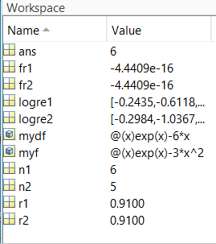
For script we see that logre1 is output from call to newtonzeros with x₀=0.5
Call with x₀=1.5 creates shorter array, logre2. Elements of logre2 are more negative.
If the data provided in the workspace is insufficient, display logre1 and logre2 in the command window.

Slide 31
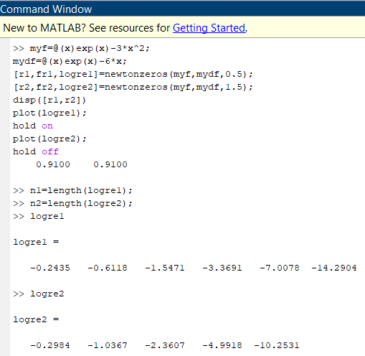
All the information we need to see that convergence is faster with initial guess 1.5

Slide 32
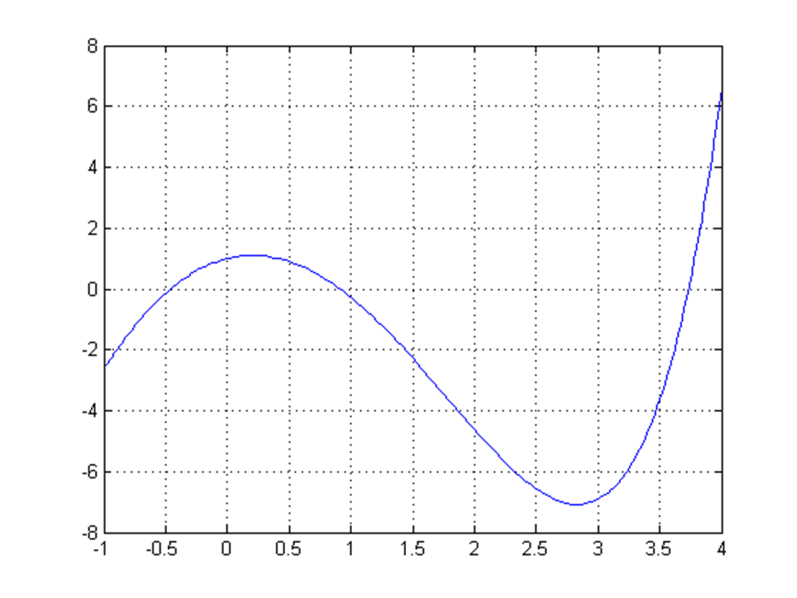
Assignment 2:
Download newtonzeros.m from class webpage.
f(x) = e^{x} - 3x² has a zero in the interval [-1, 0] (see below).
Use plot to compare the rates of convergence to the root with initial guesses 0 and -1. Verify that both initial guesses converge to the same zero. Hand in a copy of command window where Newton’s method was called Hand in your plot with labels (by hand is OK) on axes and curves to show which curve goes with which initial guess.

Slide 34
You don’t need a numerical method to find roots of the cubic y = x³ - x² - 2x.
Find roots by factoring. y = x(x² - x - 2) = x(x+1)(x - 2).
Factoring shows roots are -1, 0, and 2
What happens when you use Newton’s method to find these root?

Slide 35
This code uses relative change in root as the convergence criterion.
What happens when the root you are seeking is zero?
Note alternative to “inline”
Note suppressed output of logre

Slide 36
Note alternative to “inline”
What happens when the root and the initial guess are zero?
Note suppressed output of logre

Slide 37
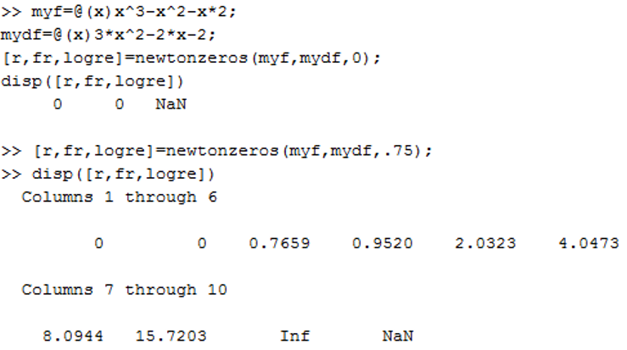
y = x³-x²-2x roots -1, 0, 2
Root and initial guess are both zero. Run this script and see what happens.
Root at zero: Initial guess = 0.75
Converges but myrel is increasing as iteration approaches divide by zero

Slide 38
y = x³-x²-2x roots -1, 0, 2
Root at zero: Initial guess = 0
Encounters divide by zero on the first iteration
Root at zero: Initial guess = 0.75
Converges but myrel is increasing as iteration approaches divide by zero

Slide 39
Note alternative to “inline”
What happens when the root is zero and initial guess is not?
Note suppressed output of logre

Slide 40
y = x³-x²-2x roots -1, 0, 2
Root at zero: Initial guess = 0.75
Check the workspace to see if function handle for f(x) and f’(x) are available. Run this script and see what happens
Root at zero: Initial guess = 0
Encounters divide by zero on the first iteration

Slide 41
y = x³-x²-2x roots -1, 0, 2
Root at zero: Initial guess = 0.75 y = x³-x²-2x roots -1, 0, 2
Converges but myrel is increasing as iteration approaches divide by zero
Root at zero: Initial guess = 0
Encounters divide by zero on the first iteration

Slide 43
Usually, the convergence of Newton’s method is quadratic. Error in the n+1 estimate of the root is proportional to the square of the error in the n^{th} estimate of the root.
Since x_{k+1} = x_{k} – f(x_{k})/f ’(x_{k}) involves f ’(x) in the denominator, convergence is not as fast when f ’(r)=0. Called a “multiple” root with multiplicity 2.

Slide 44
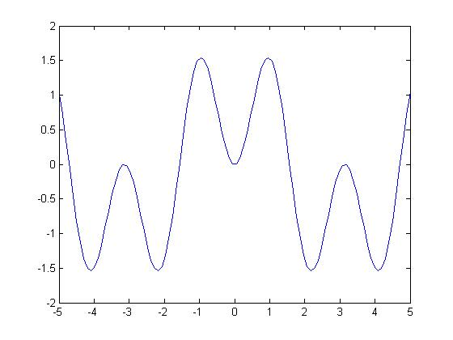
f(x) = cos(x) – cos(3x)
Ever other root is multiple, at least m=2.
X

Slide 45
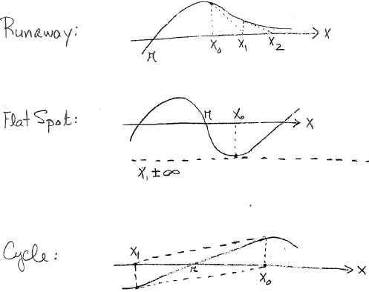
Convergence problems with Newton’s method
All can be avoided by a good initial guess

Slide 47
