Slide 1
Finding zeros (also called roots) of a function
Overview:
Define the problem
Methods of solution
Graphical
Newton’s
Bisection
Secant

Slide 2
Define the problem
For a function f(x) of a single independent variable, find all x₀
such that f(x₀)=0.
(Some methods can be generalized to functions of multiple
independent variables)
Other ways that the problem can be stated:
find all x where graphs of f₁(x) and f₂(x) intersect
In this case, find zeros of f(x) = f₁(x) - f₂(x)
find all extrema of f(x) on [a,b]
In this case, find zeros of df/dx

Slide 3
Graphical solutions
function [ ]=graphical(fh,xa,xb)
x=linspace(xa,xb,100);
plot(x,fh(x))
grid on
end
fh is a “function handle” defined before graphical is called
xa and xb are the range of x in the output graph
grid helps us locate the zeros
Note: this function only returns a graph
No numerical values are returned so no variables are needed between [ ]

Slide 4
Graphical solutions
function [ ]=graphical(fh,xa,xb)
x=linspace(xa,xb,100);
plot(x,fh(x))
grid on
end
graphical calls linspace to generate a vector of equally spaced x-values between xa and xb that includes the end points.
The semicolon after the call to linspace suppresses the display of x-values

Slide 5
Graphical solutions
function [ ]=graphical(fh,xa,xb)
x=linspace(xa,xb,100);
plot(x,fh(x))
grid on
end
graphical calls plot to generate the graph. In this case plot is using 2 vectors, x and fh(x).
When a vector is passed to a function, a vector is returned. Vector fh(x) contains the values of the function at the equally-spaced x-values.

Slide 6
Graphical solutions
function [ ]=graphical(fh,xa,xb)
x=linspace(xa,xb,100);
plot(x,fh(x))
grid on
end
This function is on the class webpage, but you could create this function using the function macro under “New” then save the .m file using the name “graphical”. We will use this function in class.

Slide 7
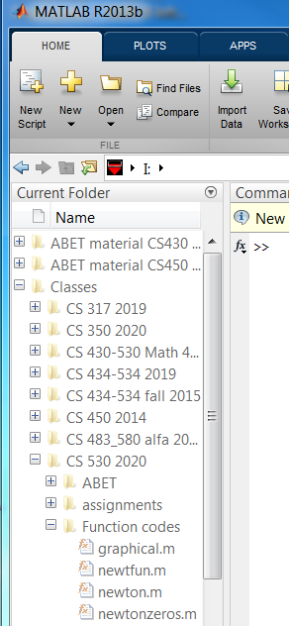
Setting the MATLAB path
I have MATLAB function codes on a thumb drive along with other lecture materials.
In this example the root-finding functions are in a folder called “function codes”
If I click on that folder name, MATLAB sets a path to these functions.

Slide 8
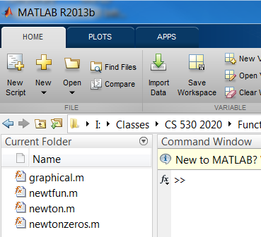
After MATLAB sets the path, the “Current Folder” window looks like this.
Now the listed functions are available to use in scripts.

Slide 9
Functions with vector arguments
In functions with vector argument, like myf=@(x) exp(x)-3*x.^2, multiply, divide and exponentiation can have several meanings.
We will always mean ‘component-by-component’, which we specify by .*, ./, and .^, respectively.
z=x.*y is a vector with components that are the product of the corresponding components of vectors x and y.
.+ and .- are not defined because addition and subtraction of vectors is always ‘component-by-component’.

Slide 10
Example of graphical solutions
Find all the zeros of the cubic 3x³ + x² – 15x +10 = 0 How many zeros do we expect?
Open the editor with “New Script” or “script” under “New” and write the script
myf=@(x) 3*x.^3+x.^2-15*x+10;
graphical(myf,-10,10)
Copy the script into the command window and run it.
What is the problem with this script?

Slide 11
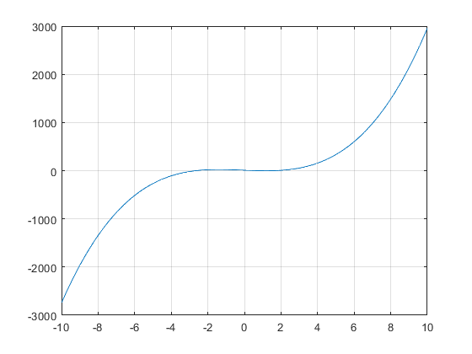
Example of graphical solutions
Result is correct but not useful because the range of x-values is too large.
No zeros exist for x < -4 and x > 4, so change the range to -4 to 4.
This can be done in the command window by using the up-arrow and changing the values in the line >>graphical(myf,-10,10). Is there still a problem?
myf=@(x) 3*x.^3+x.^2-15*x+10;

Slide 12
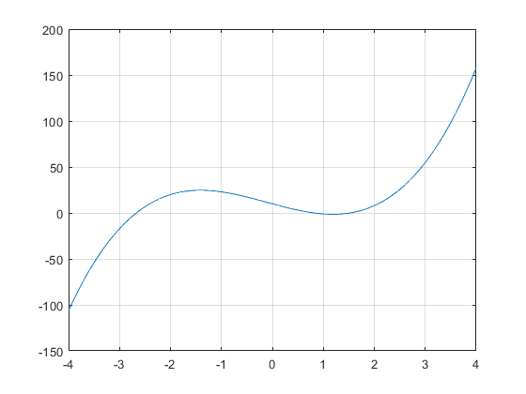
Example of graphical solutions
myf=@(x) 3*x.^3+x.^2-15*x+10;
A zero between -3 and -2 is resolved. Others may be between 0 and 2.
Refine the range of x-values until you can tell if there are 1 or 3 real zeros.

Slide 13
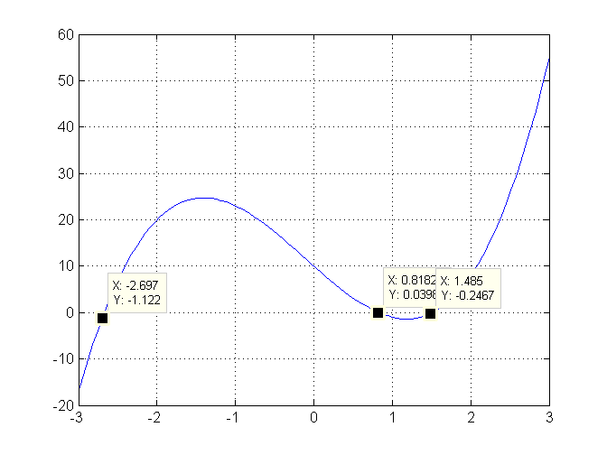
Example of graphical solutions
Now it is clear that this cubic has 3 real zeros. Use Data Cursor under the Tool menu of Plot to mark. Alt-click allows any number of Data Cursor points on plot. Using Data Cursor, good estimates of zeros are -2.7, 0.8, and 1.5

Slide 14
Another example of graphical solutions
Use graphical to estimate the zeros of f(x) = ln(x+1) + tan(2x) between 0 and 10
The MATLAB function name for ln is log. The function name for base 10 logarithm is log10
The script used for the previous problem
myf=@(x) 3*x.^3+x.^2-15*x+10;
graphical(myf,-10,10)
is easily modified in the editor of this problem. Clear the command window and workspace. Copy the modified script into the command window and run it. What is the problem with your result?

Slide 15
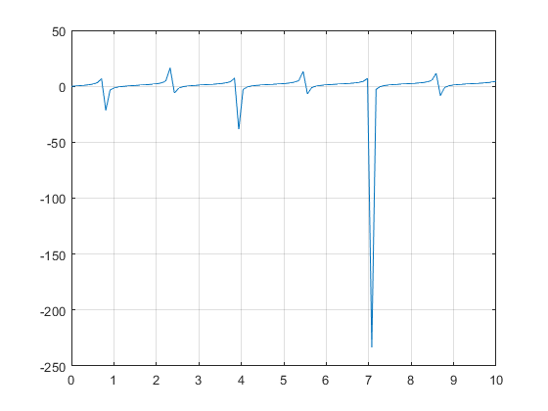
To make it more useful for estimating zeros, change range of y axis to (-20,20) using >>axis([xmin,xmax,ymin,ymax]) in the command window

Slide 16
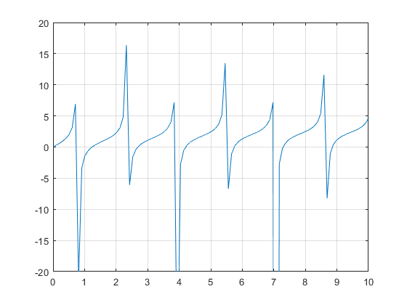
What is the approximate value of first positive zero?
f(x)
X

Slide 17
f(x) = ln(x+1) + tan(2x)
Each branch contains a zero.
Lines connecting branches are plotting artifact
f(x)
X

Slide 19
Summary of graphical method
function [ ]=graphical(fh,xa,xb)
x=linspace(xa,xb,100);
plot(x,fh(x))
grid on
End
Download from class webpage
Write script like
myf=@(x) 3*x.^3+x.^2-15*x+10;
graphical(myf,-10,10)
Adjust range of x-axis to permit accurate guess of all zeros of myf

