Slide 1
Eigenvalues and Eigenvectors: Text Chapter 8.3
Ax = λx, is the “eigenvalue” equation of square matrix A
defines a special set of vectors in span(A) such that
transformation by A only changes their magnitude
The set of eigenvalues λ of A is called the “spectrum” of A
The largest eigenvalue of A is called the “spectral radius” of A
x in Ax = λx is, technically, a “right” eigenvector
We will omit “right”
y in y^{T}A = λy^{T} is a “left” eigenvector, which we will not discuss.

Slide 2
Characteristic polynomial:
if Ax = λx, then (A - λI)x = o
(A - λI)x = o has a nonzero solution if and only if (A - λI) is singular
the eigenvalues of A are the values of λ such that det(A - λI)=0
p(λ) = det(A - λI) is the “characteristic polynomial” of matrix A
If A is nxn then p(λ) has degree n and the roots of p(λ) are the eigenvalues of A
By Fundamental Theorem of Algebra, p(λ) has exactly n roots
∴ nxn matrix has n eigenvalues but they may not be real or distinct

Slide 3
Example:
calculate eigenvalues of
det(A - λI) = det( ) = (3-λ)(3-λ) –1 = λ² – 6λ +8 = 0
by quadratic formula λ₁ = 4 and λ₂ = 2
Unless n is small, characteristic polynomial is not a useful intermediate for eigenvalue calculation.
Even if A is a real matrix, its eigenvalues and eigenvectors may be complex
Complex eigenvalues of a real matrix occur in conjugate pairs (a + i b)
Eigenvalues and eigenvectors of a real symmetric matrix (most common type in models of physical systems) are real

Slide 4
Numerical methods to find eigenvalues and eigenvectors

Slide 5
Effects of matrix modifications on its eigenvalues & eigenvectors:
Shift: subtraction of constant from each diagonal element
If Ax = λx then (A – σI)x = (λ-σ)x
Eigenvalues translated by σ
Eigenvectors unchanged
Inversion:
If A is nonsingular, Ax = λx, and λ ≠ 0, then A⁻¹ x = (1/λ)x.
Eigenvalues of A⁻¹ are reciprocals of eigenvalues of A
Eigenvectors unchanged
Powers:
If Ax = λx then A^{k} x = λ^{k}x
This property is the basis of “power iteration” to determine the largest eigenvalue and eigenvector of A

Slide 7
Power iteration to estimate the largest eigenvalue
If A is nxn, then “power iteration” on any nx1vector produces
a vector proportional to the eigenvector of A associated with
the largest eigenvalue.
Two questions remain about this method:
How to normalize the eigenvector?
What is the largest eigenvalue?

Slide 8
1) How is eigenvector normalized?
Most codes (including MATLAB’s eig) use the Euclidian norm.
(square root of the sum of squared components)
“infinity norm” (absolute value of largest component) is easier
to calculate.
2) What is the largest eigenvalue?
Given any eigenvector x, the “Rayleigh quotient” is an estimate
of the eigenvalue.
xλ ≈ Ax
x^{T}xλ ≈ x^{T}Ax
λ ≈ x^{T}Ax / x^{T}x
Rayleigh quotient is independent of eigenvector normalization

Slide 9
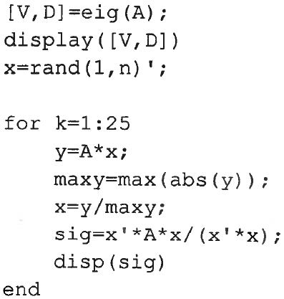
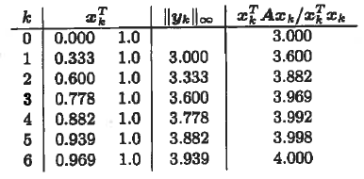
MATLAB code for power iteration for largest eigenvalue and its
eigenvector using infinity norm and Rayleigh quotient.
% MATLAB's built in for eigenvalues
% x is nx1 with random components
10
output when x₀ =[0,1]’
Infinity norm also converges to largest eigenvalue but the
Rayleigh quotient converges faster.

Slide 10
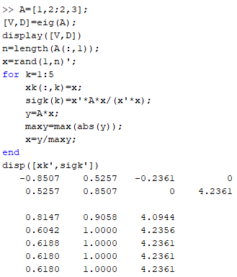
Renormalize MATLAB 0.5257/0.8507 = 0.6180

Slide 11
Inverse iteration: power iteration for smallest eigenvalue
Eigenvalues of A⁻¹ are reciprocals of the eigenvalues of A
apply power iteration to A⁻¹ to find the smallest eigenvector of A
Avoid explicit inversing by solving a linear system
If y_{k} = A⁻¹x_{k} then Ay_{k} = x_{k}

Slide 12
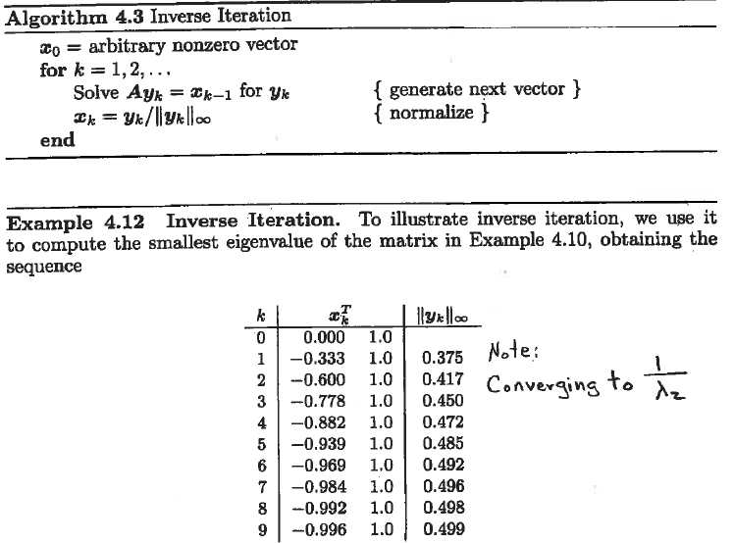
output when x₀ =[0,1]’
A =
λ₂=2
Using infinity norm,
v₂ = [-1,1]^{T}
and corresponding
eigenvector

Slide 13
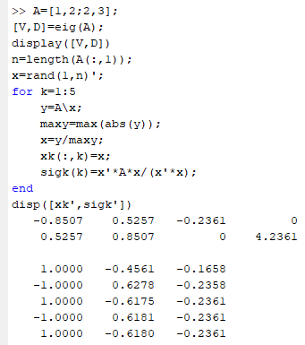
Renormalize MATLAB -0.5257/0.8507 = -0.6180

Slide 14
Inverse iteration with shift
If Ax = λx then (A – σI)x = (λ-σ)x.
If σ is good guess for eigenvalue λ_{k}, then λ_{k} – σ will be the smallest eigenvalue of A – σI
with shift, inverse iteration can be used to compute any eigenvalue and corresponding eigenvector of A using an initial guess

Slide 15
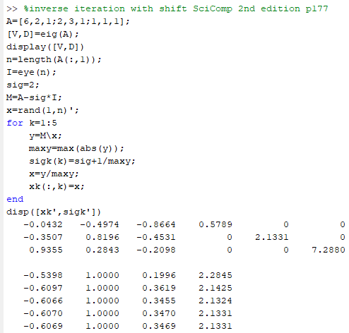
Renormalize MATLAB -0.4974/0.8196 = -0.6069
0.2843/0.8196 = 0.3469

Slide 16
Assignment 20
M =
Use Rayleigh-quotient accelerated power iteration to find the largest eigenvalue and associated eigenvector of the matrix M. Confirm by MATLAB allowing for different normalization. Show your code.
(b) Use inverse iteration to find the smallest eigenvalue and associated eigenvector of M. Confirm by MATLAB. Show your code.
(c) Use inverse iteration with a shift to find an eigenvalue of M with value near 2. What is the associated eigenvector? Confirm by MATLAB. Show your code.

