Slide 1
Rank deficiency
Ax = b is a mxn least-squares problem with m>n.
b ∉ span(A) because system is over-determined
Consider all y ∈ span(A) ∴y = Ax is a possible fit
r(y) = b – y are residuals associated with the possible fit
A unique y_{min} exist for which || r(y) ||² is smallest
However, the solution of Ax = y_{min} may not be unique
If x₁ and x₂ exist such that Ax₁ = Ax₂ = y_{min}
Then z = x₂ – x₁ ≠ o, and Az = o
Columns of A must be linearly dependent
This condition is called rank deficiency.

Slide 2
Consequences of rank deficiency for the
linear least squares problem
A^{T}A will be singular and normal equation method will fail
Linear least squares problem as formulated does not have
a unique solution.
Some of the parameters of the model cannot be determined.

Slide 3
Linear models with different types of data
Estimate height of 3 hills by combining 2 types of measurements
heights relative to a fixed reference
heights relative to each other
height of 3 hills relative to a fixed reference.
hill 1 = 1237 m
hill 2 = 1941 m
hill 3 = 2417 m
relative heights of the hills
hill 2 relative to 1 = 711 m
hill 3 relative to 1 = 1177 m
hill 3 relative to 2 = 475 m
Construct a linear model of the data with height of hills
relative to fixed reference as parameters

Slide 4
Design matrix:
How model
parameters relate
to data taken.
Ax =
=
= b
Construct normal equations
A^{T}Ax =
=
= A^{T}b
Solve by Cholesky factorization
Note that measurements of relative hill heights
affect estimate of heights relative fixed reference
x =

Slide 5
Example of rank-deficient linear least squares problem
Surveyor loses data on heights of hills above the fixed reference but continue to model the data in terms of heights above the fixed reference.
Ax = = = b
Design matrix A is singular (all row-sums are zero). Unique solution does not exist.
Chosen parameters are not all “identifiable” from remaining data.
Obviously, cannot estimate heights of hills relative to a fixed reference
from their relative heights only.

Slide 6
Reformulate the problem with the height of hill 1 as reference point
Az = = = b
New design matrix
z₁ = x₂ – x₁ = 771 height of hill 2 relative to1
z₂ = x₃ – x₁ = 1177 height of hill 3 relative to 1
z₂ –z₁ = x₃ –x₂ = 475 height of hill 3 relative to 2
A is not singular.
Normal equations can be used to find optimal z₁ and z₂
Solution: z₁ = 708 z₂ = 1180
Note that data on hill 3 relative to 2 did influence model parameters.

Slide 7
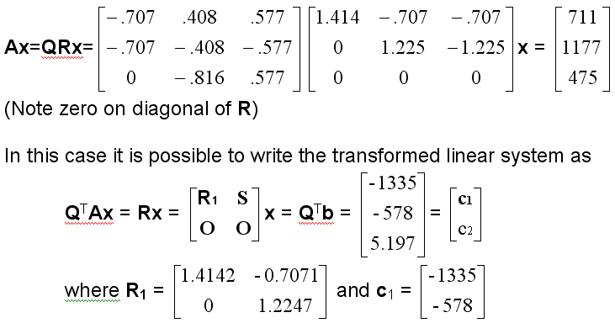
Alternative solution by QR factorization of singular design matrix
= b
Problem is reduced to one where the number of parameters equals the
rank(A) = 2. Solve R₁x = c₁ by back substitution
Solution: x₁ = -1180 height of hill 1 relative to hill 3
x₂ = -472 height of hill 2 relative to hill 3
Zero on diagonal of R determined which hill is treated as reference

Slide 8
Singular Value Decomposition
A = USV^{T} is the singular value decomposition of mxn matrix A
U is an mxm orthogonal matrix.
V is a nxn orthogonal matrix.
S is an mxn diagonal matrix with diagonal elements σ_{i} > 0
that are called the “singular values” of A
The columns of U are called the “left singular vectors” of A
The columns of V are called the “right singular vectors” of A
SVD in MATLAB is [U, S, V] = svd(A)

Slide 9
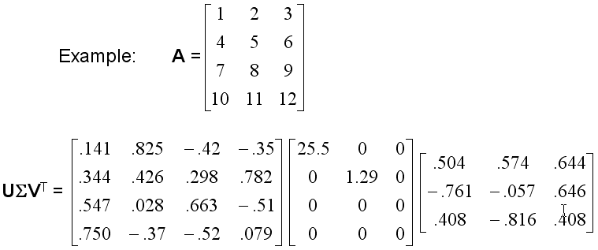
Example of SVD using exact arithmetic (no round off error)
Singular values of A are σ₁ = 25.5, σ₂ = 1.29, and σ₃ = 0
Rank of A = number of non-zero singular values = 2 in this case

Slide 10
In floating-point arithmetic, small singular values may correspond to
zeros in exact calculations
Usual procedure is to sort singular values in decreasing order and
regard singular values below some threshold as zero
This defines the “numerical” rank of a matrix
n=rank(A) calculates numerical rank using MatLab’s threshold of
7.297130x10⁻¹⁵

Slide 11
Solution of linear systems by exact SVD
Ax = b is a linear system with A rectangular or square and possibly rank deficient
is the diagonal matrix of singular values of A.
Σ⁺ is a diagonal matrix with diagonal elements 1/σ if σ ≠ 0 and 0 if σ = 0 ∴ Σ⁺ Σ = I
Ax = UΣV^{T}x = b ∴ x = V Σ⁺ U^{T} b
The rows of U^{T} and columns of V in the product V Σ⁺ U^{T} b are restricted by zeros in Σ⁺ to those associated with non-zero singular values
x = v_{i} (u_{i}^{T}b/σ_{i}), where u_{i} and v_{i} are the left and right singular vectors associated with σ_{i}.
If A has full rank, the solution using SVD is unique.

Slide 12
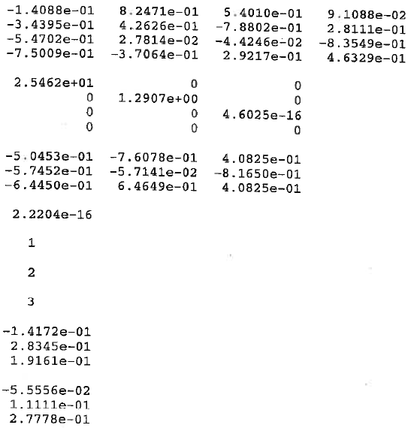
SVD of A=[1,2,3;4,5,6;7,8,9;10,11,12] in floating point arithmetic
U =
Σ =
V =
σ₁ and σ₂ are close to the values obtained by exact arithmetic
σ₃ is below MATLAB’s threshold and zero in exact calculations
To use these “floating point” result in solution of Ax=b the threshold on non-zero singular values must be included. MATLAB's Moore-Penrose ‘pseudo inverse’ pinv(Σ) provides this capability.

Slide 13
Solution of linear systems by singular values decomposition using the
Moore-Penrose pseudo inverse
A=[1,2,3; 4,5,6; 7,8,9; 10,11,12];
b=[1,2,3,4]’;
[U,S,V]=svd(A);
pS=pinv(S);
x=V*pS*U’*b;
disp(x)
Moore-Penrose enables a solution of rank deficient linear systems but
the solution is probably not unique.
In linear least squares, if A is rank deficient, reformulate problem so that
the number of parameters equals the rank of the A matrix.

Slide 14
Pseudocode for polynomial fitting using SVD
Input data
Construct the Vantemonte matrix, call it A
Get SVD of Vantemonte matrix and display singular values
If some singular values are small, evaluate rank of Vantemonte matrix
If rank is less than the number of parameter, reformulate with fewer parameters.
Solve for optimum parameters using Moore-Penrose pseudo inverse
Display optimum parameters, which we know are unique.
Calculate the sum of squared residuals and display it
Plot the data and fit on the same set of axes

Slide 15
Assignment 19
Use singular value decomposition to fit a line to the data set on page 495
of text (6th edition) surface tension vs temperature.
Temp = 0, 10, 20, 30, 40, 80, 90, 95
Tension = 68.0, 67.1, 66.4, 65.6, 64.6, 61.8, 61.0, 60.0
Report the singular values of the Vantemonte matrix
Use Moore-Penrose pseudo inverse to solve for parameters of the line
Report parameters and the minimum sum of squared deviations between fit and data.
Plot the fit and data (no error bars) on the same set of axes.

