Slide 1
Useful links for MATLAB
Washington State University Portal
Students can go here to download and install MATLAB on their personal computers. They should log in with their university id when creating a MathWorks account.
Self-Paced courses: Online courses for students to learn on their own. They can also be accessed by going to the “Home” tab and clicking on “Learn MATLAB” from the resources section from within MATLAB.
MATLAB Onramp: Introduction to MATLAB (for students not already familiar with MATLAB).

Slide 2
Basic MATLAB is all you need for this class
The online courses found at the links on the previous slide will introduce you to many high-level features in MATLAB. You will not need any of those high-level features for the coding requirements of this class.
Mainly, you will be writing scripts to use the MATLAB function on the class web page. The syntax of function calls in a script is [outputs] = name(inputs) with multiple inputs and outputs separated by commas. Include names for all output variables in a function call even if you do not use all of them in the script.

Slide 3
How to download MATLAB codes from the class web page
Open MATLAB
Follow link http://www.tricity.wsu.edu/~jhmiller to the class web page
Find the MATLAB folder
Right-click on the .m file that you want
Choose “Save link as”
Navigate to the folder where you want to save the file
Click save
A download information box will appear.
Ignore information box if all you wanted was to save the file.
If you click on Open, file will open in the MATLAB editor

Slide 4
Arrays in MATLAB
Most of the arrays that you will encounter in this class have 1 or 2 dimensions.
1-dimensional arrays are called “vectors”
2-dimensional arrays are called “matrices”
The “length” of a vector is the number of elements in the 1D array.
The “size” of a matrix is the number of rows and columns in the 2D array.
MATLAB does not require specification of array size before it is used; however, it may remind you that for efficiency this is desirable.
The rows of a matrix M can be used as row-vectors M(k, :)
The columns of a matrix M can be used a column-vectors M(:, k)

Slide 5
Row and Column vectors in MATLAB
>> is the prompt to enter statements in the command window.
Start MATLAB and enter these statements in the command window.
>>x=linspace(-1,4,10);
produces a “row” vector (i.e., 1x10 matrix)
Semicolon at the end of a statement suppresses output
>>disp(x) displays the elements in x in rows
If x is a row vector, then x’ is a “column” vector (i.e., 10x1 matrix)
>>disp(x’) displays the elements in x as a column

Slide 6
Arrays in MatLab
Arrays can have any number dimensions
The dimension of an array is the number of indices required to specify an element of the array.
Most of the arrays that you will encounter in this class have 1 or 2 dimension.
1-dimensional arrays are called “vectors”
2-dimensional arrays are called “matrices”
The “length” or “size” of an array is the number of elements in the array.
MATLAB does not require specification of array size before it is used; however, MATLAB recommends this for speed.

Slide 7
Arrays in MatLab
x=linspace(-1,4,10); produces a “row” vector (1xn matrix)
>>disp(x) displays the elements in x in rows
If x is a row vector, then x’ is a “column” vector (nx1 matrix)
>>disp(x’) displays the elements in x as a column
The rows of a matrix M can be used as row-vectors M(k, :)
The columns of a matrix M can be used a column-vectors M(:, k)

Slide 8
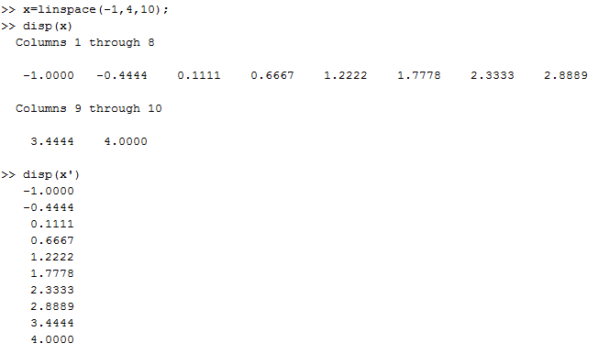

Slide 9
Arrays in MatLab
x=linspace(-1,4,10); produces a “row” vector
If a row vector is passed to a function, MATLAB returns a row vector.
If a column vector is passed to a function, MATLAB returns a column vector.
>>myf=@(x) exp(x)-3*x.^2; is setup to receive vector input
x.^2 means square vector x “component by component”.

Slide 10
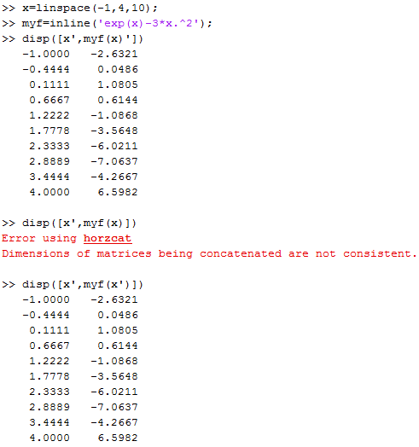
myf=inline(‘exp(x)-3*x.^2)’);
is equivalent to
myf=@(x) exp(x)-3*x.^2;
which is preferred

Slide 11
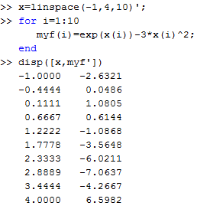
Arrays in MatLab
x=linspace(-1,4,10);
To specify components of x in a calculation, use x(index).
Note: .^ is not needed because components of x are explicit.
The for loop defined a row
vector even though x was
a column vector because
my calculation only involved
components of x.

