Slide 1
Linear models with different types of data
Estimate height of 3 hills by combining 2 types of measurements
heights relative to a fixed reference
heights relative to each other
height of 3 hills relative to a fixed reference.
hill 1 = 1237 m
hill 2 = 1941 m
hill 3 = 2417 m
relative heights of the hills
hill 2 relative to 1 = 711 m
hill 3 relative to 1 = 1177 m
hill 3 relative to 2 = 475 m
Construct a linear model of the data with height of hills
relative to fixed reference as parameters

Slide 2
Design matrix:
How model
parameters relate
to data taken.
Ax =
=
= b
Construct normal equations
A^{T}Ax =
=
= A^{T}b
Solve by Cholesky factorization
Note that measurements of relative hill heights
affect estimate of heights relative fixed reference
x =

Slide 3
QR factorization of non-square matrices
Alternative to Normal Equation

Slide 4
Solution of linear systems by QR factorization
Like Gauss elimination, QR factorization introduces zeros
into A to produce an upper triangular form
Use orthogonal transformations rather than elementary elimination
matrices.
Three commonly used procedures are
(1) Householder transformations (elementary reflectors)
(2) Givens transformations (plane rotations)
(3) Gram-Schmidt orthogonalization

Slide 5
Householder transformations
H = I – 2v v^{T}/(v^{T}v) where v is a non-zero vector chosen so that HA
induces zeros below the diagonal of some column of matrix A
H is both orthogonal and symmetric (i.e. H = H^{T} = H⁻¹)
Let a be column1, how do we find v such that Ha = = α = αe₁?
αe₁ = Ha = (I – 2v v^{T}/(v^{T}v))a
= a – 2v v^{T}a/(v^{T}v) = a – 2v (v^{T}a)/(v^{T}v)
Solve for v
v = constant (a – αe₁) choose constant =1
v = a – αe₁
choose α so that Ha has the same Euclidian norm as a
||Ha|| = α where α = + ||a||
v₁ = a₁ – α; v_{k} = a_{k} all other components of v
to avoid loss of significance chose α = -sign(a₁)||a||
(i.e. if a₁ is positive then α is negative)

Slide 6
Example: a = ||a|| = 3, a₁ is positive, α = -3
v = a – αe₁ = a + 3e₁ =
v^{T}a = 15 v^{T}v = 30 2(v^{T}a)/(v^{T}v) = 1
Ha = a – 2v (v^{T}a)/(v^{T}v) = - =
Expected result with ||a||² = 3 and a₁ is positive
Result is by construction, but we need v to build H to transform other vectors.
Given ||a|| and sign(a₁) we can construct v and H.

Slide 7
A similar approach works for annihilating other components of m-vector a
a = where a₁ is the part of a we want to keep
v = - αe_{k} where α = -sign(a_{k})||a₂|| and k is first component below a₁
Ha = a – 2v (v^{T}a)/(v^{T}v) = is an m-vector with zeros below the k^{th} component and
has the same Euclidian norm as a.
This method can be applied successively to the columns of an mxn matrix A.
obtained by construction, but we need v to build H to transform other columns.
Given ||a₂|| and sign(a_{k}) we can construct v and H.

Slide 8
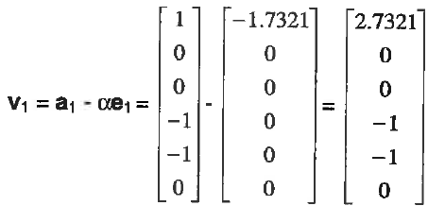
QR factorization applied to over-determined Surveyor’s problem
Ax = = = b
||a₁|| = sqrt(3)=1.7321
a₁₁ is positive; α = -1.7321
H₁ = I – 2v₁ v₁^{T}/(v₁^{T}v₁)

Slide 9
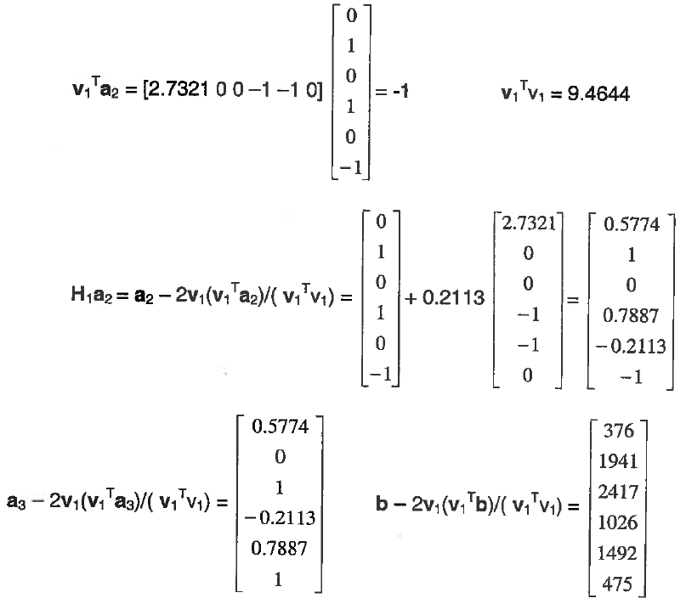
Apply H₁ to 2nd and 3rd columns of A and to b

Slide 10
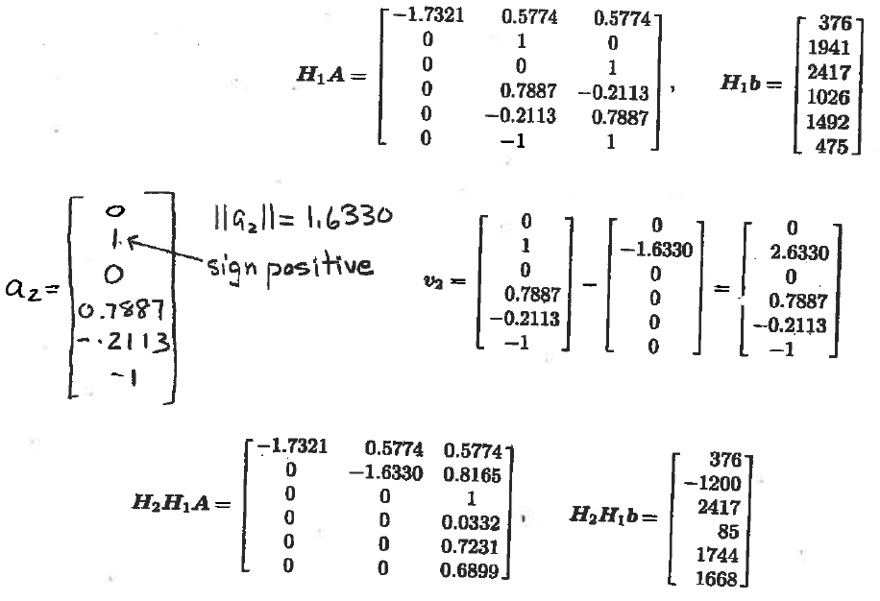
Transform column 2 of H₁A
With (H₁A)₁₂ preserved
α = -1.6330

Slide 11
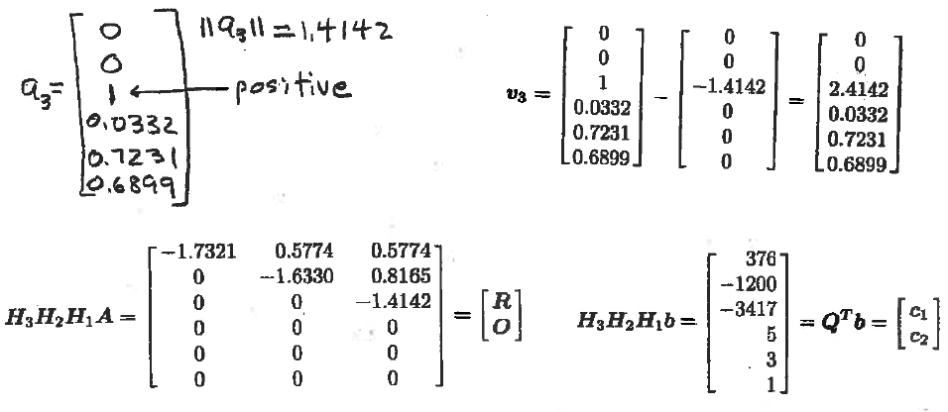
Transform column 3 of H₂H₁A
with (H₂H₁A)₁₃ and (H₂H₁A)₂₃ preserved
α = -1.4142
H₃H₂H₁Ax=H₃H₂H₁b becomes the 3x3 upper triangular system Rx = c₁
which can be solved by back substitution
x =[1236, 1943, 2416]^{T} which is the same result obtained by Normal Equations

Slide 12
Application of MatLab’s QR factorization to Linear Least Squares

Slide 13
Orthogonal transformations preserve Euclidean norm
of a vector
A real square matrix Q is “orthogonal” if Q^{T}Q = I
Qv is called an orthogonal transformation of v
||Qv||₂² = (Qv)^{T}(Qv) = v^{T}Q^{T}Qv = v^{T}v = ||v||₂²
Orthogonal transformations preserve Euclidian norm

Slide 14
QR factorization in MatLab: alternative to LU factorization that
can be applied to non-square matrix
if A is an mxn matrix with m > n, then [Q,R] = qr(A) returns
Q = mxm orthogonal matrix and
R = nxn upper triangular matrix.
= mxn matrix with zeros below R
A=Q
mxn mxm mxn

Slide 15
Solution of linear least squares problem by QR factorization:
Given a QR factorization for A, find an approximate solution
of the over-determined system Ax = b
Sum of squared residuals ||r||² = ||b - Ax||² = ||b – Q x||²
Since orthogonal transformation preserves Euclidean norm
||r||² = ||Q^{T}r||² = ||Q^{T}b – x||²
Write Q^{T}b as where c₁ is an n-vector an c₂ is (m-n)-vector
||r||² = || ||² = ||c₁ - Rx||² +||c₂||²
Minimum ||r||² obtained by solving Rx = c₁, which is an nxn upper
triangular system for parameters of best fit.
Minimum sum of squared residuals is ||c₂||² = ||Q^{T}b ||² - ||c₁||²

Slide 16
Fit parabola to data from text p495 using QR factorization %n=3
T = [0, 10, 20, 30, 40, 80, 90, 95]’;
S = [68.0, 67.1, 66.4, 65.6, 64.6, 61.8, 61.0, 60.0]’;
% T and S is a column vector (8x1) m=8
Construct V matrix %V is 8x3
[Q,R]=qr(V); %full QR factorization Q is 8x8 R is 3x3
newS=Q’*S; % 8x1 vector with c₁ 3x1 and c₂ 5x1
[Q1,U]=qr(V,0); %reduced QR factorization Q1 (8x3) U (3x3)
c₁=Q1’*S; %3x8*8x1=3x1
x=backsub(U,c1): % backsub returns a row vector
fit=V*x’;
chisq=newS’*newS-c1’*c1; %chisq without using fit
%this is the only reason we got the full QR factorization of A
plot(T,S,’*’);
hold on
plot(T,fit);
hold off

Slide 17
Fit parabola to data from text p495 using QR factorization: chisq=r^{T}r
T = [0, 10, 20, 30, 40, 80, 90, 95]’;
S = [68.0, 67.1, 66.4, 65.6, 64.6, 61.8, 61.0, 60.0]’;
% T and S is a column vector (8x1) m=8
Construct V matrix %V is 8x3
[Q1,U]=qr(V,0); %reduced QR factorization Q1 (8x3) U (3x3)
c₁=Q1’*S; %3x8*8x1=3x1
x=backsub(U,c1): % backsub returns a row vector
fit=V*x’;
r=fit-S
chisq=r’*r;
plot(T,S,’*’);
hold on
plot(T,fit);
hold off

Slide 18
Assignment 18
Use reduced QR factorization to fit a parabola to the data set below (no weights).
t = linspace(0,10,21)’
y = [2.9, 2.7, 4.8, 5.3, 7.1, 7.6, 7.7, 7.6, 9.4, 9, 9.6,10, 10.2, 9.7, 8.3, 8.4, 9, 8.3, 6.6, 6.7, 4.1]’
Plot the fit and data (no error bars) on the same set of axes.
Report the optimum value of the parameters and the sum of squared deviations between fit and data by the usual approach (i.e., no full QR factorization required.)
Hand a copy the command window that shows your script and the results.

