Slide 1
Chapter 12: Data Analysis by linear least squares
Overview:
Formulate problem as an over-determined
linear system of equations
Solve the linear system by optimization

Slide 2
Example: fit y = ax + b to m data points (x_{k}, y_{k})
Find unknowns a and b that minimize sum of
squared residuals
What is the objective function to be minimized?
What are the equations for a and b?

Slide 3
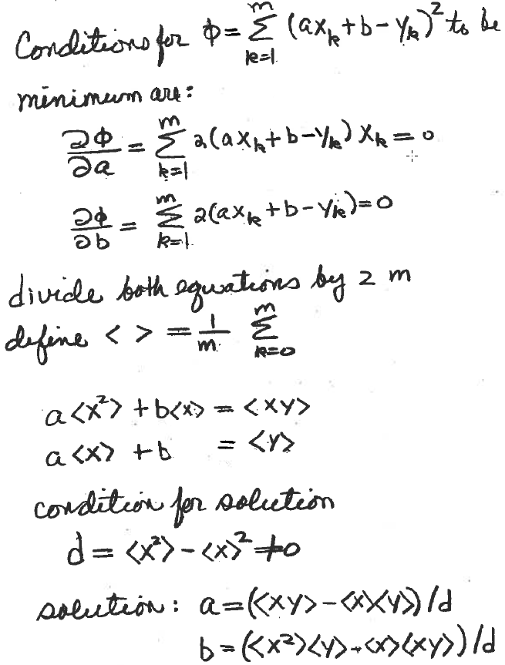
Example: fit y = ax + b to m data points
Find unknown a and b that minimize sum of squared residuals

Slide 4
Given uncertainty in data, (x_{k}, y_{k}, σ_{k}), find the line that
goes through the error bars (i.e. tightest fit where the
error is least).
What is the objective function to be minimized?
What are the equations for a and b?

Slide 5
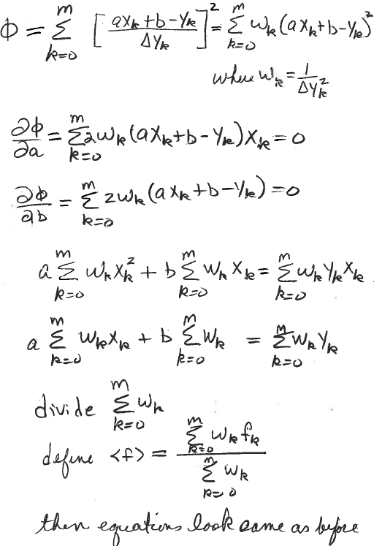
m+1 data points
indexed from zero

Slide 6
Data fitting formulated as an over-determined linear system:
Given dataset {(t_{k},y_{k}), k=1,...,m} and functions {f_{j}(t), j=1,...,n},
find the linear combination of functions that best represents the data.
Let a_{kj} = f_{j}(t_{k}) (j^{th} function evaluated at k^{th} data point)
Let b = [y₁, y₂,...,y_{m}]^{T} (column vector of the measured values)
Let x = [x₁, x₂,...,x_{n}]^{T} (column vector of unknown parameters)
To separate trends in the data from “noise”, we need m>>n.
This is an over-determined linear system. (more equations than unknowns)

Slide 7
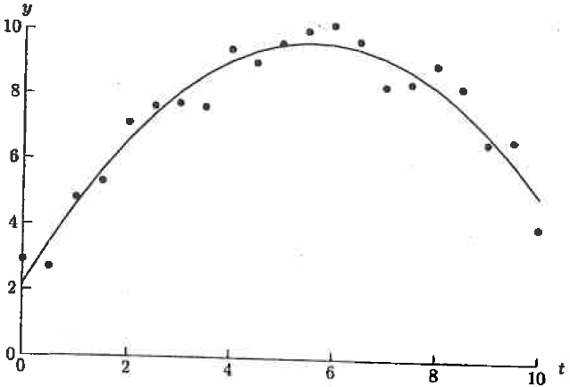
Our over-determined linear system does not have an exact solution
To get an approximate solution, find x that which minimizes the Euclidian norm of the residual vector r = b – Ax, which is equivalent to minimizing the sum of squared residuals
The result can be viewed as “dimensionality reduction”. From many data points we find a few parameters that describe the trend in the data.
In this example, the
model is a parabola
with 3 parameters

Slide 8
Let y = Ax denote the fit at all data point for parameters x
y ∈ span(A) (y is a linear combination of the columns of A)
For given data set, b is the constant vector of observations and || b – y || = f(y) are the residuals of the fit.
f(y) is continuous and strictly convex.
f(y) is guaranteed to have a unique minimum
Find y such that f(y) is a minimum
The vector y ∈ span(A) that is closest to b is unique; however, this unique vector may not correspond to a unique set of unknown parameters x
If Ax₁ = Ax₂ = y then A(x₂ – x₁) = 0 and z = (x₂ – x₁) ≠ 0
Columns of A must be linearly dependent.
This condition is called rank deficiency
Unless otherwise stated, assume A has full rank.

Slide 9
Normal Equations: let y = Ax denote the fit at all data point for parameters x
let b denote the vector of observations
Let r = b – Ax and define f(x) = r^{T}r (sum of squared residuals)
f(x) = (b – Ax)^{T}(b – Ax) = b^{T}b –2x^{T}A^{T}b + x^{T}A^{T}Ax
A necessary condition for x₀ to be minimum of f(x) is ∇f(x₀) = 0, where
∇f is a vector with components that are the partial derivatives of f(x) with respect to the unknown parameters
∇f(x) = 2A^{T}Ax – 2A^{T}b = 0
∴ the optimal set of n parameters is a solution of the nxn symmetric system
A^{T}Ax = A^{t}b called the “normal” equations of the linear least squares problem.

Slide 10
Example: Use the normal equations A^{T}Ax = A^{T}b
to fit a line y = c₂x +c₁ to m data points (no error bars).
Show that it is the same result as that obtained by differentiation of an objective function.
What are the functions {f_{j}(t), j=1,2}, that define the matrix elements, a_{kj} = f_{j}(t_{k}) j^{th} function evaluated at k^{th} data point?
What is the A matrix?
What is the b vector?
What is the vector of unknowns?
Construct the normal equations.

Slide 11
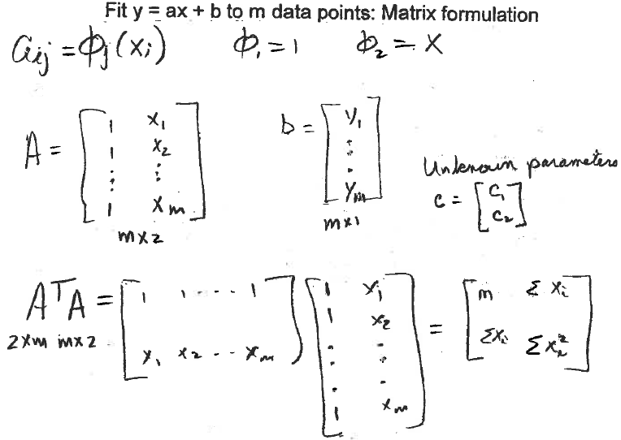

Slide 12
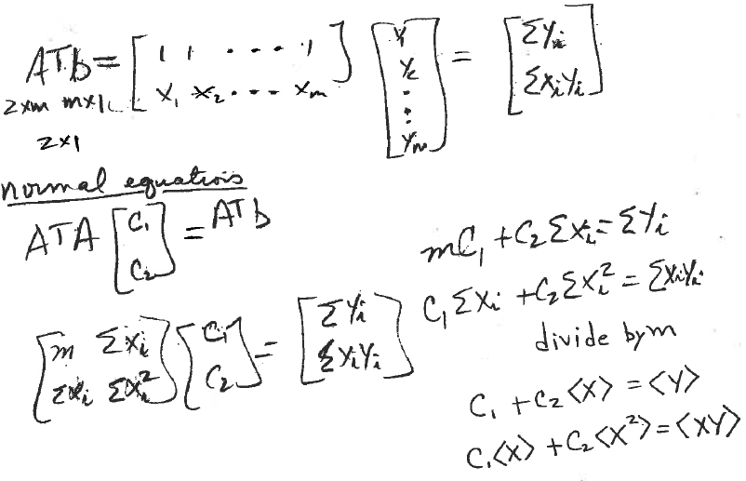
Same set of equations as obtained
by objective function method

Slide 13
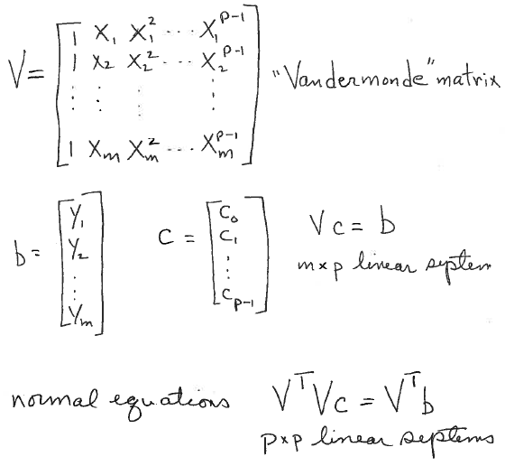
Fit a polynomial of degree p-1 to m data points (x_{k}, y_{k})

Slide 14
Given the parameters, c₀, c₁,…,c_{k}, that minimize the sum of squared deviations, evaluate fit at all the data points x^{t} by
r = Y_{fit} – y are the residuals at the data points
||r||² = r^{T}r is the sum of squared residuals
Lecture Notes for E Alpaydın 2010 Introduction to Machine Learning 2e © The MIT Press (V1.0)

Slide 15
Fit parabola to data from text p495, surface tension as a
function of temperature
T = [0, 10, 20, 30, 40, 80,90, 95]
S = [68.0, 67.1, 66.4, 65.6, 64.6, 61.8, 61.0, 60.0]
Write a pseudo-code to solve this problem by normal
equations.

Slide 16
Input data
Construct the V matrix
Construct the normal equations
Solve the normal equations
Evaluate the fit
Calculate the sum of squared residuals
Plot the data and fit on the same set of axes

Slide 17
Fit a parabola to data from text p495, surface tension as a
function of temperature
T = [0, 10, 20, 30, 40, 80, 90, 95]’; % column vector
S = [68.0, 67.1, 66.4, 65.6, 64.6, 61.8, 61.0, 60.0]’; %column vector
npts=8;
V=ones(npts,3);
V(:,2)=T;
T2=T.*T;
V(:,3)=T2;
A=V’*V; (3x8*8x3)=3x3 note not .*
b=V’*S; (3x8*8x1)=3x1 note not .*
x=A\b;
fit=V*x; (8x3*3x1)=8x1 note not .*
r=fit-S;
chisq=r’*r;
plot(T,S,’*’);
hold on
plot(T,fit);
hold off

Slide 18
m+1 data points
indexed from zero

Slide 19
Matrix formulation of weighted linear least squares
Let Δy be a column vector of uncertainties in measured values
w = 1./ Δy is a column vector of the square root of the weights
W = diag(w) is a diagonal matrix
V = coefficient matrix of the un-weighted least-squares problem
(Vandermonde matrix in the case of polynomials fitting)
y = column vector of observations
A = W V = weighted coefficient matrix
b = W y = weighted column vector of measured values
Ax = b is over-determined linear system for weighted linear least squares
normal equations A^{T}Ax = A^{T}b become (WV)^{T}WVx = (WV)^{T} W y
(note that w = 1./ Δy gets squared at this point)

Slide 20
Fit weighted parabola to data on surface tension
vs temperature
T = [0, 10, 20, 30, 40, 80, 90, 95]’;
S = [68.0, 67.1, 66.4, 65.6, 64.6, 61.8, 61.0, 60.0]’;
dS=[6, 2, 5, 3, 7, 8, 4,1]’; (note small uncertainty in last point)
% T, S, and dS are all column vectors
weights=1./dS
W=diag(weights);
S=W*S; % Weighted data points
% Construct V-matix
V=W*V; % Weighted V-matrix
Setup and solve normal equations
Evaluate the fit
Calculate the sum of squared residuals
Plot the data and fit on the same set of axes

Slide 21
T = [0, 10, 20, 30, 40, 80, 90, 95]’; % column vector
S = [68.0, 67.1, 66.4, 65.6, 64.6, 61.8, 61.0, 60.0]’; %column vector
dS=[6, 2, 5, 3, 7, 8, 4,1]’; % note small uncertainty in last point
npts=8;
V=ones(npts,3);
V(:,2)=T;
T2=T.*T;
V(:,3)=T2;
weights=1./dS
W=diag(weights);
WS=W*S; %weighted vector of observations
WV=W*V; %weighted Vandermonde matrix
A=WV’*WV; % weights are squared
b=WV’*WS; %weights are squared
x=A\b;
fit=V*x;
r=fit-S;
chisq=r’*r;
errorbar(T,S,dS,’*’);
hold on
plot(T,fit);
hold off

Slide 22
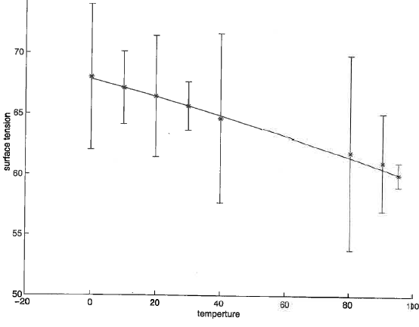
Plot using MatLab’s errorbar
Uncertainties chosen to show how small uncertainty
draws fit to data point at 95

Slide 23
Assignment 17
Use normal equations to fit a parabola to the data set below with weights that are 1/dy²
t = linspace(0,10,21)’
y = [2.9, 2.7, 4.8, 5.3, 7.1, 7.6, 7.7, 7.6, 9.4, 9, 9.6,10, 10.2, 9.7, 8.3, 8.4, 9, 8.3, 6.6, 6.7, 4.1]’
dy = 10% of the value of y.
Use MatLab’s errorbar(t,y,dy,’*’) function to plot the data. Add the fit on the same set of axes.
Report the optimum value of the parameters and the sum of squared deviations between fit and data.
Hand a copy the command window that shows your script and the results.

