Slide 1
Stabilizing Gauss elimination by preprocessing to get
the best pivot.

Slide 2
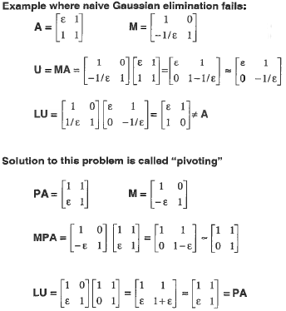
ε<ε_{mach}
P is a permutation matrix that interchanges rows
L=M⁻¹
= U
=
Note: we get the LU factorization of PA, not A

Slide 3
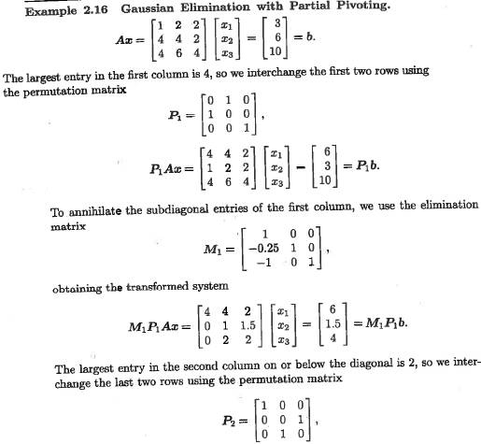
=

Slide 4
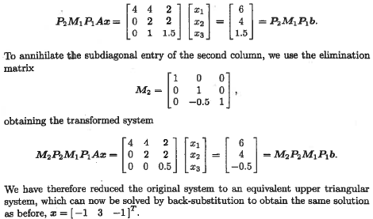

Slide 5
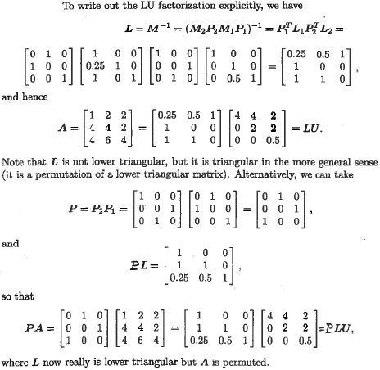
Find L
=
=
L =
L is not explicitly lower triangle
We do have the LU factorization of A
PL is explicitly lower triangle
= PLU
explicit lower triangle LU factorization is for PA, not A

Slide 6
Solving Ax = b using MatLab’s [L,U,P]=lu(A)
L is explicitly lower triangular
P is the permutation matrix such that LU = PA
PAx = Pb has the same solution as Ax = b
Ux = MPAx = MPb = y
Multiply from left by L
LUx = Ly Note that PA = LU
PAx = Ly Note that PAx = Pb
Pb = Ly solved for y by forward substitution
Given y, solve Ux = y for x by back substitution

Slide 7
Example: use MatLab’s lu(A) to solve Ax = b
A=[2,4,-2;4,9,-3;-2,-1,7];
b=[4;8;-6];
[L,U,P]=lu(A);
newb=P*b;
y=forsub(L,newb);
x=backsub(U,y);
disp(x)
test=A\b;
disp(test)

Slide 8
Assignment 16
Use the MATLAB function lu(A) and your forward and backward substitution codes to solve Ax = b where
A =
and b =
Test your results using MatLab’s method x = A\b. Hand a copy the command window that shows your script and the results

Slide 9
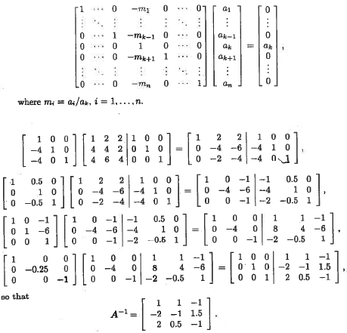
Gauss-Jordan and LU
factorization are O(n³)
G - J requires 3 times
as many operations
After A⁻¹ calculated
solution of Ax = b takes
about the same number
of n² operations as
forward and backward substitution.

