Slide 1
Linear Systems of Equations: solution and applications
Chapter 8 section 1:
Solution of linear systems by matrix factorization
Chapter 12 Data analysis by linear least squares

Slide 2
Matrix notation for system of linear equations:
Ax = b, where A is matrix and x and b are “column vectors”
A is not necessarily square
A x = b
mxn nx1 mx1
2x2 example:
Two vectors are equal if and only if their components are equal.
a₁₁ x₁ + a₁₂ x₂ = b₁
a₂₁ x₁ + a₂₂ x₂ = b₂

Slide 3
A solution of Ax = b is a column vector x whose components define a linear combination of the columns of A that equals column vector b.
There may be no such vector, a unique vector, or multiple vectors.
If any x exist (unique or not), then Ax = b is said to by “consistent”.
If A is “non-singular” then there exist A⁻¹ such that A⁻¹ A = I, and a unique solution is A⁻¹ A x = A⁻¹ b ∴ x = A⁻¹ b
Explicit calculation of A⁻¹ is not an efficient method to solve linear equations.
Our objective for studying linear system are the following:
1: An efficient method when A is a square matrix.
2: Solve Ax = b when A is not square.
(discussed in the context of linear least squares problem)

Slide 4
Existence and Uniqueness:
nxn matix A is nonsingular if any one of the following is true:
(1) A has an inverse
(2) det(A) ≠ 0
(3) rank(A) = n
(rank = max number linearly independent rows or columns)
(4) for any z ≠ 0, A z ≠ 0
If non of these are true, then A is singular.
If A is singular then, depending on b, one of the following is true:
(1) no solution exist (inconsistent),
(2) infinitely many solutions exist (consistent)
A is singular and Ax = b has a solution, then there must be a
z ≠ 0 such that Az = 0
Then A(x + γz) = Ax + γAz = b: x + γz is a solution for any scalar γ.

Slide 5
Span of a matrix
span(A) is defined as the set of all vectors that can be formed
by linear combinations of the columns of A.
If A is non-singular and Ax=b, then x=A⁻¹b is the unique vector in span(A)
that is the solution of Ax=b
if A is singular and A x = b is inconsistent, then b ∉ span(A).
if A is singular and A x = b is consistent, then b ∈ span(A).

Slide 6
Solving Linear Systems:
General strategy to solve Ax = b is to transform the system in a way that does not affect the solution but renders it easier to calculate.
Let M by any nonsingular matrix and z be the solution of MAz = Mb
Then z = (MA)⁻¹ Mb = A⁻¹ M⁻¹ M b = A⁻¹ b = x
Call “pre-multiplying” or “multiply from the left” by M.
Pre-multiplying by a nonsingular matrix does not change the solution
of Ax = b
By repeated use of this fact
Ax = b can be reduced to a “triangular” system that can be solver by successive substitution.

Slide 7
Triangular Linear Systems:
In general, A in Ax = b is “triangular” if it enables solution by successive substitution.
Permutation of rows or columns allows a general triangular matrix to take the upper triangular form defined by (a_{jk} = 0 if j > k) or the lower triangular form defined by (a_{jk} = 0 if j < k)
.
If A is a upper triangular matrix, solve A x = b by backward substitution (pseudo-code in text p252)
If A is a lower triangular matrix, solve A x = b by forward substitution
x₁ = b₁/a₁₁
x_{j} = (b_{j} - )/a_{jj} j = 2,3, ...,n
Functions for forward and backward substitution are on the class web page.

Slide 8
Solution of Ax = b by Gaussian Elimination:
Gaussian elimination (naïve or with pivoting) uses elementary elimination matrices to find a matrix M
such that MAx = Mb is an upper triangular system.

Slide 9
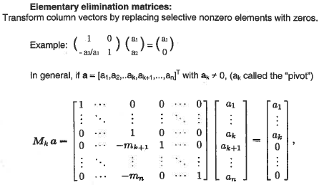
In general, if a_{k} is non-zero:
m_{k+1} = a_{k+1} /a_{k} , etc.
Note similarity of M to the
identity matrix

Slide 10
Define column vector m such that
m_{j} (j < k)=0 and m_{j} (j > k) = a_{j}/a_{k}
then M_{k} = I – me_{k}^{T} ,where e_{k} is k^{th} column of I
outer product nx1 times 1xn
a_{k} is called the “pivot” and must be non-zero

Slide 11
Reduction of linear system Ax=b to upper triangular form
(naïve Gauss elimination)
Assume a₁₁ is not zero
Use a₁₁ as pivot to obtain elementary elimination matrix M₁
Multiply both sides of Ax=b by M₁ (solution is unchanged)
New system, M₁Ax=M₁b has zeroes in the 1st column
except for a₁₁
Assume a₂₂ in M₁A is not zero and use as pivot for M₂
New system M₂M₁Ax=M₂M₁b has zeroes in the 1st and 2nd
columns except for a₁₁, a₁₂, and a₂₂
Continue until MAx=Mb, where M=M_{n-1}…M₂M₁
MA = U is upper triangular

Slide 12
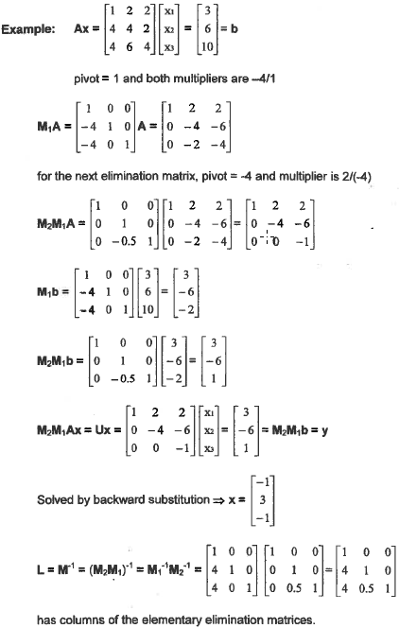
pivot=1
m=[0,4,4]^{T}
M₁ = I – me₁^{T}
rows 2 and 3 of A changed
pivot=-4
m=[0,0,0.5]^{T}
M₂ = I – me₂^{T}
Upper triangular
Same transformation of the b vector
Solve by back substitution

Slide 13
Pseudo-code for naïve Gauss elimination
for k=1 to n-1 loop over columns of A matrix
for i=k+1 to n loop over rows of submatrix
xm = a_{ik/}a_{kk} calculate multitier
for j=k to n loop over columns of submatrix
a_{ij} = a_{ij}-xma_{kj} modify matrix in place
end
b_{i} = b_{i} – xmb_{k} modify b-vector in place
end
end
solve Ax=b by back substitution
A->U is O(n³)

Slide 14
LU factorization:
Let L = M⁻¹ = M₁⁻¹M₂⁻¹…M_{n-1}⁻¹
Then LU = LMA =M⁻¹MA = A
A = LU called “LU factorization of A”
Show that L_{k} = M_{k}⁻¹ = I + me_{k}^{T}
Proof:
M_{k}⁻¹M_{k} = (I+me_{k}^{T})(I-me_{k}^{T}) = I – me_{k}^{T} + me_{k}^{T} - m(e_{k}^{T}m)e_{k}^{T} = I
(e_{k}^{T}m) is a scalar (1xn nx1) = zero because the only non-zero component
of e_{k}^{T} is a_{k} and m_{k} is zero.

Slide 15
Construction of L
L = M⁻¹ = M₁⁻¹M₂⁻¹…M_{n-1}⁻¹
Note: order of M_{k}⁻¹ in the product increases from left to right
M_{k}⁻¹M_{j}⁻¹ = (I+m_{k}e_{k}^{T})(I+m_{j}e_{j}^{T}) = I + m_{k}e_{k}^{T} + m_{j}e_{j}^{T} + m_{k} (e_{k}^{T}m_{j} )e_{j}^{T}
(e_{k}^{T}m_{j} ) is a scalar = 0 because the only non-zero component
of e_{k}^{T} is a_{k} and m_{j} is zero if k < j
M_{k}⁻¹M_{j}⁻¹ = I + m_{k}e_{k}^{T} + m_{j}e_{j}^{T}
L = M⁻¹ = M₁⁻¹M₂⁻¹…M_{n-1}⁻¹ = I + m₁e₁^{T} + … + m_{n-1}e_{n-1}^{T}
L = I + all the outer products used in the reduction of A to
upper triangular form (do on board)

Slide 16
pivot=1
m=[0,4,4]^{T}
M₁ = I – me₁^{T}
rows 2 and 3 of A changed
pivot=-4
m=[0,0,0.5]^{T}
M₂ = I – me₂^{T}
Upper triangular
Solve by back substitution
Lower triangular

Slide 17
Solving Ax =b by LU factorization of A
Given L and U, how do I find x?
Let M be the matrix that transforms A to upper triangular
MatLab’s lu(A) does not return M
The equation Ux = MAx = Mb = y can be solved by back substitution if y is known.
Mb = y cannot be used to find y because M is not known.
Multiply Ux = y from the left by L.
LUx = Ly Note that A = LU
Ax = Ly Note that Ax = b
b = Ly solve for y by forward substitution
Given y, solve Ux = y by back substitution

Slide 18
LU factorization by naïve Gauss elimination is unstable.
Assumption that pivots are not zero may not be true.
Ax=b where A is symmetric and positive definite is a special
case where assumptions about pivots are always valid.
In this case LU factorization of A is called “Cholesky” factorization

Slide 19
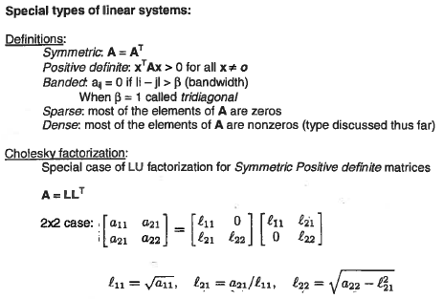
Note! U=L^{T}

Slide 20
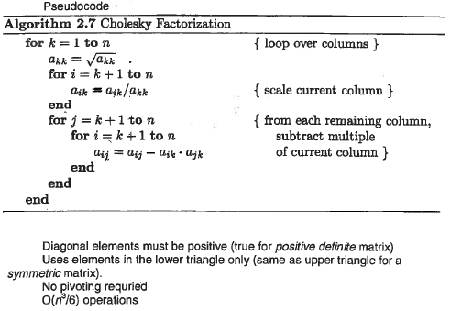
Note! Cholesky factors “in place”.
Elements of A above diagonal must
be set to zero.

Slide 21
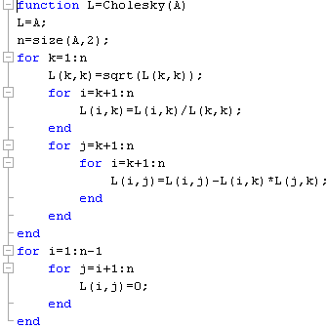
My code Cholesky factorization is on the class webpage
Above the diagonal,
set elements to zero

Slide 22
Example: use Cholesky to solve Ax = b
A=[4,-1,-1,0;-1,4,0,-1;-1,0,4,-1;0,-1,-1,4];
b=[2;4;8;-6];
L=Cholesky(A);
U=L’;
y=forsub(L,b);
x=backsub(U,y);
disp(x)
test=A\b;
disp(test)

Slide 23
Assignment 15
Use the Cholesky factorization code on the class web page to solve Ax = b where
A =
and b =
Test your results using MatLab’s method x = A\b. Hand a copy the command window that shows your script and the results

