Slide 1
Systems of Differential Equations

Slide 2
Components of MatLab codes to solve systems of differential equations
main
encoder
solver
Solver: advances matrix XM(t) → XM(t+h), with columns that are the
solutions to a system of differential equations. Independent of any
particular system of ODEs.
Encoder: m-file that tells solver how to calculate x’(t) for all of the
unknowns in the system of interest.
Main: Defines initial conditions and domain of solution
Sets solver parameters (number of points, error tolerance, etc,
Calls solver for the system of ODEs defined by encoder,
Analyzes the results.

Slide 3
Develop a solver for systems of ODEs using
Euler’s method

Slide 4
Euler’s method for a single ODE
function [t,x]=neweuler(myxp,t0,x0,tmax,npts)
n=npts-1;
h=(tmax-t0)/n;
t(1)=t0;
x(1)=x0;
for k=1:n
t(k+1)=t(k)+h;
x(k+1)=x(k)+h*myxp(t(k),x(k));
end
Modify this function to return XM, matrix with columns
that are solutions of unknowns in the problem
For a system with 2 unknowns, x(t) and y(t), XM(:,1) can
be x(t) and XM(:,2) can be y(t).

Slide 5
function [t,XM]=EulersysV2(myxpsys,t0,x0,tmax,npts)
n=npts-1;
h=(tmax-t0)/n;
t(1)=t0;
XM(1,:)=x0; % x0 is a row vector
for k=1:n
t(k+1)=t(k)+h;
XM(k+1,:)=XM(k,:)+h*myxpsys(t(k),XM(k,:)); % row vectors relationship
End
Function myxpsys must return a row vector of the slops of all unknowns using t(k) and row k of the solution matrix.

Slide 6
Given a solver, next task is to write an encoder for the problem
Encoder is a .m file
Inputs: t and a vector of values of all unknowns at t.
Output: vector of values of the 1st derivative of all unknowns at t
Example: Find a numerical solution of x’ = -3y, y’ = x/3 for 0<t<4
by Euler’s method with 100 points when x(0)=3 and y(0)=0
Step 1 write the encoder function
main
encoder
solver

Slide 7
Example: Write an encoder for the system x’ = -3y, y’ = x/3
In a problem of this type, it may be helpful to rename the unknowns.
x(t) -> x₁(t) and y(t) -> x₂(t) to indicate that x(t) is the 1st component of the
vector passed to the encoder and y(t) is the second component. Similarly,
x₁’(t) is the 1st component of the vector returned to the solver and x₂’(t)
is the second component.
function f=xpsysL15_S7(t,x)
f1=-3*x(2); % x’(t)
f2=x(1)/3; % y’(t)
f=[f1,f2]; % returns a row vector
end
In the call to EulersysV2, use @xpsysL15_S7 to show that the encoder is a .m file
in the current directory

Slide 8
main
encoder
solver
Driver code: Find a numerical solution of x’ = -3y, y’ = x/3 for 0<t<4
by Euler’s method with 100 points when x(0)=3 and y(0)=0
At t=4, calculate the percent difference from the exact solution,
x=3cos(t), y=sin(t) at t=4
Make a plot that compares your solution (curve) with exact solution (points)
for 0<t<4
If you use the same set of t-values for these plots, likely that numerical and
exact solutions cannot be distinguished on the plot. To avoid this choose a
different and smaller set of t-values to plot the exact solution.

Slide 9
solution of x’ = -3y, y’ = x/3 for 0<t<4 by Euler’s method with 100 points when x(0)=3 and y(0)=0.
[t,XM]=EulersysV2(@xpsysL15_S7,0,[3,0],4,100); %myxpsys,t0,x0,tmax, npts
plot(t,XM(:,1)); %plot x(t)
hold on;
plot(t,XM(:,2)); %plot y(t)
tex=linspace(0,4,10); % points where exact solution will be evaluated
xex=3*cos(tex); % exact x(t)
yex=sin(tex); % exact y(t)
plot(tex,xex,’*r’)
plot(tex,yex,’*b’)
hold off
pdx=100*abs((xex(10)-XM(100,1))/xex(10)); % XM(100,1) = x(4)
pdy=100*abs((yex(10)-XM(100,2))/yex(10)); % XM(100,2) = y(4)
disp([t(100),pdx,pdy])

Slide 10
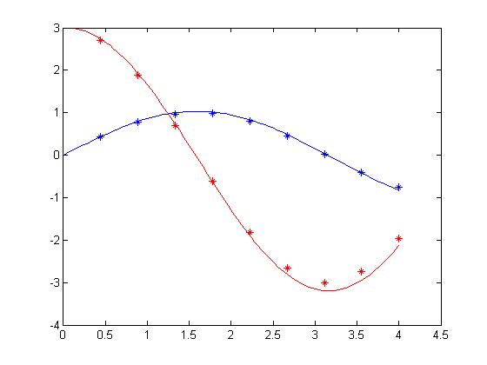
eulersys solution of x’ = -3y, y’ = x/3 compared to exact
PD x(t=4) = 8.68%
PD y(t=4) = 8.21%

Slide 11
Given ex_Euler,
write ex_Eulersys with no additional for loops
[t,XM]=ex_Eulersys(fh,t0,x0,tmax,npts)
n=npts-1;
h=(tmax-t0)/n;
t(1)=t0;
XM(1,:)=x0;
for k=1:n
t(k+1)=t(k)+h;
x=XM(k,:);
k1=h*fh(t(k),x);
k2=h*fh(t(k+1),x+k1):
XM(k+1,:)=XM(k,:)+(k1+k2)/2;
end
fh returns a row vector
[t, x]=ex_Euler(fh, t0, x0, tmax, npts)
n=npts-1;
h=(tmax-t0)/n;
t(1)=t0;
x(1)=x0;
for k=1:n
t(k+1)=t(k)+h;
k1=h*fh(t(k),x(k));
k2=h*fh(t(k+1),x(k)+k1);
x(k+1)=x(k)+(k1+k2)/2;
end

Slide 12
Find the solution of x’ = -3y, y’ = x/3 for 0<t<4 by
extended Euler’s method with 100 points when x(0)=3 and y(0)=0.
Modify script for EulersysV2 to run ex_Eulersys

Slide 13
solution of x’ = -3y, y’ = x/3 for 0<t<4 by Euler’s method with 100 points when x(0)=3 and y(0)=0.
[t,XM]=ex_Eulersys(@xpsysL15_S7,0,[3,0],4,100);
plot(t,XM(:,1));
hold on;
plot(t,XM(:,2));
tex=linspace(0,4,10);
xex=3*cos(tex);
yex=sin(tex);
plot(tex,xex,’*r’)
plot(tex,yex,’*b’)
hold off
pdx=100*abs((xex(10)-XM(100,1))/xex(10));
pdy=100*abs((yex(10)-XM(100,2))/yex(10));
disp([t(100),pdx,pdy])

Slide 14
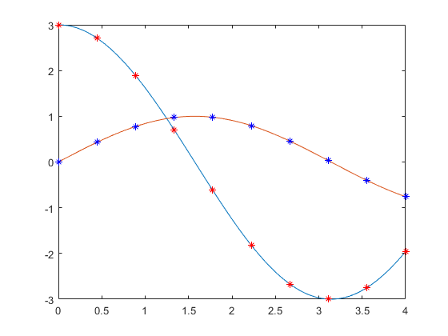
PD x(t=4) = 0.123%
PD y(t=4) = 0.097%

Slide 15
Use ode45 for a system of equations

Slide 16
MAIN to use ode45 is similar to that used to run EulersysV2 and
ex_Eulersys except that ode45 requires tspan instead of t0, tmax, and npts.
ode45 also requires that the encoder return a column vector
For the system x’=-3y and y’=x/3 encoder could be
function f=xpsys(t,x)
f1=-3*x(2);
f2=x(1)/3;
f=[f1;f2];

Slide 17
apply ode45 to
x’ = t +x² – y;
y’ = t² – x+y²;
x(0) = 3; y(0) = 2
Write the encoder
Do on board

Slide 18
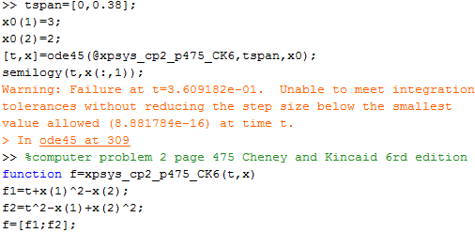
apply ode45 to x’ = t +x² – y;
y’ = t² – x+y²; x(0) = 3; y(0) = 2
Write the encoder
45(t,x)

Slide 19
apply ode45 to
x’ = t +x² – y;
y’ = t² – x+y²;
x(0) = 3; y(0) = 2
Write the main for 0<t<0.38
Make a semilog plot of x(t)
Do on board

Slide 20
tspan = [0,0.38];
x0=[3,2];
[t,x]=ode45(@xpsys_cp2_p475_CK6,tspan,x0);
45, tspan, x0);
semilog(t,x(:,1);

Slide 21
Apply ode45 to x’ = t +x² – y; y’ = t² – x+y²; x(0) = 3; y(0) = 2
Sometimes ode45 fails

Slide 22
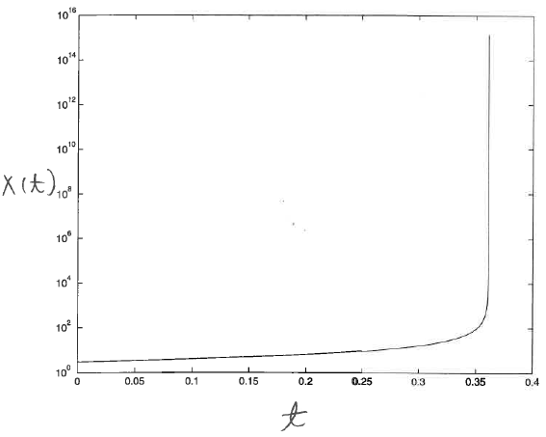
ODE45 solution for system
x’ = t +x² – y y’ = t² – x+y² x(0) = 3, y(0) = 2
Very rapid change in solution →

Slide 23
Assignment 14
Use ode45 to solve the system of equations
x’=x – y + 2t – t² – t³
y’=x + y – 4t² + t³
for 0 < t < 3, subject to the initial condition x(0)=1, y(0)=0
Solve with Eulersys and ex_Eulersys using the same number of points as ode45
Exact solutions are x(t)=exp(t)cos(t) + t² and y(t)=exp(t)sin(t) - t³
For each method:
Calculate the absolute percent difference from the exact values at t=3
Plot the exact and numerical solutions on the same set of axes.
Make sure your plots can distinguish exact from numerical results.
Hand in a copy of the command window where ode45, EulersysV2 and ex-Eulersys are called.

Slide 24
Quiz 3, Thursday 3/7/2024
Tuesday, 3/5/2024, review and answer questions about HW11-14
Discuss topics for 500-level project reports, get approval.

Slide 26
Write xpsys function for the following systems
x’ = x² + exp(t) - t²
y’ = y - cos(t)
z’ = x - sin(t)
Do on board

Slide 27
Example: Write an Encoder for the system
x’ = x² + exp(t) - t²
y’ = y - cos(t)
z’ = x - sin(t)
let x(t) be x₁(t), y(t) be x₂(t), and z(t) be x₃(t), to indicate that x(t), y(t), and z(t) are the component of the vector x passed to the encoder.
f1’(t), f2’(t) and f3’(t) be the component of the vector f returned to the solver
function f=xpsysL15_S9(t,x)
f1=x(1)^2+exp(t)-t^2;
f2=x(2)-cos(t);
f3=x(1)-sin(t);
f=[f1,f2,f3]; % returns a row vector
end
In the call to EulersysV2, use @xpsysL15_S9 to show that the encoder is a .m file
in the current directory

