Slide 1
Components of MatLab code to solve initial value problems
main
encoder
solver
Solver: advances table x(t) → x(t+h), controls propagation of error, etc.
is independent of a particular ODE
Encoder: tells solver how to calculate x’(t) for all of the unknowns in the
system.
For single ODE, encoder can be @(t,x) … in the main program
For systems of ODEs, encoder must be a separate m-file
Main: Defines initial conditions and domain of solution
Sets solver parameters (number of points, error tolerance, etc,)
Calls solver for the particular system of ODEs defined by encoder,
Analyzes the results.
Taylor-series method: solver and encoder are coupled; hence we need
different solver for every problem

Slide 2
Runge-Kutta Methods

Slide 3
Runge-Kutta:
Given x’(t) = f(t, x(t)) and x(t₀) = x₀
Find method as accurate as Taylor series that does not involve higher order derivatives so that encoder can be separate from the solver.
2nd order Runge-Kutta:
Look for solution of the form x(t + h) = x(t) + w₁F₁ + w₂F₂ where F₁ = h f(t, x(t)) and F₂ = h f(t +αh, x + βF₁), that is as accurate as 2nd order Taylor series method.
Expanding f(t +αh, x + βF₁) by Taylor series to 1st order in h gives and equation for x(t+h) that we can compare to 2nd order Taylor series to determine w₁, w₂, α, and β.
Do on board

Slide 4
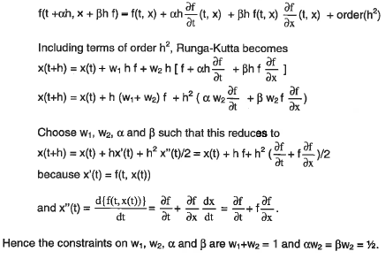

Slide 5
w₁ + w₂ =1 and αw₁ = βw₂ = 1/2
Constraints are satisfied by w₁ = w₂ = 1/2 and α = β = 1, which is choice that gives extended Euler.
Hence 2nd order Runge-Kutta is the same as extend Euler and both are equivalent to 2nd order Taylor series.
Note: F₁ alone is Euler’s method
Pseudo-code text p443

Slide 6
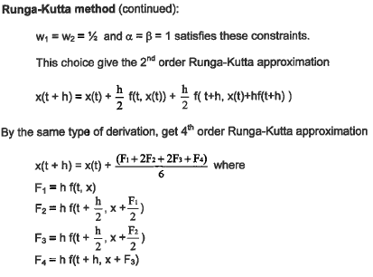
4th order Runge-Kutta
The same approach used to derive RK2 yields a result that is as accurate as Taylor 4th order.
Write a solver for RK4 with same
structure as solver for Euler’s
method

Slide 7
A solver for Rk4 with same structure as solver for
Euler’s method
function [t,x]=RK4(fh,t0,x0,tmax,npts)
n=npts-1;
h=(tmax-t0)/n;
t(1)=t0;
x(1)=x0;
for k=1:n
K1=h*fh(t(k),x(k));
K2=h*fh(t(k)+h/2,x(k)+K1/2);
K3=h*fh(t(k)+h/2,x(k)+K2/2);
K4=h*fh(t(k)+h,x(k)+K3);
t(k+1)=t(k)+h;
x(k+1)=x(k)+(K1+2*K2+2*k3+k4)/6;
end

Slide 8
Runge-Kutta-Fehlberg Method: adjust the size of h as needed
Evaluate both 4th and 5th order Runge Kutta
Use difference as estimate of error
Adjust h to keep error in bounds

Slide 9
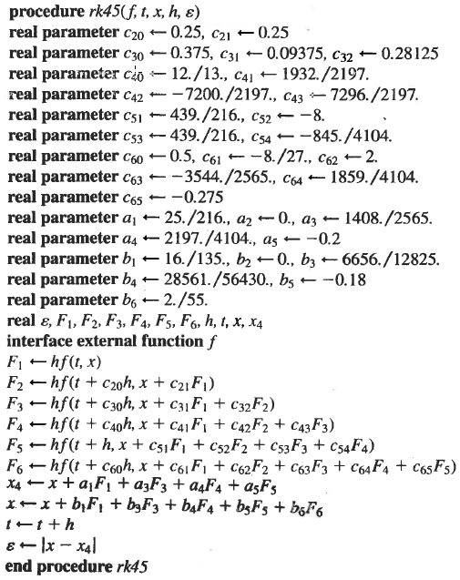
Estimate of the error in x(t)

Slide 10
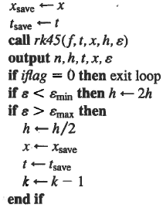
Inside a loop to generate a table of values of x(t)
Basic idea behind MatLabs ODE45

Slide 11
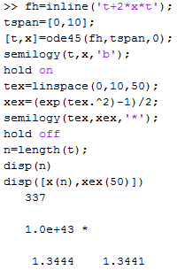
MatLab’s ode45 solver (single ODE)
fh = @(t,x) t+2*x*t
Encoder is inline function.
Specify domain of solution.
ODE45 chooses points
Initial values of x(t)
Semi-log plot compares ode45 to exact
Display number of points
Compare exact to last value
in table to exact

Slide 12
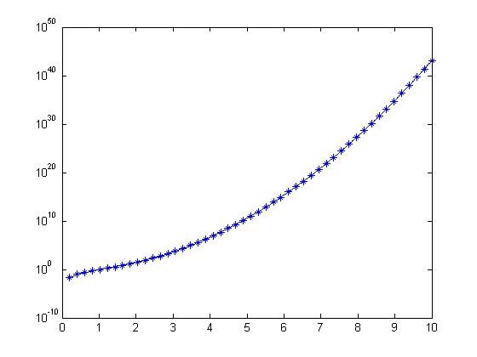
ODE45 (solid curve) vs exact (points)
x(10) correct to 4 significant figures
x(t)
t

Slide 13
Typical script to compare ode45 to an exact solution with plot
fh = @(t,x) …
Encoder is inline function.
Specify domain of solution.
ODE45 chooses points
Initial values of x(t)
plot
plot compares ode45 to exact with fewer points than n
plot
Display number of points
Compare exact to last value
in table to exact

Slide 14
Typical script to compare ode45 to another method with the same number of points
format long
myxp=@(t,x)...;
exact=…;
t0=…;
x0=…;
tmax=…;
tspan=[t0,tmax];
[t,x]=ode45(myxp,tspan,x0);
npts=length(t);
PD=100*abs((x(npts)-exact)/exact);
disp([ t(npts), x(npts), PD])
[t,x]=neweuler(myxp,t0,x0,tmax,npts);
PD=100*abs((x(npts)-exact)/exact);
disp([ t(npts), x(npts), PD])

Slide 15
Assignment 13
Use ode45 to solve x’ = 1 + x² + t³ for x(t=2) given x(t=1) = -4.
Use the same number of points as ode45 to solve for x(t) by
Euler and extended Euler methods.
In all 3 cases, calculate the absolute percent difference from the exact
value x(2) = 4.371221866 on p434 of text.
Hand in a copy of the command window where ode45, neweuler and ex-euler are called.

