Slide 1
Chapter 10 ordinary differential equations (ODEs)
Chapter 11 systems of ODEs (6th edition)

Slide 2
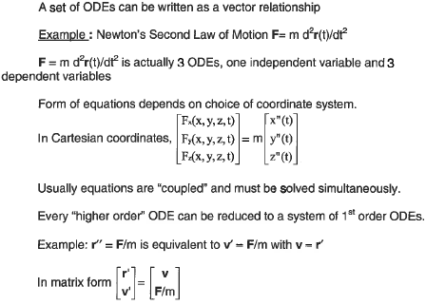
System of ODEs

Slide 3
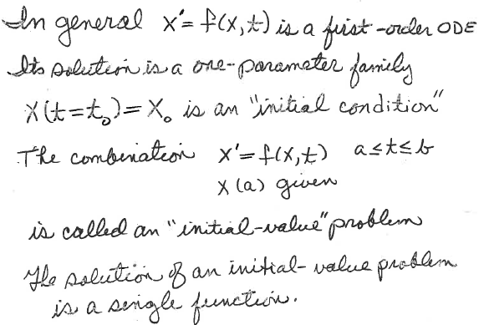
Initial value problems
Regardless of problem statement, identify f(x,t), a, b,
and x(a)

Slide 4
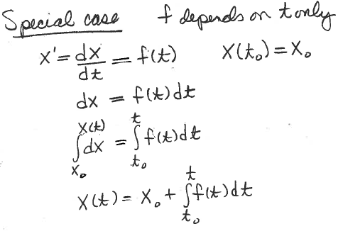
Initial-value problem: x’ = f(x,t); x(t₀) = x₀
Solved by “separation of variables”

Slide 5
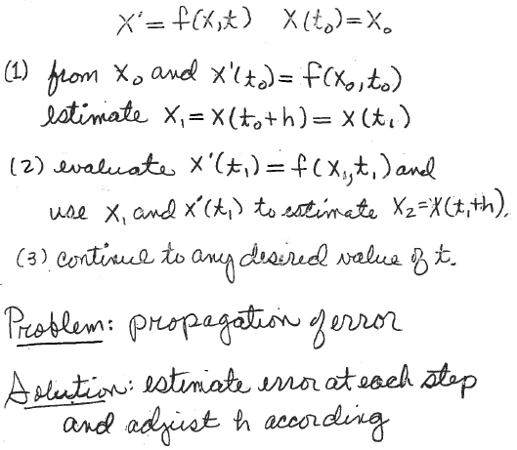
Usually a “boot strap” method is required
An approximate value of x(t₁) was used to calculate x’(t₁)
Solution: use small values of h

Slide 6
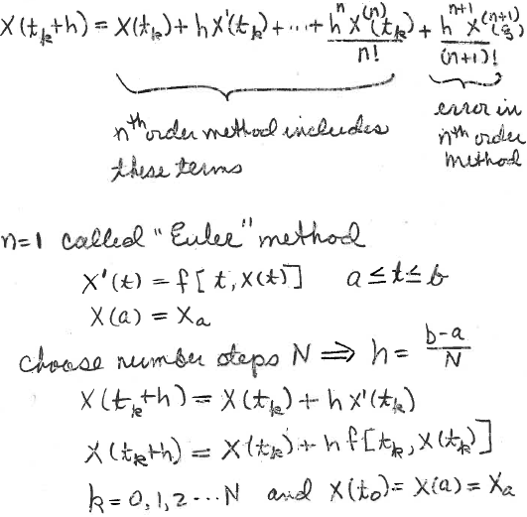
With small h, we can use Taylor-series for x(t_{k}+h)
Given

Slide 7
Pseudo code for Euler’s method to solve
x’=f(x,t), x(t₀)=x₀ t₀<t<t_{max}
Advance the table using
x(t+h) = x(t) + hx’(t, x(t))
where h is the common step size
Use the following conventions:
initial condition is 1st table entry
last table entry is at t_{max}
npts=number of table entries

Slide 8
Pseudo code for Euler’s method
function [t,x]=euler(fh,t0,x0,tmax,npts)
% fh is a function handle for x’=f(t,x(t))
Calculate number of steps
Calculate the step size = h
Assign values to t(1) and x(1)
In a For-Loop from 1 to number of steps
t(k+1)=t(k)+h
x(k+1)=x(k)+h*fh(t(k),x(k));
Note the order of arguments when fh is used
In your script, the definition of fh myxp=@(t,x)... must have the same order …;

Slide 9
A solver for Euler’s method
x(t+h) = x(t) + hx’(t, x(t))
function [t,x]=neweuler(fh,t0,x0,tmax,npts)
n=npts-1;
h=(tmax-t0)/n;
t(1)=t0;
x(1)=x0;
for k=1:n
t(k+1)=t(k)+h;
x(k+1)=x(k)+h*fh(t(k),x(k));
end
Note: neweuler returns 2 vectors. x(npts) is solution at tmax.
Use plot(t,x) to show results.

Slide 10
Example: Use Euler’s method to solve
x’ = 1 + x² + t³ for x(t=2) given x(t=1) = -4
Use 10 points, plot result, and
compare to “exact” value x(t=2)=4.371221866 (text p434)
Download function “neweuler” from the class web page
Write a script to use it to solve this problem.
Run the script
What answer do you get?

Slide 11
Example: Use Euler’s method to solve
x’ = 1 + x² + t³ for x(t=2) given x(t=1) = -4
Use 10 points, plot result, and
compare to “exact” value x(t=2)=4.371221866 (text p434)
myxp=@(t,x) 1 + x^2 + t^3;
exact=4.371221866;
t0=1;
x0=-4;
tmax=2;
npts=10;
[t,x]=neweuler(myxp,t0,x0,tmax,npts);
plot(t,x)
PD=100*abs((x(npts)-exact)/exact);
disp([ t(npts), x(npts), PD])

Slide 12
Taylor-series methods
We can use analytical expressions for x’’(t), x’’’(t), etc., to
develop a Taylor-series method of any order we choose;
however, the accuracy of Euler can be improved by a simpler
approach.
Given

Slide 13
Predictor-Corrector Methods:
At every value of t, predict x_{p}(t+h)
Use x_{p}(t+h) to get a more accurate x(t+h)
Example: extended Euler
x_{p}(t+h) = x(t) + hx’(t,x(t)) (normal Euler)
x’(t,x(t)) is slope at t using x(t)
x’(t+h,x_{p}(t+h)) is slope at t+h using x_{p}(t+h)
Average these slopes to get a better x(t+h)
x(t+h) = x(t) + h[x’(t,x(t))+x’(t+h, x_{p}(t+h))]/2
Modify newruler to create ex_euler

Slide 14
A solver for Euler’s method
x(t+h) = x(t) + hx’(t, x(t))
function [t,x]=neweuler(fh,t0,x0,tmax,npts)
n=npts-1;
h=(tmax-t0)/n;
t(1)=t0;
x(1)=x0;
for k=1:n
t(k+1)=t(k)+h;
x(k+1)=x(k)+h*fh(t(k),x(k));
end

Slide 15
Solver for Extended Euler method
function [t, x]=ex_Euler(fh, t0, x0, tmax, npts)
n=npts-1;
h=(tmax-t0)/n;
t(1)=t0;
x(1)=x0;
for k=1:n
t(k+1)=t(k)+h;
dx1=h*fh(t(k),x(k));
dx2=h*fh(t(k+1),x(k)+dx1);
%x(k)+dx1 is Euler approximation used as predictor
x(k+1)=x(k)+(dx1+dx2)/2;
end
end

Slide 16
Use extended Euler’s method to solve
x’ = 1 + x² + t³ for x(t=2) given x(t=1) = -4
Use 10 points, plot result, and
compare to “exact” value x(t=2)=4.371221866 (text p434)
Download function “ex_euler” from the class web page
Write a script to use it to solve this problem. Run the script
What answer do you get?

Slide 17
Assignment 12
Compare Euler and extended Euler for the solution of
x’ = 1 + x² + t³ for x(t=2) given x(t=1) = -4 using 10 points.
Report the absolute percent difference of from the “exact” value
x(t=2) = 4.371221866 for the 2 methods
Hand in a copy of the command window where neweuler and ex-euler are called.

Slide 18
Problem-specific Taylor series method

Slide 19
Taylor-series methods
We will show later that extended Euler is equivalent to Taylor-series with n=2.
We can use analytical expressions for x’’(t), x’’’(t), etc., to develop a Taylor-series
method of any order we choose
How do we get these analytical expressions for x’’(t), x’’’(t), etc?
Given

Slide 20
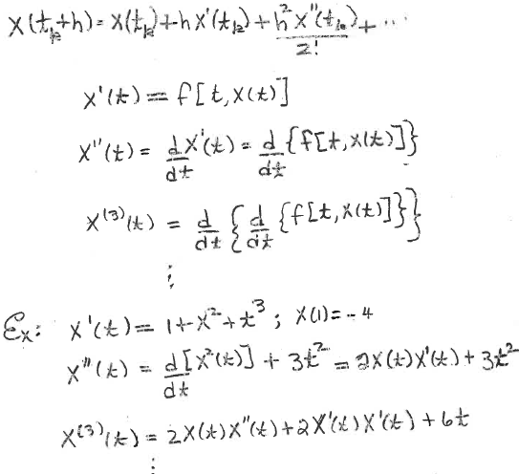
Higher-order derivatives for use in Taylor series methods
given
etc.
Use these analytical expressions for higher-order derivatives in the
Taylor series to relate x(t+h) to x(t). Since x’(t) has both explicit and implicit time dependence, we most apply the chain rule.

Slide 21
Pseudo code for high-order Taylor-series method
Given the value of x(t₀) by initial conditions
Evaluate x’(t₀), x’’(t₀), x’’’(t₀), etc.
Calculate x(t₀+h) = x(t₀)+hx’(t₀)+h²x’’(t₀)/2…
Evaluate x’(t₀+h), x’’(t₀+h), x’’’(t₀+h), etc.
Calculate x(t₀+2h) = x(t₀+h)+hx’(t₀+h)+h²x’’(t₀+h)/2…

Slide 22
Example:
Use 4th order Taylor series to solve
x’ = 1 + x² + t³ for x(t=2) given x(t=1) = -4.
First task, derive x”, x’”, and x⁽⁴⁾ from x’(t,x(t))
Do on board

Slide 23
x’ = 1 + x² + t³
x” = 2xx’ + 3t²
x’’’ = 2xx’’ + 2x’x’ +6t
x⁽⁴⁾ = 2xx’’’ + 6x’x’’ + 6
Substitutions to make x”, x’”, and x⁽⁴⁾ functions of t and x(t) are not necessary if we calculate x”, x’”, and x⁽⁴⁾ in sequence. (i.e., use the value of x’ in calculation of x’’, use the value of x’’ in calculations of x’”, etc.)
Use these results to write a function to solve x’ = 1 + x² + t³ for x(t=2) given x(t=1) = -4 by 4th order Tayor method.

Slide 24
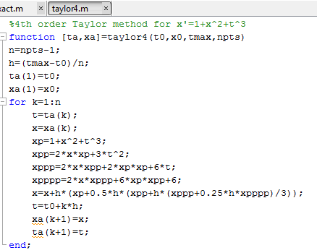
Note: no function handle in arguments
This code is for a specific problem.

Slide 25
Use the Taylor series method to solve
x’ = 1 + x² + t³ for x(t=2) given x(t=1) = -4
Use 10 points, plot result, and
compare to “exact” value x(t=2)=4.371221866 (text p434)
Download function “taylor4” from the class web page
Write a script to use it to solve this problem. Run the script
What answer do you get?

Slide 27
Script for HW12
myxp=@(t,x) 1 + x^2 + t^3;
exact=4.371221866;
t0=1; x0=-4; tmax=2; npts=10;
[t,x]=neweuler(myxp,t0,x0,tmax,npts);
PD=100*abs((x(npts)-exact)/exact);
disp([ t(npts), x(npts), PD])
[t,x]=ex_euler(myxp,t0,x0,tmax,npts);
PD=100*abs((x(npts)-exact)/exact);
disp([ t(npts), x(npts), PD])

