Slide 1
Chapter 2:
Floating point number systems and Round-off error
Floating point number system = the set of real numbers
that can be represented exactly by a finite word length.
fl(x) = the machine number that represents real number x
Called the “floating point” representation of x
|fl(x) – x| = round-off error in fl(x)
The distance between 1 and the next larger floating-point number is a common measure of round-off error called “machine epsilon” and denoted ε _{mach}

Slide 2
Definition of a floating-point number system
β = base
p = precision (number of digits: d₀, d₁,…d_{p-1})
L = lower limit of exponent
U = upper limit of exponent
All floating-point numbers in the system can be written as
fl = (d₀ + d₁/β + d₂/β² + ... + d_{p-1}/β^{p-1})β^{E}
A period is commonly placed between d₀ and d₁
The base is commonly indicated by a subscript on d_{p-1}
Example: 1.11₂x2¹ = (3.5)₁₀ (1+1/2+1/4)2=7/2
In a normalized system d₀ ≠ 0
0 < d_{i} < β -1 for i = 1, ..., p-1
E is any integer such that L < E < U.

Slide 3
Floating-point number system are finite and discrete:
number of normalized floating-point numbers =
1+2(β-1)β^{p –1} (U – L + 1) explain
smallest possible = UFL = β^{L} explain
largest possible = OFL = β^{U +1} (1-β^{-p}) prove
ε _{mach} = β^{1-p} derive

Slide 4
fl = +(d₀ + d₁/β + d₂/β² + ... + d_{p-1}/β^{p-1})β^{E}
Number for floating-point numbers=1+2(β-1) β^{p –1} (U – L + 1)
Zero
2 choices of sign,
(β-1) choices for first digit,
β choices for the remaining p-1 digits,
(U-L+1) choices for the exponent

Slide 5
fl = (d₀ + d₁/β + d₂/β² + ... + d_{p-1}/β^{p-1})β^{E}
Smallest positive floating-point number = UFL = β^{L}
Smallest values for digits and exponent
ε _{mach} = distance between 1 and next floating-point number
When E = 0, next floating-point number above 1 is 1+1/β^{p-1} = 1+β^{1-p}
Largest positive floating-point number (do on board)

Slide 6
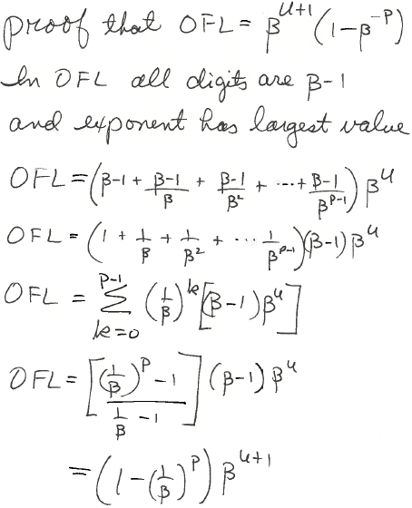
Multiply by β/β
Factors (β-1) cancel

Slide 7
fl = +(d₀ + d₁/β + d₂/β² + ... + d_{p-1}/β^{p-1})β^{E}
Example of quiz question:
β = base = 2
p = precision (number of digits: d₀, d₁,…d_{p-1}) =3
L = lower limit of exponent = -1
U = upper limit of exponent = 1
Total number of floating-point numbers = ?
UFL = ?
OFL = ?
ε _{Mach =} ?

Slide 8
Bring this slide to the next quiz
number of normalized floating-point numbers = 1+2(β-1)β^{p –1} (U – L + 1)
smallest possible = UFL = β^{L}
largest possible = OFL = β^{U +1} (1-β^{-p})
ε _{mach} = β^{1-p}

Slide 9
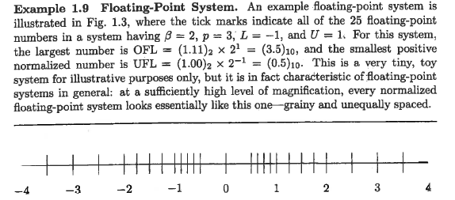
What is ε_{mach} in this system?
Note gap between 0 and β^{L} (UFL)
Filled be allowing d₀ to be zero when exponent has smallest value
Called “sub-normals”
What are the sub-normals in this system (do on board)

Slide 10
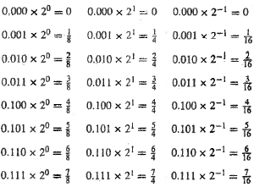
All numbers of the form (0.b₁b₂b₃)₂ x 2^{k} k = 0,+1 (text p55)
Which are excluded from a normalized system when β=2, p=3, L=-1, U=1?
Move the point with adjustment of the exponent until d₀ = 1. Is the exponent in the allowed range?
Which ones come back when sub-normals are allowed?
Among the last column, which can be represented by 3 digits when the leftmost digit is counted as d₀?

Slide 11
ε_{uro} (called “unit round off”) ≡ upper bound on absolute value of the relative round-off error in the floating-point representation of x
|(fl(x)-x)/x| < ε_{uro} depends on the method of round off
chop = drop digits when word length is exhausted
fl(x) is the nearest machine number on the side of x toward zero
Also called “round toward zero”.
ε_{uro} = β^{1-p} = ε_{mach}
round to next means fl(x) is the nearest machine number to x
on either side with ties broken by choosing the floating-point number
with last stored digit even.
ε_{uro} = 0.5β^{1-p}

Slide 12
Errors in floating-point arithmetic due to round-off error
fl(x op y) is the result of instruction x op y in floating point arithmetic.
Recall that ε_{uro} ≡ upper bound on relative round-off error
Relative floating-point error is
= |δ| < ε_{uro}
Drop absolute values and solve for fl(x op y)
fl(x op y) = (x op y)(1 + δ), where |δ| < ε_{uro}
fl(y + z) = (y + z)(1 + δ₁) where |δ₁| < ε_{uro}
fl(x(y + z)) = (x(y + z)(1 + δ₁))(1 + δ₂) where |δ₂| < ε_{uro}
fl(x(y + z)) = (x(y + z)(1 + δ₁ + δ₂) + O(δ₁δ₂)
fl(x(y + z)) = (x(y + z)(1 + δ) where |δ| = |δ₁ + δ₂| < 2ε_{uro}
Fortunately, errors in floating point arithmetic tend to cancel out

Slide 13
Loss of significance: when round-off error matters
Subtraction of two numbers of same sign and nearly the same magnitude
results in the loss of the most significant (i.e., leading) digits of the operands
Example: if 0 < ε < ε_{mach} then fl(1 + ε) – fl(1 – ε) = 1 – 1 = 0 ≠ 2ε
Note that the subtraction operation is exact for its operands
The rounding error prior to subtraction left the operands with inadequate
precision.
Subtraction has simply enhanced the implications of rounding error.
Example: Calculating standard deviation
σ² =
(x_{i} - <x>)² safe method (2 passes)
σ² =
x_{i}² – n<x>²) sensitive to round-off error (single pass)

Slide 14
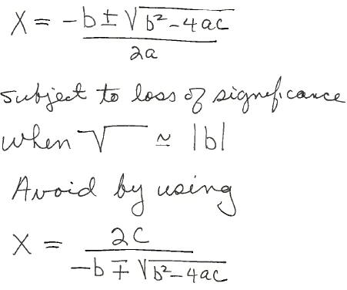
Example 2:
Solution of ax² + bx + c = 0 by quadratic formula
for the root that is affected
by loss of significance

Slide 15
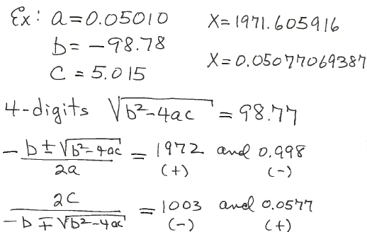
Example: loss of significance when
ax² + bx + c = 0 solved by quadratic formula

Slide 16
Problem from text p56 #18 :
β=10, p=5, rounds to nearest.
Find all x such that fl(1+x)=1.

Slide 17
Problem from text p56 #18 :
β=10, p=5, rounds to nearest.
Find all x such that fl(1+x)=1.
Solution: fl(1)=1.0000
If x < 0.00005 fl(1+x)=1
Similarly for negative machine number
Answer |x| < 0.00005

Slide 18
Problem from text p58 #38 :
β=10, p=5, rounds to nearest.
x=0.5321487513
y=0.5321304421
Find the relative error in fl(x)-fl(y).

Slide 19
Problem from text p58 #38 :
β=10, p=5, rounds to nearest.
x=0.5321487513
y=0.5321304421
Find the relative error in fl(x)-fl(y).
Solution:
fl(x)=5.3215x10⁻¹ fl(y)=5.3213x10⁻¹
fl(x)-fl(y) = 2.0000x10⁻⁵
x-y = 0.0000183092
100|(fl(x)-fl(y))-(x-y))/(x-y)|=9.2%

Slide 20
Problem from text p68 #4:
y = 1-sin(x),
For what values of x, does this assignment of a value to y involve loss of significance?
Find a way to make the assignment without loss of significance.

Slide 21
Problem from text p68 #4:
y = 1-sin(x),
For what values of x, does this assignment of a value to y involve loss of significance?
Find a way to make the assignment without loss of significance.
Solution:
When x ~ π/2, sin(x)~1, y~0 with low significance.
(1-sin(x)) 1+sin(x) = (1-sin²(x)) = cos²(x)
1+sin(x) 1+sin(x) 1+sin(x)
y = cos²(x)/(1+sin(x)) when x ~ π/2 the value assigned to y~0 but with high precision.

Slide 22
Solution to Problem from text p69 #6:
f(x) = tan(x)-sin(x)
x-sqrt(1+x²)
For what values of x is the denominator ~ 0 with low significance?
What is the solution?

Slide 23
Solution to Problem from text p69 #6:
f(x) = tan(x)-sin(x)
x-sqrt(1+x²)
For x>>1 denominator ~ 0 with low significance.
Solution: rationalize the denominator
f(x) = (tan(x)-sin(x)) x+sqrt(1+x²) = (sin(x)-tan(x))(x+sqrt(1+x²))
x-sqrt(1+x²) x+sqrt(1+x²)
when x>>1, x+sqrt(1+x²) ~ 2x very large with high significance.

Slide 24
Solution to Problem from text p69 #6:
f(x) = tan(x)-sin(x)
x-sqrt(1+x²)
After rationalizing the denominator
f(x) = (sin(x)-tan(x))(x+sqrt(1+x²))
When x~0, f(x) ~ (sin(x)-tan(x))(1+x) ~ 0 with low significance because both sin(x) and tan(x) approach zero as x->0.
Solution: Use power series for sin(x) and tan(x). Keep the term with the lowest power of x that does not cancel.
Do on board

Slide 25
Solution to Problem from text p69 #6:
f(x) = tan(x)-sin(x)
x-sqrt(1+x²)
After rationalizing the denominator
f(x) = (sin(x)-tan(x))(x+sqrt(1+x²))
When x~0, f(x) ~ (sin(x)-tan(x))(1+x) ~ 0 with low significance because both sin(x) and tan(x) approach zero as x->0.
Solution: Use power series for sin(x) and tan(x). Keep the term with the lowest power of x that does not cancel.
f(x) ~ -(x³/2) (1+x) ~ 0 with high significance when x~0

Slide 26
Assignment 11: show all algebra in derivations
(a) Derive a form of the function f(x) = sqrt(x²+1) - x that can be evaluated at x>>1 without loss of significance.
(b) Use power series to derive a form of f(x) = exp(x)-sin(x)-cos(x) that can be evaluated at x near zero without loss of significance.
(c) Find solutions of quadratic equation x² – 10⁵ x + 1 = 0 without loss of significance.

Slide 27
Express these base 2 numbers as fractions

Slide 28
Which of the base 2 number below are part a normalized system when β=2, p=3, L=-1, U=1?

Slide 29
Which of the base 2 number below are sub-normals in the system β=2, p=3, L=-1, U=1?

Slide 30
Problem from text #18 p56:
β=10, p=5, rounds to nearest.
Find all x such that fl(1+x)=1.

Slide 31
Problem from text p69 #6:
f(x) = tan(x)-sin(x)
x-sqrt(1+x²)
For what values of x is it difficult for evaluate f(x) without loss of
significance?
Find an approximation to f(x) without this problem.

Slide 32
Problem from text p58 #38 :
β=10, p=5, rounds to nearest.
x=0.5321487513
y=0.5321304421
Find the relative error in fl(x)-fl(y).

Slide 33
Problem from text p68 #4:
y <- 1-sin(x)
For what values of x does this assignment involve loss of significance?
Find a way to make the assignment without loss of significance.

