Slide 1
Laguerre quadrature

Slide 2
Integrand diverges at the lower limit, but the integral has a finite value.
Anti-derivative of x^{-1/2} is 2x^{1/2}
= 2
Exact value of 2. Can it be estimated by the composite trapezoid and Simpson rule? What about Gauss quadrature?

Slide 3
Change the variable of integration in
by the transformation y = ln(1/x) = -ln(x)

Slide 4
Change the variable of integration in
y = ln(1/x) = -ln(x)
when x=0 y=infinite
when x=1 y=0
dy = -dx/x
x(y) = exp(-y)

Slide 5
By arguments like the Guass-quadrature theorem, Laguerre derived an approximation to infinite integrals in which the integrand is evaluated at the zeroes of the Laguerre polynomials
This formula only can be applied when f(x) is rapidly decreasing with increasing x, which is required for the integral to be finite.

Slide 6
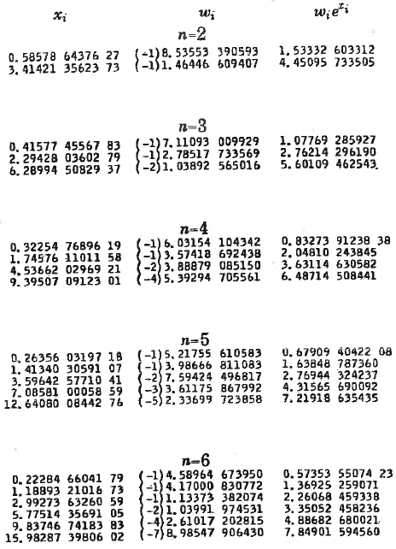
Note:
Only applies to 1 type of integral
Less symmetry than with Gauss quadrature
Use first and last columns. Watchout for errors in data entry.

Slide 7
Pseudo-code LQ2345(f)
% Laguerre quadrature for integral between 0 and infinity with 2-5 points
enter points and weights from table
initialize sum
for each number of points
calculate integrand where it is to be sampled
calculate weighted average of integrand samples
return values

Slide 8
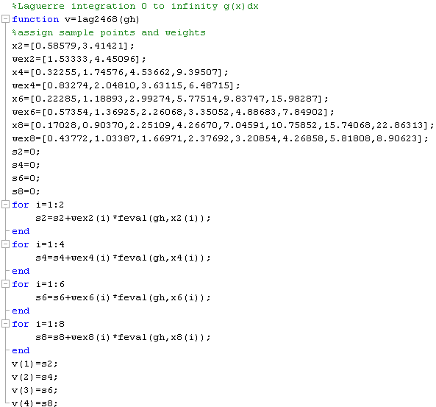
Note that the only argument is a function handle for the integrand and output is a vector.

Slide 9
Download lag2345_Garima.m from the class web page

Slide 10
Assignment 10
Approximate integral in x variable by Gauss quadrature with 2, 3, 4, and 5 points
Approximate integral in y variable by Laguerre quadrature with 2, 3, 4, and 5 points
Report your results as a table of absolute percent difference from exact = 2.
Hand in a copy of the command window where Gauss and Laguerre are called.

Slide 11
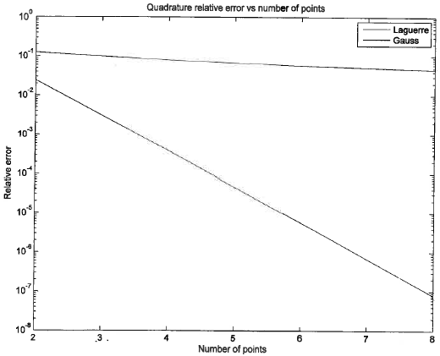
Gauss with x as integration variable
Laguerre with y = -ln(x) as integration variable

