Slide 1
Gauss Quadrature

Slide 2
Let {x₀, x₁, …, x_{n}} be n+1 points on [a, b] where integrand evaluated, then the numerical integration formula
Will be exact for polynomials of degree at least n.
Derive weights by a system of n+1 linear equations obtained by requiring the formula to be exact for
f(x) = 1, x, x², …x^{n}
Trapezoid rule: (n = 1) exact for a line
In general, error proportional to |f’’(ζ)|
Simpson’s rule: (n = 2) exact for a cubic
In general, error proportional to |f⁽⁴⁾(ζ)|
How is this extra performance (cubic) possible?

Slide 3
Gauss quadrature
Gauss quadrature extents the idea of Simpson’s rule to its logical extreme: Give up all freedom about where the integrand will be evaluated to maximize the degree of polynomial for which formula is exact.
Theorem: nodes {x₀, x₁, …, x_{n}} exist on [a, b] such that
is exact for polynomials of degree at most 2n+1
Nodes are zeros of polynomial g(x) of degree n+1 defined by
for 0 < k < n
How many coefficients are in a polynomial of degree n+1?

Slide 4
Proof of Gauss quadrature theorem

Slide 5
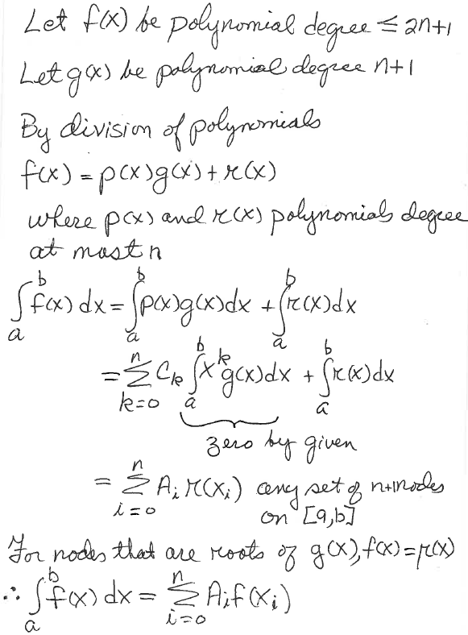
Write p(x) as c₀ + c₁x +…+ c_{n}x^{n}
Exact for polynomial degree 2n+1

Slide 6
Example of Gauss quadrature
3 nodes on [-1, 1] gives approximation
Steps in deriving this quadrature result (finding x_{k} and A_{k})
1. Find cubic g(x) such that
for 0 < k < 2
Is this enough information to define a cubic?
2. Find roots of g(x) (values of x_{k} )
3. Find the weights A₀, A₁ and A₂
Do on board

Slide 7
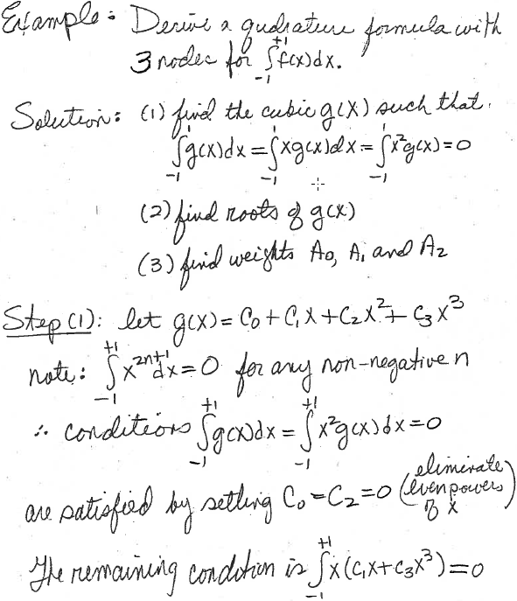
Degree of g(x) = number of nodes
conditions on g(x)
Number of conditions not sufficient
to determine all the coefficients
Terms with odd powers of x in g(x) do not
contribute to these integrals due to
symmetry

Slide 8
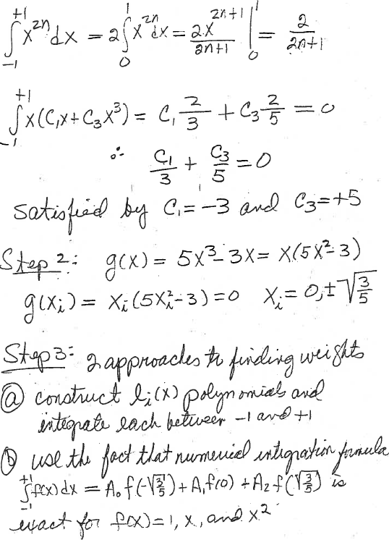
Determines ratio of C₁ and C₃ only.
As noted before, number of
conditions on g(x) insufficient
to determine all 4 coefficients
of a cubic but are sufficient to
determine the zeros

Slide 9
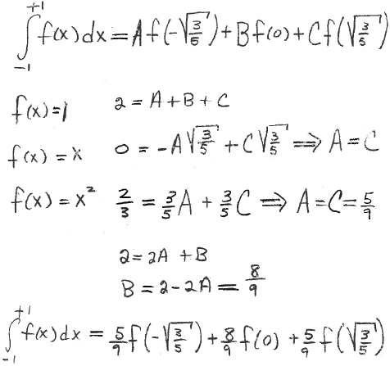
Using plan (b)
Compare with table 6.1, text p236

Slide 10
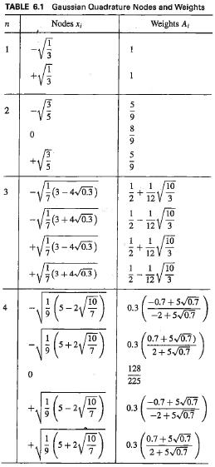
Table from C&K 6th ed. p236
We derived the result for n=2 (aka 3 points)
Note symmetry of points and weights
1.odd number always contains 0
2.nonzero points, symmetric about origin, always have same weight

Slide 11
Points and weights of Gauss quadrature are determined for
To use these points and weights for an integral from a to b, we make a change of integration variable that transformed the integral from a to b into an integral from -1 to 1
Do on board

Slide 12
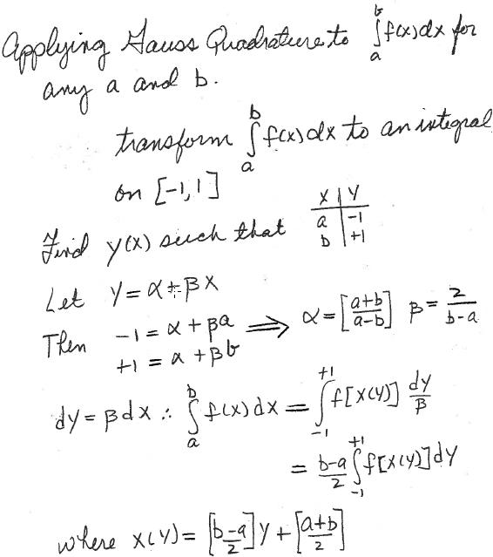
Given values of y from table, this x(y)
determines values on [a,b] where
integrand will be evaluated

Slide 13
Gauss quadrature with n+1 points
Points and weights from 2, 3, 4, and 5 points: table 6.1, text p236
Example:
Do on board

Slide 14
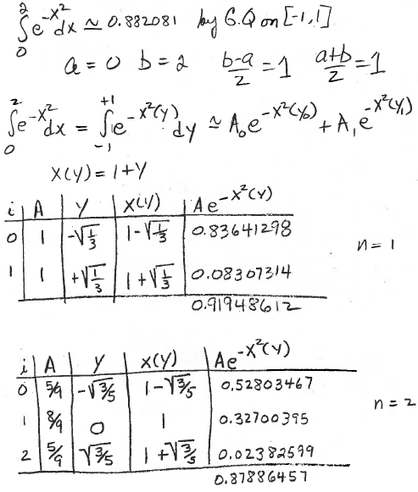
(no anti-derivative)
with 2 nodes

Slide 15
Assignment 9
Find functions for Gauss quadrature with 2, 3, 4 and 5 points on the class web page. Apply these functions to the integral
Take -18.79829683678703 as the exact value. Hand in a copy of the command window where you called the Gauss functions and calculated the absolute percent differences from the exact value 100abs((exact-Gauss)/exact).

Slide 16
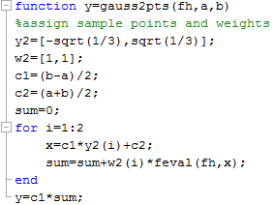
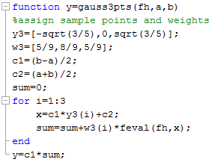
fh(x);
fh(x);
Arguments of functions are function handle and range of integration.
No vector input.

Slide 17
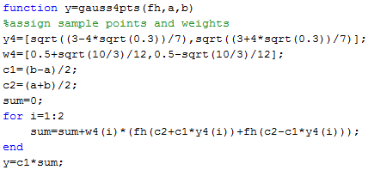
These functions take advantage of the symmetry of points and weights.
For loop is shorter than number of points
Contribution from y=0 used to initialize sum.

Slide 18
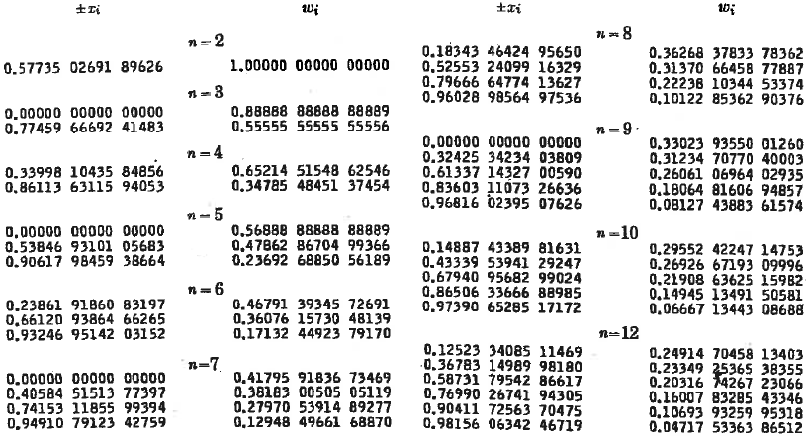
More extensive tables of nodes and weights than given in text. Note that symmetry has been used to compress the table. Verify that values for n = 2 to 5 are the same as n = 1 to 4 in table from text. Watch out for data entry errors.

