Slide 1
Review for Quiz 1 Jan 22, 2025
lectures L1 and L4
assignments 1 and 4
text chapters 1 and 3
topics
line-by-line analysis of runtime
induction on integers for sums
evaluating sums
informal proof of Theta
formal proof of Big O and Big omega
proof of little o and little omega by taking limits

Slide 2
Line-by-line analysis: Given a pseudo code
Count number of operations in each line
In loop control, include operation resulting in failure
Specialize count to worst case
What type of input leads to worst case?
Add the cost of each line to get the worst-case total cost.
Find the dominant term at large n
Express the worst-case total cost in Big O notation

Slide 3
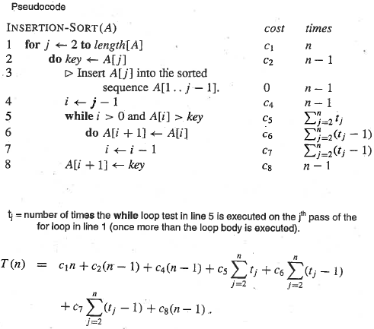
Worst case analysis of insertion sort: t_{j} = j
In worst-case, every element in A[1…j-1] sorted part of the array must be moved to the right. With t_{j} = j sums can be evaluated because they are related to the arithmetic sum
j
j
j
Evaluate these sums (do on board)

Slide 4
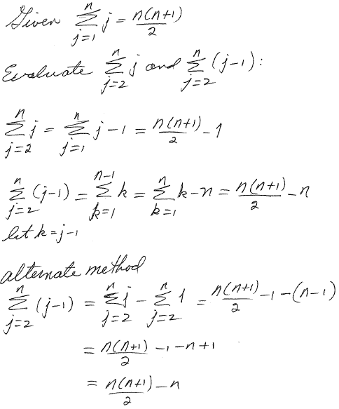
Use the arithmetic sum to evaluate the sums in the analysis of insertion sort runtime

Slide 5
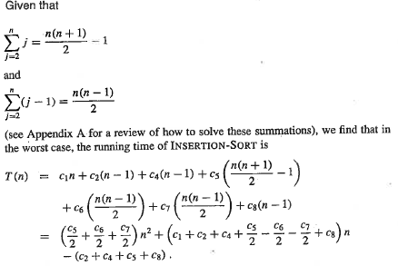
Collecting terms with the same power of n: T(n) = a + bn + cn²
This is an upper bound that has the possibility of being equal
to the runtime
In notation of Chapter 3, T(n) = O(n²)
We find the quadratic dependence of runtime on input size in worst case

Slide 6
Prove by induction on integers that
Σ_{k=1 to n} k = n(n+1)/2
Structured proof:
Base case: test if true for n=1
what is the RHS equal to when n=1?
what is the LHS equal to when n=1?
are they the same?
Setup equation: S(n) is on the LHS and S(n-1) is on the RHS
Inductive hypothesis (IH): assume S(n-1) is true to enables algebra
Application of IH: equations with S(n) on the LHS and all algebraic manipulations on the RHS.

Slide 7
Assignment 2
Prove by induction on integers that recurrence
T(2^{k}) = 2 if k=1
T(2^{k}) = 2T(2^{k-1}) + 2^{k} if k>1
has solution T(2^{k}) = k2^{k}
For k=1, base case is true by definition
Prove base cases for k=2.
Setup equation: T(2^{k}) = 2T(2^{k-1}) + 2^{k}.
Inductive hypothesis: assume solution valid for T(2^{k-1})
Application: substitute inductive hypothesis into setup equation and simplify

Slide 8
Informal proofs of Θ notation
If we have an equation for f(n), and g(n) is the dominant term
in that equation at large values of n, then f(n) = Θ(g(n))
Example: Show by informal proof that (n+a)^{b} = Θ(n^{b})
real a & b a not zero b > 0
Binomial expansion: (n+a)^{b} = C_{b}n^{b} + C_{b-1}n^{b-1}+…+C₀
Since n^{b} is dominant term at large n, (n+a)^{b} = Θ(n^{b})
by informal proof

Slide 9
Structured proof that max(f(n),g(n)) = Ο(f(n)+g(n))
1. Find c and n₀ such that 0 < max(f(n),g(n)) < c(f(n)+g(n)) all n>n₀
2. Arguments for values of c and n₀
choose n₀ so that f(n) and g(n) are non-negative for all n>n₀
Since f(n) and g(n) are non-negative,
0 < max(f(n),g(n)) < f(n)+g(n) for all n>n₀
hence choose c=1
3. Conclusion
exist c=1 so that 0<max(f(n),g(n)) < c(f(n)+g(n)) all n>n₀
hence, max(f(n),g(n)) = Ο(f(n)+g(n)) by definition
Structured proof that max(f(n),g(n)) = Ω(f(n)+g(n)) is similar.

Slide 10
Little o notation
f(n) = o(g(n)) means f(n) is a member of a set of functions
such that for any c > 0 (no matter how small)
0 < f(n) < cg(n) all n > n₀
Can only be true if f(n) is insignificant relative to g(n) at large n
Equivalent to limit f(n)/g(n) = 0
n →∞
g(n) is strictly an asymptotic upper bound on f(n)
Asymptotic equality (within a constant) of f(n) and g(n) is
excluded
2n = o(n²) 2n² is not o(n²) (see text p 50)

Slide 11
Little omega notation
f(n) = ω(g(n)) means f(n) is a member of a set of functions
such that for any c > 0 (no matter how large)
0 < cg(n) < f(n) all n > n₀
Can only be true if g(n) is insignificant relative to f(n) at large n
Equivalent to limit g(n)/f(n) = 0
n →∞
g(n) is strictly an asymptotic lower bound on f(n)
Asymptotic equality of f(n) and g(n) is excluded
n²/2 = ω(n) n²/2 is not ω(n²) text p51

Slide 12
Prove that 2^{n} = ω(2^{n/2})
What is f(n)?
What is g(n)?
What is limit g(n)/f(n)?
n →∞

Slide 13
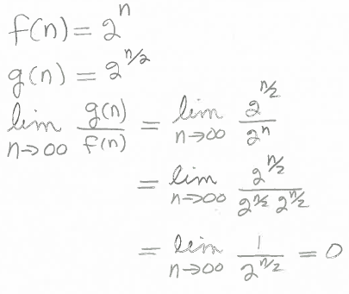

Slide 14
Assignment 4
Use Stirling’ approximation,
to show that n! = o(n^{n}) and n! = ω(2^{n})
May be a mixture of algebra and Lhopital’s rule
n! = (2πn)^{1/2} (n/e)^{n} (1+Θ(1/n)) -> (2πn)^{1/2} (n/e)^{n} for large values of n

