Slide 1
Chapter 23:
Minimum Spanning Trees:
A graph optimization problem
Given undirected graph G(V,E) and a weight function
w(u,v) defined on all edges (u,v) ∈ E, find an acyclic
subset T ⊆ E that connects all the vertices and for which
the total weight is a minimum
w(T) =

Slide 2
Any acyclic subset T ⊆ E that connects all the vertices is a spanning tree.
Any T with minimum total weight is a minimum-weight spanning tree.
Most often called “minimum spanning tree

Slide 3
Chapter 23 covers 2 approaches for solving the minimum spanning tree problem; Kruskal’s algorithm and Prim’s algorithm.
Both are examples of greedy algorithms (no global search strategy)
Generic greedy MST(G,w)
A = null set
while A is not a minimum spanning tree
add the lightest edge unless it generates a cycle
(trees are acyclic graphs)

Slide 4
Growing a minimum spanning tree (MST):
G(V,E) is an undirected graph.
A is subset of V that defines part of a MST.
edge (u,v) is a safe edge if A ∪ (u,v) is also
part of a MST.
Kruskal and Prim algorithms differ in how they search for safe edges.
Safe edges are defined by “cuts”.

Slide 5
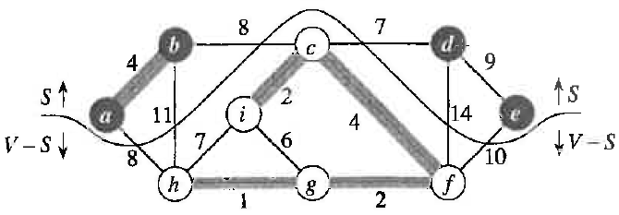
Theorem 23.1(next slide) provides a rule for finding safe edges
A cut (S,V-S) is a partition of vertices in G(V,E)
Edge (u,v) crosses cut (S,V-S) if one end is in S and
the other is V-S
A cut respects set A if no edge in A crosses the cut
An edge that crosses a cut is a light edge if it has the
minimum weight of edges crossing the cut
Edges in A are shaded. White and black V’s are in different parts of partition. (c,d) is a light edge and a safe edge for growing MST.

Slide 6
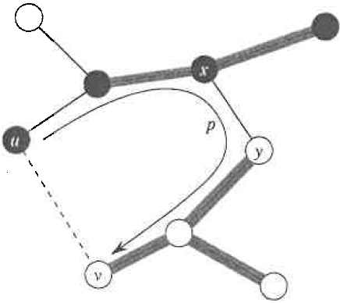
Theorem 23.1
Let (S,V-S) be a cut in G that respects A, a growing MST.
Let (u,v) be a light edge crossing (S,V-S).
Then (u,v) is a safe edge for A.
Proof: Let T be a MST that contains A (shaded) and (x,y)
but not (u,v).
Both (u,v) and (x,y) cross (S, V-S) (connect B&W vertices).
Define T′ = {T – (x,y)}∪{(u,v)}
w(u,v) < w(x,y) because (u,v) is a light edge
w(T′) = w(T) – w(x,y) + w(u,v) < w(T)
but T is a MST ∴ w(T) < w(T′)
∴ w(T′) must also be a MST
∴ (u,v) is a safe edge for A

Slide 7
Corollary 23.2:
G(V,E) a is connected, undirected, weighted graph.
A is a subset of E that is included in some MST of G.
G_{A} (V,A) is a forest of connected components (V_{C},E_{C}),
each of which is a tree.
If (u,v) is a light edge connecting C to some other
component of A, then (u,v) is a safe edge of A
Proof: cut (V_{C}, V-V_{C}) respects A and crosses (u,v)
∴ (u,v) is a safe edge by Theorem 23.1

Slide 8
Corrllary 23.2 is basis for Krustal algorithm
Look for a cut that respects the growing MST, A, and crosses the lightest edge not already in A.
If such a cut exists, include lightest edge in A; otherwise repeat with next lightest edge.
Repeat until all vertices are in the MST

Slide 9
Example from text

Slide 10
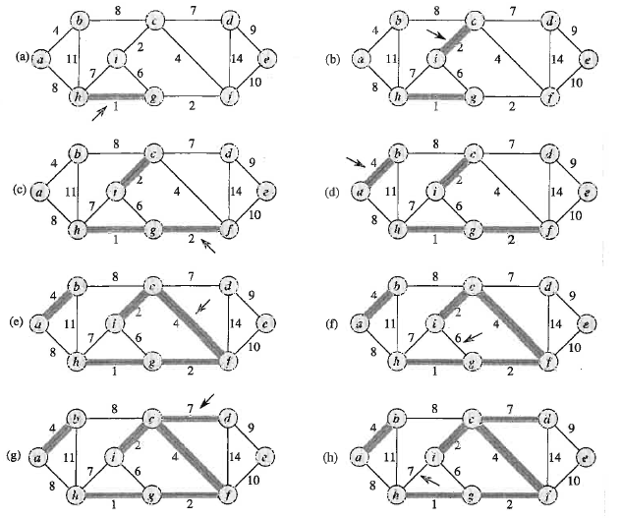
Steps in Krustal’s Algorithm
Sometimes you
can’t add the light
edge
(no cut or will
create a cycle)

Slide 11
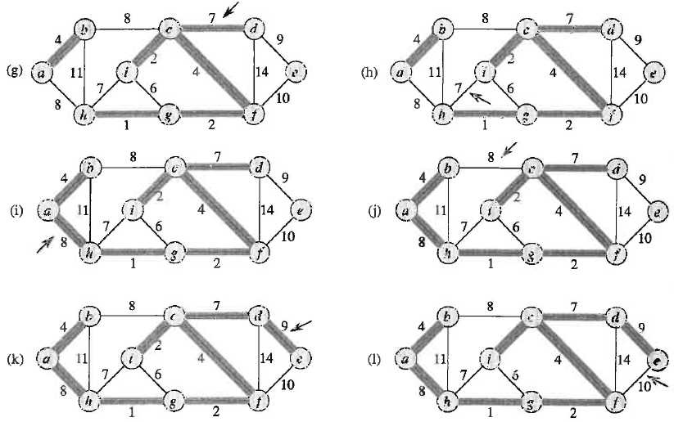
Final steps in Krustal’s algorithm
All vertices connected

Slide 12
Pseudo-code for Krustal’s algorithm: p 569
Uses operations on disjoint-set data structures that are described in Chapter 21, p499.
Make-Set(x) creates a new distinct set whose only member, x, is the representative of that set.
Find-Set(x) returns a pointer to the representative of the unique set that contains element x.
Union-Set(x,y) unites the sets S_{x} and S_{y} that contain elements x and y, respectively. Chooses a representative for S_{x} ∪ S_{y} and destroys S_{x} and S_{y}

Slide 13
MST-Kruskal(G,w)
(initialization)
A ← 0
for each v ∈ V[G] do Make-Set(v)
sort edges E[G] in non-decreasing order by weight
(process edges in sorted order)
for all edges (u,v)
do if Find-Set(u) ≠ Find-Set(v)
(vertices u and v are in different trees)
then A ← A ∪ {(u,v)}
Union-Set(u,v)
return A
Running time:
Sorting edges by weight takes O(E lgE) (most time-consuming step)
Disjoint-set operations (21.3 p505-509) O((E+V)lgV)
Total O(ElgE + (E+V)lgV) -> O(ElgE) if E >> V

Slide 14
Rationale of Prim’s algorithm:
Starts from an arbitrary root.
At each step, consider all edges that connect the growing MST, A, to a vertex not already in the tree. Add the lightest of these if it is a safe edge (i.e., does not create a cycle).
In hand calculation, resolve any ambiguity by alphabetical order of vertices in A.
As MST is built, record p[v] if ask to draw the final MST.

Slide 15
Example from text

Slide 16
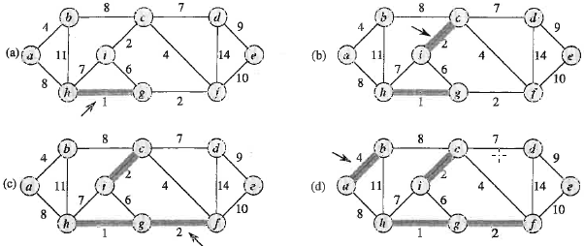
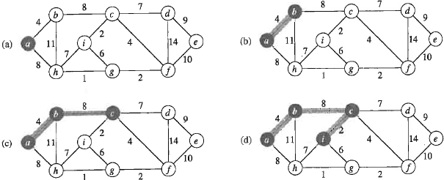
Krustal
A is root. Record p(v)
Prim

Slide 17
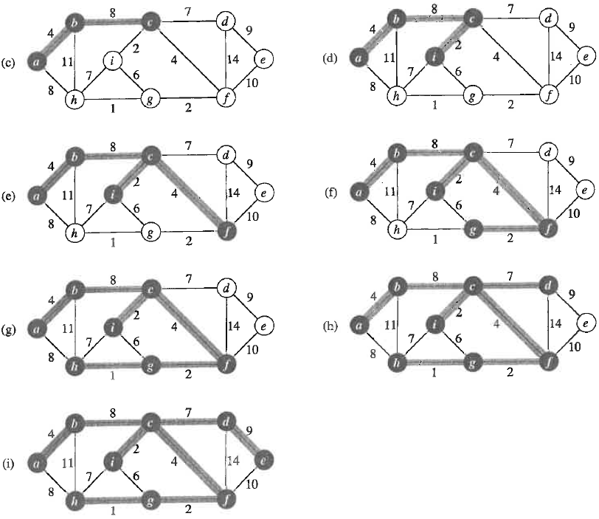
Completes solution by
Prim’s algorithm

Slide 18
MST-Prim(G,w,r)
for each u ∈ V[G]
do key[u] ← ∞, p[v] ← NIL
key[r] ← 0
Q ← V[G]
(initialization completed)
while Q ≠ 0
do u ← Extract-Min(Q)
(get the external vertex with the lightest connecting edge)
for each v ∈ Adj[u]
do if v ∈ Q and w(u,v) < key[v]
(update the fields of all vertices that are adjacent to u but not in the tree)
then p[v] ← u, key[v] ← w(u,v)
Performance of Prim: (assuming Q is a binary min-heap)
Build-Min-Heap requires O(V) time
while Q ≠ 0 loop executes |V| times
∴ Extract-Min operations take total O(V lgV) time
body of the for loop over adjacency lists executes |E| times
Q membership test can be implemented in constant time Decrease-Key to update key[v] requires O(lgV) time
Total time O((V + E)lgV ) same as disjoint-set operations in Krustal

Slide 19
Implementation of Prim’s algorithm:
Start from an arbitrary root.
At each step, add a light edge that connects growing MST to a vertex not already in the tree. (a safe edges by Corollary 23.2)
To facilitate selection of new edges, maintain a minimum priority queue of vertices not in the growing MST.
key[v], which defines the priority of v, is the minimum weight among all the edges that connect v to any vertex in the current MST. key[v] = ∞ if no such edge exist.
Algorithm terminates when queue is empty.
{(v, p[v]): v ∈ V – {r} –Q} implicitly defines the growing MST = A

Slide 20
Assignment 20
Use the rationale of Prim’s algorithm to find an MST in the graph below. Resolve ambiguity about the order of vertex addition by alphabetical order. Use vertex h as the root. As vertices are added, record their predecessor. Use this information to draw the MST.
a
18
b
7
c
5
4
9
g
11
2
h
14
8
6
10
f
e
d
1
3

