Slide 1
Chapter 22 part 3: applications of DFS

Slide 2
Graph topology:
Information content of a graph is connectivity of data.
Layout of graph may reflect convenience of drawing or
clarity of presentation
Topological sort is a layout for interpretation of data.
Directed acyclic graph (DAG) is used to show “precedence of events”.
Topological sort: linear ordering of vertices in a DAG such that if G contains edge (u->v), then u appears before v in the ordering of vertices (left to right, for example).
Pseudocode for topological sort:
Topological-Sort(G)
DFS(G) yields f[v] for all vertices
At each f[v], insert the vertex into the front of a linked list
return list

Slide 3
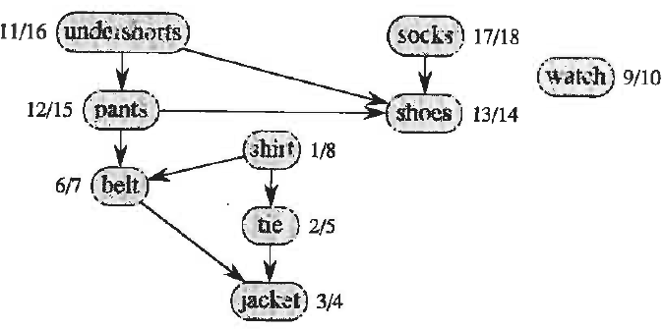
Example: precedence of events getting dressed
Arrows point from earlier to later
d[v] and f[v] reflect textbook’s order of sources
Topological sort is independent of this order

Slide 4
Result of topological sort using textbook’s order of
choosing sources for DFS:
With any order of choosing sources, all edges would still point left-to right
Consider a DFS with the following order of sources:
watch, socks, shorts, and shirt
Do on board

Slide 5
under shorts
socks
7/14
3/6
pants
4/5
shoes
8/13
15/18
shirt
belt
9/12
1/2
watch
tie
16/17
DFS with the following order of sources:
watch, socks, shorts, and shirt
10/11
jacket

Slide 6
shirt
tie
shorts
pants
belt
jacket
socks
shoes
watch
15/18
16/17
7/14
8/13
9/12
10/11
3/6
4/5
1/2
With any order of choosing sources, all edges would still point left-to-right

Slide 7
Theorem 22.12:
Proof of the correctness of Topological-Sort(G)
When edge (u->v) is explored in the DFS of a DAG, v must be white
or black because
if v is gray, then (u->v) is a back edge (we would be exploring the
adjacency list of v) and DFS of a DAG cannot yield a back edge.
If v is white, then v is a descendant of u and f[v] < f[u] (Corollary
of the Parenthesis Theorem)
If v is black, then f[v] has already been assigned and, since we are
still exploring the adj[u], f[v] < f[u].
Thus, for any edge(u->v) in the DAG, f[v] < f[u]
in topological sort, v will be on the right of u
all edges point to the right

Slide 8
Assignment 18
Ex 22.4-1 text p614 Topo sort on DAG of Fig 22.8 p615
Perform a DFS using alphabetical order to resolve ambiguities in order of discovery of new vertecies and choosing new sources. Mark each vertex with d[v] and f[v]. Make a table of v and f[v] with f[v] in decreasing order.

Slide 9
Strongly Connected Components (SCCs)
Strongly connected components (SCCs) of directed graph G(V,E)
are a set of vertices V_{SCC} ⊆ V that form a cycle
Component graph G^{SCC} = (V^{SCC}, E^{SCC})
Let C₁, C₂, ..., C_{k} denote the SCCs of directed graph G
V^{SCC} = {v₁, v₂, ..., v_{k}} contains a vertex from each SCC
E^{SCC} are edges of the component graph that connect the SCCs of G
Transpose of directed G(V,E) = G^{T}(V,E^{T}): E^{T} = {(u->v) if (v->u) ∈ E}
(G^{T} has same vertices a G, but its edges are reversed)

Slide 10
SCC(G) Pseudocode:
Call DFS(G) to get f[u] for all vertices
Construct the transpose of G
Call DFS(G^{T}) with source vertices in order of decreasing f[u] of DFS(G)
The vertices of each tree of the DFS(G^{T}) forest are a SCC of G
Example Fig.22.9 p616
Do on board

Slide 11
a
b
c
d
T
11/16
T
12/15
1/10
2/5
B
G
B
T
T
T
B
13/14
7/8
6/9
3/4
T
e
f
g
h
Example: Fig 22.9 p616
a
b
c
d
B
B
1/6
3/4
7/10
8/9
T
G^{T}
T
T
T
T
T
2/5
12/13
11/14
15/16
B
e
f
g
h

Slide 12
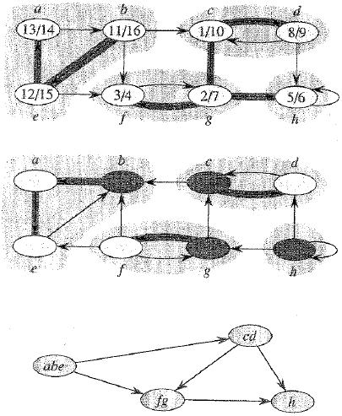
a
b
G
c
d
G
T
T
12/15
1/10
2/5
11/16
B
B
T
T
T
B
13/14
7/8
6/9
3/4
T
e
f
g
h
SCC

Slide 13
Assignment 19
Ex 22.5-2 text p 620 SCCs on graph in Fig 22.6 p611
Perform DFS Perform a DFS using alphabetical order to resolve ambiguities in order of discovery of new vertecies and choosing new sources. Mark each vertex with d[v] and f[v]. Construct the transpose graph. Find SCCs and draw G^{scc}
2 most common mistakes in DFS are (1) failure to use alphabetical order to remove abiguity in discovery of vertices and choice of next source, and failure to detect the opportunity to discovery new vertices while beack tracking .

Slide 14
Another example of finding SCCs
Do on board

Slide 15
a
1/16
c
8/11
d
F
T
9/10
a
T
B
T
G
b
2/15
B
7/12
e
T
3/14
T
b
c
d
e
f
g
h
B
T
T
f
6/13
h
g
4/5
a
1/2
c
7/12
d
T
6/13
T
G^{T}
b
3/16
T
8/11
e
T
5/14
T
T
4/15
f
9/10
h
g

Slide 16
Theorems behind the SCC pseudo-code
Lemma 22.14
Let C and C’ be distinct SCCs of directed G(V,E).
Let (u,v) ∈ E be an edge with u in C and v in C’,
then f(C) > f(C’)
If d(C) < d(C’) true by white path theorem
If d(C) > d(C’) true by parenthesis structure
Corollary 22.15
Let C and C’ be distinct SCCs of directed G(V,E).
Let (u,v) ∈ E^{T} be an edge with u in C and v in C’,
then f(C) < f(C’)

Slide 17
How Strongly-Connected-Components(G) works:
In the DFS of G^{T}, start with a vertex in C_{max}, the SCC that has
the largest finish time.
The search will visit all of the vertices of C_{max} but will not find an edge
that connects C_{max} to any other SCC.
If such an edge was found to C’, then by Corollary 22.15 of
Lemma 22.14 f(C_{max}) < f(C’), which violates the choice of C_{max}
as the SCC with the largest finish time
As the source of the next DFS in G^{T}, chose a vertex in C’, the SCC with
f(C’) larger than all other finishing time except those in C_{max}.
The search will visit all the vertices of C’ and may find some edges that
connect it to C_{max} but not to any other SCC.
Since the vertices of C_{max} have already been discovered, the only new
vertices visited from the second source are those in C’.

