Slide 1
Chapter 22 part 2: Depth-First Search

Slide 2
Depth-first search: Explores all edges leaving a given vertex, v,
before “backtracking” to explore edges leaving the vertex from
which v was discovered
Continues until all vertices reachable from a given source are discovered
If the graph still contains undiscovered vertices, choose a new source
π[v] = u if v was discovered in a search of the adjacency list of u
As in BFS, vertices initialized to white, colored gray when discovered,
colored back after their adjacency list has been examined
d[v] is the timestamp field when v was discovered
f[v] is the timestamp field when v was blackened
range of timestamps is 1 to 2|V| d[v] < f[v]

Slide 3
Classification of edges:
Tree edge connects vertex to its predecessor
Back edge connects vertex to an ancestor in the same tree
(also self loops in directed graph)
Forward edge connects vertex to descendant in the same tree
Cross edge: all others
If in the same tree, then one vertex cannot be an ancestor of the other

Slide 4
Classification of edge (u->v) by color of v when edge u->v
is “explored”
If v is white when u->v is explored then u=π(v), u->v is a
tree edge and v is “discovered”
In DFS, adj(u) can contain vertices that have already been
discovered.
If v is gray, u->v is back edge.
If v is black, u->v is forward or cross edge

Slide 5
DFS Pseudo codes:
DFS(G)
for each u ∈ V (initialization)
do color[u] ← white, π[u] ← NIL
time ← 0
for each u ∈ V (choose a new source)
do if color[u] = white then DFS-Visit(u)
DFG-Visit(u) (DFS from source u)
color[u] ← gray, time ← time +1, d[u] ← time
(vertex u discovered)
for each v ∈ adj[u]
do if color[v] = white
then π[v] ← u, DFG-Visit(v)
color[u] ← black, f[u] ← time, time ← time +1
(finished with vertex u as source)

Slide 6
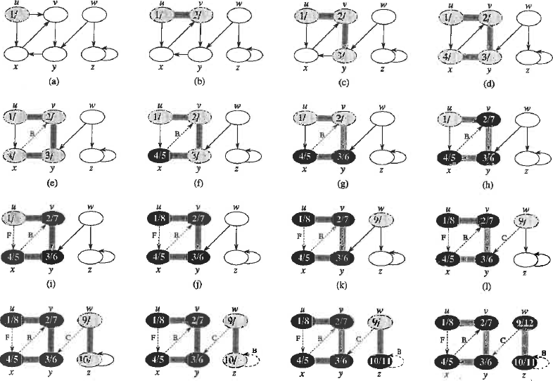
DFS: Fig 22.4 p605

Slide 7
DFS by hand: unnecessary to perform all steps of pseudo-code
Suggested “Miller” rules on the next slide.

Slide 8
DFS: Fig 22.4 p605
DFS by hand:
Enter d(v) in vertex when discovered. Mark the edge from parent with T.
If more than one vertex can be discovered from the current vertex, resolve
ambiguity by alphabetical order.
If no vertices can be discovered from the current vertex add f(v) and begin
backtracking. Abandon backtrack if discovery of new vertex is possible.
If more than one new source is available, resolve ambiguity by alphabetical
order.
When all tree edges are marked, label remaining edges as back, forward or
cross.

Slide 9
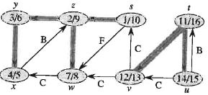
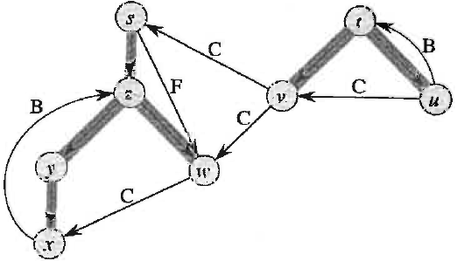
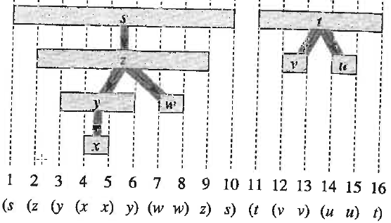
Fig 22.5 p607
Predecessor subgraph Gπ = (V,Eπ);
Eπ = {(π[v],v) ; v ∈ V and π[v] ≠ NIL}
Gπ contains all the vertices of G;
hence, may be multiple trees
Where does this DFS violate “Miller” rules?
Do on board with Miller rules.
Predecessor subgraph with addition of non-tree edges.
May be useful in labeling non-tree edges. After adding non-tree edges, we have the original graph in a different topology
Predecessor subgraph showing
“parenthesis” structure

Slide 10
Assignment 17
Ex 22.3-2 text p 610 Perform DFS
Use alphabetical order to resolve ambiguities in order of discovery of new vertecies and choosing new sources.
Label all edges as tree (T), back (B), forward (F) or cross (C).
Mark each vertex with d[v] and f[v].
Draw G_{π}

Slide 11
Properties of DFS:
Gπ of DFS is a forest of trees, each of which reflects the pattern of
recursive calls to DFS-Visit
Pattern of discovery and finishing times has “parenthesis structure”
For any 2 vertices u and v, exactly one of the following is true
(1) intervals [d[u], f[u]] and [d[v], f[v]] are disjoint
neither u nor v is a descendent of the other
edges connecting u and v must be cross edges
(2) [d[u], f[u]] is contained entirely in [d[v], f[v]] and
u is a descendent of v
v -> u forward edge
u -> v back edge
(3) [d[v], f[v]] is contained entirely in [d[u], f[u]] and
v is a descendent of u
u -> v forward edge
v -> u back edge

Slide 12
Simple example of : “parenthesis structure”
(1 (2 3) (4 5) 6) (7 (8 9) (10 11) 12)
r
s
t
T
1/6
2/3
7/12
?
T
T
T
?
4/5
8/9
10/11
v
w
x

Slide 13
Theorem 22.10: DFS of an undirected graph has no cross edges.
The predecessor graph of a DFS of undirected graph is a single tree. One call to DGS-visit will discover all vertices. Hence, no between-tree cross edges.
All non-tree edges connect vertices in the same branch. They could have been tree edges if a different path to discover vertices had been taken. Hence, no between-branch cross edges.
Non-tree edges in DFS of undirected graph are between related vertices. Text chooses to call then “back” edges.
Do example on board

Slide 14
DFS of undirected graph
s
r
s
r
t
t
T
1/12
2/11
1/12
2/11
5/8
5/8
B
T
T
T
3/10
4/9
3/10
4/9
6/7
6/7
T
B
v
w
x
v
w
x

Slide 15
White-Path Theorem:
Vertex v is a descendant of u in the predecessor forest of a DFS if and only if at the time d[u] when u is discovered, v can be reached from u by a path consisting entirely of white vertices.
r
s
t
1
v
w
x
White-Path theorem says s can be descendent of r by either of 2 paths.

Slide 16
Lemma 22:11
A directed graph is acyclic if and only if a DFS yields no back edges
Prove if G has a back edge then G is cyclic:
If G has a back edge (x->v) then v is an ancestor of x and (x->v)
completes a cycle in G.
Prove if G is cyclic then it has a back edge:
If G contains cycle c and v is the first vertex discovered in c, then a
white path exist to vertex x the last vertex in c
By white-path theorem, x is a descendent of v
∴ (x->v) must be a back edge

Slide 17
White-Path Theorem:
Vertex v is a descendant of u in the predecessor forest of a DFS if and only if at the time d[u] when u is discovered, v can be reached from u by a path consisting entirely of white vertices.
r
s
t
1
v
w
x
s can be descendent of r by White-Path theorem but that will not create a cycle because r->s will be a forward edge

Slide 18
Example illustrating Lemma 22.11
(1 (2 3) (4 5) 6) (7 (8 9) (10 11) 12)
r
s
t
T
1/6
2/3
7/12
T
C
T
T
C
4/5
8/9
10/11
v
w
x
r
s
t
B
1/6
3/4
7/12
T
T
T
T
2/5
C
8/9
10/11
v
w
x
(1 (2 (3 4) 5) 6) (7 (8 9) (10 11) 12)

Slide 20
Corollary of the Parenthesis Theorem:
Vertex v is a descendant of u in the depth-first forest of G
if and only if d[u] < d[v] < f[v] < f[u]

Slide 21
Fig 22.5 p607
Predecessor subgraph Gπ = (V,Eπ);
Eπ = {(π[v],v) ; v ∈ V and π[v] ≠ NIL}
Gπ contains all the vertices of G;
hence, may be multiple trees
Predecessor subgraph showing
non-tree edges
Another way to draw “parenthesis structure”
Are B and F edges correctly labeled? Easy to answer by tree structure.

Slide 22
White-Path Theorem:
Vertex v is a descendant of u in the predecessor forest of a DFS if and only if at the time d[u] when u is discovered, v can be reached from u by a path consisting entirely of white vertices.
r
s
t
T
1
2
v
w
x
Neither V or W can be a descendent of S.

