Slide 1
Chapter 22: Elementary Graph Algorithms
Overview:
Definition of a graph
Representation of graphs
adjacency list
matrix
Elementary search algorithms
breadth-first search (BFS)
depth-first search(DFS)
topological sort
strongly connected components

Slide 2
Chapter 22 part 1: Fundamentals and Breadth-First search

Slide 3
Notation
Graph G(V,E) is a data structure defined by
a set of vertices V
a set of eges E
|V| = # of vertices
|E| = # of edges
Usually omit | | in asymptotic notation
Θ(V, E) means Θ(|V|, |E|)

Slide 4
Adj = adjacency-list representation of G(V,E) is an array of |V| lists
Adj[u] contains all vertices adjacent (connected by edges) to vertex u
For a directed graph, edge (u→v) represented by v in Adj[u].
∴ sum of lengths of adjacency lists = |E|
For an undirected graph, edge (u,v) appears as v in Adj[u]
and as u in Adj[v].
sum of lengths of adjacency lists = 2|E|
Memory requirement is Θ(V+E)
A weighted graph has a function w(u,v) defined on the domain E.
The weight of edge (u,v) can be stored as property of vertex v in Adj[u].

Slide 5
adjacency-matrix representation:
Number the vertices 1,2,...|V|
Define |V| x |V| matrix A such that a_{ij} = 1 if (i, j) ∈ E,
a_{ij} = 0 otherwise
For a weighted graph, set a_{ij} = w(i,j) if (i, j) ∈ E
Disadvantage is requires Θ(V²) memory regardless of |E|
Advantage is speed of determining if edge (u,v) is in graph
For an undirected graph A is symmetric
A sparse graphs mean |E| << |V|²
adjacency-list representation preferred (saves space)
A dense graph means |E| ~ |V|²
adjacency-matrix representation preferred (speed)

Slide 6
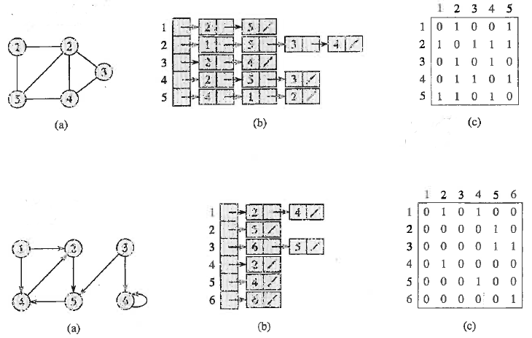
Graph representations
1
1

Slide 7
Breadth-first search: Given G(V,E) and a source vertex s,
Breadth-first search does the following:
(1) finds every vertex v reachable from s
(2) calculates distance (minimum number of edges)
between s and v
(3) produces a Breadth-first tree with s as the root and
every reachable vertex as a node
The path from s to v in the Breadth-first tree corresponds to the
shortest path between s and v in G.
“Breadth-first” finds all vertices at distance k from s before
searching for any vertices at distance k+1.

Slide 8
BFS(G,s) pseudo code
for each u ∈ V(G) – {s}
do color[u] ← white, d[u] ← ∞, π[u] ← NIL
(Initialization: color all vertices white for “undiscovered”
set distance from s as infinite,
set predecessor in Breadth-first tree to NIL)
color[s] ← gray, d[s] ← 0, π[s] ← NIL
(initialize s as gray for “discovered” i.e. reachable from s
A gray vertex has been discovered but its adjacency list
has not been searched for links to other vertices.
After adjacency list is searched, color is changed to black)
Q ← 0, Enqueue(Q,s)
(A “first-in first-out” queue holds a list of the current gray vertices
Gray vertices with the smallest distance from s are processed first

Slide 9
BFS(G,s) algorithm continued
while Q ≠ 0
do u ← Dequeue(Q)
for each v ∈ Adj[u]
do if color[v] = white then
color[v] = gray
d[v]←d[u] + 1
π[v]← u
Enqueue(Q,v)
color[u] ← black (adj list searched)
Runtime analysis:
initialization requires O(V).
each vertex is discovered at most once
∴ queue operations require O(V).
searching adjacency lists requires O(E)
∴ total runtime O(V+E)

Slide 10
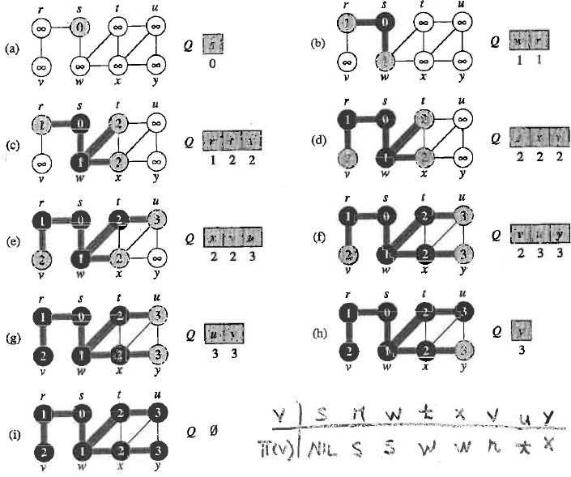
Example of BFS (p596) using pseudo-code

Slide 11
Example of BFS (p596) using pseudo-code
How would this result be different if x was dequeued before t?

Slide 12
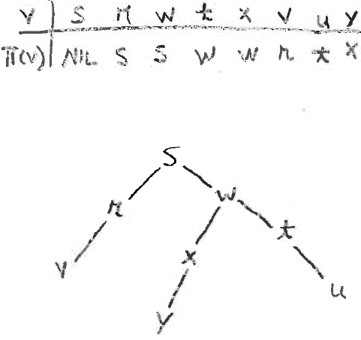
Predecessor of v:
π(v) is the vertex in whose
adjacency list v was discovered
Predecessor sub-graph Gπ(Vπ,Eπ)
Vπ = {v ∈ V : π[v] ≠ NIL} ∪ {s}
Eπ = {(π[v],v) : v ∈ Vπ - {s}}
Predecessor sub-graph of BFS is a
single tree
How would this tree be different if x was dequeued before t?

Slide 13
BFS by hand:
Unnecessary to perform all steps of pseudo-code
Find all vertices at distance k from s before searching for any vertices at distance k+1.
Resolve ambiguities about which adjacency list to search next by alphabetic order
Mark the edges used in a search with a T for tree edge. Keep a record of parentage.
Simple example
s
t
0
v
u

Slide 14
BFS by hand:
When a new vertex is discovered enter number one greater than the parent.
Resolve ambiguities about which adjacency list to search next by alphabetic order
Example: u can be discovered from either t or v. Choose t
Mark the edges used in a search with a T for tree edge. Keep a record of parentage.
s
t
T
0
1
T
1
v
u

Slide 15
BFS by hand:
With ambiguity resolved by alphabetical order, edge (t,u) becomes a
tree edge rather than (v,u)
s
t
T
0
1
T
T
1
2
v
u

Slide 16
Finding shortest path is most common application of
Breadth-first search
If a vertex is reachable from the source, the integer in each vertex, δ(s,α),
is the length in edges of the shortest path from the source.
δ(s,α) = ∞ if α is not reachable from s
s
t
T
0
1
T
T
1
2
v
u

Slide 17
Weight of a path
Weight of a path is the sum of the weights of its edges
For an unweighted graph,
weight of path = number of edges = length of path
For weighted graph, least-weight is not necessarily shortest path

Slide 18
Theorem 22.5: On termination of BFS(G,s),
all reachable vertices have been found
(2) d[v] = δ(s,v) for v ∈ V (some may be infinite)
(3) for any reachable v ≠ s, a shortest path includes
π[v] followed by edge (π[v],v).

Slide 19
Assignment 16
Ex 22.2-2 text p 601. Perform BFS. Use alphabetical order to resolve ambiguity in order of discovery. Mark tree edges. Make a table of π[v] for all v. Draw G_{π} Note: u is the source vertex.

