Slide 1
Chapter 9: Selection of Order Statistics: Given an array of n distinct elements, find the element that is larger than exact i-1 other elements.
Common order statistic
min (i=1), max (i=n), median (i~n/2)
Selection by sorting T(n) = Ω(nlgn)
Partition allows selection in linear time

Slide 2
Median order statistics
parity of a set of n elements is whether n is even or odd
median is roughly halfway between min and max
unique for an odd parity set
i^{th} smallest with i = (n+1)/2
regardless of parity
lower median means i^{th} smallest with i = ⎣(n+1)/2⎦
upper median means i^{th} smallest with i = ⎡(n+1)/2⎤

Slide 3
The selection problem
Find the i^{th} order statistic in set of n (distinct) elements A=<a₁, a₂,...,a_{n}>
(i.e. find x ∈ A such that x is larger than exactly i –1 other elements of A)
Selection problem can be solved with T(n)=Ω(nlgn) by sorting
Since min and max can be found in linear time, expect that any order
statistic can be found in linear time.
We will analyze deterministic algorithm, SELECT, that finds the i^{th} order
statistic with worst-case runtime that is linear.
We analyze RANDOMIZED-SELECT that finds the i^{th} order statistic by
randomized partition that has a linear expected runtime.

Slide 4
Select-by-partition pseudocode
Select-by-Partition(A,p,r,i) % argument i specifies which order statistic
1 if p=r then return A[p] % single element is i^{th} smallest by default
2 q ← Partition(A,p,r) % get upper and lower sub-arrays
3 k ← q – p + 1 % number of elements in lower including pivot
4 if i = k then
5 return A[q] % pivot is the i^{th} smallest element
6 else
7 if i < k then return Select-by-Partition(A,p,q-1,i)
8 else
9 return Select-by-Partition(A,q+1,r,i - k)
Note: index of i^{th} order statistic changed in upper sub-array
With favorable splits, T(n) = O(n)
Why not O(nlg(n)) as in quicksort?

Slide 5
Selection algorithm with worst-case runtime = O(n)
Possible to design a deterministic selection algorithm that
has a linear worst-case runtime.
Make the pivot an input parameter to partition.
Process before calling partition to determine a good
choice for pivot.

Slide 6
SELECT by partition with preprocessing: T(n)=O(n)
Step 1: Divide n-elements into groups of 5 elements each and at most one
with less than 5: cost = Θ(n)
Step 2: Use insertion sort to find median of each subgroup:
cost = constant (cost of sorting 5 elements) x number of subgroups = Θ(n)
Step 3: Use SELECT to find the median of the medians: cost = T(ceiling(n/5))
The median of the group that may contain less than 5 is included.
Step 4: Partition the input array with pivot = median of medians. Calculate k,
the number of elements < pivot: cost = Θ(n) + constant. If k=i return pivot.
Step 5: If pivot is not the i^{th} smallest element, get upper bound on runtime
by assuming the i^{th} smallest element is in larger sub-array:
cost < T(7n/10 + 6) (to be explained)

Slide 7
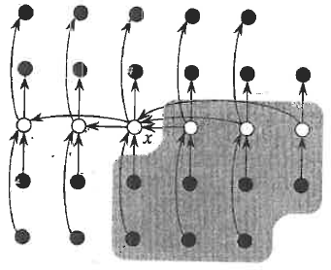
Diagram to explain upper bound on lower sub-array if pivot is the lower median of medians of groups of 5. Arrows point from larger to smaller.
Odd number of elements in full groups so that median is unique
Total number 28 so that partial group also has unique median
Choose lower median of medians so that we are sure that every element
in shaded area is >x

Slide 8
Upper bound on lower sub-array = Total – Under count of
elements of upper sub-array when pivot is x
Under count of elements > x are elements in shaded area that
are part of complete groups of 5 that do not contain x

Slide 9
Under count of elements > x are elements in shaded area that
are part of complete groups that do not contain x
Neglecting floors and ceilings,
n/5 = number of groups of 5
(1/2) n/5 = number of groups of 5 with median > x
((1/2) n/5)-2 = number of complete groups of 5 with median > x
3 elements in each complete gourp
3((1/2) n/5)-2) = (3n/10)-6 under count of upper sub-array
n-[(3n/10)-6] = (7n/10)+6 upper bound on lower sub-array

Slide 10
By similar argument,
Upper bound on upper sub array = (7n/10)+6
Worst case described by the recursion
T(n) < T(ceiling(n/5)) + T(ceiling(7n/10+6)) + Θ(n)
step 3 step 5 steps 1,2,4
Get median of medians recurse on larger subarray setup groups and call partition

Slide 11
Show by substitution that
T(n) = T(ceiling(n/5)) + T(ceiling(7n/10+6)) + Θ(n)
has asymptotic solution T(n) = O(n).
Do on board

Slide 12
Show by substitution that
T(n) = T(ceiling(n/5)) + T(ceiling(7n/10+6)) + Θ(n)
has asymptotic solution T(n) = O(n).
Setup: T(n)=T(n/5)+T(7n/10+6)+dn d>0
I.H. assume T(n/5)=O(n/5), T(7n/10+6)=O(7n/10+6)
Exist c>0 such that T(n/5)<cn/5, T(7n/10+6)<c(7n/10+6)
Application:
T(n) < cn/5+7cn/10+6c+dn < cn
9cn/10+6c+dn < cn
-cn/10+6c+dn < 0 not homogeneous in n
n(d-c/10)+6c < 0
(d-c/10) must be negative
c >10d constraint on c choose c=20d

Slide 13
Application continued
Substitute c = 20d into inequality to find constraint on n
-nd +120d < 0
n > 120 constraint on n choose n₀ = 120
Conclusion:
Exist c = 20d such that 0<T(n)<cn all n>n₀=120
Therefore T(n) = O(n) by definition

Slide 14
Assignment 14
Ex 9.3-1 p 223:
a) Show by structured substitution method that SELECT with groups of 7 has a linear worst-case runtime.
b) Show that substitution method fails to prove that SELECT with groups of 3 has a linear worst-case runtime.
Hint: model after result in slide 9 of L15 for the upper bound on the larger subarray with groups of 7 and 3.

Slide 15
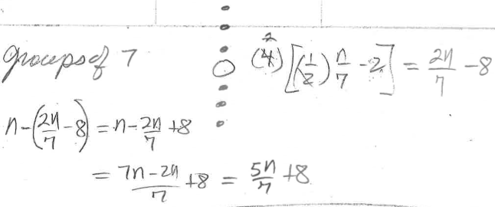
Upper bound on larger sub-array for groups of 7

Slide 16
Basic conclusion of Chapter 9: Best runtime of Quicksort and Select using Partition occurs when subarrays are balanced.
Use a “black box” algorithm Median(A,p,r) that will return the median of the elements of A between p and r to create a pseudo code for Good_Partitian, Good_Quicksort, and Good_Select.

Slide 17
Good-Partition(A,p,r)
m=Black-Box Median(A,p,r)
exchange A(r) with A(m)
return Partition
Good-Quicksort(A,p,r)
if p<r then
q=Good-Partition(A,p,r)
Good-Quicksort(A,p,q-1)
Good-Quicksort(A,q+1,r)

Slide 18
Good-Select(A,p,r,i)
1 if p=r then return A[p]
2 q ← Good-Partition(A,p,r)
3 k ← q – p + 1
4 if i = k then
5 return A[q] (pivot is the i^{th} smallest element)
6 else
7 if i < k then return Good-Select(A,p,q-1,i)
8 else
9 return Good-Select(A,q+1,r,i –k)

Slide 19
Assignment 15
a) Write a recurrence for the runtime of Good_Quicksort(A,p,r) and solve it.
b) Write a recurrence for the runtime of Good_Select(A,p,r,i) and solve it.

