Slide 1
Review for Quiz 5, Monday 11/13/23
Text Chapter 5
Lecture L10-13
Homework 12 & 13

Slide 2
Example: Leftmost/Rightmost Derivations
Balanced-parentheses grammar:
S -> SS | (S) | ()
perform S =>*_{lm} (())()
perform S =>*_{rm} (())()
S =>_{lm} SS =>_{lm} (S)S =>_{lm} (())S =>_{lm} (())()
S =>_{rm} SS =>_{rm} S() =>_{rm} (S)() =>_{rm} (())()

Slide 3
Parse tree is the same for lm and rm derivations
Derivation of (())() in S -> SS | (S) | ()
S =>_{lm} SS =>_{lm} (S)S =>_{lm} (())S =>_{lm} (())()
S =>_{rm} SS =>_{rm} S() =>_{rm} (S)() =>_{rm} (())()
S
S
S
(
S
)
(
)
(
)
Yield: (())()

Slide 4
Ambiguous CFG
More than one way to use content of a CFG to derive the strings in L(CFG)
Proof of ambiguity
For any string in L(CFG) there exist
2 distinct left-most derivations,
2 distinct right-most derivations,
or 2 distinct parse-tree derivations

Slide 5
S -> SS | (S) | () is ambiguous Prove by 2 lm derivations of ()()()
S=>SS=>SSS=>()SS=>()()S=>()()()
S=>SS=>()S=>()SS=>()()S=>()()()

Slide 6
Ambiguous CFGs
Sometimes 2 ways to start a derivation causes ambiguity, as demonstrate in HW12. Derivations of aab can start with either S=>aS or S=>aSbS.
Blocking 1 way can remove ambiguous derivation of a given string but does not prove that the resulting CFG is unambiguous

Slide 7
LL1 CFGs are intrinsically unambiguous
LL1-> left-most derivation look ahead 1 production
Example for balance parenthesis CFG
B -> (RB | ε R -> ) | (RR
B is the start symbol
Derivations must start with B ->(RB
To expand with “(“, use R->(RR
To expand with “)”, use R ->)
End with B->ε

Slide 8
Inherently ambiguous CFG: two left-most derivations on some strings cannot be avoided
The language {0^{i}1^{j}2^{k} | i = j or j = k} is inherently ambiguous.
At least some of the strings of the form 0^{n}1^{n}2^{n} can be generated by two left-most derivations depending on which you check 1st: equal number of 0’s and 1’s or equal number of 1’s and 2’s.

Slide 9
Example of ambiguous grammar for {0^{i}1^{j}2^{k} | i = j or j = k}
S -> AB | CD
A -> 0A1 | 01
B -> 2B | 2
C -> 0C | 0
D -> 1D2 | 12
A generates equal 0’s and 1’s
B generates any number of 2’s
C generates any number of 0’s
D generates equal 1’s and 2’s
2 lm derivations of 012
lm: S => AB => 01B =>012
lm: S => CD => 0D => 012
Similarly for n=2

Slide 10
CFGs in Chomsky Normal Form (HW 13)
CFG -> clean CFG
clean CFG -> CNF
CFG -> clean CFG
remove ε-productions
find nullable variables
remove Variable ->ε productions
make families from products that contain nullable variables
remove unit productions
expansion and pair search
remove useless variables
non-generating and/or non-reachable

Slide 11
Example: Eliminating ε-Productions
S->ABC, A->aA|ε, B->bB|ε, C->ε
A, B, C, and S are all nullable.
Productions S->ABC|AB|AC|BC|A|B|C come from S->ABC
Productions A->aA|a come from A->aA
Productions B->bB|b come from B->bB

Slide 12
Eliminating ε-Productions continued
Removing A->ε, B->ε, C->ε makes C is not generating
Eliminate C in productions of the new CFG
S -> ABC | AB | AC | BC | A | B | C
A -> aA | a
B -> bB | b

Slide 13
A unit production is a production whose right side consists of exactly one variable.
A->a is not a unit production because
a is terminal
“Expansion” is the most common approach to eliminate unit production but “pair search” is another approach.

Slide 14
Eliminate by expansion
In the CFG defined by
E->T|E+T
T->F|T*F
F->I|(E)
I->a|Ia
Keep I->a|Ia
Expand F->I|(E): F->a|Ia|(E)
Expand T->F|T*F: T->a|Ia|(E)|T*F
Expand E->T|E+T: E->a|Ia|(E)|T*F|E+T

Slide 15
Pair search: Alternative to expansion for elimination of unit productions
Find all pairs (A,B) such that A=>*B by a sequence of unit productions only.
Basis: A=>*A, therefore (A,A) selected.
Induction: If we have found (A,B), and B->C is a unit production, then add (A,C) to the pair list.

Slide 16
Example of pair search for CFG
E->T|E+T
T->F|T*F
F->I|(E)
I->a|Ia
[E,E] basis [T,T] basis [F,F] basis [I,I] basis
[E,T] E->T [T,F] T->F [F,I] F->I
[E,F] T->F [T,I] F->I
[E,I] F->I
Associate each pair with a reachable non-unit production, if present.

Slide 17
Combine pair search with non-unit productions
(E,E) E->E+T
(E,T) E->T*F
(E,F) E->(E)
(E,I) E->a|Ia
(T,T) T->T*F
(T,F) T->(E)
(T,I) T->a|aI
(F,F) F->(E)
(F,I) F->a|Ia
(I,I) I->a|Ia
Original CFG with unit productions
E->T|E+T
T->F|T*F
F->I|(E)
I->a|Ia
New CFG with no unit productions
E->E+T|T*F|(E)|a|Ia
T->T*F|(E)|a|Ia
F->(E)|a|aI
I->a|Ia
same as by expansion

Slide 18
Clean to CNF
Step 1: For each right side not a single terminal, make the right side all variables.
Step 2: Break right sides longer than 2 into a chain of productions with right sides of two variables using “cascade of productions” text p273
Do not combine steps 2 and 3. Show all strings of variables before applying cascading productions
Example of cascading productions: A->B₁B₂B₃B₄ is replaced by A->B₁C₁, C₁->B₂C₂, and C₂->B₃B₄.

Slide 19
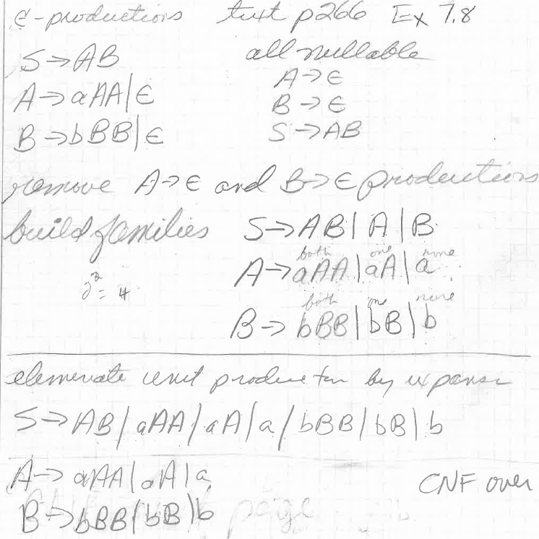

Slide 20
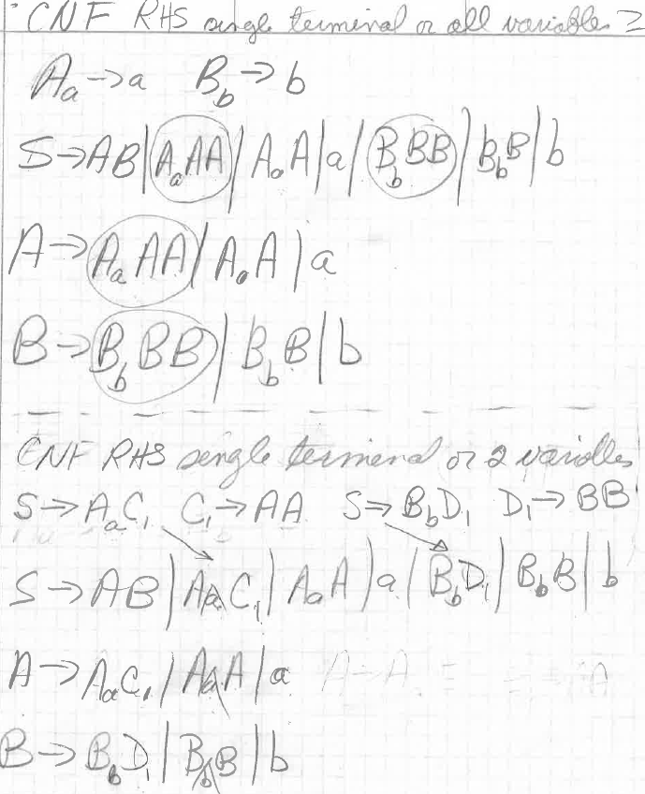

Slide 21
Assignment 13
Exercise 7.1.2 text p 275 and 277
S->ASB|ε
A->aAS|a
B->SbS|A|bb
Clean and convert to CNF
S is nullable
Family from B->SbS B->SbS|Sb|bS|b

