Slide 1
Review for quiz3, Wednesday 10/2/2024
Regular expressions (RE)
Covers HW6-8
Enumeration of strings defined by RE
Given DFA, find equivalent RE by k-paths
Given DFA, find equivalent RE by elimination of states
Given RE, find equivalent e-NFA

Slide 2
Definition of + . and * operations
L + M the is set of all strings either in L or in M or in both
Example: {001,10,111} + {e,001}={e,10,001,111}
L.M or simply LM is the set of all string that can be formed by concatenating any string in L with any string in M.
Example: {001,10,111}.{e,001}=
  {001,10,111,001001,10001,111001}
Note! left-right order is preserved
L* is set of strings obtained by taking any number of strings from L and forming all possible concatenation.

Slide 3
L* in relation to powers of L
L* = U_{k>0} L^{k} Union of all powers of L (including zero)
L+ = U_{k>1} L^{k} Union of all powers of L excluding zero
L⁰ = {e}; hence, L* contains {e} for any L
L¹ = L
L^{k} (k>1) concatenation of k copies of L
  If L={0,11}, L² = {0,11}{0,11} ={00,011,110,1111}
L(∅) is the empty language (no strings)
L(∅)*={e} rare example of finite closure

Slide 4
Enumerate the strings in L(RE)
L(01) = {01}.
L(01+0) = {01, 0}.
L(0(1+0)) = {0}{0,1}={00, 01}.
L(0*) = {ε, 0, 00, 000,… }.
L(01*) = 0{e,1,11,…}={0,01,011,…}
L((01)*) = {e,01,0101,…}
L((01)⁺) = {01,0101,…}

Slide 5
Useful relationships in simplification of R_{ij}^{k}
L⁺ = LL* = L*L
∅* = ε
(R+ε)*= R* and (R+ε)⁺= R*
∅ is the identity for +
  R + ∅ = R
ε is the identity for concatenation.
  εR = Rε = R
∅ is the annihilator for concatenation.
  ∅R = R∅ = ∅
Some simplified R_{ij}k forms
R₁₁¹ = (R₁₁⁰)⁺
R₁₂¹ = (R₁₁⁰)*R₁₂⁰
R₂₁¹ = R₂₁⁰(R₁₁⁰)*
R₂₂¹ = R₂₂⁰ + R₂₁⁰(R₁₁⁰)* R₁₂⁰
R₁₂² = R₁₂¹ (R₂₂¹)*

Slide 6
Example 3.5 text pp 95-97
Find equivalent RE
0,1
1
1
0
2
  R₁₁⁰ = 1 + ε
  R₁₂⁰ = 0
  R₂₁⁰ = ∅
  R₂₂⁰ = 0+1+e
R_{ij}^{k} = R_{ij}^{k-1} + R_{ik}^{k-1}(R_{kk}^{k-1})* R_{kj}^{k-1}
Apply with k=1 for 4 cases
Simplify then substitute
R₁₁¹ = (R₁₁⁰)⁺
R₁₁¹ = (1+e)⁺ = 1*

Slide 7
Example 3.5 text pp 95-97
Find equivalent RE
0,1
1
1
0
2
  R₁₁⁰ = 1 + ε
  R₁₂⁰ = 0
  R₂₁⁰ = ∅
  R₂₂⁰ = 0+1+e
R_{ij}^{k} = R_{ij}^{k-1} + R_{ik}^{k-1}(R_{kk}^{k-1})* R_{kj}^{k-1}
Apply with k=1 for 4 cases
Simplify then substitute
R₁₂¹ = (R₁₁⁰)*R₁₂⁰
R₁₂¹ = ((1+e)*)0 = 1*0

Slide 8
Example 3.5 text pp 95-97
Find equivalent RE
0,1
1
1
0
2
  R₁₁⁰ = 1 + ε
  R₁₂⁰ = 0
  R₂₁⁰ = ∅
  R₂₂⁰ = 0+1+e
R_{ij}^{k} = R_{ij}^{k-1} + R_{ik}^{k-1}(R_{kk}^{k-1})* R_{kj}^{k-1}
Apply with k=1 for 4 cases
Simplify then substitute
R₂₁¹ = R₂₁⁰(R₁₁⁰)*
R₂₁¹ = ∅(1+e)* = ∅

Slide 9
Example 3.5 text pp 95-97
Find equivalent RE
0,1
1
1
0
2
  R₁₁⁰ = 1 + ε
  R₁₂⁰ = 0
  R₂₁⁰ = ∅
  R₂₂⁰ = 0+1+e
R_{ij}^{k} = R_{ij}^{k-1} + R_{ik}^{k-1}(R_{kk}^{k-1})* R_{kj}^{k-1}
Apply with k=1 for 4 cases
Simplify then substitute
R₂₂¹ = R₂₂⁰ + R₂₁⁰(R₁₁⁰)* R₁₂⁰
R₂₂¹ = 0+1+e + ∅(1+e)*0 = 0+1+e

Slide 10
Example 3.5 text pp 95-97
Find equivalent RE
0,1
1
1
0
2
  R₁₁⁰ = 1 + ε = ε
  R₁₂⁰ = 0
  R₂₁⁰ = ∅
  R₂₂⁰ = 0+1
R₁₂¹ = 1*0
R₂₂¹ = 0+1+e
R₁₂² = R₁₂¹ + R₁₂¹(R₂₂¹)* R₂₂¹
Only k=2 path that we need
R₁₂² = R₁₂¹ (R₂₂¹)*
R₁₂² = 1*0(0+1+e)* = 1*0(0+1)*

Slide 11
Example 3.6 text pp 101-103
0
A
1
B
0,1
C
0,1
D
0
A
1
B
0+1
C
0+1
D
Eliminate B: q=A, Q=1, p=C, P=0+1, R_{AC}=nil, S=nil
R_{AC}+QS*P=nil+1nil*(0+1)=1e(0+1)=1(0+1)
0
A
1(0+1)
C
0+1
D

Slide 12
Example 3.6 text pp 101-103 step 2
0
A
1(0+1)
C
0+1
D
Eliminate C: q=A, Q=1(0+1), p=D, P=0+1, R_{Ad}=nil, S=nil
R_{AD}+QS*P=nil+1(0+1)nil*(0+1)=1(0+1)e(0+1)=1(0+1)(0+1)
R
U
S
0
1(0+1)(0+1)
D
1
2
A
T
R=0, S=1(0+1)(0+1), T=nil, U=nil, U*=e
RE_{c}= (R+SU*T)*SU* = R*S = 0*1(0+1)(0+1)

Slide 13
Example 3.6 text pp 101-103 step 3
0
A
1(0+1)
C
0+1
D
Eliminate D: q=C, Q=(0+1), no successor, P=nil, R_{ij}=nil, S=nil
R_{ij}+QS*P=nil+(0+1)nil*nil=nil
R
U
S
0
1(0+1)
C
1
2
A
T
R=0, S=1(0+1), T=nil, U=nil, U*=e
RE_{D}= (R+SU*T)*SU* = R*S = 0*1(0+1)
RE_{eq}= RE_{C}+RE_{D}= 0*1(0+1)(0+1) + 0*1(0+1)
Don’t simply

Slide 14
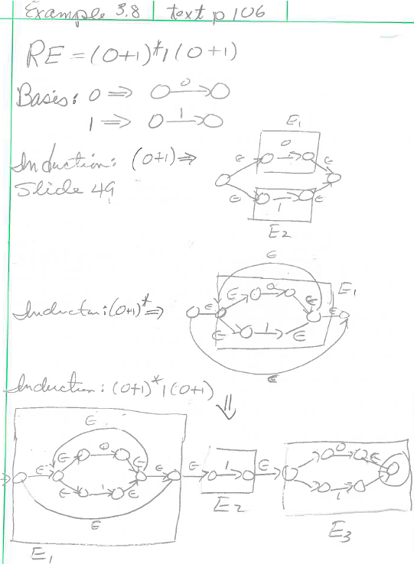
Boxes are not part of
ε-NFA graph. Added to
show that each RE in
the inductive construction
must be distinct (i.e.
boxes cannot overlap)
Required e-transitions

